Slide 3
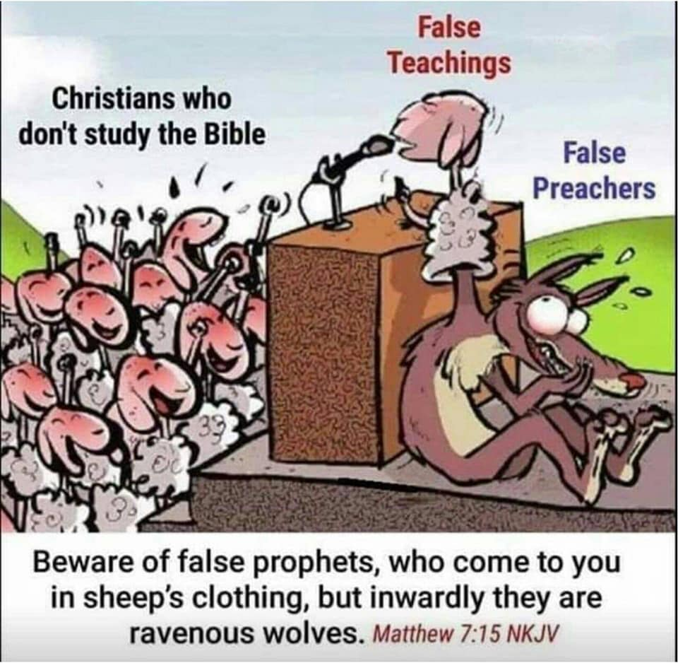

Slide 4
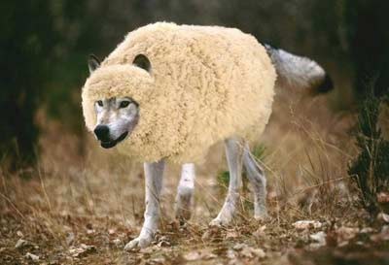
THE FALSE PROPHET OF REV 13:11-18

Slide 5
REV 13:11 -18 ; Then I saw another beast coming up out of the earth, and he had two horns like a lamb and spoke like a dragon. And he exercises all the authority of the first beast in his presence, and causes the earth and those who dwell in it to worship the first beast, whose deadly wound was healed. He performs great signs, so that he even makes fire come down from heaven on the earth in the sight of men. And he deceives those who dwell on the earth by those signs which he was granted to do in the sight of the beast, telling those who dwell on the earth to make an image to the beast who was wounded by the sword and lived.

Slide 6
He was granted power to give breath to the image of the beast, that the image of the beast should both speak and cause as many as would not worship the image of the beast to be killed. He causes all, both small and great, rich and poor, free and slave, to receive a mark on their right hand or on their foreheads, and that no one may buy or sell except one who has the mark or the name of the beast, or the number of his name. Here is wisdom. Let him who has understanding calculate the number of the beast, for it is the number of a man: His number is 666.

Slide 7
The false prophet arises at the same time the beast is on the world scene who “Wars against the Saints” for 42 months. The false prophet , the beast and the 8th King of Rev 17: 10-11 are all in the 5th Seal, 6th Bowl and 6th Trumpet fulfilments. One of the first things the false prophet does is call fire down from heaven then he creates an image of the wounded head of the Rev 13:1-3 beast that has 7 heads . The wounded head is identified in these end time fulfilments as the Ottoman Empire defeated in WW1 (Trumpet 1, 1914-1918). The false prophet is mentioned 4 times in the book of Revelation in Rev 13:11-18, Rev 16:13, Rev 19:20 and Rev 20:10. The false prophet is under the same religious antichrist system as the beast .They stand before each other the false prophet is both a political leader as well as a religious leader.

Slide 8
The false prophet with his false mark of the beast religion and the image he creates causes people to receive the mark of this beast that no one may buy or sell except he has the mark , name (Allah/ Muhammad/ Islam) or number (666) of the beast with the wounded head (Ottoman Empire/ Islam) that recovers. The false prophet advances his religion as the first beast did in prophecy found in Dan 11:39 . The “War against the saints’ and the “abomination of desolation” under the Rev 13:1-11 first beast happens for 42 months, while he is a world leader Rev 13:5-7. Then Gods “Favour “ Dan 7:22 comes at the end of the 42 month “War against the Saints” Rev 13:5-7. The “War against the Saints” is the first tribulation the “Tribulation of the saints”. This sets the stage for the False Prophet to arise to fulfil his role according to the Prophetic narrative of scripture.

Slide 9
The First Beast war on the saints leads you to the second beast Dan 7:25 He shall speak pompous words against the Most High, Shall persecute the saints of the Most High, And shall intend to change times and law. Then the saints shall be given into his hand For a time and times and half a time (42 months). Rev 13:5-7 And he was given a mouth speaking great things and blasphemies, and he was given authority to continue for forty-two months. Then he opened his mouth in blasphemy against God, to blaspheme His name, His tabernacle, and those who dwell in heaven. It was granted to him to make war with the saints and to overcome them. And authority was given him over every tribe, tongue, and nation. We go through these fulfilments of the first beast Rev 13:5-7 before the false prophet second beast Rev 13:11-18 from the land arises in the Earth at the end of the “war against the saints” of 42 months (Rev 13:5-7, Dan 7:21, Dan 9:27 and Dan 12:11).

Slide 10
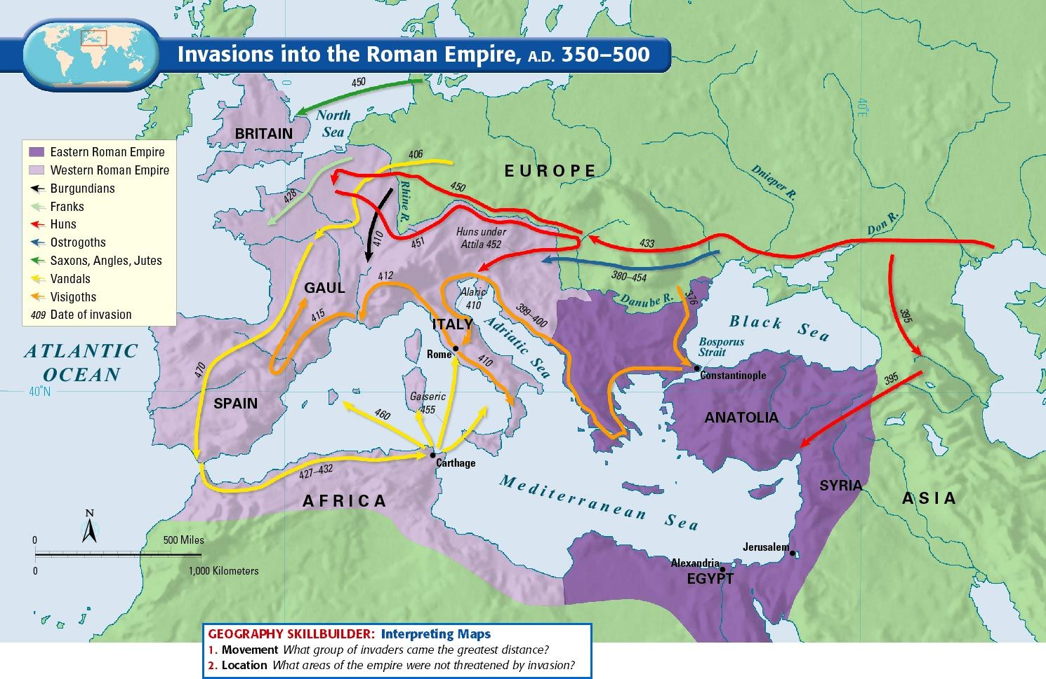
Rev 17 is a prophecy of the Vatican, the city of Rome the papacy “A city built on seven hills” . The beast the woman rides is the Holy Roman Empire the feet and toes of Dan 2:40- 44, the last world Empire the false prophet emerges from.

Slide 11
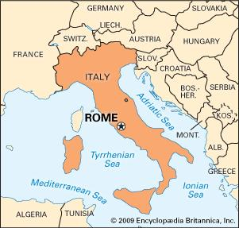

Slide 12
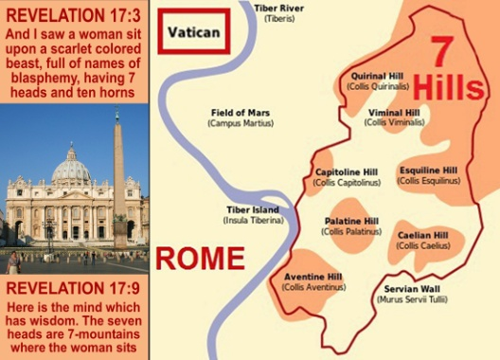

Slide 13
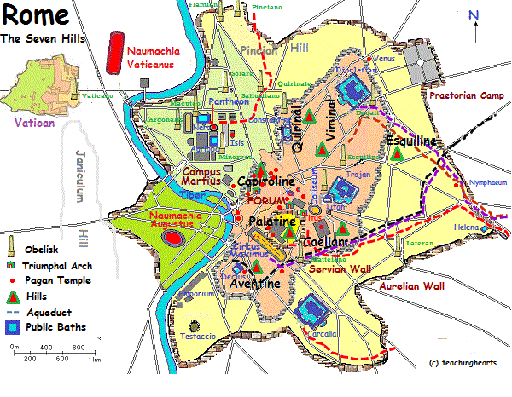

Slide 14
The Holy Roman Empire began in 313 A.D with Constantine the Great signing the “Treaty of Milan” stopping the Roman persecution of Christians. Then for a 1260 year period Rev 12 from 538 A.D starting with the Pope Vigilius decree to punish heretics, the papacy persecuted the saints up until 1796 A.D. Napoleon’s general arrested the last Holy Roman Emperor whom stopping all inquisitions in 1796, he then resigned on August 6th 1806. Then for 123 years the papacy continued without a Holy Roman Emperor over them. The following Popes after 1806 then considered themselves to be prisoners in the Vatican refusing to leave as a sign of protest.

Slide 16
Then in 1929 the “Lateran Treaty” was signed with Prime minister Mussolini of Rome giving official land and nationhood to the Vatican making the Vatican its own nation state. For the first time in it’s history the Vatican was now it’s own nation it’s own kingdom having the first ever Pope King on the Vatican throne. The pope at that time was Pope Pius 11th the first Pope King of Rev 17:11, just before WW2.

Slide 17
Lateran Treaty 1929

Slide 18
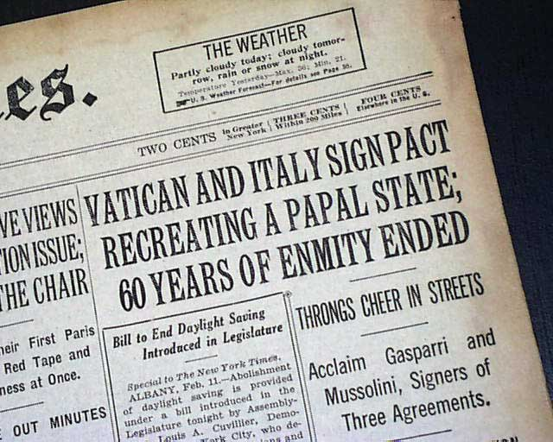

Slide 19
The Pope is a false prophet over a false religious system of 1.2 billion people. There has been 266 false prophet popes up to Pope Francis 1st from 2013 (1700 years since treaty of Milan 313 A.D). The papacy started out Christian then became false because of riches corruption, altered doctrines and religious practices. 88 popes have come from Rome, 196 popes are from Italy 1 from Germany and 1 from France. Nearly all end times teachers say the Pope is the false prophet of Rev 13:11-18 yet prophecy being fulfilled in our current times tells us something else. Since the “Lateran Treaty” in 1929 up until 2013 we have had exactly 8 popes on the Vatican throne 8 Pope Kings.

Slide 20
The current pope is not the false prophet of Rev 13:11-18, he is the 8th king of Rev 17: 11 from 1929 “Lateran Treaty”.
If the pope is not the false prophet of Rev 13:11-18 then who is ???? He’s a Pope King with their own nation since 1929.

Slide 21
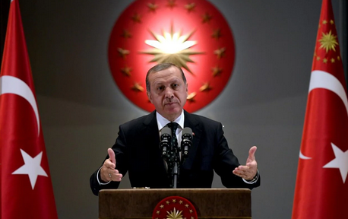
ERDAGON OF TURKEY IS THE FALSE PROPHET OF REV 13:11-18 (Revealed in 2014, 3 years before Obama steps down as President) Recep Tyep Erdagon was mayor of Istanbul from 1994-1998, then Prime minister of Turkey 2003-2014. Then he became president of Turkey in 2014, 3 years after Obama appeared as president of the USA. Erdagon is Sunni Muslim Brotherhood, the beast of Rev 13:1-11 “Obama” also has ties to the Muslim Brotherhood. Now lets see why this man is the false prophet of Rev 13:11-18.

Slide 22
In 2016 the cue against Erdagon took place the result was increased dictorial powers as President. Erdagon abolished the prime ministers position in Turkey. He has gone through a fast elevation in power after the first beast appeared in 2009. Erdagon arrested over 100’000 and fired 150’000 people because of the cue. Obama formed a close relationship with Erdagon later that friendship was strained over Iran. Erdagon and Obama were said to have spoken Arabic to each other. Obama chose Turkey as the first Muslim country he visited as president in 2009. In 2011 Obama spoke with Prime minister Erdagon , more than any other world leader apart from Prime minister David Cameron of Great Britain. Obama and Erdagon were in unity during the “Arab Spring uprising” of 2011. They both put Mohamed Morsi into power in 2012 in Egypt a Muslim Brotherhood member who went out immediately killing and crucifying Christians . Erdagon in the Muslim world is seen as a Caliph a Sultan the King of Islam.

Slide 23
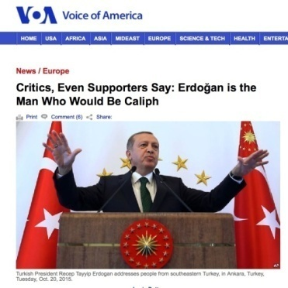
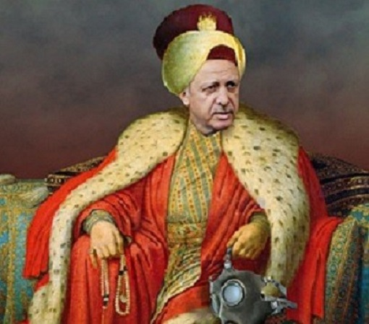
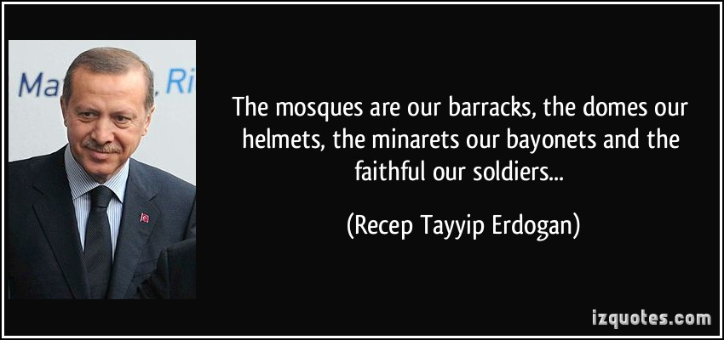

Slide 24
Erdogan visited Mecca in 2015. Erdogan entered “The Gate of Allah” the Gate to the Kaaba made of pure gold. The Kaaba is the place of Islamic pilgrimage for the entire Muslim world of 1.7 billion, Muslim prayers are directed to Mecca. The gates of the Kaaba are historically only opened 6 times a year, for Muslim purification twice a year and twice a year for special royalties it is opened once to wash it and once to change its dress. The gates were opened up in 2015 just for the sake of Erdogan to visit the Kaaba this was ordered from the top leaders of Islam. This was a bold statement of importance of who Erdagon is as a Muslim leader the potential new Caliph of Islam. This further positions Erdogan as the powerful political and religious “False Prophet” (Rev 13:11-18) with influence over multitudes of peoples , Muslims and nations. Erdagon oversees the 10th most powerful army in the world the Pope doesn’t have an army to fight with against Israel as the beast and False prophet are prophesied to do.

Slide 25
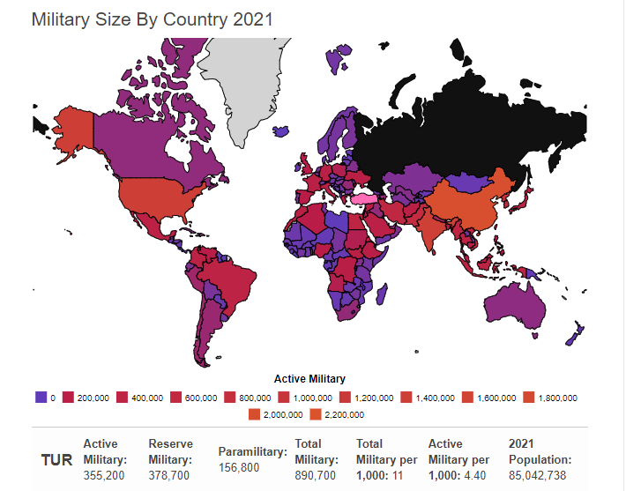

Slide 26
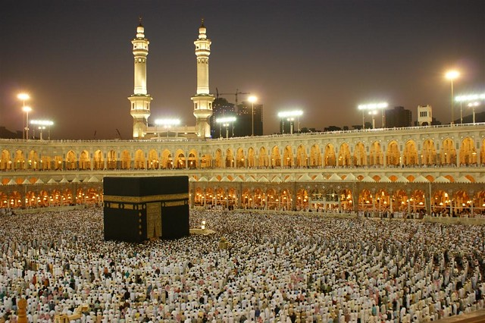

Slide 27
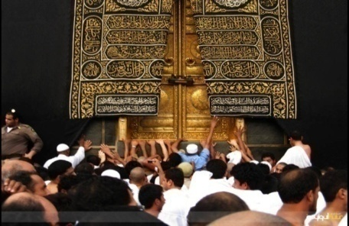
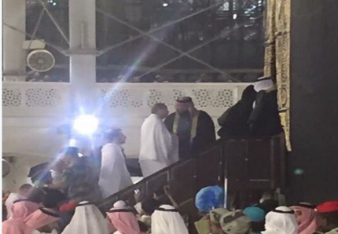
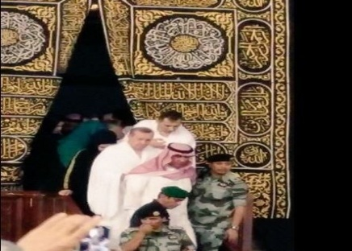
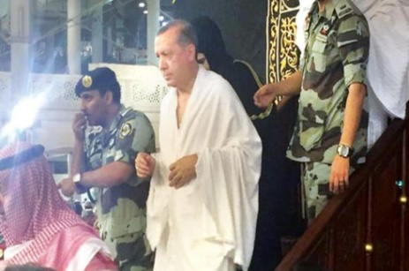

Slide 28
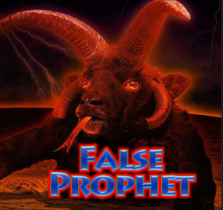
11 Then I saw another beast coming up out of the earth, and he had two horns like a lamb and spoke like a dragon. This false prophet has two horns like a lamb this is religion and politics/government. Jesus was both a religious leader and the King of a government the government of Heaven, he was the Lamb and the lion. The false prophet doesn’t speak like a lion but like a dragon, the dragon is Satan the fallen one. The false prophet is a false King with a false evil religious spirit speaking like a dragon with a lying deceiving tongue.

Slide 29
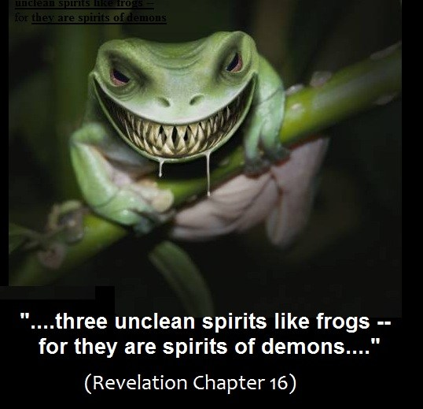
The False prophet has an unclean deceiving frog spirit in his Dragon mouth “Islam” Rev 16:13. Rev 16:13 -14 And I saw three unclean spirits like frogs coming out of the mouth of the dragon, out of the mouth of the beast, and out of the mouth of the false prophet. For they are spirits of demons, performing signs, which go out to the kings of the earth and of the whole world, to gather them to the battle of that great day of God Almighty (Armageddon Rev 16:16).

Slide 30
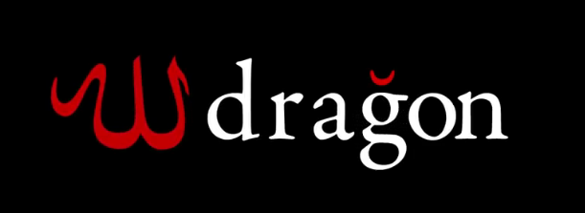

Slide 31
12 And he exercises all the authority of the first beast in his presence, and causes the earth and those who dwell in it to worship the first beast, whose deadly wound was healed. Since 2014 President Erdagon has become politically powerful and a powerful religious Muslim leader with great influence and authority with 1.7-9 billion Muslims. His power and influence is in the Middle East, the UN, the leadership of the OIC, “Organisation of Islamic Unity” made up of 57 Islamic nations handed to Erdagon from Egypt in 2017.The UN is now made up of one third Muslim nations, Erdagon has become the head influential leader for Islam at the UN. Islam as a religion is militant in Jihad and larger than the Catholic religion. Erdagon has threatened the European refugee crisis to explode if the UN doesn’t abide with Turkey’s wishes and financial support. Erdagon also strongly influences as a head leader the “Arab League” founded 1945 (Dan 11:23 “leauge with 1st beast”) made up of 22 Arab States, all Muslim. Erdagon is being called the new Caliph the “King of Islam” he sees himself as an Ottoman Sultan.

Slide 32
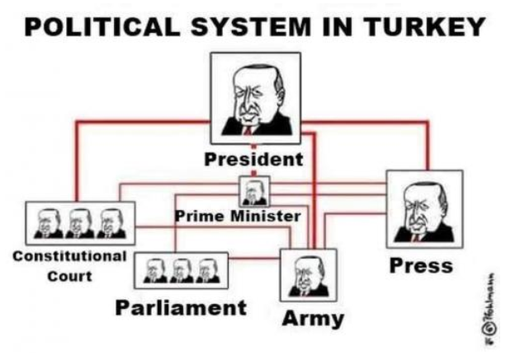
Erdagon’’s Authority in Turkey since 2016

Slide 33
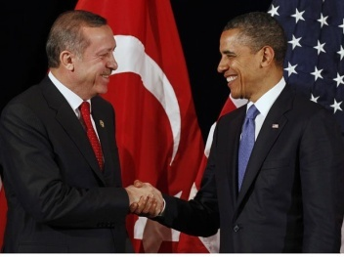
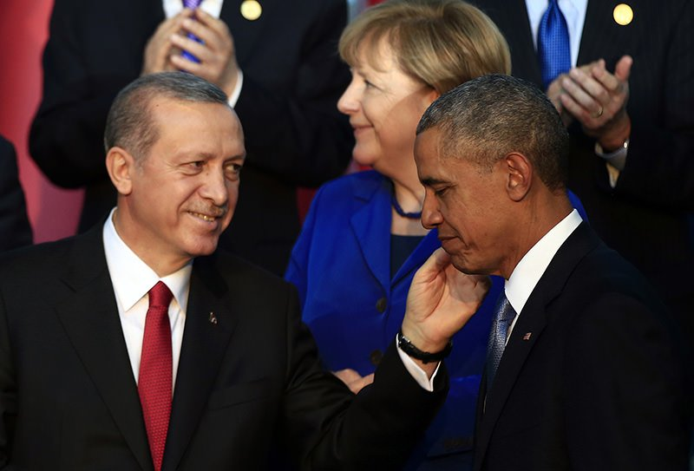
He exercises all the authority of the first beast (Obama a Muslim) In his presence “Islamic” beast and causes the worship of the first beast whose deadly wound (Islam) was healed (head / Ottoman Empire WW1 ,1st Trumpet) .This first Rev 13 beast with 7 heads is the antichrist spirit world wide. Obama as the Rev 13:1-11 “little horn” of Dan 7:8,23-24, Dan 8:9, 25 as identified in this beast. This beast has one of its seven heads wounded Rev 13:3 (WW1) “Islam” the “Ottoman Empire”, it is 96 years in between the wound and its recovery with Hezbollah in Syria 2013 then Isis in 2014 and Erdagons rise to power in 2014.

Slide 34
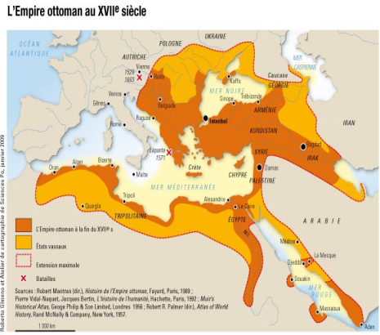
He causes earth and those who dwell in it , to worship the first beast who’s wound was healed the Earth here is the Middle East region where Turkey and Erdagon resides. All nations in this region are Islamic nations except Israel the only democratic nation left in west Asia. The UN has now led Islamic immigration into all the world from the Middle East region (Immigration Pact Dec 2018 of 164 countries) nations are now bowing down to the threat of Islam (666). Erdagon has been elevated to the caliph the king of Islam by Muslims. This is the “MIDDLE EAST BEAST”.

Slide 35
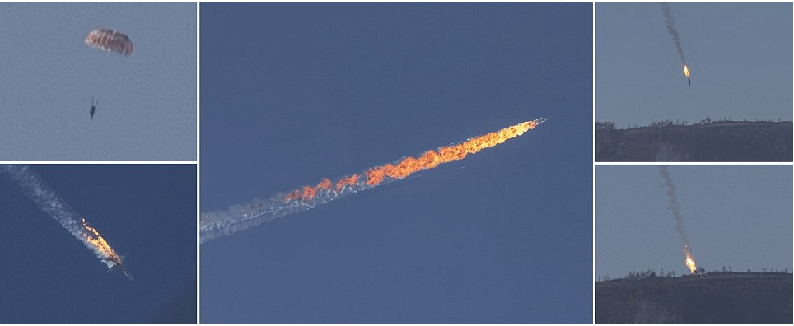
13 He performs great signs, so that he even makes fire come down from heaven on the earth in the sight of men. The false prophet calls down fire in front of the nation from above this happened with Erdagon one year after becoming prime minister in 2014, under Obama’s backing, Erdagon then shot down a Russian mig in Dec 2015 . A ball of fire was seen falling from the sky to the ground on the world news. John the revelator was seeing modern technology as part of these false signs. Erdagon uses predator drones missile fire from above against his enemies such the Kurds in Turkey killing many .(video)

Slide 36
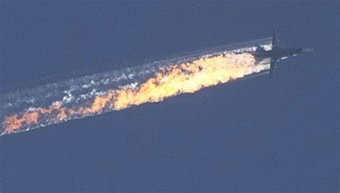

Slide 37
P President Erdogan uses US predator drones supplied by Obama to kill enemies such as the Kurds in Turkey and Iran, “missiles” from above literal Hell fire from the sky in the sight of men causing death on the Earth. The AGM-114 Hellfire (AGM stands for air to ground misslle) is an air to surface missille (ASM) first developed for anti-armor use, but later models were developed for precision drone strikes against other target types, and have been used in a number of actions aimed to "destroy high value targets) Source: https://en.wikipedia.org/wiki/AGM-114_Hellfire

Slide 38
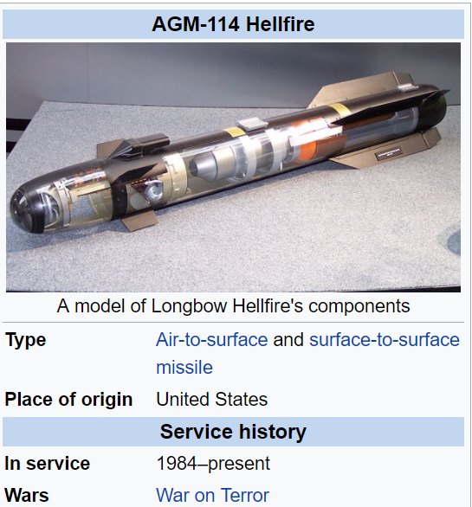

Slide 39
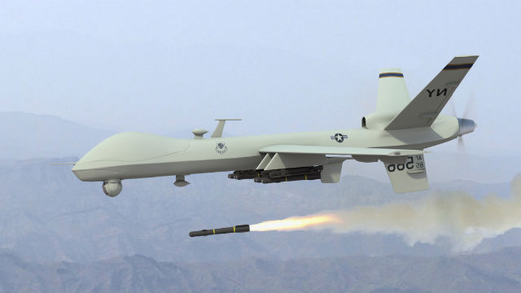

Slide 40
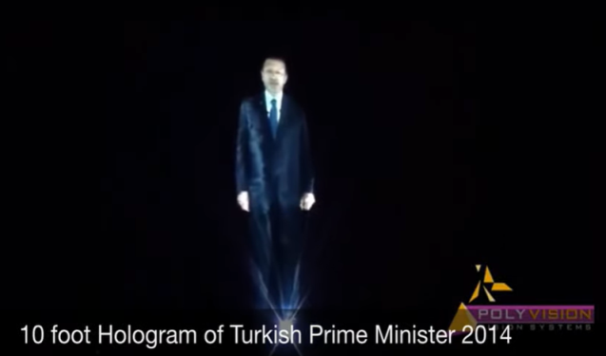
False signs and wonders of the false prophet, he uses holograms at some of his meetings to speak with the people, creating an atmosphere of false wonder.

Slide 41
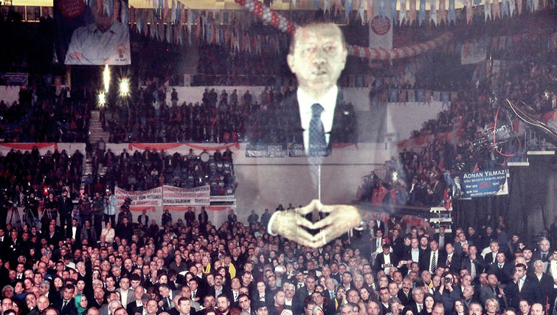

Slide 42
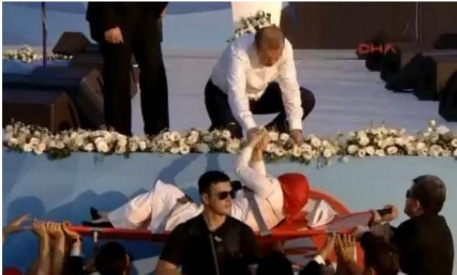
Erdagon has been known to heal the sick at his rallies. Erdogan ministering to a woman, who recovered instantly after fainting as he touched her, as reported in the Turkish news. http://www.vocativ.com/world/turkey-world/tayyip-ergodan/

Slide 43
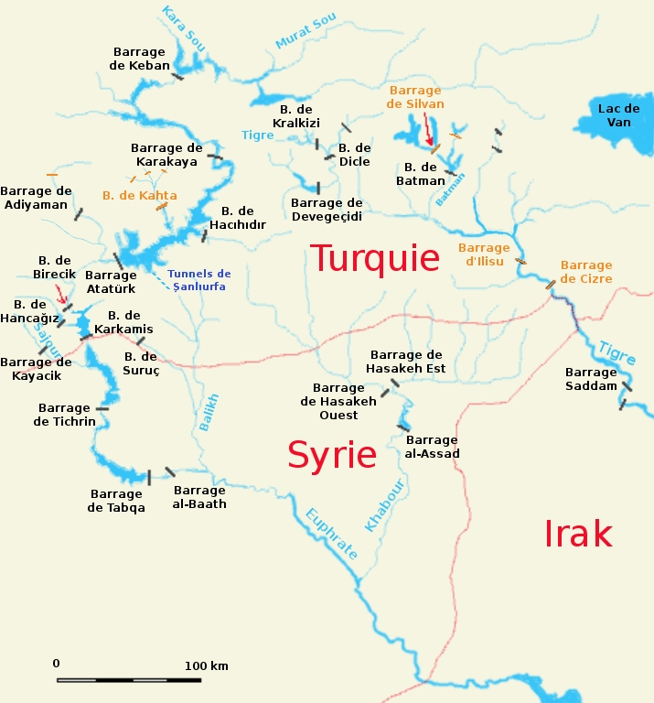
Turkey and Erdagon are also key to the Euphrates river drying up in 2009 , 6th bowl Rev 6:12-16. 2009 is the same year the Rev 13:1-11 first beast appeared on the world scene. Turkey blocked its flow with dams into Iraq and Syria they now have up to 22 dams along the Euphrates river.

Slide 44
¹⁴ And he deceives those who dwell on the earth by those signs which he was granted to do in the sight of the beast, telling those who dwell on the earth to make an image to the beast who was wounded by the sword and lived. The false prophet after the beasts 42 month war aginst ther saints is over sets up an image to the wounded head (Ottoman Empire WW1) of the beast. This took place in mid 2017 on June 15th just 6 months after Obama stood down as president. Erdagon unveiled a statue of the Ottoman Empire that stood around 150 feet high commemorating the 2016 cue against him.

Slide 45
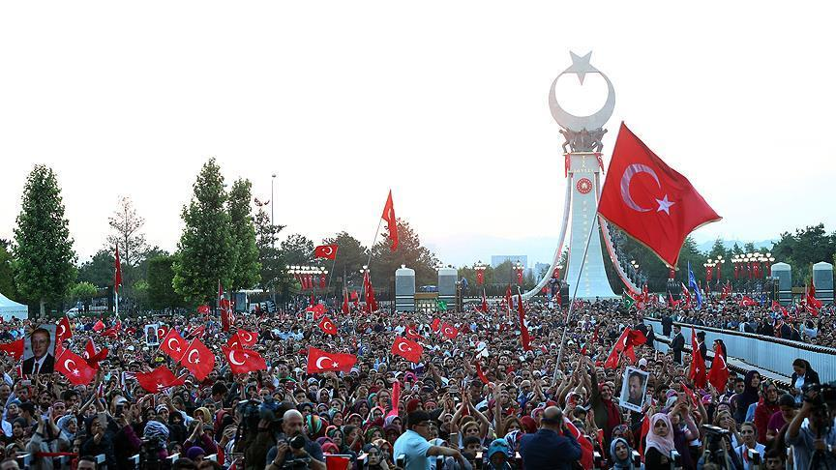
The June 2017 statue image the false prophet built of the wounded head (WW1) part of the 7 headed beast of Rev 13:14 was unveiled two and a half years after becoming President of Turkey a historical fact. (Video)

Slide 46
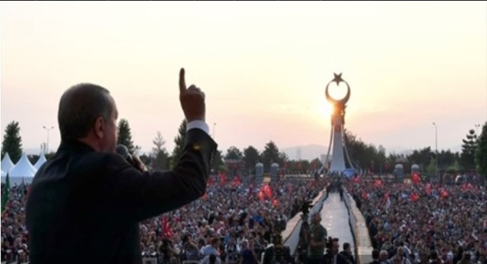
To great applause Erdagon called his followers to give him allegiance in front of this statue saying he would kill and behead all of his enemies. Over 100 thousand were arrested as enemies against the Turkish state from that cue. In the false prophet scripture It says “worship the image or be killed” again this is Islam under Sharia law which Erdagon is re-instating in Turkey.

Slide 47
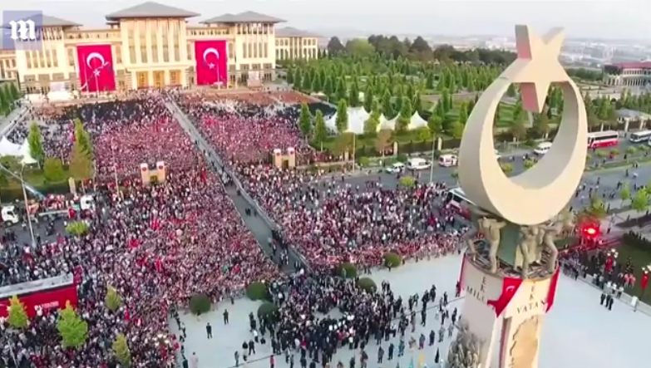
The statue is placed outside Erdagon’s $600 million US Ottoman styled palace he built as prime minister finished in 2014 when he became president of Turkey.

Slide 48
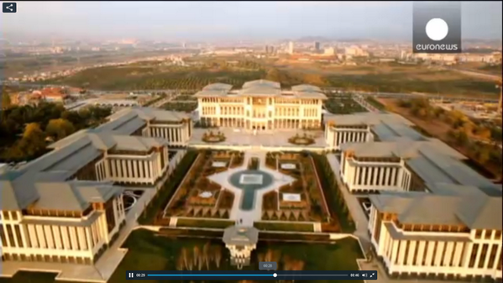
Ottoman Palace (Video)

Slide 49
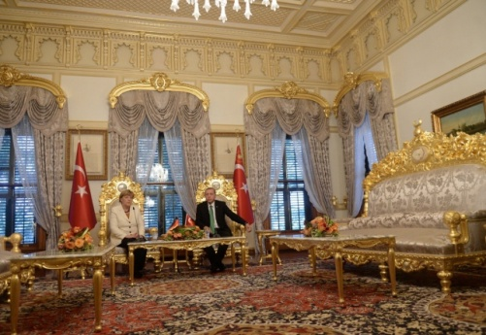
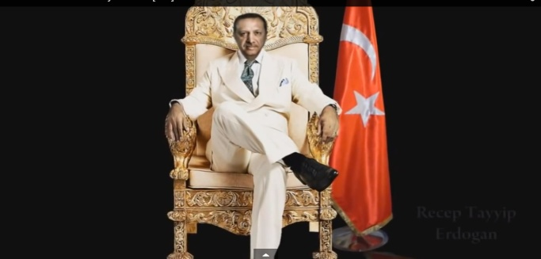

Slide 50
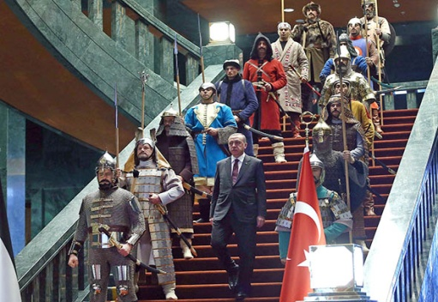

Slide 51
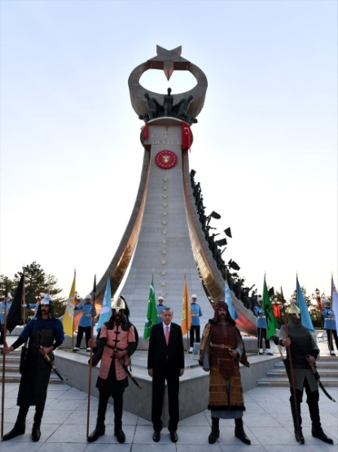

Slide 52
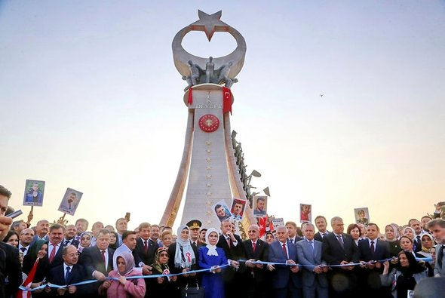
The Image/statue is of the 81 provinces and 7 regions of Turkey with the Ottoman moon and star on top a symbol of Turkish unity. (7 men/regions on top holding up moon and star of the Ottoman Empire the Ottoman seal of Turkey in the centre). This image set up by Erdogan is the symbolism of revival for the Ottoman Empire beast the wounded head, the revival of “Islam” as a power.

Slide 53
¹⁵ He was granted power to give breath to the image of the beast, that the image of the beast should both speak and cause as many as would not worship the image of the beast to be killed. Then Erdagon built himself a Mosque in 2019 right next to his 1150 room palace and his statue,the mosque seats 3000 people called “the Bestepe peoples mosque”. With the Islamic prayer call of “Azan” 5 times a day he has given his statue a voice, thie image of the wounded beast speaks. This Mosque sits on the gigantic palace grounds beside his palace and statue in Istanbul “Giving the image a voice. (Video) Erdagon also built the 100 million dollar Camlica Mosque in Ankara Turkey it seats 63’000 people the biggest in Turkey, he also converted the famous Hagia Sophia church back into a mosque by July 2020. Erdogan in Feb 2016 re-instated the Old Ottoman Empire language back into Turkish colleges to become the new national language he is giving the image of Islam its voice back in its original language. The Islamic call to prayer is 5 times per day released from loud speakers on mosques bearing the image of Islam, heard for miles around.

Slide 54
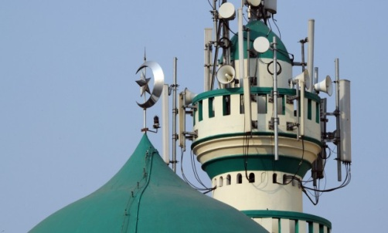
Voice of the image

Slide 55
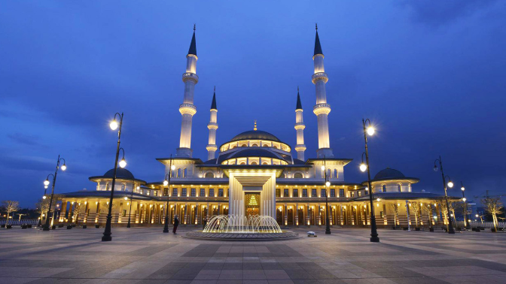
Erdagon’s Bestepe peoples Mosque 2019

Slide 56
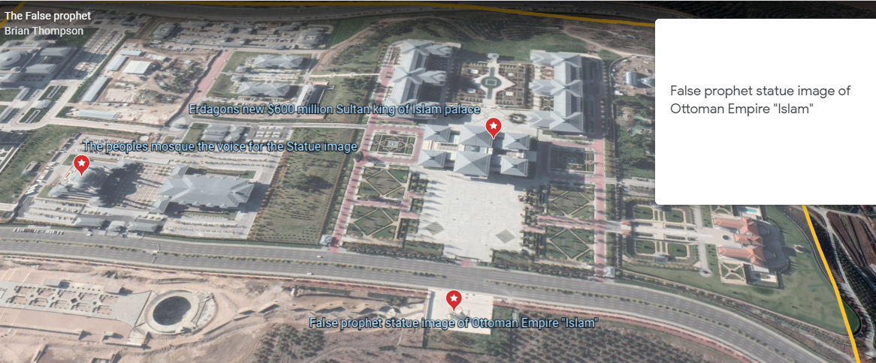
Google earth May 2020 Erdagon’s Palace, the statue image of the wounded head the voice of beast mosque in Ankara Istanbul Turkey 2014-2019. Marked with a red marker is Erdagon’s presidential Palace. The red marker below that is the statue image Erdagon built and unveiled in June 2017, 6 months after Obama stood down as US president. To the left is the 3000 seat Bestepe national people’s mosque he built and opened in 2019.

Slide 58
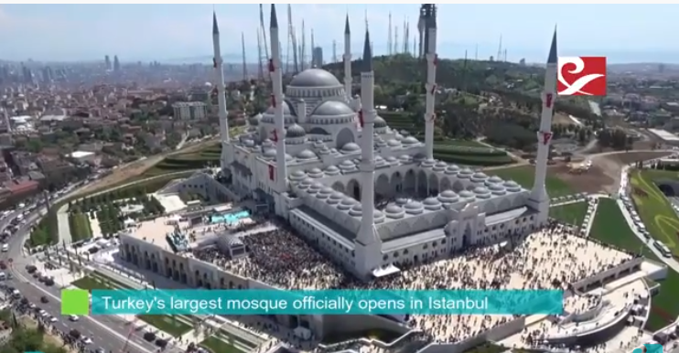
$100 million dollar Camlica Mosque in Ankara, Istanbul Turkey it seats 63’000.

Slide 59
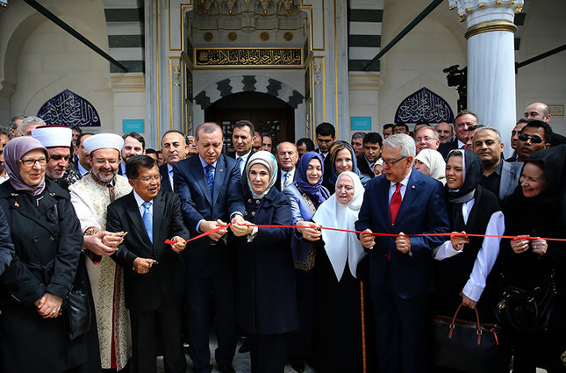
Erdagon has funded built and opened the largest mosque in the USA, Germany and the biggest in west Africa in Ghana that holds 10’000 people. Below Erdagon opened the Maryland $100 million Mosque in the USA in 2016 under Obama’s watch and permission.

Slide 60
¹⁶ He causes all, both small and great, rich and poor, free and slave, to receive a mark on their right hand or on their foreheads, ¹⁷ and that no one may buy or sell except one who has the mark or the name of the beast, or the number of his name. Under the false prophet Turkey is becoming a Sharia law state once again. Turkey became a democracy after WW1 (1st Trumpet) but no longer. As Obama advanced the cause of his God (Dan 11:39) so to Erdagon is advancing its cause. Under Sharia law you cannot buy or sell or trade unless you are a devout Muslim. You have no rights non Muslims become slaves or are killed. Erdagon is a devout Sunni Sharia Muslim he is killing the Kurds in Turkey and surrounding areas for religious reasons, calling missile fire down upon them. Erdagon is strengthening Ottoman Empire style influence in the Muslim world just as prophesied the wounded head recovers. The cue against him in 2016 was because of his radical reformation of Turkey back to Islamic Sharia rule. Erdagon has begun arresting Christian leaders and church members he has confiscated many church buildings and land into Turkish control to be state owned no longer to be used as churches.

Slide 61
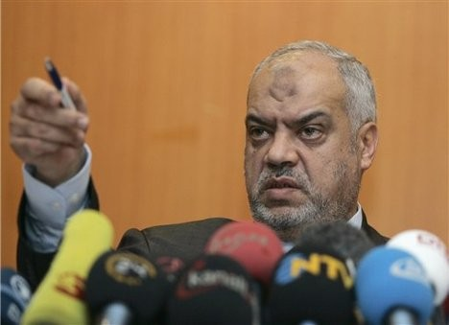
Mark of beast on hand of forehead This specific mark is under the false prophet and his religion. Strangely many devout Muslims that bow five times a day to Allah in prayer actually end up with permanent marks on their foreheads. No one can buy or sell unless they have the mark or the name of the beast, or the number of his name that’s three things that can be used. The mark of the false prophet is “Islamic” the number 666 is the symbolic number for man and the name of the beast under the false prophet is “antichrist / Muhammad / Allah / Islam”. (go to Mark of Beast PowerPoint)

Slide 62
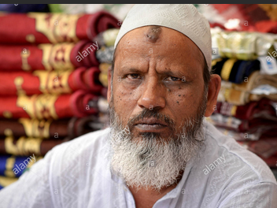
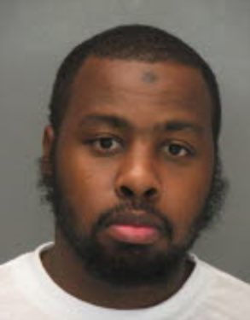
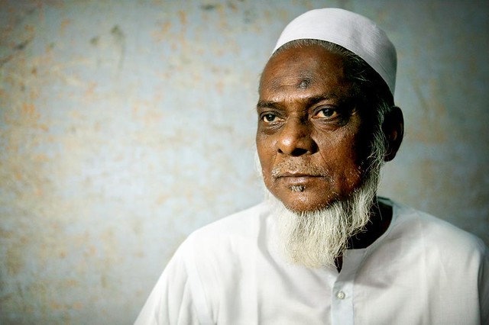

Slide 64
The false prophet causes the beasts mark on their right hand or forehead. Islam has around 1.7 billion people in its religion as of 2019. In the Islamic religion the “Shahada” is a declaration of allegiance to Allah and Muhammad an Islamic creed to the oneness of God. This Islamic symbol writing is found on flags, Mosques, head and arm bands worn by Islamic militants this badge can be seen openly with Isis, Hamas and other Islamic militants, this writing in Arabic has 666 in it.

Slide 66
From the Shahada a declaration is found the “Bismillah” this is a “badge of servitude” to Allah (beast). This Islamic symbol writing is found on flags, Mosques, head and arm bands worn by Islamic militants this badge can be seen openly with Isis, Hamas and other Islamic militants, this writing in Arabic has 666 in it saying “Allahu Akbar” meaning “Allah is Great”.

Slide 68
In Greek the three similar letters are “XES” turned sideways they are almost identical to the “Bismillah” Arabic Islamic symbol. The Greek word charagma used for mark means an imprinted stamp. In John the revelator’s time this word charagma was used to brand a person as a slave. With Islam this is a physical manifestation of a printed mark on head bands and arm bands.

Slide 71
The letters in the Greek word XES turned sideways on its back is the same mark and symbol of Islam in Arabic identical in form and symbol. The first letter in the Greek XES number of the Beast is the “X” character turned sideways it becomes the crossed swords in Islam. For the last 1500 years the “Bismillah” similar to the Greek “XES” has been the symbol of Islamic Jihad used by Muslims on flags and military symbols killing an estimated 669 million people since Islam’s inception. The second letter “E” is in the Islamic “Bismillah” the name for “Allah” or in the name of “Allah” turned on its side and placed in a mirror it forms the same Greek middle character as written by John. The third character of the XES is the “S” in Arabic this is a stigma or badge of servitude . These three letters in Greek seem to translate to the 666 that John sore over 2000 years ago. John wrote his Revelations prophecies 610 years before Islam was formed in 610 AD. The Roman Catholic church was formed in 313 A.D under Constantine.

Slide 78
Muslims state when the beast comes he divides between believers and non believers this is actually what Jesus does. The Hadith is a collection of traditions containing sayings of the prophet Muhammad which, with accounts of his daily practice (the Sunna), constitute the major source of guidance for Muslims apart from the Koran. Any of the sayings from the Hadith. Oxford dictionary “Bing search engine”

Slide 79
So in Muslim belief Allah gives them a Mark a badge to save them from damnation. In the Hadith they say the beast comes forth with Moses staff to draw a line on the head of the believer then with Solomon's ring seals the nose of every non believer. They say many tmes in the Qur’ran Allah is the best deceiver. In the Bible Satan is the deceiver, it is only God who judges between the wicked and the saved, the mark is of damnation it is not for the saved.

Slide 80
The Quran openly states many times that Allah is the 'best deceiver'. The Arabic word used here is "ماكر" "maakir", coming from the root m-k-r م-ك-ر, with the word Makr "مكر" meaning deception. Qur'an 3:54 , Qur'an 7:99, Qur'an 8:30, Qur'an 10:21, Qur’an 13:42. https://wikiislam.net/wiki/Allah,_the_Best_Deceiver_(Qur%27an_3:54)

Slide 83
18 Here is wisdom. Let him who has understanding calculate the number of the beast, for it is the number of a man: His number is 666. The number of the beast (the spiritual mark of the end times false prophet) 666 is the number of a man (the demonic comes through man Eph 6:12). Islam was started by Muhammad in 610 A.D the name of the man is “Muhammad” worshipping “Allah” disguised as Satan the beast., who comes to steal destroy and kill (Jn 10:10). This is what John the revelator could have seen Greek turned sideways in Arabic for “Allah” Satan the beast.

Slide 84
Mark of the Beast Law In 1982 Archaeologist Ron Wyatt was doing excavation work for the Israeli government in Jerusalem at Jeremiah’s grotto at the base of the Golgotha the place of the scull where Jesus was crucified. It was during this dig he was digging to find the Ark of the covenant. Ron eventually broke into a small cave that led to a hidden chamber that housed the Ark buried by Jeremiah several thousand years before at the invasion of Babylon in Daniels day. According to Ron’s testimony the Israeli government then took over the find the Ark still remains where it was found no one can get to it as they get struck dead. Ron was the only one God allowed into the chamber of discovery. in the chamber was found the Temple tools such as table of showbread , candle sticks and other items such as Goliaths sword. Ron had visited this chamber on several occasions before being locked out by the government. On his fourth trip to the chamber he returned all the items in the chamber had been put in their correct placing moved around

Slide 85
Four angels then appeared to Ron lifting off the Arks solid gold lid so he could film, the ten Commandments they then laid against a cleft in the rock. The angels then told Ron in the days ahead the nations would bring forth a new law the “Law of the Mark of the beast” to be enforced upon nations. That the nations would think they were doing the right thing but it wouldn’t be it would be deception for nations to bow to this “Mark of the beast law”. That angelic encounter and message was 38 years ago. The angels instructed Ron hat at the time this “Mark of the beast law” would come forth his ministry would be given permission to release the filmed footage of the Ten commandments found in the Ark in the chamber. Ron Wyatt has since died yet his ministry is still operating. They released an updated video about Ron’s discoveries saying the felt the “mark of the beast Law” was about to come.

Slide 86
After the Christ Church Muslim Massacre in New Zealand March 15th 2019 where 55 Muslims were killed the NZ prime minister , Pakistan and Erdagon of Turkey began heading up a campaign for a new law in the United Nations launched by June 2019. Erdagon of Turkey the false prophet headed up the charge on this new law to come it was an anti hate speech law an anti “Islam phobia law” to be enforced. Which would cause nations to bow down to Islam the “Mark of the beast “ religion. This is the Law the angels referred to back in 1982 with Ron Wyatt in the Ark of the covenant discovery in the cave, now under process at the UN since 2019.

Slide 87
In 2021 Canada brought forth a Bill called the BC – 10 that strips Canadians of the freedom of free speech (Mark of beast Law). The government will now tell its people what they can and cannot say in public across all media. This is a new law in acted due to a Christian activist making a stand against homosexual activity in the nation. Justin Trudeau the Canadian Prime Minister is a known Catholic who embraces Islam His father was Jesuit. Free Speech Killed Overnight in Canada with New Law (June 23, 2021) Free speech rights of Canadians have been strangle overnight by the leftist Canadian government as it passed a new bill overnight without due Democratic process. Canadian patriot Chris Sky joined Stew Peters on the Stew Peters Show on Tuesday (June 22) to break the news of the bill C-10 signed into law giving the government total control of internet content in the country. Sky was seen saying: They can outright censor virtually anything they want. It is literally the most draconian bill ever passed. https://www.ernestdempsey.com/free-speech-killed-overnight-in-canada-with-new-law/

Slide 89
Ark of the Covenant

Slide 92
The Rev 13:1-11 first beast returns at a later time in the last 42 month period of the “Great Tribulation” also known as “Jacobs Trouble” Jer 30:7. The two witnesses appear for this 42 month period with their testimony. The Rev 14:14-16 “Harvest of souls” happens between these two tribulation periods. This all culminates with the battle of “Armageddon” Rev 16:16 where the beast and the false prophet are destroyed Rev 19:20. At the same time you have the “Great supper of God” Rev 19:17-18. In this seventh Trumpet Wrath at Jesus return Rev 11:15-19, is a term known as the “Day of the Lord” Is 2:6-22 .

Slide 93
Daniels 70 weeks Prophecy the last week or 7 years The last week (7 years) of the Daniel 9:26-27, 70 weeks (490 years) is interpreted in two ways. It has been proven from the time of this prophecy historically 1 day is as a year till the Messiah being cut off . The first interpretation is Jesus starts his ministry at 30 years old around 27-30 A.D. The end of the 69 weeks is then fulfilled at Jesus death around 30-33 A.D then an unknown period of time a “gap” happens, then the last week or 7 year period of the antichrist comes. When it comes to the years of Christ s start of ministry no one fully knows its guess work. Its taught the last week or 7 years is the end times antichrist making a covenant a peace treaty with Israel of 7 years , he breaks it mid way through. The 69 week (483 years) start point is from the decree of Cyrus in 457 B.C to set the Hebrews free from 70 years of Babylonian captivity Jer 29:10. The beast at the end of this 7 years stops the worship and sacrifice of Gods people “Wars“ against them for a final 42 months then Jesus returns (Jesuit teaching).This theory of 7 years under an antichrist was taught by Jesuit priests to counter the Martin Luther reformation, it is a false teaching.

Slide 94
As part of the Counter Reformation, the Catholic Church commissioned Jesuit priests to write counter interpretations of Bible prophecy as a counter response to the Protestant reformation when the finger was pointed at them as being antichrist. Spanish Jesuit, Francisco Ribera (1537-1591) proposed that the final seven years of the 70 weeks of Daniel was a future antichrist and that antichrist would bring an end to sacrifices in a rebuilt temple. This is where the supposed 7 years of tribulation comes from before the second coming of Christ. But this was manufactured prophecy, written with the sole purpose of deceiving Christians on the true identity of antichrist (at the time the Pope was being called the antichrist). http://www.daniels70weeks.com/

Slide 95
The second is Jesus starts his ministry at age 30 around 27-30 A.D at the beginning of the 70th week . The 7 years or one week was given as a grace period promise to Israel at the Messiahs coming. Jesus preached for 42 months then is cut off crucified in 30-33 A.D. After His death another 42 months is given for His chosen people Israel to repent and receive Him as Messiah but they rejected Him it ends with Stevens death in Acts 7 said to be 34 -36 A,D. Yet God in the last days will save Jacob known today as modern Israel Rom 11. At the end of the 7 year grace period Steven is killed in 36-37 A.D, Jesus then gives salvation to the Gentiles Acts 10 through Peter and the house of Cornelius. Persecution breaks out against the Jewish Christians ordered by the Pharisees through Saul Acts 8 brother turns against brother the staff of bonds is broken Zec 11:7, Zec 11:10-14. Saul is then saved at Damascus Acts 9. The narrative (a spoken or written account of connected events) of scripture for correct understanding is “Historism” not “Futurism” or “Preterism” Rev 1:19 (Hermeneutics is the the branch of knowledge that deals with interpretation, especially of the Bible or literary texts ) . (Mainstream theology Futurist dispensationalist teachers teach the later about the antichrist of end times bringing in a 7 year peace treaty then breaking it mid way. This is all taught from the C.I Schofield Bible filled with Jesuit false teachings on end times).

Slide 97
Rev 17:8 The beast that you saw was, and is not, and will ascend out of the bottomless pit and go to perdition. And those who dwell on the earth will marvel, whose names are not written in the Book of Life from the foundation of the world, when they see the beast that was, and is not, and yet is. (This is the Dan 2 last Empire of the Dragon “Babylon” The Holy Roman Empire) Rev 17:9 -11 "Here is the mind which has wisdom: The seven heads are seven mountains on which the woman sits (Vatican City). There are also seven kings. Five have fallen, one is, and the other has not yet come. And when he comes, he must continue a short time. (This is the Holy Roman Empires last 8th King Pope). The beast that was, and is not, is himself also the eighth (1929 Lateran Treaty), and is of the seven, and is going to perdition (Destruction as the beast and False prophet do). Rev 17:12 -13 -14 "The ten horns which you saw are ten kings (leaders over nations) who have received no kingdom as yet, but they receive authority for one hour as kings with the beast. These are of one mind, and they will give their power and authority to the beast. (This is the “man of sin” Beast from the sea Obama) These will make war with the Lamb, and the Lamb will overcome them, for He is Lord of lords and King of kings; and those who are with Him are called, chosen, and faithful."

