Slide 1
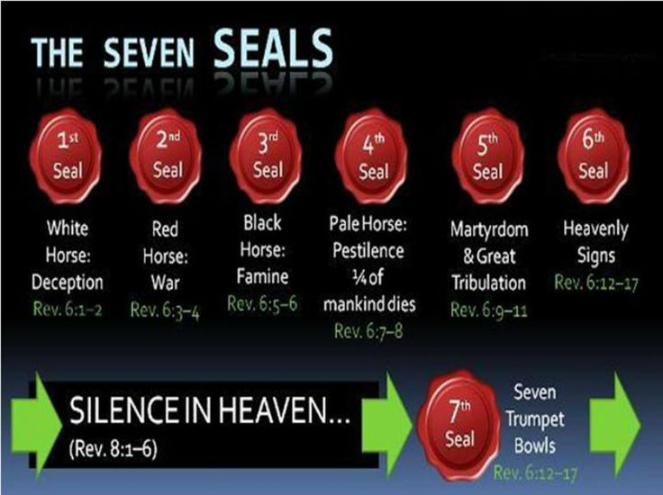

Slide 3
Revelation 6:3-4 the second Seal: Conflict on Earth/Peace removed
³ When He opened the second seal, I heard the second living creature saying, "Come and see." ⁴ Another horse, fiery red, went out. And it was granted to the one who sat on it to take peace from the earth, and that people should kill one another; and there was given to him a great sword. (NKJV)

Slide 4
2nd seal the Red horse released

Slide 5
For 1260 years estimates of 70 – 150 million people died at the hands of the Vatican with millions of Martin Luther reformer protestants being targeted through inquisitions. Then for the last 1500 years targeting Christians and other ethnics you have had ongoing Islamic Jihad which has killed an estimated 669 million people according to historians the biggest generational killing machine on earth. These examples above are just a few ongoing conflicts of what's happened in the Earth. Throughout the ages up until the 19th century you have had wars and rumors of wars since the days of Christ and before. Yet no war before the 19th and 20th centuries has been worldwide or as devastating as the 19th century wars.

Slide 6
Worldwide Conflict WW1, 1914 -1918 (1st Trumpet blast peace removed) The First World War started June 28th, 1914 till November 11th, 1918 a four year war involving the entire known world .Over twenty seven allied and associated nations and four Central Powers fought in WW1. The estimated total number of people killed during WW1, was 20 million you also had up to 100 million die from the Spanish flu that emerged from the USA 1917-1918 infected from this war. At the turn of the 19th century mass genocide killings also began to take place starting with the Turkish genocide of 1.8 million Armenians Christians in the early 1915-1923 in attempts to start a new Turkish “Ottoman” styled empire but they failed. Stalin of Russia killed up to 60 million. Mao of China killed 59.5 million 1958-1962. Rwanda 1.1 million, Indonesia 3 million, Bangladesh 3 million etc. For 19 years you had the great depression a loss of 70 trillion worldwide 15% of the worlds GDP from 1929 to the late 1930’s (This was equivalent to the monetary loss of the 2008 worldwide stock market crash), then came the start of WW2 by 1939.

Slide 7
Worldwide Conflict WW2, 1939-1945 (2nd Trumpet blew peace removed) The Second World War was from September 1939 to September 2nd, 1945 a six year war. There were 104 countries either involved in or affected by World War II. World War II was the deadliest military conflict in the world’s history. There were between an estimated 70-80 million people killed in this war this was over 2.5% of the world’s population. Virtually every country was involved in one form or another. Even the neutral counties were harmed economically by their neighbors being at war and unable to trade as in the past. Oas prophecy states in the 2nd Trumpet one third of all ships involved merchant and navy were sunk 36’387 ships.

Slide 8
Other conflicts were the Pakistan genocide of 3 million Christians in the 70’s by peaceful Muslims. You had the Cambodian killing fields under Pol Pot where 1.7 million were killed 1975-1979, 21% of the population. You had the Vietnam 20 year war from 1955-1975 with 300 thousand killed , the Russian Stalin massacres of 20 million people 1921-1953. There has been over 110 million directly killed in wars from 1900 -2019 with an estimated 1 billion since mans beginnings. From mid 2013-2017 you had a 42 month period with 2.2-3 million Christians destroyed from Iraq and Syria in the “war against the saints“ tribulation period with another 5 million Syrians displaced and 570 thousand killed. There has been up to 150 million people massacred by other conflicts and corrupt dictatorships in the last 100 years. regardless of WW1 and WW2. Up to 100 million killed in WW1 and WW2 and another 50-100 million die from Spanish flu. This brings the death toll of over 300-350 million people killed through war and massacres in the last 100 years alone that’s peace removed the red horse. As mentioned estimates killed by wars from mans beginnings are 1 billion. In last 100 years you have over a third of that figure killed.

Slide 9
In real historical terms peace has been stolen on earth by Satan for generations due to wars, revolutions and national conflicts between nations, countries and tribes. To take away worldwide peace from many nations is another level again this has only occurred recently in history. Between the two world wars there has been a certain level of peace for many nations yet also in several nations conflicts have been ongoing. In the past 100 years there has been over 150 major conflicts killing millions.
As of 2017 there were 40 wars around the world in constant conflict between nations and tribes. The 7 Trumpets, the 7 seals and 7 bowls started being released at the beginning of the 19th century (last 100 years) as a time line of historical fulfillments with WW1 and WW2. This red horse seal and its fullness has been reserved for these last days to herald in the return of Christ according to words of prophecy found in scripture.

Slide 10
Matthew White, Historical Atlas of the Twentieth Century, 2010: Deaths by War and Oppression during the 20th Century: 203 million See: http://necrometrics.com/all20c.htm (Video go to end of vid)

