Slide 1
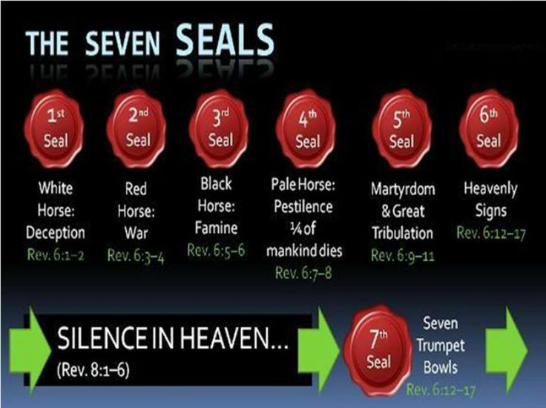

Slide 2
One of the 4 horsemen

Slide 4
Rev 6:1-2 Seal 1 rider on a white horse the conqueror
1And I saw when the Lamb opened one of the seals, and I heard, as it were the noise of thunder, one of the four beasts saying, Come and see. 2And I saw, and behold a white horse: and he that sat on him had a bow; and a crown was given unto him: and he went forth conquering, and to conquer. (NKJV)

Slide 5
And he that sat on him had a bow; and a crown was given unto him: and he went forth conquering, and to conquer. A crown speaks of rulership spiritually over people, the bow speaks of loosing something truth or deception in this case it’s deception. So when God allows the loosing of something in the spiritual all over the earth its spiritual dominion. What began worldwide for the first time like never before at the turn of the 19th century was an acceleration of drugs and alcohol in the international trade of mind altering substances. This 1st seal began its purpose just before the first Trumpet of WW1. This has placed billions into the cycle of spiritual deception, sin and bondage in the last hundred years.

Slide 6
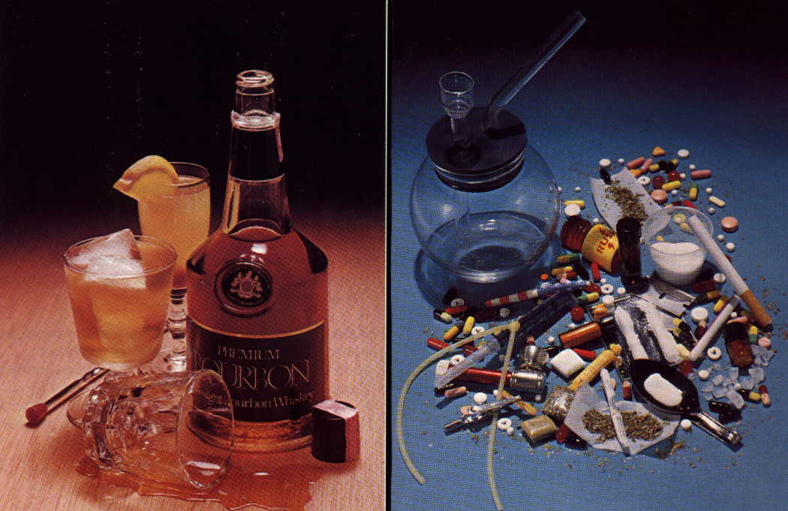
The Dominion of “Bondage”

Slide 7
I used to be an alcoholic and drug user before I was saved in 1997. At salvation I was sovereignty delivered from drinking alcohol and taking drugs. I know longer had addiction urges from salvation forwards. It was about 12 months later at Christmas time I decided to have half a glass of beer. As soon as I took a mouthful of beer I felt an oppressive demonic spirit settle over me it scared the daylights out of me so I never touched it again. Later on in 2001 after a major deliverance and a 40 day fasting period I began getting headaches at work. This conquerer revelation goes deeper than what you may think. One day at work the Lord prompted me to drink a bottle of Coca cola so I did and my headache disappeared. I asked Him why that was ? He said you need to stop drinking caffeine it is a drug causing your headaches through the antichrist of drugs and alcohol. Caffeine was first discovered and used in Arabia 1000 years ago in Muslim nations through an antichrist religion , tea began 5000 years ago in ancient China in both civilisations caffeine became an integral part of their cultures. These substances both came into to Europe around the 16th century. And increased in the 19th century. I then asked the Lord to confirm this so I did some research. (Video)

Slide 8
Coca Cola first started in 1886 in Atlanta, it was created in Georgia, by Dr. John S. Pemberton a medical pharmacist. Coca Cola gained its name from its two main ingredients Coca leaf used to make cocaine and the Cola/Kola nut which contains caffeine both are mind altering drugs. When Coca Cola was first made it was made with the leaf of the Peruvian Coca with Coca alcoholic wine it was called “French wine Coca” then it was changed to Coca Cola due to alcohol being outlawed in the US. Coca Cola from 1886-1929 contained extracts of cocaine and the caffeine rich Cola/Kola nut. It wasn’t until the early to mid 19th century that Coca Cola took off with 1 billion bottles sold per day worldwide by 2014. Cocaine was put into Coca Cola to get sales by getting people addicted to it this then stopped, they then laced it with caffeine to continue that addictive trend. Caffeine is now in tea , Coffee and most soft drinks. (Video)

Slide 9
The first seal is release through the international drug and alcohol trade, dramatically increasing its dominion over entire nations.
At the time of this revelation several years ago, not long after my headache experience at work with Coca Cola, I was given a tape with Bob Jones and Paul Cain (major Christian Prophets) talking about how God had revealed to them that the White Horse of Rev 6:1 the first seal was called Cocaine & drugs that it had gone out into all the world to conquer. At the same time a well known preacher from the US was preaching on stage he had strong pain in his right arm he asked the Lord what was causing it God told him to stop drinking caffeine as it was attached to an antichrist spirit coming against his authority causing the pain (Right arm is authority in Scripture). This was a huge revelation as the entire Earth drinks caffeine, even after church in most western nations truly a people conquered. I am in no way condemning the use of pain medications or doctor medications there is grace over these things. I myself still take pain killers at the Lords direction until I am healed.
There is an antichrist spirit of drugs and alcohol behind these substances violating, oppressing, killing, maiming and conquering people all over the Earth. Truly this white horse has done what it was released to do spiritually. The current worldwide alcohol consumption we now see conquering the world was first created as far back as 10’000 B.C, through archeological records.

Slide 10
A few years ago at a prayer group meeting in New Zealand Gods Holy Spirit fell and deliverance began on some Christians. One newish Christian girl fell to the floor screaming as she went through deliverance it got every ones attention so they all prayed for her. It turned out to be an antichrist spirit of alcohol and drugs she had been oppressed by causing much anger in her life from her past. After the deliverance took place her whole countenance changed she became much more lighter and joyful. Over the years I have met several Christians who testified also about how God had spoken to them not only about alcohol but also caffeine to stop taking the substances due to demonic oppression. God is the same yesterday today and forever He speaks truth and it’s knowing the truth that sets one free. Many are caught up in cycles of demonic warfare and problems still being conquered after being forgiven, deliverance is needed.

Slide 11
With these substances such as alcohol and drugs a study throughout scripture from Genesis to Revelation on wine and intoxicating drink will give you a very clear picture of the spiritual effects of these substances. Through the use of drugs and alcohol your discernment gets confused you get conquered by Satan the master of confusion. There is a curse of death, violence , carnality, rape , murder, divorce, mental health , depression, suicide addictions and all kinds of sin tied to these substances. It is also the origin the root of the child sex slave trade all over the earth. Joel 3:3 They have cast lots for My people, Have given a boy as payment for a harlot, And sold a girl for wine, that they may drink. (NKJV)

Slide 12
Its identifying the doorways that lead to being oppressed by demonic influences then shutting those doors down to keep your healing. Truly we are a people that has been conquered until saved and delivered. In one place in scripture it indicates that alcohol mars ones discernment between what is Holy and unholy: Lev 10:9-10 "Do not drink wine or intoxicating drink, you, nor your sons with you, when you go into the tabernacle of meeting, lest you die. It shall be a statute forever throughout your generations. That you may distinguish between holy and unholy, and between unclean and clean. (NKJV) When you can discern what is clean and unclean holy and unholy before God and repent of what your doing, then you will see true freedom and healing .

Slide 13
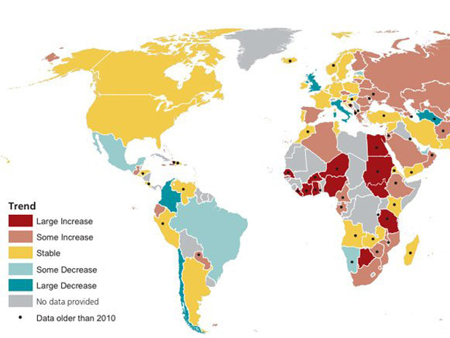
Map of illegal drug use around the world

Slide 14
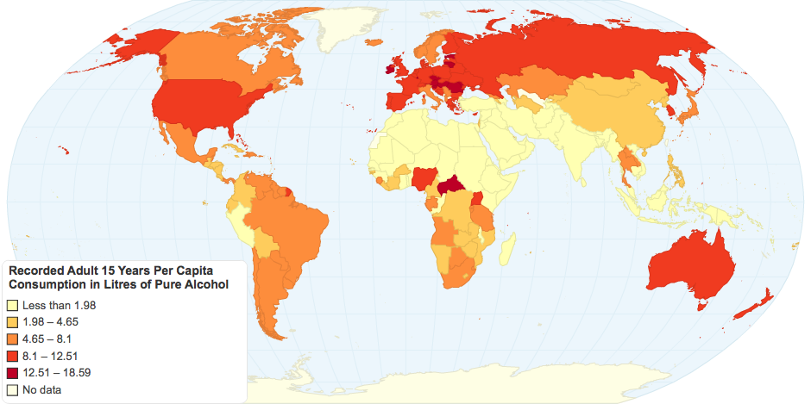
Total recorded alcohol per person of consumption (15+), in liters of pure alcohol

Slide 15
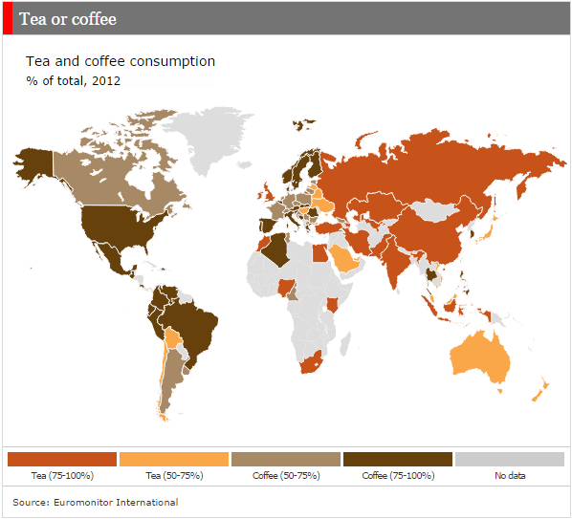

Slide 16
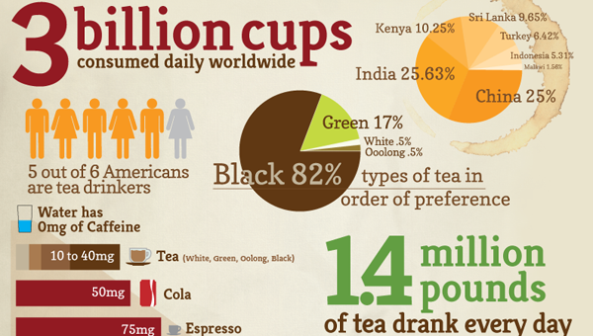

Slide 17
Drugs and Alcohol is a problem in New Zealand with both young and old a conquered people.

Slide 18
Video

