Slide 2
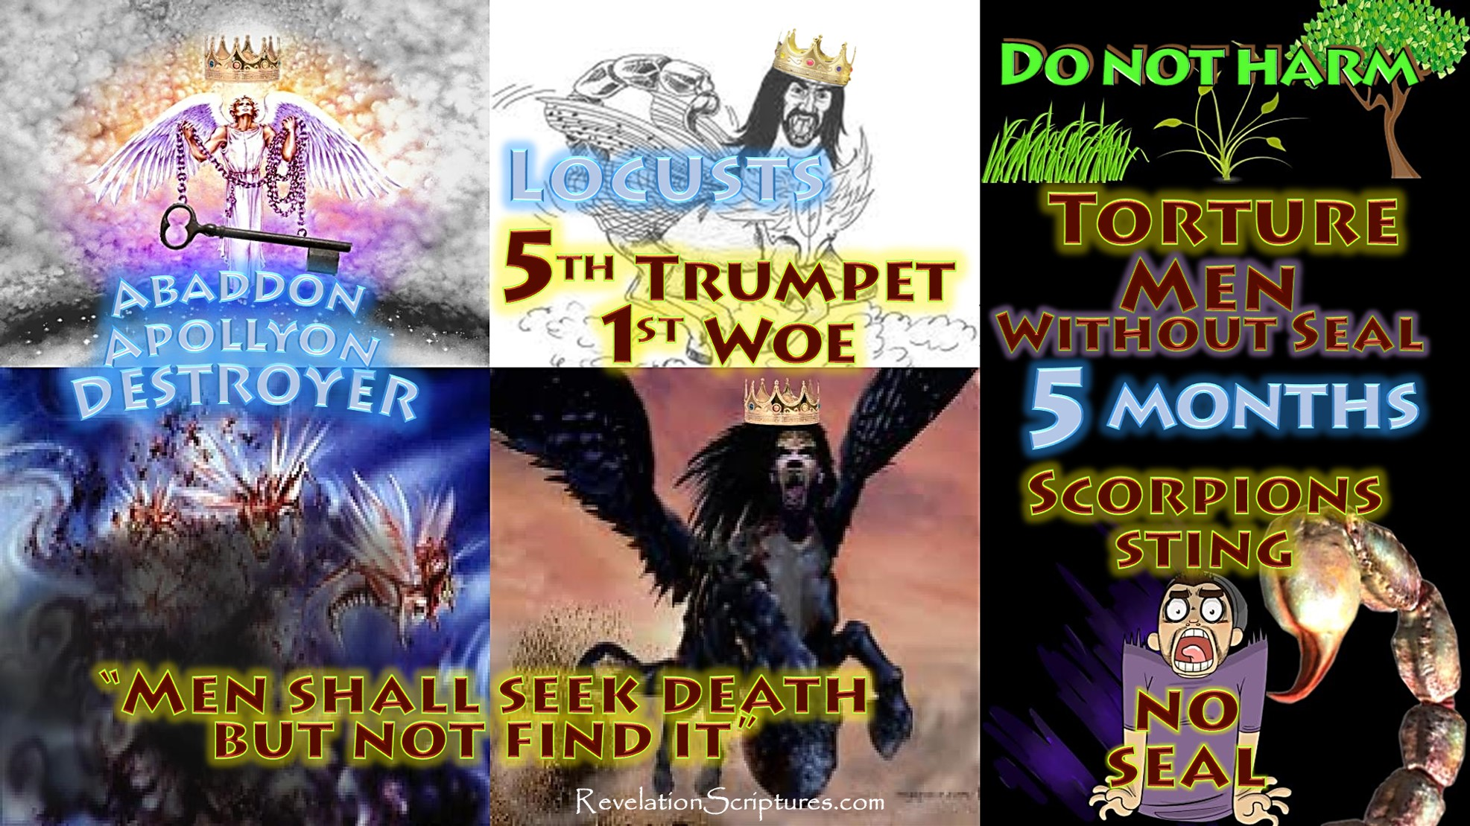

Slide 3
The Fifth Trumpet Rev 9:1-11
Fifth Trumpet: The Locusts from the Bottomless Pit
Then the fifth angel sounded: And I saw a star fallen from heaven to the earth. To him was given the key to the bottomless pit. ² And he opened the bottomless pit, and smoke arose out of the pit like the smoke of a great furnace. So the sun and the air were darkened because of the smoke of the pit. ³ Then out of the smoke locusts came upon the earth. And to them was given power, as the scorpions of the earth have power. ⁴ They were commanded not to harm the grass of the earth, or any green thing, or any tree, but only those men who do not have the seal of God on their foreheads. ⁵ And they were not given authority to kill them, but to torment them for five months. Their torment was like the torment of a scorpion when it strikes a man.
⁶ In those days men will seek death and will not find it; they will desire to die, and death will flee from them.⁷ The shape of the locusts was like horses prepared for battle. On their heads were crowns of something like gold, and their faces were like the faces of men. ⁸ They had hair like women’s hair, and their teeth were like lions’ teeth. ⁹ And they had breastplates like breastplates of iron, and the sound of their wings was like the sound of chariots with many horses running into battle. ¹⁰ They had tails like scorpions, and there were stings in their tails. Their power was to hurt men five months. ¹¹ And they had as king over them the angel of the bottomless pit, whose name in Hebrew is Abaddon, but in Greek he has the name Apollyon. ¹² One woe is past. Behold, still two more woes are coming after these things. (NKJV)

Slide 4
Breakdown historically of the 5th Trumpet fulfillment:
This 5th Trumpet the “release of the caterpillar” has been fulfilled known as “Operation Iraqi Freedom” the US war invasion of Iraq in 2003. (Video)
then the fifth angel sounded :
This Trumpet began with the 9/11 event of Sept 11th 2001. The terror attack on the Twin Towers World Trade Centre in Manhattan down town New York City in America killing 2745 people causing 3 billion in damages. This led to the invasion of Iraq under President George W Bush, the invasion started March 20th 2003 with UN coalition forces entering Iraq eventually toppling Saddam Hussein. (Video of invasion)

Slide 5
The initial invasion lasted 2 months until victory was declared over the central city of Bagdad , it took months longer for the rest of the cities outer suburbs with strong resistance. After the Bagdad victory in 2003 Saddam Hussein went on the run he hid from US forces for months. No one new where he was they searched every where for him.

Slide 6
And I saw a star fallen from heaven to the earth. To him was given the key to the bottomless pit. ² And he opened the bottomless pit, and smoke arose out of the pit like the smoke of a great furnace.
“The wise will shine like stars forever” people can be referred to as stars in scripture Dan 12:3 also as angels Rev 12:4 “a third of the stars fell” by the “fallen morning star Lucifer “ Isaiah 14:12.
For the first time in human history Saddam had set over 700 oil wells on fire in Kuwait in 1991. Then again Saddam again set fire to oil wells in 2003, this time he set 7- 9 major oil wells ablaze when coalition forces invaded. Oil trenches were also filled with oil then set on fire by Saddam’s forces across Iraq . Again this was to block US vision of Iraq’s troops from air strikes by laser guided missiles, the sun was also blocked out over areas of Iraq due to the thick smoke.

Slide 7
So the sun and the air were darkened because of the smoke of the pit. it has been estimated thousands of locals died of smoke poisoning to their lungs from these oil fires and health issues from ground pollution. According to reports up to 32% of the local population from the 1991 oil fires have suffered ongoing health related problems such as headaches, fatigue, lung cancer and respiratory complaints . The 2003 fires released more of the same pollution into the atmosphere. Yet the US scientific research on its own troops indicate no long term effects to oil fire smoke possibly due to them leaving the region.

Slide 8
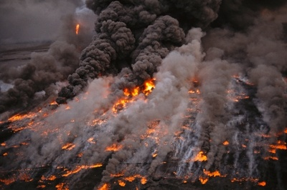
Oil trench on fire

Slide 9
³ Then out of the smoke locusts came upon the earth. And to them was given power, as the scorpions of the earth have power. ⁴ They were commanded not to harm the grass of the earth, or any green thing, or any tree, but only those men who do not have the seal of God on their foreheads. ⁵ And they were not given authority to kill them, but to torment them for five months. Their torment was like the torment of a scorpion when it strikes a man.
7 The shape of the locusts was like horses prepared for battle. On their heads were crowns of something like gold, and their faces were like the faces of men. ⁸ They had hair like women’s hair, and their teeth were like lions’ teeth. ⁹ And they had breastplates like breastplates of iron, and the sound of their wings was like the sound of chariots with many horses running into battle. ¹⁰ They had tails like scorpions, and there were stings in their tails. Their power was to hurt men five months.

Slide 10
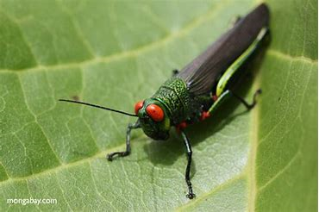
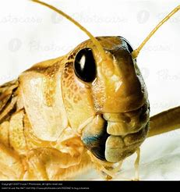
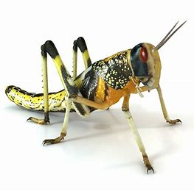
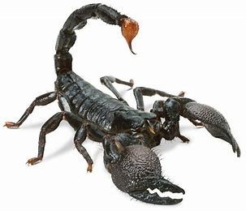
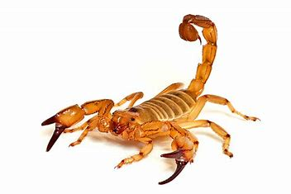

Slide 11
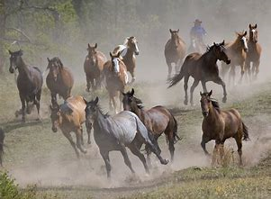
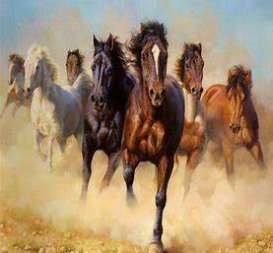
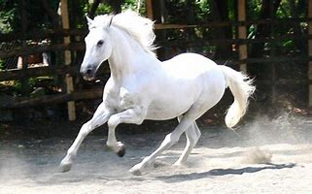

Slide 12
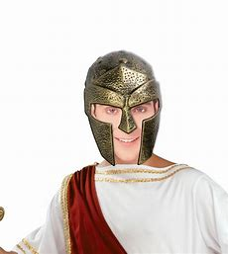
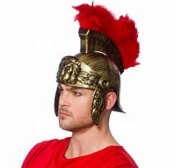
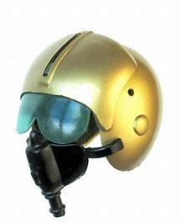
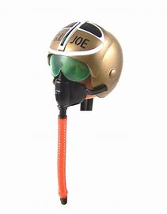
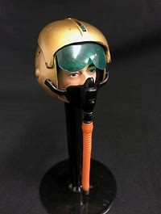
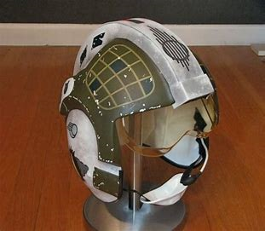

Slide 13
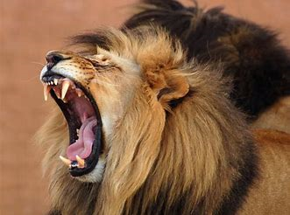

Slide 14
³ Then out of the smoke locusts came upon the earth And to them was given power, as the scorpions of the earth have power. John the revelator was seeing modern war technology in visions 2000 years ago. This was many apache helicopters flying through oil well smoke all over Bagdad firing missiles along with other US military vehicles used in this war. The helicopters looked like locusts with stings. (sound Video)

Slide 15
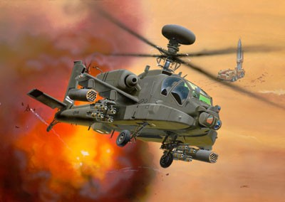
⁴ They were commanded not to harm the grass of the earth, or any green thing, or any tree, but only those men who do not have the “seal of God” on their foreheads. the unsaved of Iraq many are Muslims ⁵ And they were not given authority to kill them, but to torment them for five months. Their torment was like the torment of a scorpion when it strikes a man. ⁶ In those days men will seek death and will not find it due to the upheaval of war; ⁷ The shape of the locusts was like horses prepared for battle.

Slide 16
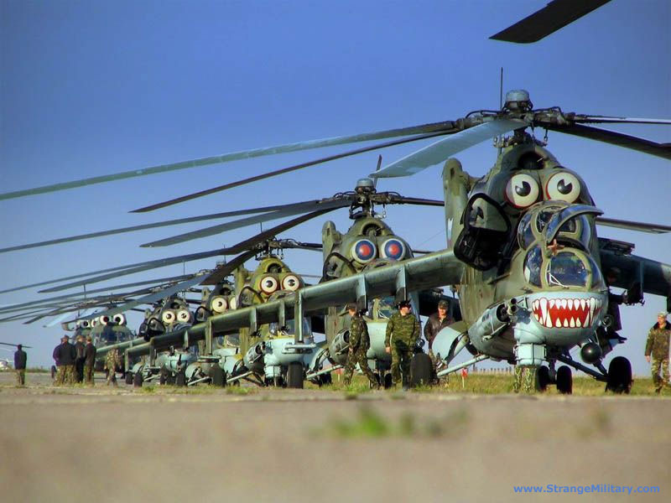
On their heads were crowns of something like gold, and their faces were like the faces of men. Pilots flying the apache helicopters with helmets on ⁸ They had hair like women’s hair, and their teeth were like lions’ teeth. some of the helicopters used had actual teeth painted on the front. This is what John the revelator was seeing in future visions. The Apache helicopters looked like locusts with the radar portals as eyes.

Slide 17
⁹ And they had breastplates like breastplates of iron, helicopters are made of steel plate; and the sound of their wings was like the sound of chariots The helicopter thud thud thud noise of the rotors, like many horses running into battle many helicopters were used in the Iraq war.

Slide 18
10 They had tails like scorpions rear rotor blades and there were stings in their tails: missiles and machine guns their power was to hurt men five months the AH-64 Apache helicopters had Hell Fire missiles and M230 chain machine guns mounted on them. From 2003 to 2011 the Iraq war killed 500 thousand Iraqis, the war debt cost was 4 trillion with interest it will exceed 6 trillion US dollars over the next 4 decades. The war displaced 4.3 million Iraqis. Both Britain and the US with George W Bush lied about reasons for war with Iraq of “weapons of mass destruction” in Iraq this lie was proven true none were found. British reporter Katharine Gun in 2003 leaked a top secret memo to the press concerning illegal activities by the US National Security Agency within the UN and its push for the invasion of Iraq. Bush said going to war in Iraq was Gods will he had heard from God (God of lies). Iraq had never attacked America American by UN standards it was an illegal war.

Slide 19
On March 3rd 2003 : A dream came prior to the Iraq invasion by the USA. I saw a gold box at the feet of God for “priority prayer” for the world including Muslim nations. God prompted me to ask Him for souls I said “Lord I don’t know how many to ask for can You tell me the number?”. He then said “ask Me for 3 billion souls” (Rev 14:14-16 harvest to come). In Gods treasure box were His riches I saw gem stones silver and gold representing people and nations. I was then awoken at 3.33 am and prayed in His presence for mercy and grace upon the nations for the coming war and shaking of the world (5th trumpet war). That bloodshed and loss of life would be kept to a minimum. To see Babylon fall spiritually, to see Muslim strongholds crumble to allow salvation to flow for His harvest to come.

Slide 20
Then another dream came early in March of 2003: A dream came of President George W Bush just prior to the Iraq war invasion of March 20th 2003. In this dream I was in a kitchen with George W Bush he had in his hand a jar with a caterpillar in it he was about to take off the lid to let the caterpillar out. I said to him: “do you know that if you let that caterpillar out you will cause a release of destruction beyond belief to begin?” George Bush just smiled at me and undid the jar lid he didn’t care then out crawled the caterpillar. The caterpillar is symbolic of destruction like the locust that eats and destroys everything Joel 1:4.

Slide 21
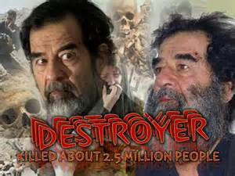
11And they had a king over them whose name in Hebrew is Abaddon, but in Greek he has the name Apollyon Saddam Hussein was leader of Iraq for 24 years from 1979 - 2003 , an atheist non Muslim, he favored Sunni Muslims . Saddam is the “destroyer” of the 5th Trumpet , Saddam was called the butcher of Bagdad , he invaded Kuwait and Iran. In scripture Abaddon a Hebrew word means “Destroyer”. The term Apollyon in Greek means “A Destroyer”. In Arabic Saddam means “The Destroyer” he was named Hussein at birth . Prior to taking power in Iraq in 1979 he took on the name Saddam Calling himself Saddam Hussein meaning “Hussein the destroyer”. Saddam murdered 2.5 million Iraq citizens during his rule through torture and execution .

Slide 22
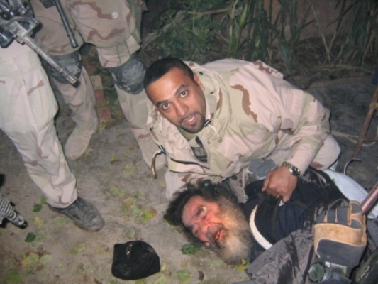
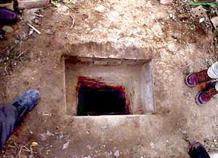
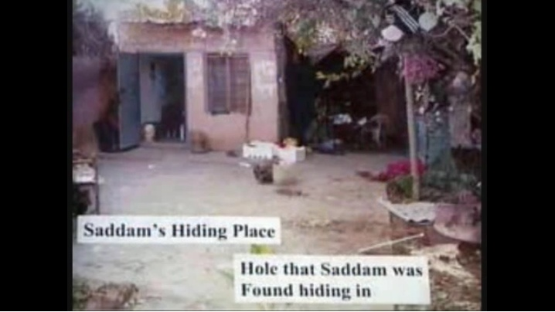
Dream diary: “A dream came on the 3rd March 2003, of the capture of Saddam Hussein by solders in Iraq”. The invasion began on 20th March. It was 4 months from this dream that two of Saddam’s sons were caught and killed on the 14th August 2003. Then 9 months from this dream Saddam himself was captured at the border of Iraq hidden in a hole in the ground on the 14th February 2003. He was later tried then executed by hanging.

Slide 23
From March 2003 there were continual ongoing battles with Saddam’s ex army members joining resistance groups now known as terrorist groups. Saddam had a one million man army. You had suicide bombings of the Jordanian Embassy in Baghdad on August 7th 2003 , then the United Nations headquarters in Baghdad on August 20th 2003. Dec 16th 2008 President George W Bush signed the ”US - Iraqi status of forces agreement” a troop withdrawal agreement with the Iraq Prime minister to with draw all US troops by 2011. Two shoes were thrown at bush at the announcement on live TV by an Iraqi journalist as an insult in protest to what the US imperialist Bush had done to Iraq killing hundreds of thousands. So 8 years on from 2003 coalition forces were finally with drawn from Iraq in 2011 under President Obama. (Video) George W Bush in 2007 warned about withdrawing US troops from Iraq that it would create a terrorist vacuum in the region of mass destruction he knew this yet he signed the agreement in 2008 ready to with draw the troops . (Video) The 2011 withdrawal created an environment for new terrorist backed groups to rise up such as the unemployed 2003 Saddam Iraqi forces who had joined Al-Qaeda in Syria and Iraq. Then from this group Isis was formed the new Sunni Muslim terror group in the region. There was continual ongoing terrorist resistance and bombings in Iraq up to 2013 dozens of bombs went off in Baghdad I killing many.

Slide 24
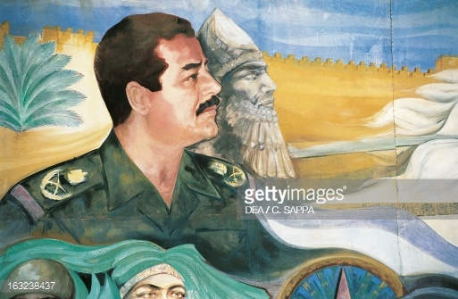
Prior to his 1979 leadership of Iran Saddam was already a powerful military and political influence in Iraq he had plans to rebuild the ancient city of Babylon. Saddam’s workers began reconstructing a 600 room palace of King Nebuchadnezzar II in 1982 right on top of the ancient ruins, photo from 2003. The remains of ancient Babylon are 55 miles south of Bagdad. Babylon was the first empire of Nebuchadnezzar's stature from 612 B.C – 539 B.C. Saddam said “Babylon’s great palaces would rise from the dust” but God said it would never be rebuilt .

Slide 25
The Lord had prophesied that the “Babylonian city would never be rebuilt again”. This prophecy was fulfilled gradually between the 2nd and 7th century B.C (Islam) a slow destruction by various people groups until the 20th century when Saddam tried to resurrect the Babylonian city as his own. The original destruction of Babylon prophecy is found in Jeremiah 51:11 and 60-64 at the demise of King Nebuchadnezzar. Jeremiah 51:11 The LORD has raised up the spirit of the kings (Persians Cyrus 11 defeated Babylon in 539 B.C) of the Medes. For His plan is against Babylon to destroy it, Because it is the vengeance of the LORD, The vengeance for His temple (Babylon destroyed his Temple in 586 B.C in Jerusalem built by King Solomon). Jeremiah 51:61-64 ⁶¹ And Jeremiah said to Seraiah, “When you arrive in Babylon and see it, and read all these words, ⁶² then you shall say, ‘O Lord, You have spoken against this place to cut it off, so that none shall remain in it, neither man nor beast, but it shall be desolate forever.’ ⁶³ Now it shall be, when you have finished reading this book, that you shall tie a stone to it and throw it out into the Euphrates. ⁶⁴ Then you shall say, ‘Thus Babylon shall sink and not rise from the catastrophe that I will bring upon her ”. (NKJV)

Slide 26
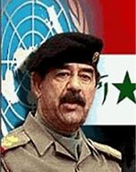
Saddam Hussein, was stopped in his rebuild of the city of Babylon when the allied armies invaded in 2003 . This part of the wall is known as "The Ishtar Gate."

Slide 27
¹² One woe is past. Behold, still two more woes are coming after these things. (NKJV) This is the first of three woes to come leading us to the return of Jesus “the third woe” at His return.

