Slide 2
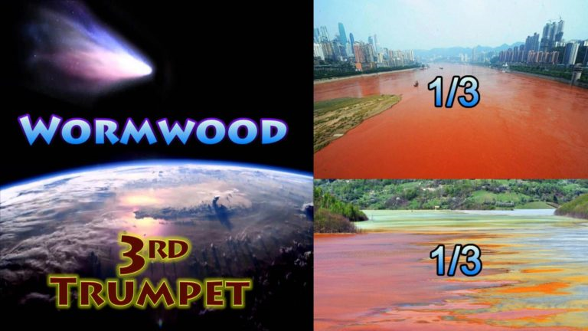
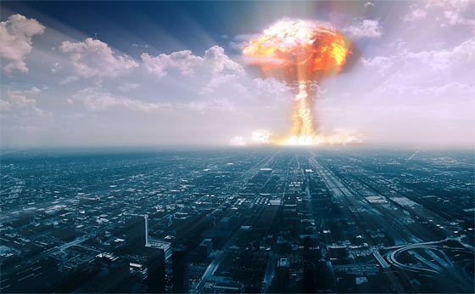

Slide 3
The 3rd Trumpet “Rev 8:9-10”
Then the third angel sounded: And a great star fell from heaven, burning like a torch, and it fell on a third of the rivers and on the springs of water. The name of the star is Wormwood. A third of the waters became wormwood, and many men died from the water, because it was made bitter. (NKJV)
Trumpet 3 sounded with the Chernobyl nuclear accident the worst nuclear disaster the world has seen. This happened on 1:23am 26th April 1986 at the Chernobyl Nuclear Power Plant in Ukraine Russia. A reactor over heated it blew up due to human error it was like an exploding star.
(Video)

Slide 4
The Ukraine word Chernobyl translated to English is “”Wormwood” the wormwood plant grows in Ukraine it is a plant of “bitterness”. The term “Wormwood” in scripture was foretold accurately and historically 2000 years ago. The wormwood plant yields a poisonous bitter extract used to put fragrance into wines. The Ukraine people have a Christian Bible translation in their own Ukraine language with the word “Wormwood” written as “Chernobyl” it reads … “The name of the star is Chernobyl. A third of the waters became Chernobyl”. In the Ukrainian language the actual Ukraine city named Chernobyl means mugwort a bitter plant of the same wormwood plant family species. Both the mugwort and wormwood plants are referred to by many locals as wormwood both have medicinal purposes with biter fragrances.

Slide 5
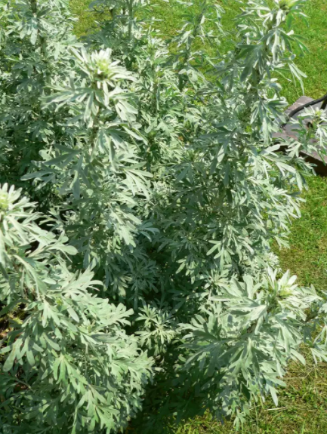
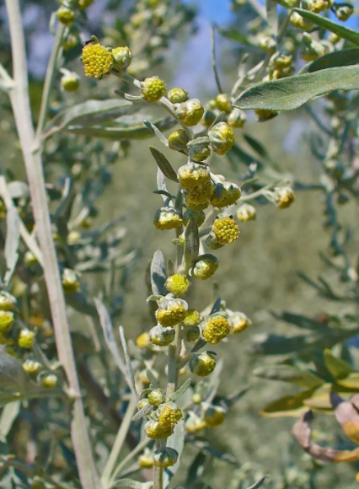
The wormwood plant/herb of Ukraine

Slide 6
The explosion in Chernobyl's reactor released an immense cloud of radiation 1 mile into the air north of the Ukrainian capital of Kiev, the fires burnt for 10 days. The nuclear explosion at Chernobyl had nuclear fall out that went all over Europe and Russia. The immediate radiation on the ground covers a 2400 km square area becoming a no go zone the total area contaminated was 100,000 kms. Belarus over the border to Ukraine took 60% of the permanent radiation in the ground, Ukraine took 40% of the contamination. The plutonium contamination can last up to 24 thousand years in the ground so it is forever contaminated until God heals it.

Slide 7
In Chernobyl Ukraine you have what’s referred to as the “Star of Wormwood” memorial. Created by Ukrainian artist Anatoly Haidamaka, who calls it the “Monument of the third angel” taken from Rev 8:10-11 the third Trumpet scripture. This is an angel holding a trumpet to its mouth blowing a trumpet for the falling star wormwood .This seems to be a further testimony of this third Trumpet fulfillment.

Slide 8
Monument of the third angel at Chernobyl Ukraine

Slide 9
Nuclear Disaster

Slide 11
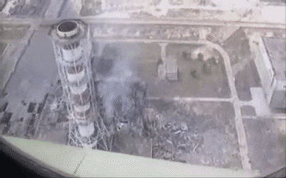

Slide 12
Core reactor before and after

Slide 16
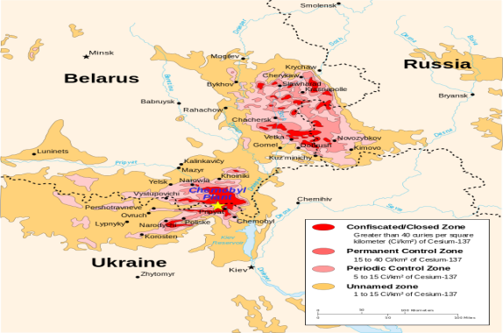
Area directly affected by Chernobyl radiation a 2000 square kilometer no go zone

Slide 17
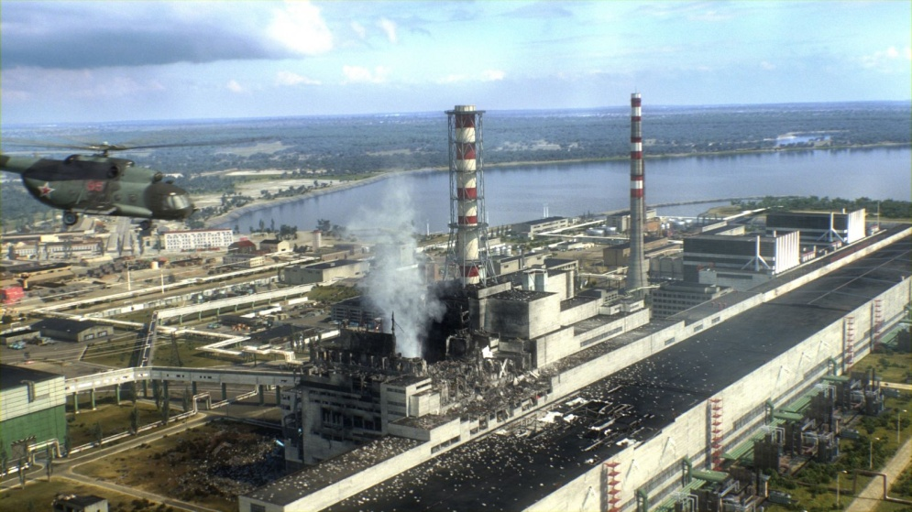

Slide 18
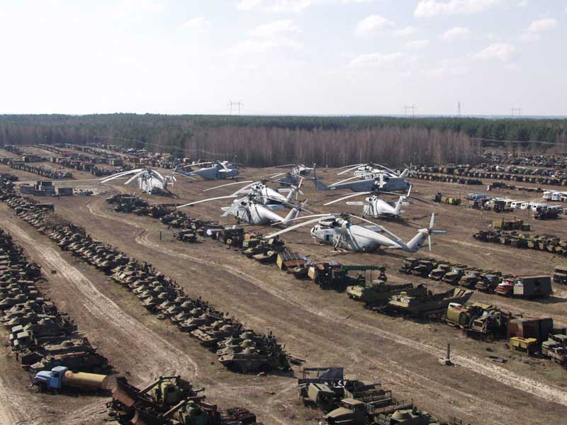

Slide 19
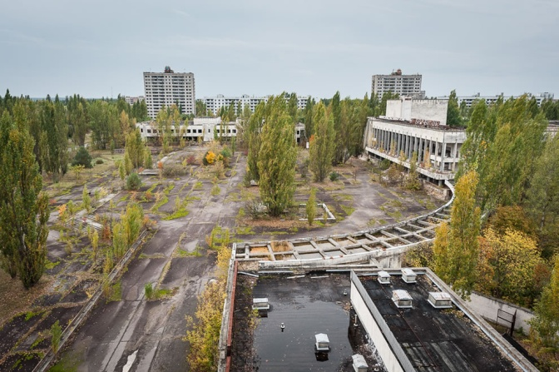

Slide 20
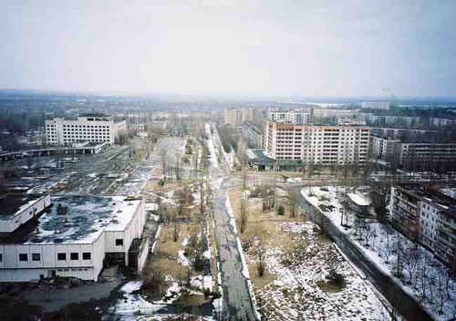

Slide 21
The Chernobyl meltdown released 100 times the amount of radioactive substances as was released by the bombing of Hiroshima and Nagasaki in World War II. Nuclear rain from the disaster fell as far away as Ireland. Up to 320 thousand people were evacuated and relocated from the region of the accident. An estimated 125,000 people in Ukraine have died because of the Chernobyl disaster, with an estimated two million more that have been infected by radiation. Disease rates in some regions are three times higher for children than before the accident, and four to five times higher for pregnant women. There have been many birth defects especially in humans in the region. Ukrainian scientists estimate due to worldwide radiation effects from the disaster one million extra cases of cancer predicted worldwide within 70 years of the disaster. Over 200 million people in Russia and across Europe have experienced excess exposure to radiation because of Chernobyl, truly a worldwide tragic event.

Slide 22
The accident affected an estimated 530,000 locals and recovery workers who averaged an effective dose equivalent to an extra 50 years of typical natural background radiation exposure each. The Chernobyl no go exclusion zone around the site is 1000 square miles for radiation safety a 2000 square Km area from Chernobyl itself encompassing mass land lakes rivers and streams. This incident has cost billions of dollars it left ghost towns with millions of dollars worth of equipment abandoned due to radiation contamination a huge part of the country of the nation of Ukraine was closed off. It was only in 2017, 28 years later that authorities finally sealed up the site with a make shift mettle roof only millimeters thick due to its size and weight.

Slide 23
The Chernobyl cover built in 2017

Slide 24
Nuclear radiation that came from the destroyed Chernobyl power plant contaminated more than 33 percent a third part of the water supply in Europe and Western Asia, it killed thousands of people and animals affecting hundreds of thousands of other citizens with diseases caused by the radiation. As the nuclear cloud produced by Chernobyl drifted over the Soviet Union then over Europe, an extraordinary amount of rain fell. The rain brought the radiation from the nuclear cloud onto the soil, the animals, the crops, the trees and into the rivers. The greater the rainfall the greater the amount of radioactivity, these heavy rains increased the magnitude of this horrible disaster, much of Europe was affected.
There was the culling of tens of thousands of Russian rain deer in the area that were contaminated by the radiation fall out. Over time several feet of contaminated soil has been removed from the site as well. To reduce the radiation footprint. Chernobyl remains a threat even today with ongoing work been done on the failed plant. The thin mettle roof erected is already showing signs of erosion and rust. There are several international agencies now committed to ongoing clean ups at the site this is a ongoing procedure. The wild life in the region seems to have boomed with few abnormalities due to no human activity there except on the site itself. All that were evacuated within 30 hours of the disaster have never returned to their homes. The immediate exclusion zone of evacuation around the site was 30kms.
(Video)

Slide 25
