Slide 3
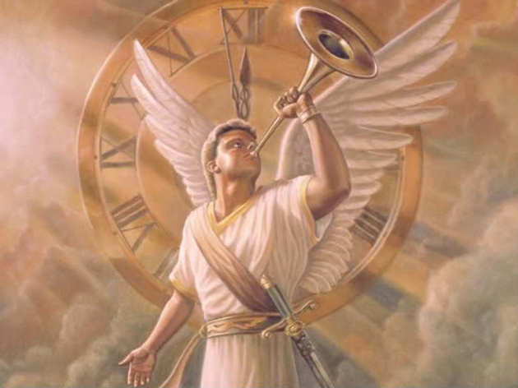
The 4th Trumpet “Rev 8:12-13”
Then the fourth angel sounded
And a third of the sun was struck, a third of the moon, and a third of the stars, so that a third of them were darkened. A third of the day did not shine, and likewise the night. And I looked, and I heard an angel flying through the midst of heaven, saying with a loud voice, “Woe, woe, woe to the inhabitants of the earth, because of the remaining blasts of the trumpet of the three angels who are about to sound!” (NKJV)

Slide 4
This 4th Trumpet fulfillment is known as the Iraq/Kuwait gulf war
“Dessert Storm’
This war went from 2nd August 1990 to 28th February 1991, it was a 6 month war . George W Bush senior was president of the USA and Saddam Hussein was leader of Iraq at the time.
Saddam’s invasion of Kuwait lasted 6 months from August 1990 to Dec 1991 he wanted Kuwait's oil fields. The international community especially the USA rejected Saddam’s advancement into Kuwait as oil is economic power , so they sent in a coalition of forces to remove him. At Saddam’s retreat over 700 oil well fires were set on fire in January and February of 1991. This was done to protect Iraqi solders from US laser guided missiles that could not penetrate through the thick smoke. This oil well event was man made and unprecedented in human history. The last oil well was extinguished by November 1991 after months of continual fire and smoke over Kuwait and Iraq.
(Video)

Slide 5
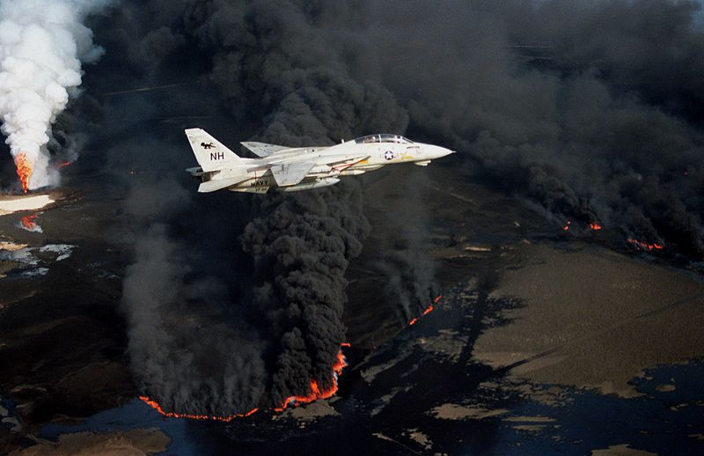
Burning oil lake 1991 “Kuwait”

Slide 6
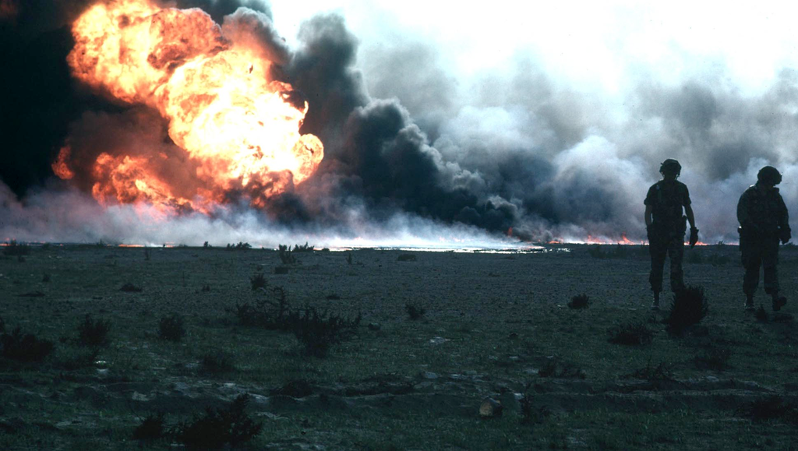
An oil field on fire 1991

Slide 7
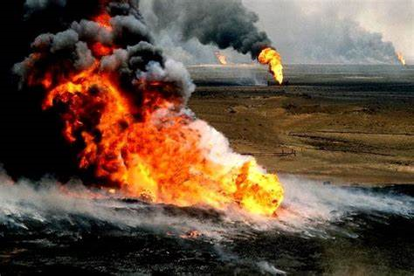

Slide 8
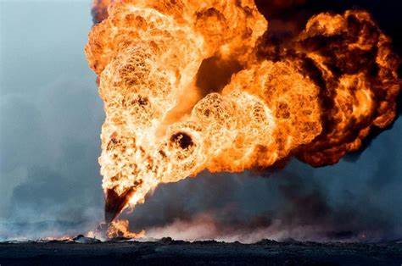

Slide 9
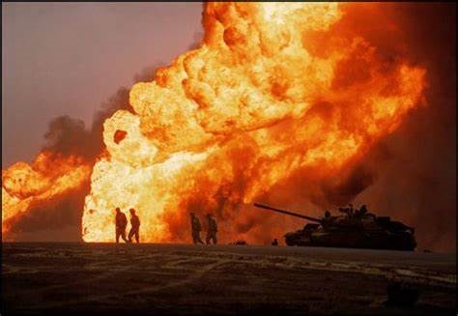

Slide 10
In 1991 the skies over Kuwait and Iraq were darkened for an 11 month period . The only other event that can block out night and day on such a scale is major bush fires or a volcano spewing forth ash clouds having a similar effect. The smoke infested darkness over Iraq and Kuwait appeared during the day blocking out the sun for long periods of time over huge areas in the region . The thick smoke blocked out the stars and moon at night as well just as scripture states.
And a third of the sun was struck, a third of the moon, and a third of the stars, so that a third of them darkened. A third of the day did not shine, and likewise the night. (NKJV)
The smoke plume from these oil fires was over 100 km wide. This all started as Iraq’s forces began retreating from Kuwait in February of 1991, Kuwaiti oil wells and oil lakes were set on fire, creating thick blankets of black smoke. 50 kms of oil lakes were ablaze 30 million barrels of oil were spilt covering 25% of Kuwait's desert area.
Up to 732 oil well s were set ablaze and approximately 5 million barrels of crude oil was burned per day. Smoke blanketed the sun darkness came all seen from satellite over Iraq. Oil well fires created health hazards killing many even causing cancer as the smoke contained many poisonous ingredients. The oil fires caused a dramatic decrease in air quality,. This caused respiratory problems for many soldiers on the ground without gas masks.

Slide 11
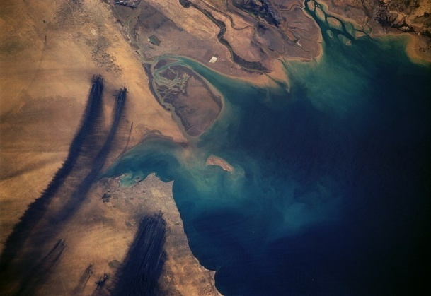
Satellite photos of smoke plumes from the Kuwait oil fires & burning oil lakes April 7, 1991

Slide 13
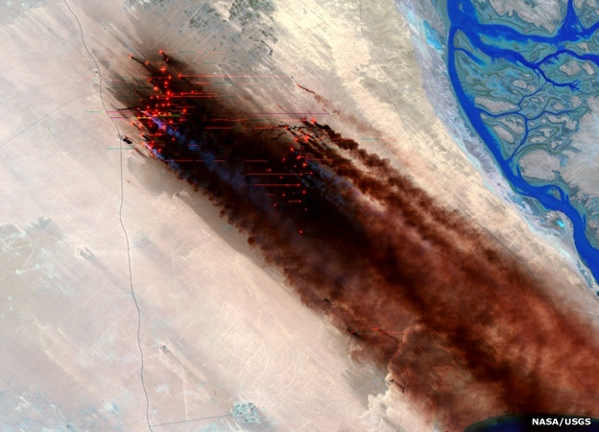
1991 satellite photo by NASA, Iraq /Kuwait region,732 oil wells on fire blocking out the sun, moon and stars by day and by night.

Slide 14
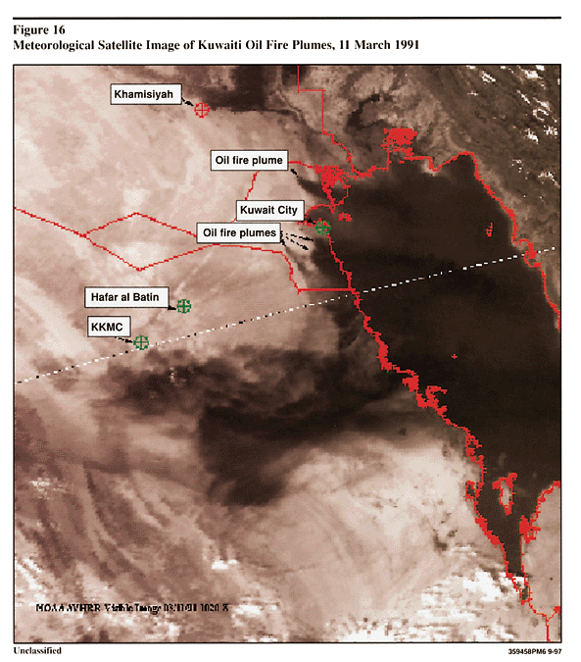

Slide 15
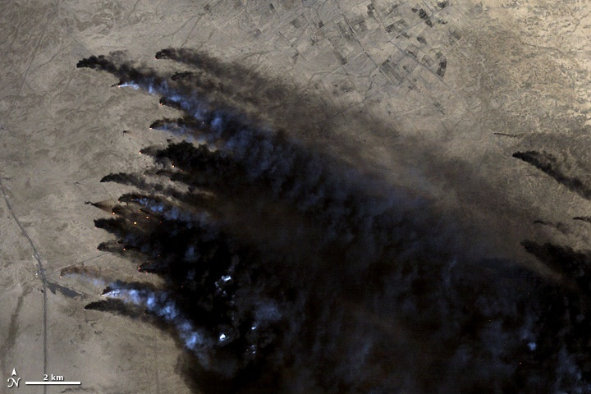

Slide 16
In this 1991 oil fires event about 8,000,000 million barrels of crude oil had also been purposely spilled into the Persian Gulf, creating an environmental hazard to marine life and birds, approximately 20,000 birds died. A 12-inch thick oil slick was created that covered an estimated 400 miles of shoreline. Only a very small portion of the oil was recovered one million barrels. The oil slick threatened the desalinization plants at Jubal and Saudi Arabia, booms and skimming operations were launched to protect the plants. The darkness blocking the daylight and moonlight for 11 months was a “shortening of the times” for men in the light of day and night., a “shortening of the times” warning to the world. And I looked, and I heard an angel flying through the midst of heaven, saying with a loud voice, “Woe, woe, woe to the inhabitants of the earth, because of the remaining blasts of the trumpet of the three angels who are about to sound!” (NKJV) The 4th Trumpet leads us into the 5th trumpet woe the first of the last 3 woes of Revelations. .

Slide 17
Ten years later 9/11 hit on Sept 11th , 2001 the world felt and new something had changed dramatically the 5th Trumpet first woe had begun. Since 9/11 an increased acceleration of the “shortening of times and seasons” has occurred, taking us into quickened revelation chapter fulfillments. With increased disasters increasing sorrows, weather patterns, floods, earthquakes, wars and economic turmoil in nations. Then on the world scene in 2009 the Rev 13:1-10“Antichrist Beast from the sea” appears. in 2009 the Euphrates Rev 16:12-16 river starts drying up . The Muslim Arab spring happens in 2011 causing three nations to come under Muslim Brotherhood control. In 2013 Christians begin to get “warred against” by Hezbollah and Isis in Syria and Iraq as found in Rev 13:7 all manifesting in the Middle east. Persecution of Christians in Muslim dominated nations doubles in 2013 alone with reports of 160 to 200 thousand per year now being martyred around the world a huge increase.

Slide 18
There was the economic collapse in 2008 equivalent to the 1929 stock market crash both lost an estimated 70 Trillion. This crash sent nations into global economic crisis and debt many have not recovered such as Venezuela , Brazil , Canada, Mexico , Nigeria , Argentina , Ireland and China now at a ten year low . The emerging international market debt bubble has grown in the last 16 years from 9 trillion to 63 trillion dollars. You have had increased violence and multiplied terrorist attacks around the world . We now have the UN enforced international refugee crisis of mainly Muslim immigration into European nations by the millions causing an invasion of Islamic ideals. You have the UN/Vatican New World Order advancement from 2009 with ex German Chancellor Herman Van Rompy’s declaration that the “New World Order” has begun. All of these historical events since Kuwait , 9 /11 and the 2003 Iraq invasion have loosed the spiritual Islamic beast nature to rise up to bring recovery to the “Rev 13:3 ” beasts wounded head from WW1, the first Trumpet . This is all being stirred into action with “WW3” looming in the Middle East that will lead us into the final battle of Armageddon against Israel. All of this flows into the “5th then 6th Trumpet “. See website for more information: https://en.wikipedia.org/wiki/Kuwaiti_oil_fires

