Slide 2
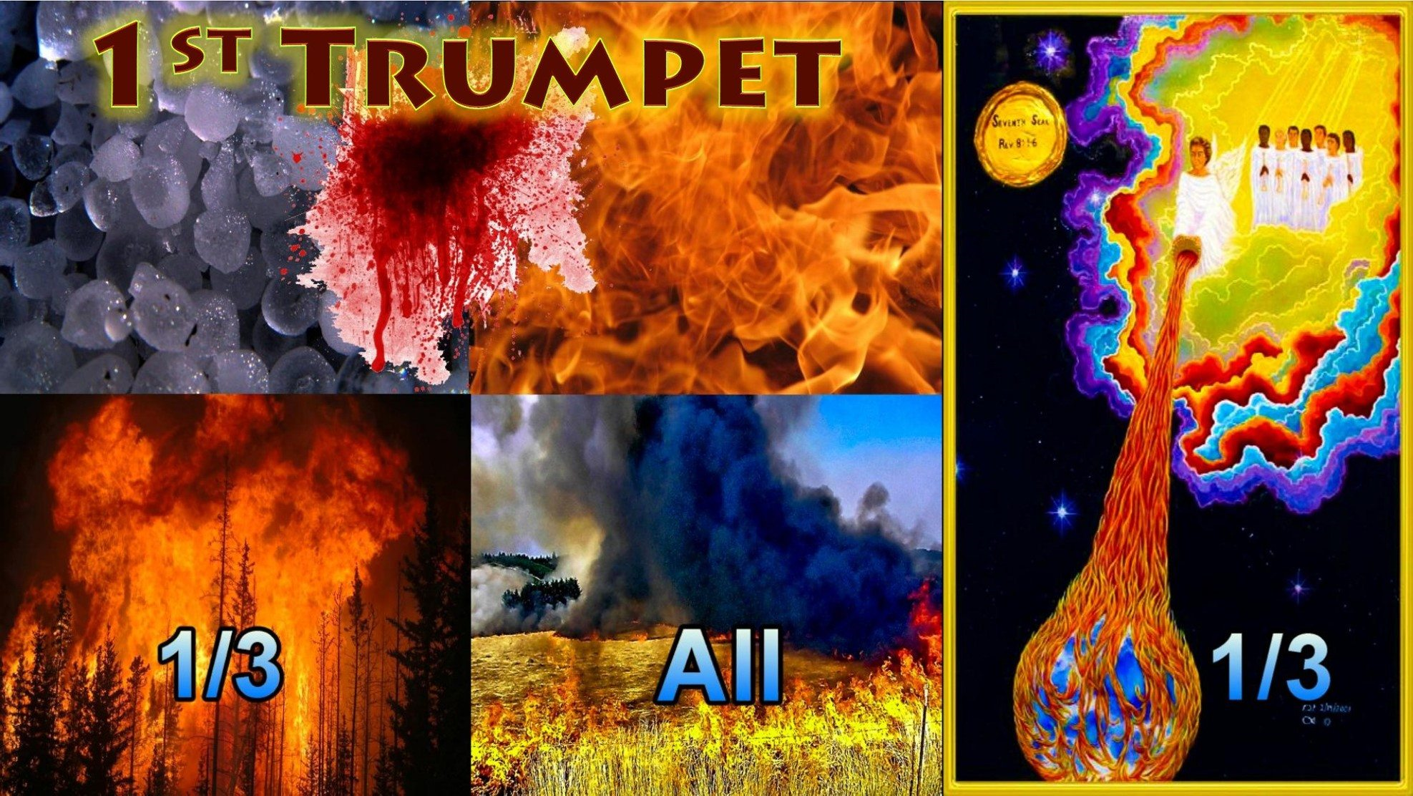

Slide 3
WW1 1914 -1918 the first Trumpet
Rev 8:6 -7: So the seven angels who had the seven trumpets prepared themselves to sound. The first angel sounded and there followed hail and fire mingled with blood, and they were cast upon the earth:
WW1 was a 4 year trench war referred to as the “GREAT WAR” involving 100 nations, artillery was used for the first time with deadly explosions, 17 - 20 million people were killed in this war.
During and after the war due to unclean conditions an outbreak of the influenza virus called the “Spanish Flu” took place from 1917-1918 killing an estimated 50 million people some say it was 100 million worldwide. This was the second deadliest plague in history, so WW1 actually killed up to 120 million people. and the third part of trees was burnt up, and all green grass was burnt up .
The “Scorched Earth” policy was used in the region of WW1 they burnt everything even entire cities.
(Video’s)

Slide 4
Technological advancement
The spark that ignited WW1 was struck in Sarajevo, Bosnia, where Archduke Franz Ferdinand heir to the Austro Hungarian Empire was shot to death along with his wife Sophie by the Serbian nationalist Gavrilo Princip on June 28, 1914.
See: https://www.history.com/topics/world-war-i/world-war-i-history
Due to alliances and treaties between nations at the time conflict came one month after this assassination, war broke out between nations protecting one another that led to the “Great War”. (Video)
WW1 brought forth a technological acceleration in warfare, it brought the first steel helmets, the first armored tanks, the first artillery shells, the first fleet of fighting aircraft, the first air craft carriers, the first chemical warfare, the first gas masks, the first guide dogs, the first x-ray machines, the first blood banks, the first enlisted woman in the armed forces. WW1 saw the first flame throwers created by the Germans used in trench warfare in 1915, then came the WW1 scorched earth policy.
WW1 set the stage in the 1900’s for modern technological development in a new era of industrial boom and growth for the nations.

Slide 5
Scorched Earth Policy
During WW1 the warfare tactic “Scorched Earth “ was used, first initiated by the Russians who burnt 1200 km of Earth in 1915 against the Germans, then the Germans used it along the western front with another 1200 km of scorched earth burning everything even complete cities, villages, trees and grass all burnt leaving only scorched dirt so the allies had nothing to use. The scorched earth policy was used in the region of the WW1 battle fields of Germany and Russia along a 2400km stretch of land.
WW1 was also known as the great trench war soldiers were dug into the ground for months, chemical weapons and artillery shells were used for the first time on troops. Massive underground TNT bombs were used in tunnel systems to destroy enemy forces over 10’000 Germans were killed this way blowing up everything in a 200 meter radius from an explosion. The vibrations from such bombs were even felt 140 miles away reigning down fire, stones, blood, body parts metal and wood.
(Video)

Slide 6
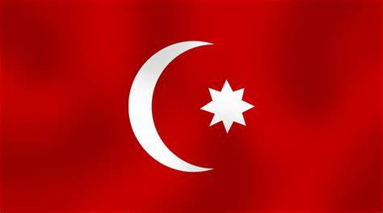
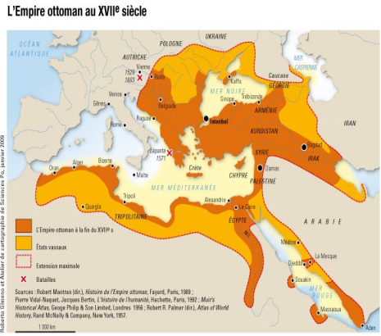
The Ottoman Empire
WW1 ushered in the defeat of the “Ottoman Empire” the beast of the east, the Muslim empire ruled the Middle East region from 1299-1924 a 625 year period.
The Ottoman Empire was wounded “by the sword of war ” this is the wounded head of Rev 13:3.
Rev 13:3 And I saw one of his heads as if it had been mortally wounded, and his deadly wound was healed. And all the world marvelled and followed the beast. (NKJV)
The Islamic “Ottoman Empire” was a powerful head a governing authority in the Middle East as an empire/religion, it took a devastating defeat it’s authority as a power was killed off in WW1.
(Video)

Slide 7
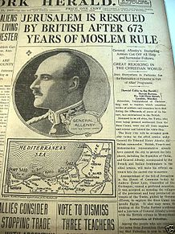
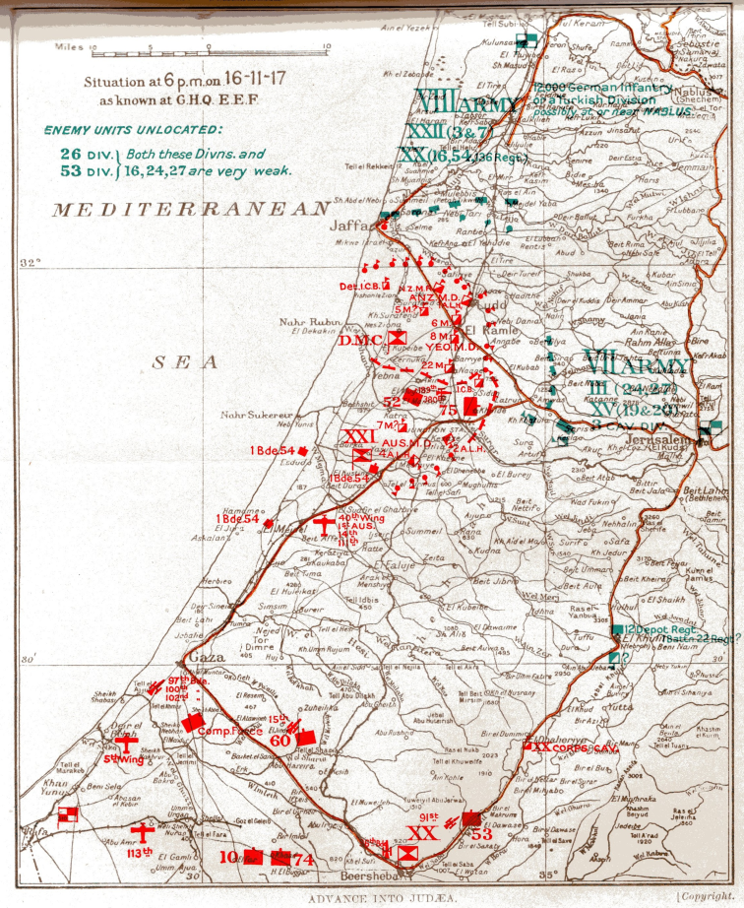
Jerusalem liberated
It was during WW1 on October 31st 1917 at Beersheba meaning “well of Oath” near Jerusalem the British were attacking the Ottomans. In this fight 50 thousand British troops and several tanks had been driven into the hot sunny desert with no water by the Turks. The British were trying to break through to Beersheba at Abrahams well a source of water for men and horses this well is found in Genesis 21:31 named by “Abraham” . The area was very protected heavily enforced with Ottoman troops, artillery and machine guns. Beersheba was blocking the road leading into Jerusalem. A new plan was formed to liberate Beersheba from the Ottoman Turks who directly ruled over the area . This liberation was achieved by the 800 light Horseman brigade made up of New Zealanders and Australians who charged Beersheba on horse back and achieved what 50 thousand troops could not against all odds “victory” over the Turks. Jerusalem was then captured from the Turks by the British forces on December 30th 2017. Victories also took place in the Judean hills of the west bank and Gaza securing the city. Jerusalem and the West bank known as Palestine had been under direct Ottoman Muslim domination rule from 1517-1917 a 400 year period.
Then came the “Balfour Declaration” of 1917 a statement by the British government in support for the Jewish people to have a national home in Palestine. This then led to the establishment of Israel as a nation in 1948 after WW2.
(Video) (New York Herald & London times) (Battle map November 1917)

Slide 8
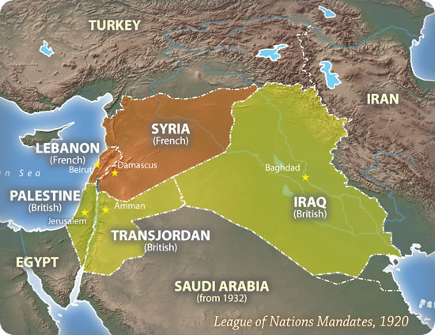
After WW1 the British then broke the Middle East region into 5 new nations Emirate of Trans Jordan, Iraq, Palestine, and Syria later on Turkey was formed then an unplanned miraculous sixth nation came on the world scene in 1948 “Israel”.
The sixth nation Israel was prophesied to reform to be revived by God through Hosea after nearly 2000 years or 2 days from its destruction in 70 A.D. the 3rd day represents the 1000 year millennial reign at His return.
Hosea 6:2 After two days He will revive us; On the third day He will raise us up, That we may live in His sight. (NKJV)
This was destruction was by Rome under General Titus destroying Jerusalem and the 2nd temple just as Jesus had predicted.
Mathew 24:2 And Jesus said to them, "Do you not see all these things? Assuredly, I say to you, not one stone shall be left here upon another, that shall not be thrown down.“ (NKJV)
(Map)

Slide 9
Wounded Head the Islamic recovery Rev 13:3
In the 20th century the wounded Islamic head the Old Ottoman Empire is tied into the end times “Beast” of Rev 13:1-10. This wounded head was then empowered to begin to recover and rise up again. There is 96 years between the words of prophecy with its wound then its recovery in Rev 13:3. The recovery stage was set with President George W Bush junior with the 9/11 Twin towers attack in 2001. Then came the Iraq invasion in 2003 causing a shift in Islamic unity with Jihad against westernized nations. Islamic international Jihad attacks and conflicts began to manifest rapidly against European nations tightening up international security.
This international re-emergence of Jihad extremism rose up in Iraq and Syria the Ottoman Empire region 96 years on from its initial wound in 1918. By 2014 in international news and social media a huge increase of Islamic terrorism was pushed forward onto the world stage with Hamas, Hezbollah the Taliban, Boko Haram, Isis and many other Islamic groups rising up. This came with the international UN agenda of a forced Islamic refugee crisis now known as the “Global refugee compact” an invasion of nations by Muslims mainly young men. You then had in 2015 Russia enter the conflicts in the Middle East backed by China. Then you had Russia’s partnership with Iran as well the biggest Muslim terrorist supporting nation in the Middle East Israel’s arch enemy.

Slide 10
This wounded head recovery of the Islamic cause was advanced further under President Obama “The Beast” of Rev 13:1-10 and his foreign policies for 8 years, he withdrew all US troops from Iraq in 2011 creating a terrorist vacuum he was heavily involved in the Arab spring uprising of 2011.
Obama loosed massive financial support in the billions to Islamic countries he created the Iran Nuclear deal releasing 150 billion to them alone. Obama increased financial support to Palestine by hundreds of millions who supported Hamas. Obama had ongoing terrorist training camps where many defected to Isis. Obama supplied hundreds of millions of dollars worth in weapons to the Middle East.
This push forward included Erdogan of Turkey the “False prophet” Rev 13:11-18 rising to presidential dictatorship powers as prime minister in 2014 then president in 2016 dismantling Turkish democracy returning Turkey back to her Islamic Ottoman roots.

Slide 11
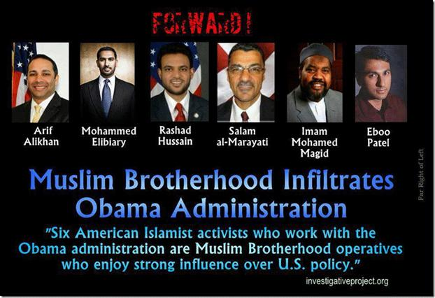
The empowerment of Islam peeked under President Obama (He has ties to the Muslim Brotherhood) with his presidential win in 2008. The Middle East foreign policies came through a succession of US Presidents leading to war and conflict in the region. This began with President Herbert Bush senior 1991 Kuwait invasion, Bill Clinton 1993 Gaza Strip self rule and the West bank lands given over then you had George W Bush junior with 9/11 and the 2003 Iraq invasion. Hamas, Isis and Hezbollah terrorism was empowered in the Middle East through US foreign policy, financial support, military training and weapons supply. This support also came with Turkey and Saudi Arabia as political Islamic partners to the USA.
Islamic empowerment for an uprising was accelerated and launched strongly by President Obama's administration with their US foreign policy deployments. The Obama administration never changed the Bush administration's grand plan and strategy in the Middle East. This was to gather together a terrorist army, to de stabilize the Middle East region the CIA referred to it as the “Hornets nest”. Obama withdrew all US troops in 2011 creating the power vacuum for Isis and Hezbollah to rise up bringing yet further destruction to Iraq and Syria. Obama employed several Muslim Brotherhood members onto his USA foreign policy team for 8 years, advancing Islam “Daniel 11:39” with forces Daniel “11:31” helping the wounded head to recover “Rev 13:3”. (Picture of 6 Muslim Brotherhood members)

