Slide 3
Rev 16:10-11 “The fifth bowl” Darkness and pain
10And the fifth angel poured out his vial upon the seat of the beast ; and his kingdom was full of darkness; and they gnawed their tongues for pain, and blasphemed the God of heaven because of their pains and their sores, and repented not of their deeds. (NKJV)

Slide 4
The original seat of the beast was in the Middle East in Pergamum Turkey in Asia minor it was called the Pergamum alter or the “Throne of Satan” as referred to in scripture “The seat of Satan” Rev 2:12-17. The Rev 13:1-10 beast from the sea is President Obama from 2009 – 2017 in the White House in Washington D.C. The Rev 13:1-10 beast had power and authority in the natural, for 8 years, during specific revelation fulfillments from scriptural prophesy. The armies under this spiritual beasts dominion are Islamic in the Middle East specifically against the saints in modern times.
The actual seat where this 5th bowl is poured out is in the Middle East upon the spiritual kingdom of the antichrist beast and the darkness of “Satan’s Throne”. Even though the Leishmaniasis skin disease has been in the region for many years it was first reported in Sudan at the turn of the 19th century. Recently there has been a huge increase of this disease from 2007 onwards with further outbreaks following the Arab Spring uprising of 2011 in the Middle East. (Video)
Article 2016:
Until 1960, the disease's prevalence in Syria was restricted to two areas , Aleppo and Damascus. However, as Syria’s civil war continues the resulting refugee crisis has triggered a catastrophic outbreak of the disease, with the regions most affected under Isis control.
https://www.independent.co.uk

Slide 6
This disease is now affecting hundreds of thousands of people trapped in refugee camps in the Iraq, and Syrian conflict zones. Where ever these refugees have travelled to in Turkey, Jordon, Europe, Lebanon, Yemen, Saudi Arabia, Spain , Brazil, India, Italy , France, Sudan, Somalia and Ethiopia in Africa this disease is now found, refugees are now spreading around the world. 2 million new cases have been reported each year on average with 20 to 50 thousand dying each year this is now on the increase, Currently as of 2019, 12 million are now infected in 98 countries. One of the earliest known descriptions of this disease goes back to 1756 some reports go back to 1500 BC that sound like this skin disease but cannot be proven. This skin curse is poured out on the kingdom of the Beast (unsaved worldwide), an increase in 2014 of this painful skin disease came upon those that were killing the saints of God “Islam” in the “warring against the saints” under the Rev 13:1-10 beast . This disease hit Isis and Hezbollah who were killing the saints in the region the disease came as a huge outbreak in the terrorist ranks. This Leishmaniasis disease of pains and sores can be found across much of Asia, and in the Middle East .

Slide 7
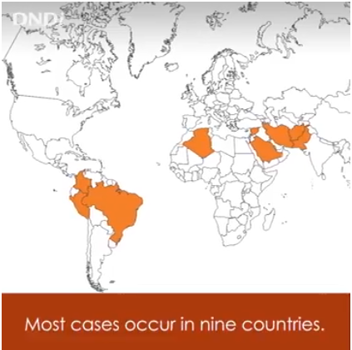
Before 2007 this sores on the skin disease was in only 9 countries, it is now spreading to 98 countries. A painful skin disease poured out on the seat of the beast.

Slide 8
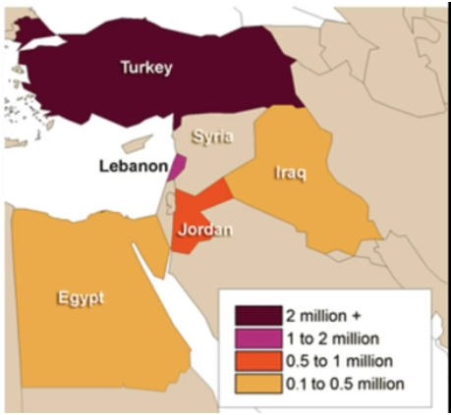
2016 – 2017 Graph of Leishmaniasis in Middle East

Slide 9
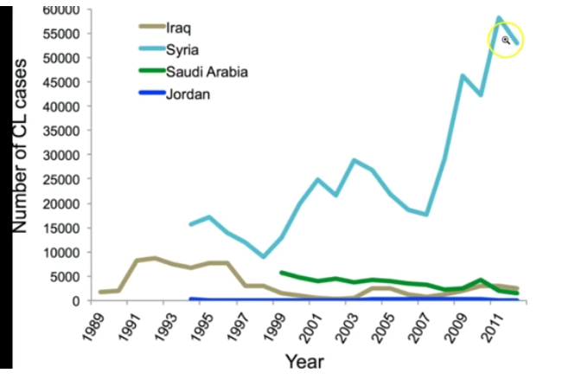

Slide 10
The disease is spread by the bites of certain types of sand flies in un sanitized conditions in tropical and sub tropical areas it doesn't survive well in the cold. There is no known cure for this yet as a disease only treatments. Isis and Hezbollah left dead rotting bodies behind, every where they went mass graves were found, heads were hung in towns on spikes, bodies beheaded by the thousands and crucified. Leishmaniasis is mostly a disease of third world nations or the developing world, and is rarely known in the developed world. Small cases of this disease were contracted by US marines in the Gulf war of 1990. Kabul of Iraq is estimated to be the largest center of leishmaniasis in the world, with around 67,500 cases as of 2004. By 2015 alone 100’000 plus cases were reported in Iraq with Isis fighters and locals who now had “pains and sores” the numbers had doubled this is just as this 5th bowl prophecy states. Isis also had dramatic outbreaks of HIV AIDS in their ranks which also causes painful sores and lesions on the skin due to their unclean sexual practices. This is directly tied into the Bowl 1 “Loathsome sores” upon the bodies of those that worship the image of man with the beast nature.

Slide 11
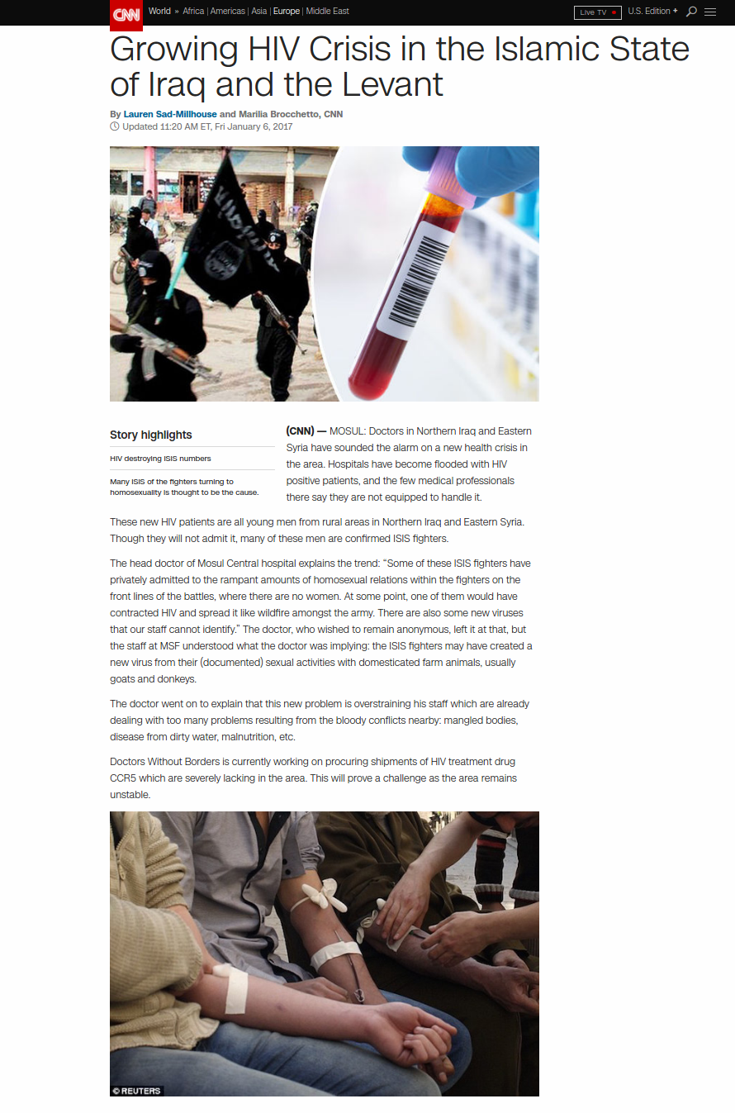

Slide 12
Article: By JPOST.COM STAFF April 6, 2015 19:48 Islamic State fighters are being attacked by a debilitating skin disease called leishmaniasis. The disease, which is spread by sandflies, is quickly spreading thanks to pollution and poor hygiene conditions, there have been more than 100,000 cases this year a British media outlet reported earlier this week. The jihadi fighters are refusing medical treatment which has led to more outbreaks, according to the reports. Medical centers have closed since medical staff have fled the violence making the spread of the disease more acute, according to the reports. The infection appears as red sores on the skin a few weeks or months after being bitten by the sand fly that erupt weeks to months after the person affected is bitten by sand flies. The infection can also damage the liver and spleen and cause anemia. The sores can cause permanent, ugly scars if untreated. https://www.jpost.com/Middle-East/ISIS-militants-reportedly-being-attacked-by-serious-skin-disease-396336

Slide 13
Isis committed many atrocities causing the literal disappearance of 1.2 million Christians in Iraq and 1 million in Syria not counting other countries such as Egypt, Turkey, Sudan and Somalia. Due to the terrible spiritual darkness Isis operated under these atrocities were committed creating unhygienic practices opening them up to disease and sickness. As mentioned in this scripture above Rev 16:10-11 a curse was placed upon the antichrist kingdom of darkness due to the lack of repentance for what they had done (killing Gods children and blaspheming him). Even with treatment this skin disease does not normally heal so the victims are left in much pain continually just as scripture states in the 5th bowl poured out.

Slide 14
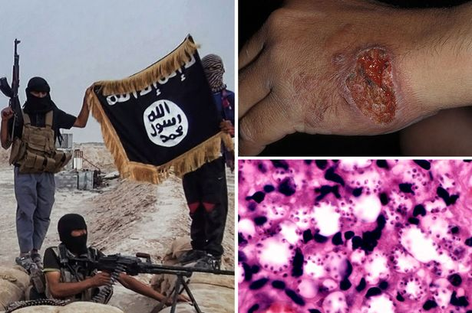
The skin disease leishmaniasis

Slide 15
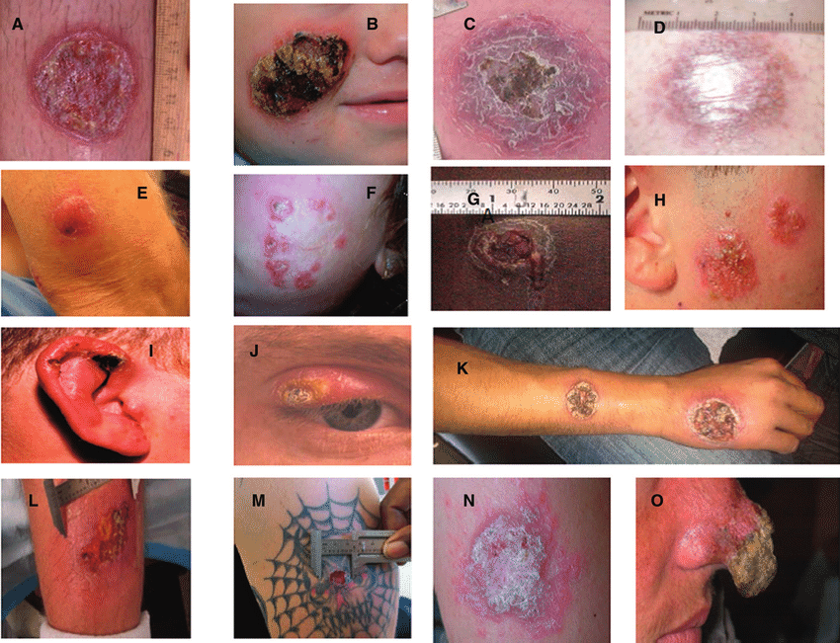
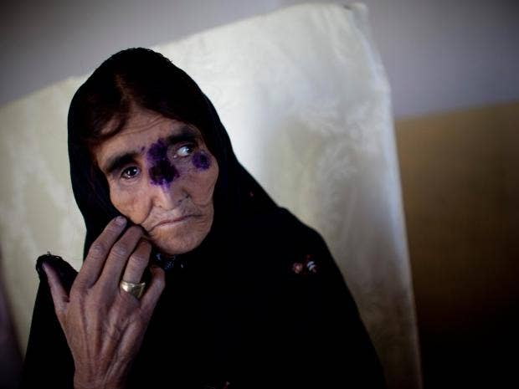
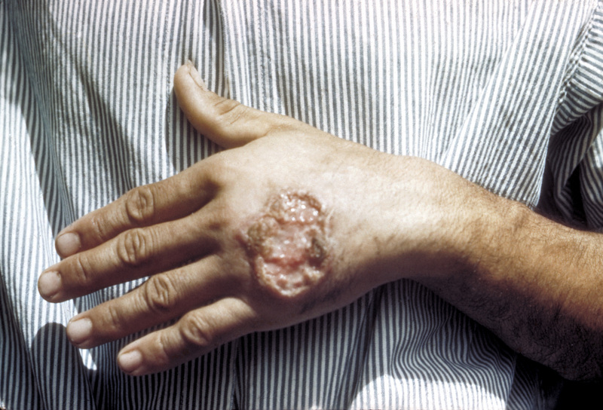
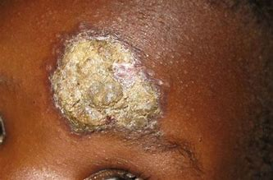
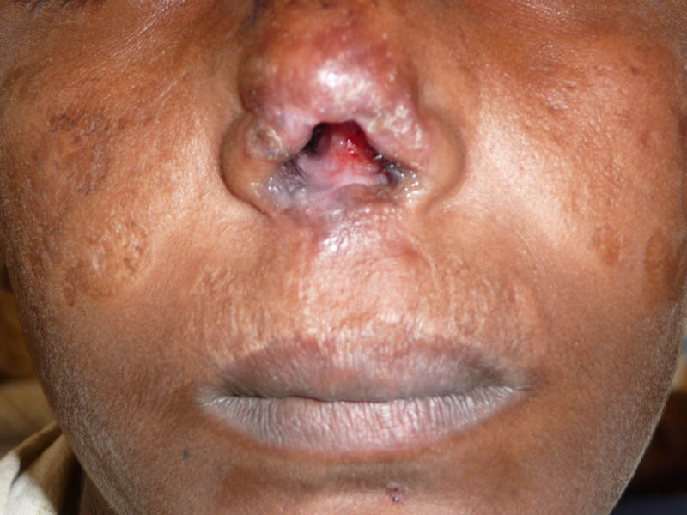

Slide 16
