Slide 1
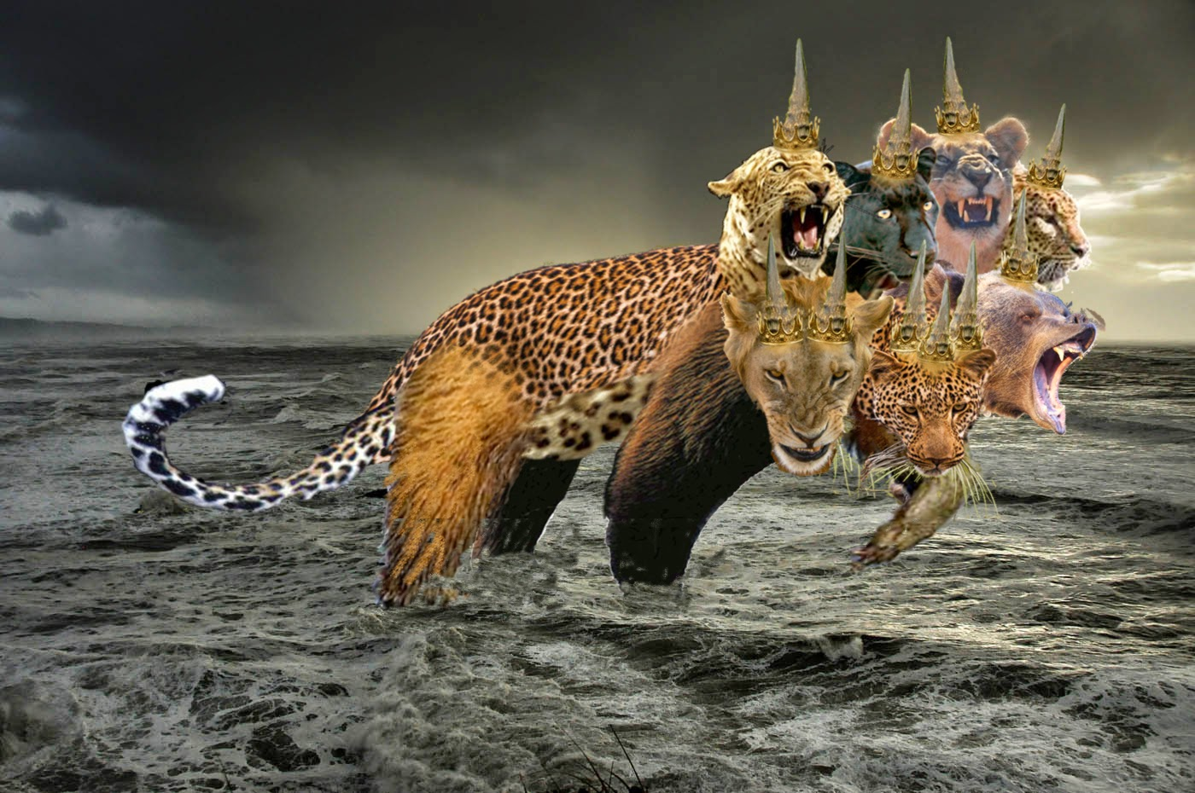
Rev 13:1-10 “Beast”

Slide 2
The First Beast Rev 13:1-2 Then I stood on the sand of the sea. And I saw a beast rising up out of the sea, having seven heads and ten horns, and on his horns ten crowns, and on his heads a blasphemous name.

Slide 3
Rev 13:2 Now the beast which I saw was like a leopard, his feet were like the feet of a bear, and his mouth like the mouth of a lion. The dragon gave him his power, his throne, and great authority.

Slide 4
Rev 13:3 And I saw one of his heads as if it had been mortally wounded, and his deadly wound was healed. And all the world marveled and followed the beast. Rev 13:4 So they worshiped the dragon who gave authority to the beast; and they worshiped the beast, saying, "Who is like the beast? Who is able to make war with him?"

Slide 5
Rev 13:5 And he was given a mouth speaking great things and blasphemies, and he was given authority to continue for forty-two months. Rev 13:6 Then he opened his mouth in blasphemy against God, to blaspheme His name, His tabernacle, and those who dwell in heaven. Rev 13:7 It was granted to him to make war with the saints and to overcome them. And authority was given him over every tribe, tongue, and nation.

Slide 6
Rev 13:8 All who dwell on the earth will worship him, whose names have not been written in the Book of Life of the Lamb slain from the foundation of the world. Rev 13:9 If anyone has an ear, let him hear. Rev 13:10 He who leads into captivity shall go into captivity; he who kills with the sword must be killed with the sword. Here is the patience and the faith of the saints.

Slide 7
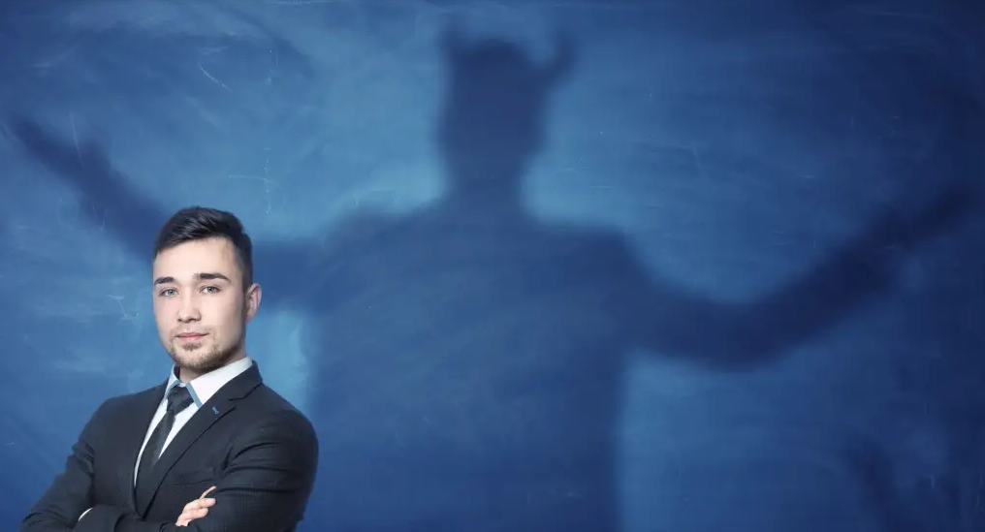
The Beast Spirit

Slide 8
Understanding the “Beast” The antichrist spirit is a “beast” spirit that is worldwide over all people its in all false religions and worldly systems its generational. In the passage of Rev 13 it manifests in two realms the spiritual and the natural. The Rev 13 first beast has a antichrist beast spirit he puts himself above Gods law, he loves to be worshipped he prospers through deception and lies he destroys. This beast spirit places himself even in the temple of God (man the church) putting himself in the place of God in end times.

Slide 9
This antichrist spirit is in the false prophet causing many to bow down and worship this beast and its image to receive its mark, number and name. This antichrist beast spirit that’s worldwide helps us to understand the actual spiritual mark of the beast 666 as first being all who are unsaved in Christ born into the beast nature. From the spiritual realm then in the natural realm in the end times you have the mark of the beast enforced in both the spiritual and the natural through the false prophet a leader in a powerful position, through his system of politics and religion.

Slide 10
Eph 6:12 For we do not wrestle against flesh and blood, but against principalities, against powers, against the rulers of the darkness of this age, against spiritual hosts of wickedness in the heavenly places. (NKJV) There are seven beasts operating in the last days end times book of Revelation and Daniel, all are antichrist. 1. The Dragon (Satan the serpent) 2. The Man of sin (beast from sea antichrist) 3. The False prophet (beast from the land) 4. The 8th King beast (Head of a beast system/Vatican) 5. The Wicked Woman (Jezebel of Babylon rides the beast) 6. The last empire Beast (Holy Roman Empire) 7. The Wounded Head of the Beast (Islam)

Slide 11
In Dan 7:7 the fourth world empire beast was devouring breaking in pieces and trampling the residue with its feet . Dan 7:23 it devours the whole Earth breaks it into pieces causing chaos and division this is an antichrist principality the generational spirit of the beast. In Rev 12 its seen as a fiery red Dragon Satan yet is also the antichrist beast for Satan is against Christ, it wars against Gods children. In Rev 17 it is in the 8th beast king, the woman of wickedness rides this beast. In Rev 11 this beast Spirit rises up from the pit to kill the two witnesses through people. In Rev 13 its in the false prophet and man of sin. Rev 13:8 All who dwell on the earth will worship him, whose names have not been written in the Book of Life of the Lamb slain from the foundation of the world. That's a generational beast spirit in the man of sin that is worshipped. No man has lived for 6000 years since creation began or 2000 years since Christ brought forth the Book of Life.

Slide 12
The Dan 7:7 last empire fourth beast the Rev 12 -7 heads with 7 diadems and 10 horns beast (spiritual power an authority to rule) the Rev 13 -7 heads 10 horns 10 crowns on the horns beast (worldly Kingship rule) and the Rev 17 -7 heads 10 horns beast a city on 7 mountains are all the same antichrist beast spirit operating generationally ,symbolically changing as it progresses down the generations. This goes back all the way to Satan in the garden of Eden in Gen 3:1 The serpent Satan. The whole world worships this beast spirit its in the unsaved the fallen nature of the beast Is 14:12 (Lucifer Fallen) or you worship Christ as being saved a new creation in Him 2 Col 5:17.

Slide 13
In the Bible the term Antichrist appears four times (NKJV) referring to an antichrist Spirit a spiritual ruler a principality one who acts falsely one whom denies Christ is against Christ or in place of. This Antichrist Spirit was recognized and referred to in the days of the disciples whom walked with Jesus. Scripture also refers to this as being down the generations, leading into the end times a generational antichrist Spiritual force. 1 Jn 2:22 - Who is a liar but he who denies that Jesus is the Christ? He is antichrist who denies the Father and the Son. (NKJV) 2 Jn 1:7 - For many deceivers have gone out into the world who do not confess Jesus Christ as coming in the flesh. This is a deceiver and an antichrist. (NKJV) 1 Jn 4:3 - And every spirit that does not confess that Jesus Christ has come in the flesh is not of God. And this is the spirit of the Antichrist, which you have heard was coming, and is now already in the world. (NKJV) 1 Jn 2:18 - Little children, it is the last hour; and as you have heard that the Antichrist is coming, even now many antichrists have come, by which we know that it is the last hour. (NKJV)

Slide 14
In the Revelations there is the mention of “The first Beast from the sea” Rev 13:1-11 the “man of sin” 2 Thes 2:3-4. Then the “second beast from the earth the false Prophet” Rev 13:11-18 and the “8th King beast” Rev 17:10-11. There is the “woman that rides the beast” Rev 17:4-8 and the “Dragon” beast Rev 13:4 whom influences many. There is no mention in the book of Revelation or Daniel of the term Antichrist as an individual entity a one world human ruler. There is no where in scripture that says a one world ruler shall emerge or come to rule the world, this is pure man made futurist theology. It does say in Rev 13:1-10 the Dragon (Satan) shall empower a “Beast from the sea” who blasphemes God who wars against the saints for 42 months referred to as the “Tribulation of the saints”. This is where you find an end times manifestation of the antichrist spirit in the warring against the saints of God. Then you see this against Israel in the Ezekiel 38 & 39 Gog of Magog war by the Lawless one 2 Thes 2:9 leading to “Armageddon” Rev 16:16. What we have had take place since 2009 is historic fulfillments of the Rev 13:1-11 “beast” influenced by the antichrist beast spirit appearing on the world stage. This “man of sin” the “Beast” comes with a fulfilling of many major prophecies throughout the book of Daniel and Revelation proving and revealing who he is.

Slide 15
The Eight names that are all the Rev 13 :1-10 beast in prophecy form the picture of who he is. 1Jn_2:18 Little children, it is the last hour; and as you have heard that the Antichrist is coming, even now many antichrists have come, by which we know that it is the last hour. 2Th 2:3 -4 Let no one deceive you by any means; for that Day will not come unless the falling away comes first, and the man of sin is revealed, the son of perdition. Eze_38:16 You will come up against My people Israel like a cloud, to cover the land. It will be in the latter days that I will bring you against My land, so that the nations may know Me, when I am hallowed in you, O Gog, before their eyes.“ 2Th 2:8-9 And then the lawless one will be revealed, whom the Lord will consume with the breath of His mouth and destroy with the brightness of His coming. The coming of the lawless one is according to the working of Satan, with all power, signs, and lying wonders.

Slide 16
Rev 13:1-2 Then I stood on the sand of the sea. And I saw a beast rising up out of the sea, having seven heads and ten horns, and on his horns ten crowns, and on his heads a blasphemous name. Dan 11:40 -41 "At the time of the end the king of the South shall attack him; and the king of the North shall come against him like a whirlwind, with chariots, horsemen, and with many ships; and he shall enter the countries, overwhelm them, and pass through. He shall also enter the Glorious Land, and many countries shall be overthrown. Dan 11:45 And he shall plant the tents of his palace between the seas and the glorious holy mountain; yet he shall come to his end, and no one will help him. Dan 8:9 And out of one of them came a little horn which grew exceedingly great toward the south, toward the east, and toward the Glorious Land.

Slide 17
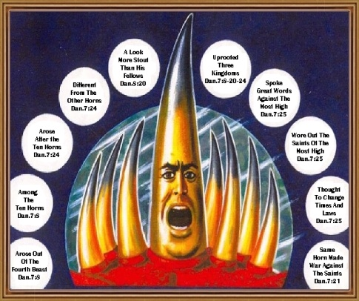

Slide 18
Rev 13:1 “The First Beast from the sea” Then I stood on the sand of the sea. And I saw a beast rising up out of the sea, having seven heads and ten horns, and on his horns ten crowns, and on his heads a blasphemous name. Now the beast which I saw was like a leopard, his feet were like the feet of a bear, and his mouth like the mouth of a lion. The dragon gave him his power, his throne, and great authority. And I saw one of his heads as if it had been mortally wounded, and his deadly wound was healed. And all the world marveled and followed the beast. So they worshiped the dragon who gave authority to the beast; and they worshiped the beast, saying, "Who is like the beast? Who is able to make war with him?" And he was given a mouth speaking great things and blasphemies, and he was given authority to continue for forty-two months.

Slide 19
Then he opened his mouth in blasphemy against God, to blaspheme His name, His tabernacle, and those who dwell in heaven. It was granted to him to make war with the saints and to overcome them. And authority was given him over every tribe, tongue, and nation. All who dwell on the earth will worship him, whose names have not been written in the Book of Life of the Lamb slain from the foundation of the world. anyone has an ear, let him hear. He who leads into captivity shall go into captivity; he who kills with the sword must be killed with the sword. Here is the patience and the faith of the saints. We will go through line by line

Slide 20
So who is this end times ?

Slide 21
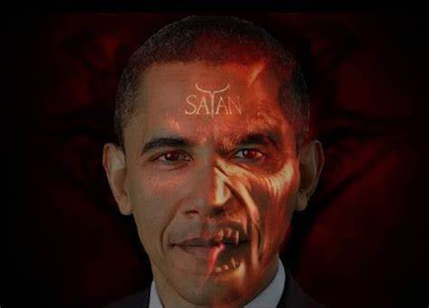
Guess who ?

Slide 22
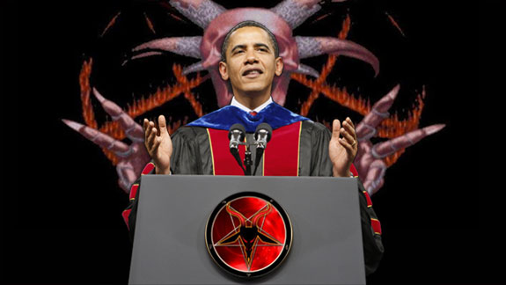
Why Obama ?

Slide 23
Dream 18.6.2000 In a dream I saw a “man on fire” coming out of the bush (symbolic of his actual sir name) walking up over a hill , then a “beast on fire” twice the man’s size was coming in behind him. Both of these creatures were demonic they had come to bring destruction to what was in the dream “Christian city” (Rev 13:5-7) the bride of Christ. I then saw several giant demonic strongmen 2-3 hundred feet high in the spirit standing over a city called “Christian City” in the spirit working with these two creatures on fire . These two creatures on fire the man and beast went into “Christian City” grabbed Christians and sucked the life out of them they fed on them. This is the “Antichrist spirit” coming on the rise in the Earth these two beasts worked together (US foreign policy). The Lord then said in the dream "the next President elected after Clinton (the 42nd president) is to be a part of the Book of Revelation fulfillment “ (Is 30:25), this was during the 2000 elections (George W Bush won the election the 43rd President “the man of fire” from Jan 20, 2001 – Jan 20, 2009 then the 44th President Obama the “Beast of fire” antichrist came Jan 20, 2009 - Jan 20, 2017).

Slide 24
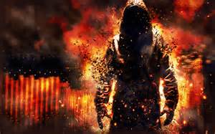
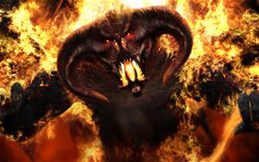
George W Bush 2001 – 2009 Barak Hussein Obama 2009 – 2017

Slide 25
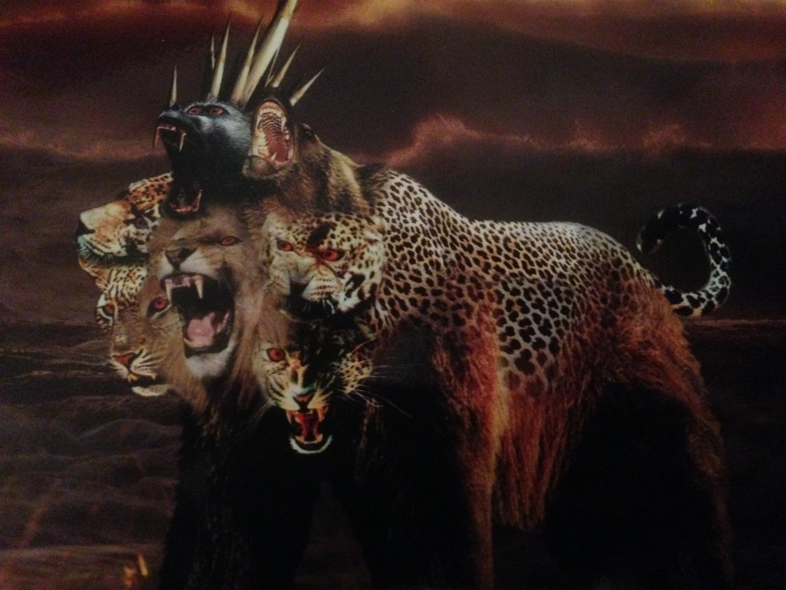
The “Beast” of Rev 13:1-10. fulfillments.

Slide 26
1. Then I stood on the sand of the sea. And I saw a beast rising up out of the sea. Barack Hussein Obama was born in 1961 his father was Barack Obama Senior a Muslim from Kenya educated in Hawaii. Obama grew up in Honolulu Hawaii an Island of the sea. His mum Ann Dunham married Indonesian Lolo Soetoro a Muslim. Obama left Honolulu for four years to live in Jakarta Indonesia, with his mum and step dad. An enrollment document at the Catholic/Muslim Fransiskus Assisi school in Jakarta, listed Barry Soetoro as an Indonesian citizen. Lolo Soetoro listed the boy’s religion at the school as “Islam” . Obama then returned to Hawaii to finish middle school and high school he graduated in 1979 then moved to the USA. Obama’s Hawaii birth certificate was proven to be a fraud his own lawyers admitted to this in court on live TV in 2012, no one knows where he was actually born.

Slide 27
The meaning of Obama’s name (article) The meaning of Hussein is “blessed” in Arabic, the O in Obama means male or man, and ba means soul, and ma comes from ma/mother, the goddess of the sea (from which the term marine, and the African nation’s name Mauretania come), Obama means “man’s soul from the sea”. Barak in Hebrew means lightning. The meaning of Hussein is “blessed” in Arabic, so Obama Barak Hussein’s full name means “Thunderous soul double of the sun blessed from the sea mother”.

Slide 28
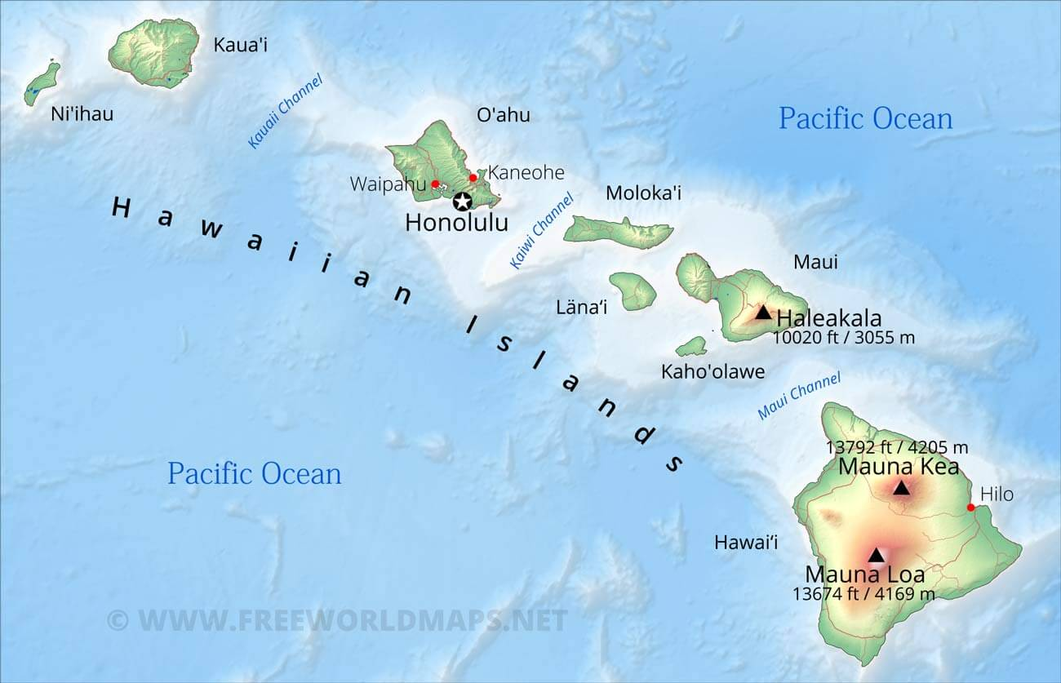
Beast rising up out of the sea

Slide 29
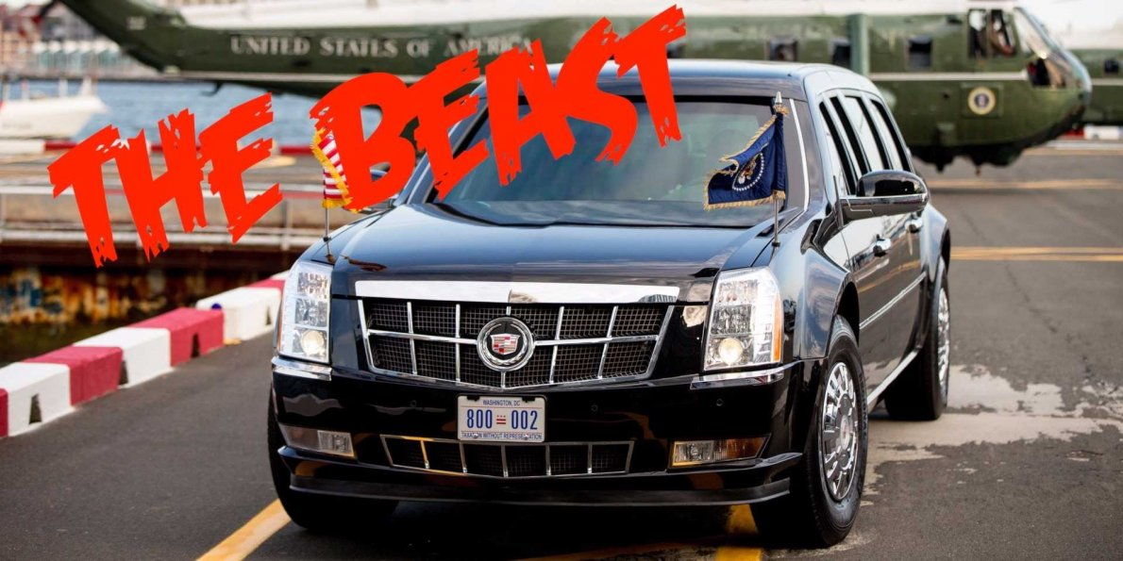
The car Obama traveled in: Obama had a protective special armored limo nicknamed “The Beast” by the CIA with a motorcade of over 40 vehicles and decoy cars that he traveled in. Each new president builds a protective car, it is normal to have such a large motorcade both in the US and abroad.

Slide 30
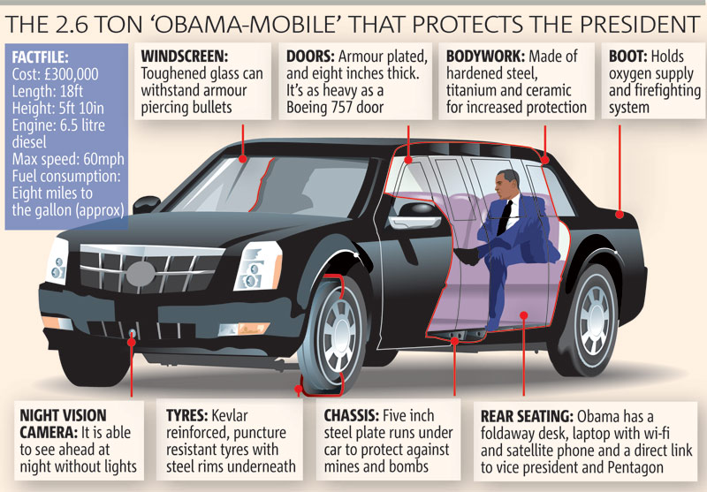

Slide 31
2. Having seven heads (and ten horns, and on his horns ten crowns) To Identify the 7 heads and ten horns and ten crowns on the horns you need to see what the beast is involved with what these actually represent.

Slide 32
7 Heads Heads speak of authority leadership over a nation or kingdom. The Lord said we are to be the head not the tail (Deut 28:13. The 7 heads are leaders of nations the G7 “Group of Seven”. The G7 was officially established in 1985 it is the 7 largest advanced economies on Earth. The managing director of the IMF “International Monetary Fund” (189 Countries) World Bank is involved GATT (Trade Rules) and the EU. As US President you are an influential leader in this circle of power and authority. The G7 countries have a net wealth of 317 Trillion 45% of the worlds GDP (Global Domestic Product). Obama as the beast headed up the G7 for 8 years from 2009-1917. The G7 would then meet with the newly formed G20 (1999) made up of another 13 emerging economic nations (90% of world GDP), 3 of these 13 nations are Muslim Turkey, Saudi Arabia and Indonesia. The G7 are part of the UN made up of one third being Muslim nations. The beast Obama is a Muslim, under Obama the Ottoman Empire beast was recovering through his Muslim influence, one of the 7 heads” wounded and recovered”.

Slide 33
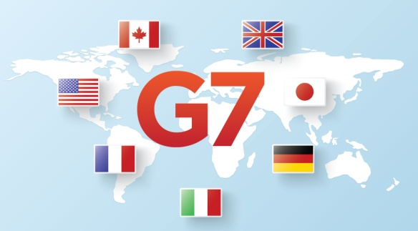
The Group of 7 (G7) is a group consisting of finance ministers, central bank governors and leaders of the seven most advanced economies on Earth as reported by the IMF the “International Monetary Fund”.

Slide 34
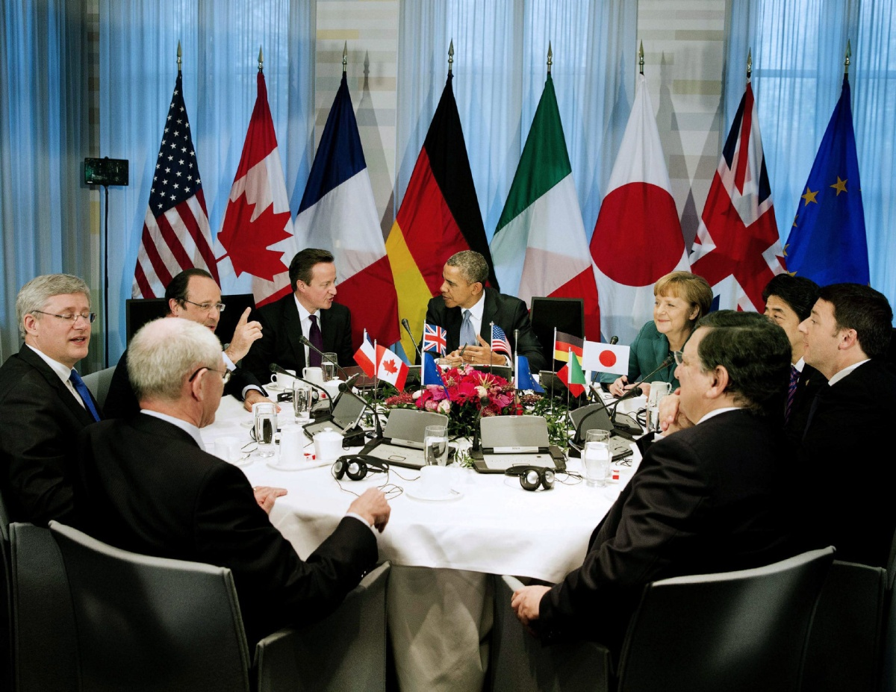
Here is G7 leaders of 7 nations and EU leaders.

Slide 35
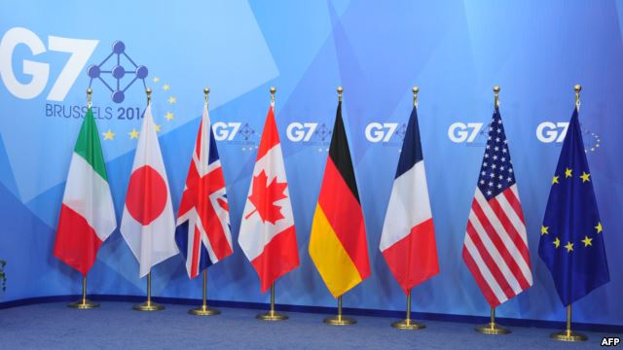
The G7 is Canada , France , Germany, Japan, Italy, United Kingdom and United States attended by the World Bank and the EU.

Slide 36
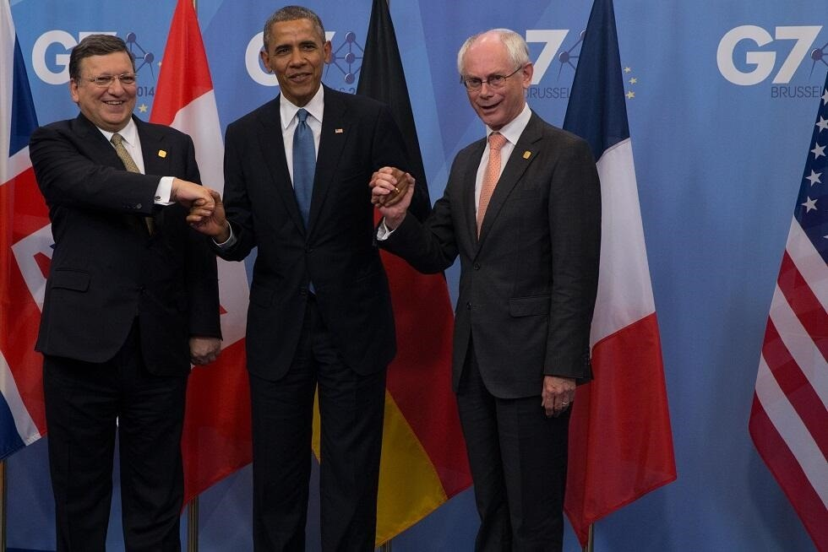
Jose Barosso, Obama and Herman Van Rompuy of the EU “Roman Empire” 2014, 40th summit.

Slide 37
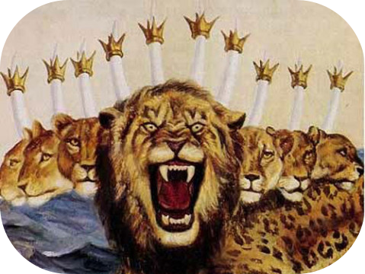
3. The ten horns (and on his horns ten crowns). Rev 13:1 Then I stood on the sand of the sea. And I saw a beast rising up out of the sea, having seven heads and ten horns, and on his horns ten crowns, and on his heads a blasphemous name. Rev 17:12 -13 "The ten horns which you saw are ten kings who have received no kingdom as yet, but they receive authority for one hour as kings with the beast. These are of one mind, and they will give their power and authority to the beast.

Slide 38
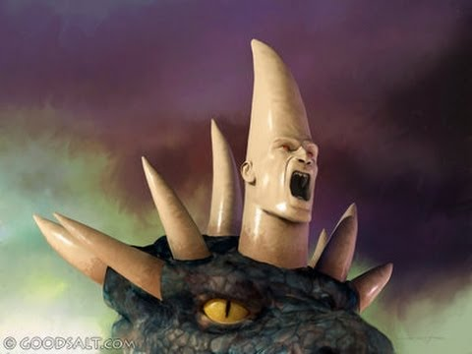
Dan 7:23-24 'The fourth beast shall be A fourth kingdom on earth, Which shall be different from all other kingdoms, And shall devour the whole earth, Trample it and break it in pieces. The ten horns are ten kings Who shall arise from this kingdom. And another shall rise after them; He shall be different from the first ones, And shall subdue three kings. (Dan 11:43, Dan 7:7)

Slide 39
The 10 Horns The Club of Rome was founded in 1968 during a meeting at Rockefellers private house in Bellagio, Italy, this is one of the Dragon elite banker families. The meeting was organized by Aurelio Peccei, an Italian industrialist who had close relations to the Olivetti Corporation and Fiat. He claimed to have solutions for world peace and prosperity, which could be accomplished through a New World Order. On 17, September, 1973, the Club of Rome published a report entitled the “Regionalized and Adaptive Model of the Global World System“, which was authored by Eduard Pestel and Mihajlo Mesarovic. The report revealed the Club’s intention to divide the world into ten economic political regions, called “Kingdoms”, which would unite the entire world under a common leadership. The term “Kingdoms” was left out, when the plan was released in a book entitled “Mankind at the Turning Point“ in 1974, which stated that the solutions to the problems of the world could only “be developed in a global context” basically a New World Order. http://conspiracywiki.com/new-world-order/club-of-rome/

Slide 41
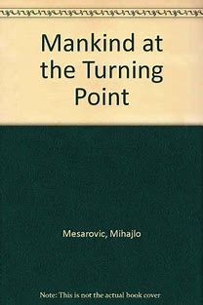
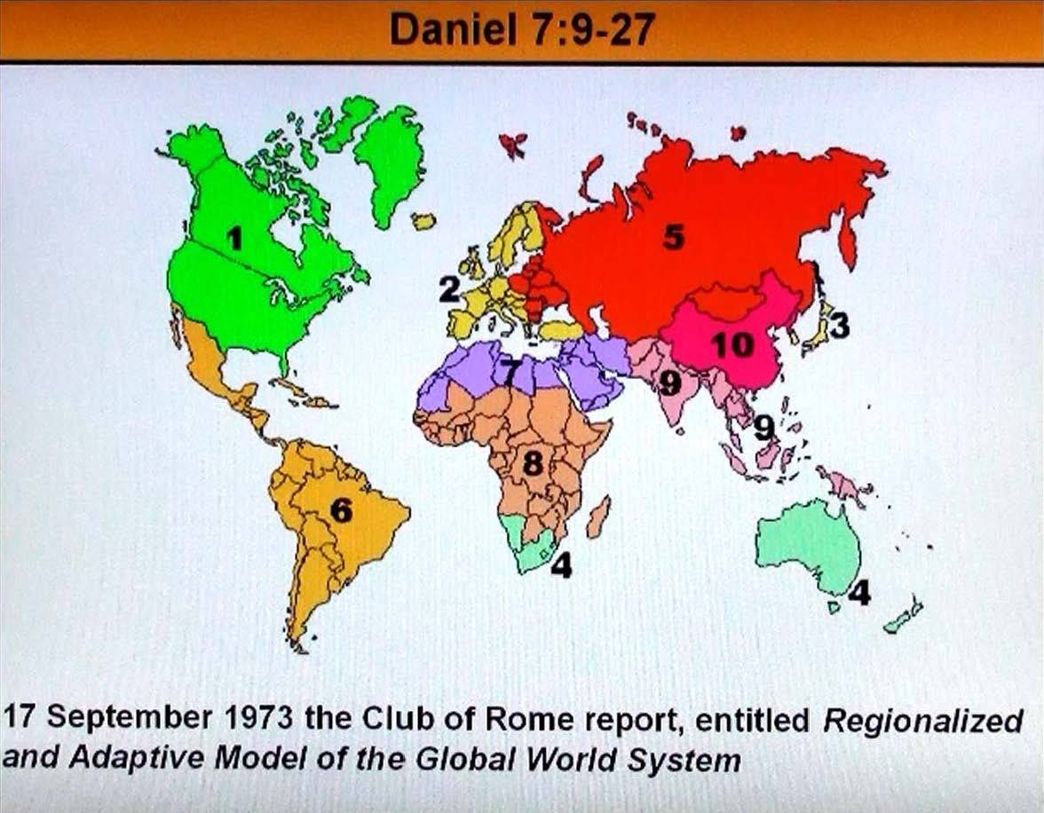
The Club of Rome 10 governing economic regions the ten horns of the beast .

Slide 42
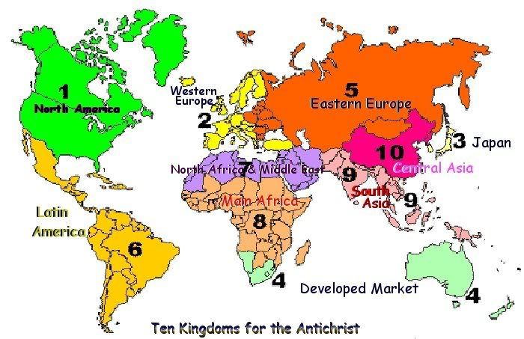
Dan 7:24 The ten horns are ten kings who shall arise from this kingdom. And another shall rise after them; He shall be different from the first ones, And shall subdue three kings. (NKJV)

Slide 43
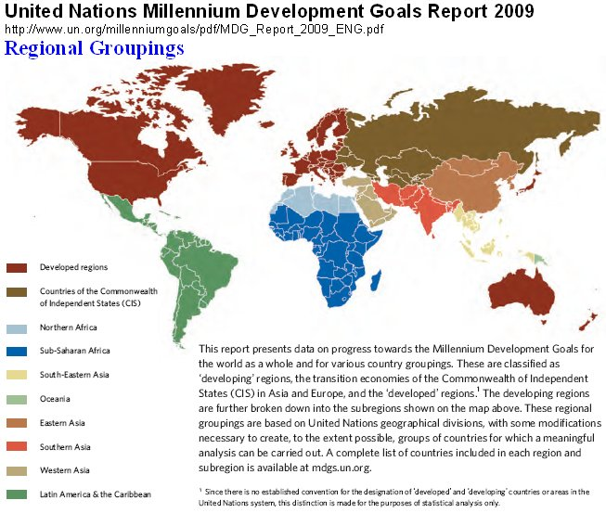
Seat of the Dragon Rev 13:4 UN assigned 10 regions in 1996.

Slide 44
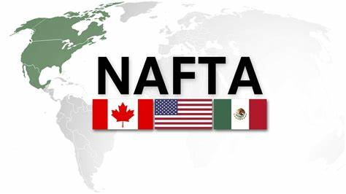
NAFTA governed regions of economics from the USA , the richest nation on Earth . Obama was president from 2009-2017 (8 years).

Slide 45
NAFTA “North American Free Trade agreement” came into force under President Bill Clinton in 1994 as a trade agreement between the USA, Canada and Mexico. NAFTA in 1996 then assigned the world’s geographical nations into ten economic regions creating a map of these nations, the same year as the UN. This was done in alignment with the “Club of Rome” 10 regions first assigned in 1973, this reveals a connection between these organizations. There are very slight differences in the regional assignments with NAFTA and the Club of Rome in Africa region 8 and South America region 2. The Ten Horns are also the 10 “Club of Rome” 10 “NAFTA” 10 UN regions. NAFTA is a US organisation for international trade deals.

Slide 46
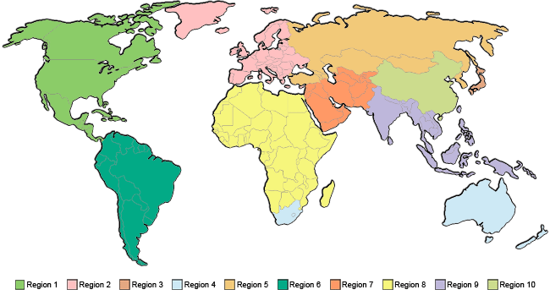
The 10 “NAFTA” regions are: 1.America, Canada and Mexico 2.South America 3.Australia and New Zealand 4.Western Europe 5.Eastern Europe 6.Japan 7.South Asia 8.Central Asia 8.North Africa and Middle East 10.The remainder of Africa.

Slide 47
The Ten Global Government World Trade Organization (WTO) regions the 10 Horns: 1 US, NAFTA (North American Free Trade Agreement) 2 Europe EU (European Union) revived Roman Empire (TTIP, EU & USA) 3 Australasia APEC (Asia Pacific economic cooperation) (CPTPP, 10 nations from TPPA) 4 Middle East / North Africa WFTO (World Fair Trade Organization) 5 Western Asia / Eastern Europe OECD (Organization for Economic Cooperation and Development) 6 Central Asia EAEC (Eurasian Economic Community) 7 South East Asia ASEAN (Association of Southeast Asian Nations) now EAFTA. 8 Orient Japan JETRO (Japan International Trade Organization) 9 Africa OAU (Organization of African Unity) 10 South America USAN (Union of South American Nations)

Slide 48
Ten crowns on Ten horns During his Presidency Obama was given “Fast Track” trade powers in April of 2015 .The first time ever given to a US president by the US senate. Given to Obama to negotiate and finalise the TPPA (Trans Pacific Partnership Agreement) the Trade powers here came from NAFTA. Fast Track powers gave him authority to negotiate solely on his own without congress, with 12 economic nations making up 40 % of the worlds GDP (economic trading wealth) covering 800 million people. The TPPA was a big business corporate take over of the sovereignty and rule over nations for the banker elites the puppets to the Dragon the New World Order “Club of Rome”. The 12 nations were actually 10 nations Australia and New Zealand were classed as one America and Canada were classed as one nation. The TPPA was signed into agreement in New Zealand on Feb 4th 2016. The TPPA was changed to the CPTPP (comprehensive progressive Agreement) after Trump withdrew the USA from it in 2017.

Slide 49
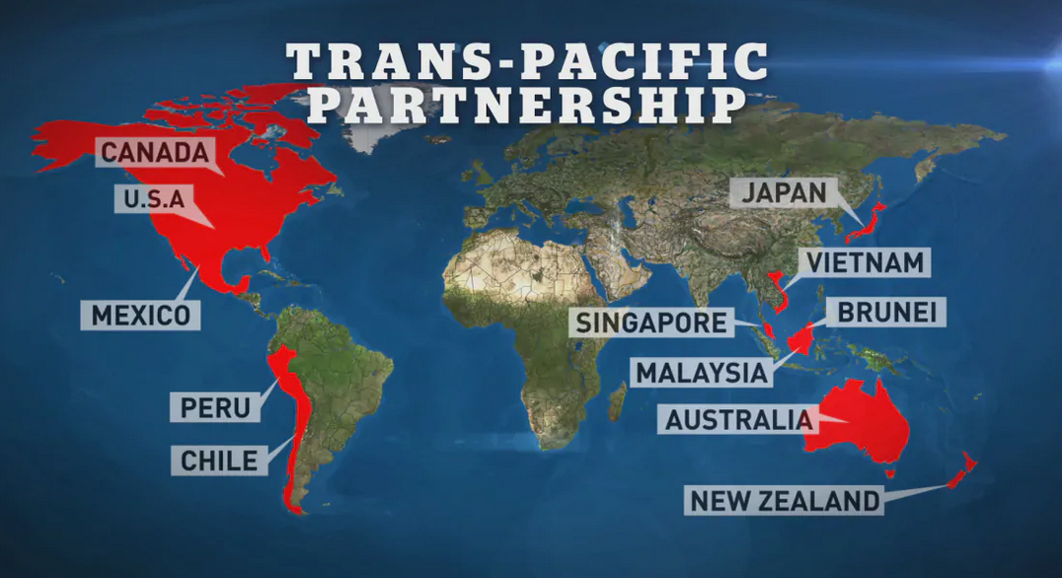
NAFTA was involved through Obama negotiating the TPPA in 2015-2016. The TPPA 10 nation deal was the ten crowns placed onto the ten horns the “Club of Rome” beast the last Empire beast of Dan 7:19-20 the ten toes of Dan 2:31-35 the “Holy Roman Empire”.

Slide 50
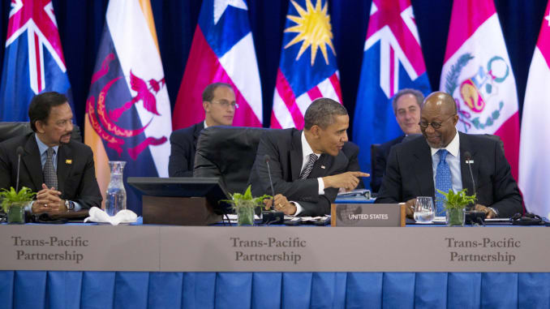
A meeting of Obama at the table of the TPPA talks negotiating the deal Oct 2015; Rev 13:1 and Rev 17:12-13 the ten crowns going onto the ten horns.

Slide 52
4.And on his heads a blasphemous name.

Slide 53
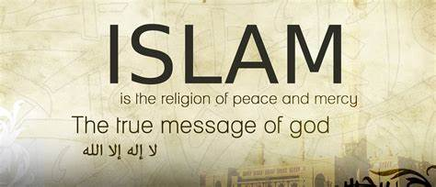

Slide 54
Islam and the Roman Catholics are under the same antichrist false religion murderous spirit that blasphemes God. In 1500 years Islam has killed 669 million people. In 1800 years the Vatican has killed up to 150 million people (70 million Christians). The testimony of Roberto Rivera an ex Jesuit priest turned Christian testifies to a connection between both religions. The last 2 Popes now declaring Islam and the Vatican worship the same God with Popes visiting Mosques to pray together and forming “Chrislam” in Europe. Rev_17:3 So he carried me away in the Spirit into the wilderness. And I saw a woman sitting on a scarlet beast which was full of names of blasphemy, having seven heads and ten horns.

Slide 55
The Blasphemous name on the Rev 13:1, 7 heads through Obama is “ISLAM” a religion of the nature of the beast for 1500 years . The G7 embrace the “OIC” the “Organisation of Islamic cooperation and unity” of 57 state Muslim nations with 1.8 billion people through UNIDIR a UN organisation . The G7 agrees in Islam's desire for a return to a caliphate through the United Nations UNIDIR Islamic cyber protection “Islamphobia” and cooperation policies. The UN embrace Islam the UN is the seat of the “Holy Roman Empire” they created the UN “Immigration Pact “ in 2019 signed by 164 nations. Islamic nations make up one third of the UN. Muslim immigrants are being loosed into all nations to bring fear economic hardship and chaos. This is also to do with the mark of the beast, many nations are bowing to Islam “Sharia courts” are being set up in many nations out of fear. This is being done for a reason by the antichrist system of world rulership, to tear down nations for the “New World Order” to take over. More Muslim mosques are built than churches.

Slide 56
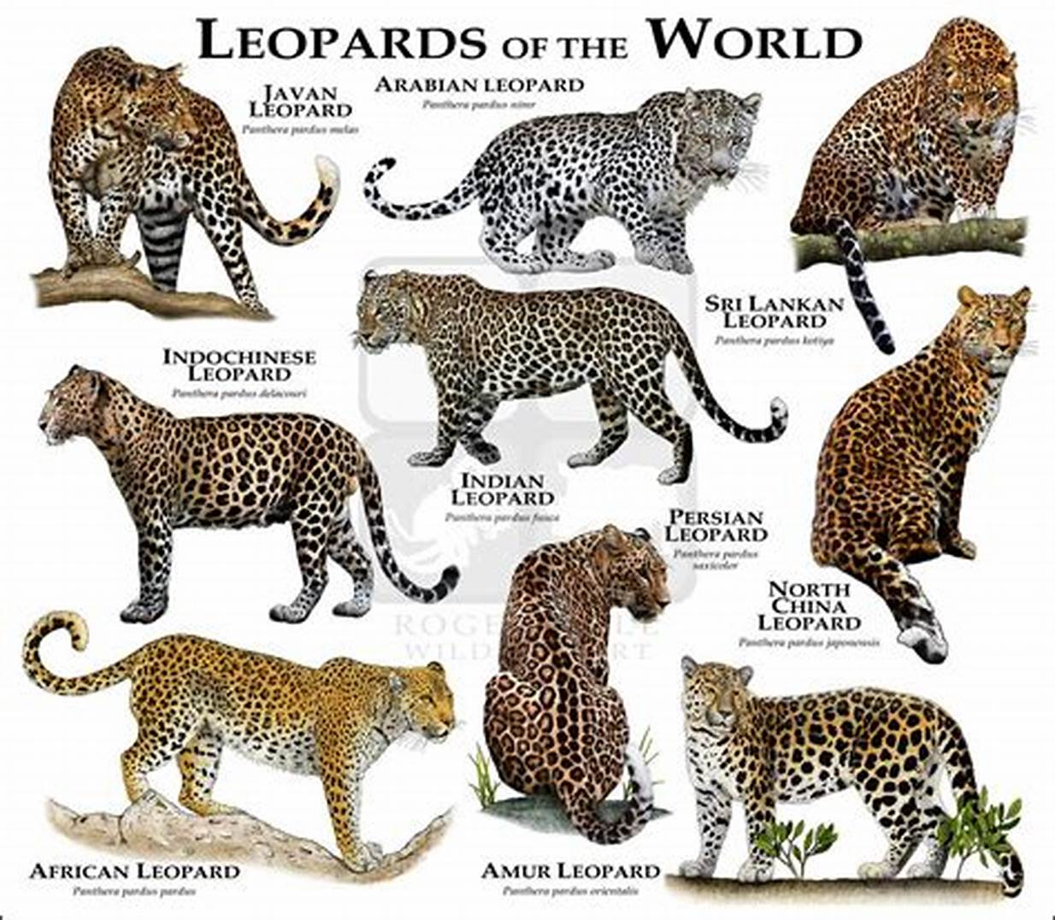
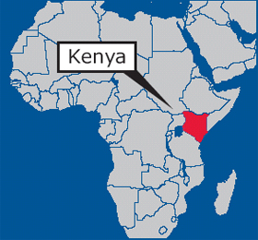
5. Now the beast which I saw was like a leopard There are 9 breeds of Leopard in the world 6 breeds of leopards come from Kenya 70% of all Leopard breeds. Obama has a black father from Kenya and a white mother from the USA, he is half black and half white just as a leopard is two colors.

Slide 57
6. His feet were like the feet of a bear, and his mouth like the mouth of a lion Obama’s ancestry is from Kenya Africa, he is a Muslim. He has Kenyan family members with ties to the Muslim Brotherhood. Obama's own brother from Kenya has close ties to the Muslim Brotherhood. Obama states he is a Christian but is clearly not while oversees he goes to Muslim mosques. Obama is also reported to have been born in Kenya he even states this on live video (video). Both his step dad and father where Muslims. Obama grew up in Muslim educated schools. Muslims deny Christ as God they are an antichrist religion. The bear in Dan 7:5 and Rev 13 is symbolic in the Bible as both the Persian Empire and antichrist. The bears feet is ones walk what one believes like the shoes of the gospel Eph 6:15. The mouth of the lion is to destroy and consume 1 Pet 5:8, to blaspheme God “Islam” is known as a religion of war it blasphemes God it consumes and destroys. Islam has killed 669 million people in 1400 years the greatest generational killing machine on Earth. Obama himself admits he’s a Muslim on video. (video).

Slide 58
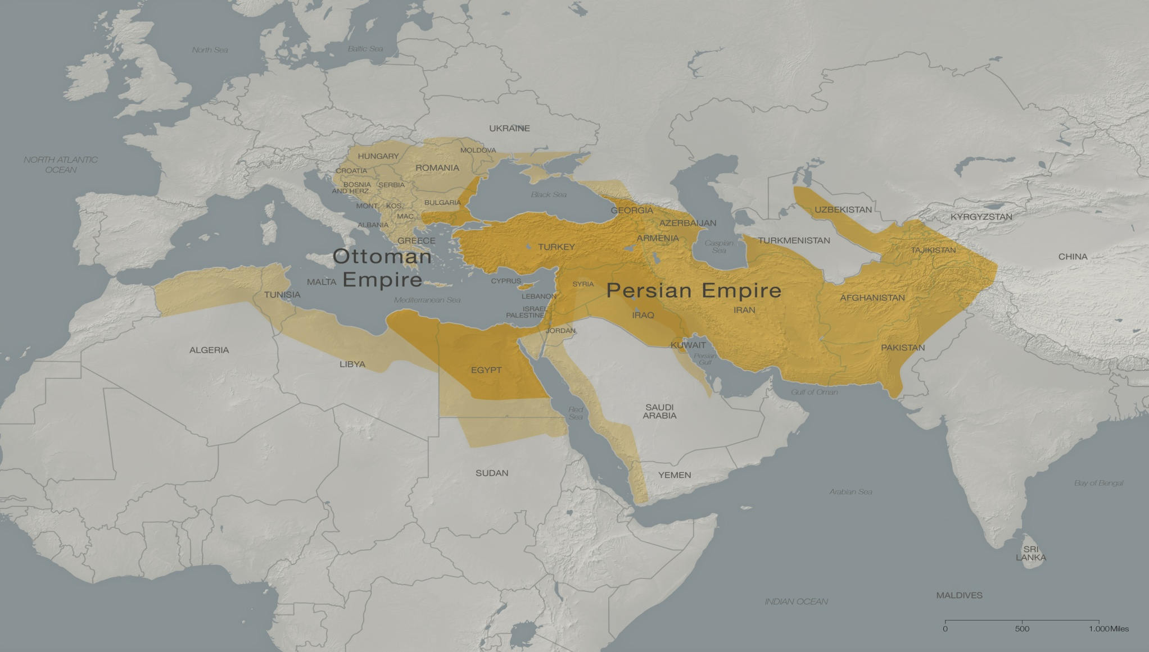
The end times Rev 13:1-10 beast religion and ancestry comes from the region the Medo Persian bear “Iran” is found in Dan 7:5 . The Middle East region of Ishmael the Arab people. The region of Leopards , lions and bears . The region of the Ottoman Empire religion the bears feet “Islam”. The area the “war against the saints “ happens in Rev 13:5-7.

Slide 59
Pro_28:15 Like a roaring lion and a charging bear is a wicked ruler over poor people. Lam_3:10 He has been to me a bear lying in wait, Like a lion in ambush. The Medo Persian Empire modern day Islamic Iran Dan_7:5 "And suddenly another beast, a second, like a bear. It was raised up on one side, and had three ribs in its mouth between its teeth. And they said thus to it: 'Arise, devour much flesh!'

Slide 60
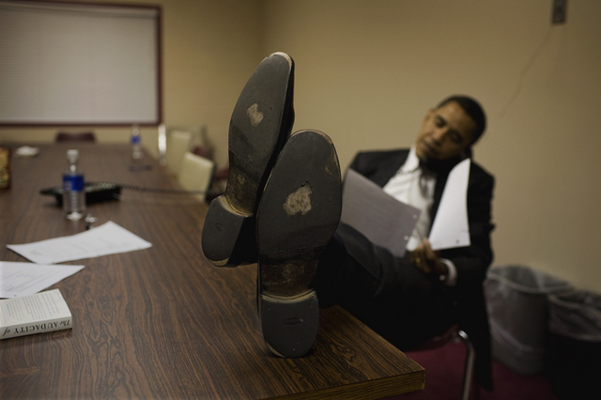
It’s interesting Obama has huge feet like a bear he wears size 12 US , 45 EU,11.5UK shoes he has very large feet, the biggest feet of any US President.

Slide 61
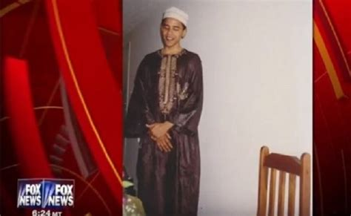

Slide 63
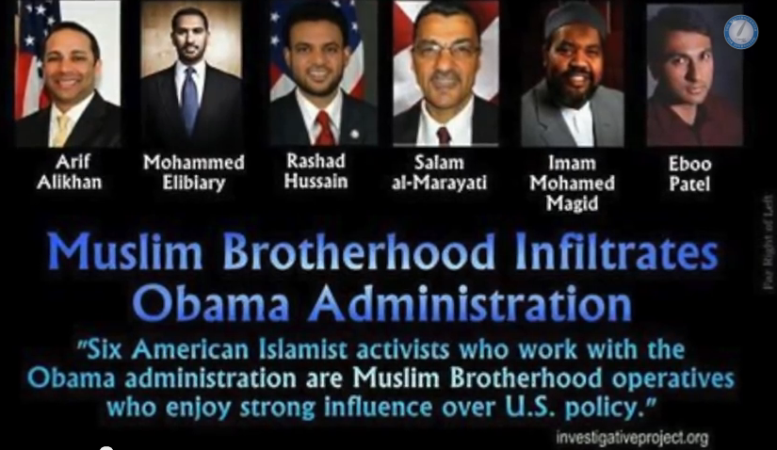

Slide 64
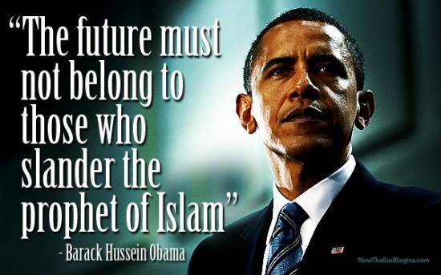

Slide 65
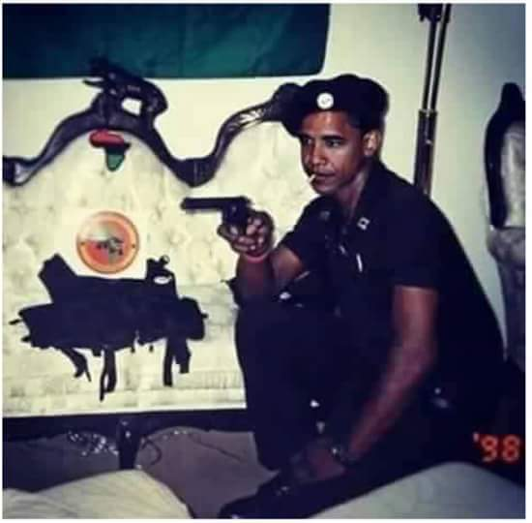

Slide 66
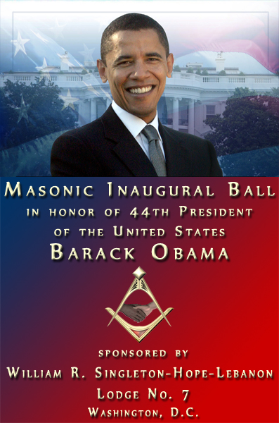

Slide 67
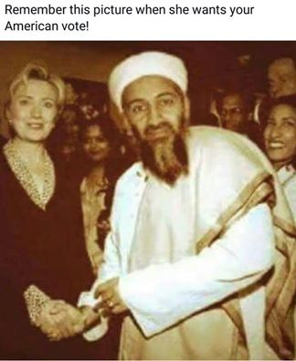

Slide 68
7. The dragon gave him his power, his throne, and great authority. Obama during His time as President for 8 years was a head authority in the G7. He negotiated the NAFTA and Club of Rome, TPPA trade deal with 12 nations, the ten crowns going on the ten horns. He was chairman in 2009 of the powerful UN security council for 1 year made up of 15 nations. He was a head influential leader at the UN with 198 nations for 8 years. He was involved as a head authority with NATO overseeing 29 European countries. Obama led the NATO coalition forces in the Middle East against Isis. He started the UN Global Police force in 2015. Obama was involved in the TTIP (Trans Atlantic Trade and Investment partnership) between the 28 country European Union (1957 Treaty of Rome) and the US. Obama promoted the New World Order Global Unity UN and Club of Rome agenda. Obama removed all US troops from Iraq in 2011 creating the Isis terrorist vacuum he led the coalition forces in the Middle East. Obama had great authority given to him by the Dragon of this world. Obama was heavily involved in the Arab Spring uprising in 2011.

Slide 69
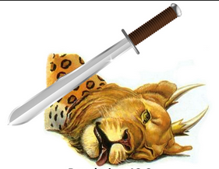
8. And I saw one of his heads as if it had been mortally wounded, and his deadly wound was healed. And all the world marvelled and followed the beast. This mortal wound happened in WW1,1914-1918 the first Trumpet blast (Rev 8:7) it was the defeat of the Islamic Ottoman Empire after 600 years of rule in the Middle East region. In between the words mortally wounded and the wound was healed is 96 years. The Ottoman Empire head wound was in WW1 1914-1918 it was then dissolved fully with the “Treaty of Sevres“ in1920.

Slide 70
The wound began to be healed after the 2011 Arab Spring uprising that Obama was heavily involved in along with Erdagon of Turkey. This was also the 3 horns ripped up Libya, Egypt and Tunisia in the Arab Spring of 2011. You find the scripture for this in Dan 11:43. Obama withdrew US troops from Iraq in 2011 creating the vacuum for Isis terrorists to come into Iraq from Syria in early 2014.

Slide 71
Isis began killing every one they targeted the Yazidis and Christians in their destruction destroying hundreds of churches that had been there going back to the times of Christ. Isis declared a caliphate in Iraq and Syria the wounded head had recovered. Turkey through Erdagon began supporting Isis helping Isis wounded in their hospitals and oil trade . On social media the world marvelled at the atrocities being committed by this Islamic antichrist beast with beheading, rapes and the sex slave trade . The refugee crisis came forth in mass into Middle eastern , African and European nations by the millions nations began bowing down to Islamic refugees.

Slide 72
9. So they worshiped the dragon who gave authority to the beast; and they worshiped the beast, saying, "Who is like the beast? Who is able to make war with him?" The who is able to war against him this is the spirit of the beast the principality of the beast it’s the dragon in this case in end times it wars through Obama the false prophet the UN, Islamic terrorists and the elite. The Jihad of Islam has been around for 1400 years killing 669 million, in the end times it has become a hidden enemy of millions almost undetectable , unpredictable and undefeatable. This beast spirit operates through the Papacy in the past killing 70 million over 1260 years in the inquisitions. This is because its generational and spiritual the west does not understand it, Islam is a barbaric religion unchanging. In modern times bringing much fear . Governments have bowed down to this beast through fearing the unknown.

Slide 73
10. And he was given a mouth speaking great things and blasphemies, and he was given authority to continue for forty-two months. Then he opened his mouth in blasphemy against God, to blaspheme His name, His tabernacle, and those who dwell in heaven. The blasphemies come from false God worship of the beast/Allah/Satan by Obama’s religion Islam. The beast nature is to be against Christ to speak against Him to blaspheme Christ mock Him. This is Obama’s embrace of Islam his belief in Islam his worship of Allah his Islamic advancement and political protection of Islam and his Islamic bias against Christians. (video)

Slide 75
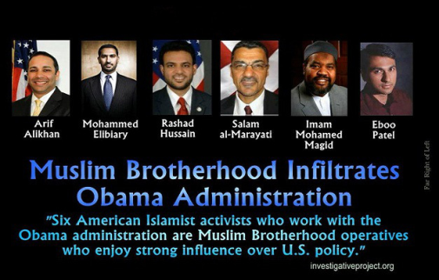
While in power Obama had many US congress FBI, CIA , Homeland security positions filled by Muslims. He had 6 known Muslim Brotherhood members over seeing US foreign policy. He held Muslim prayer and special ongoing Muslim Organisation meetings in the White House (video). His war with Isis was a false flag war , that’s why Trump destroyed them in 8 months what Obama never did in 42 month 3.5 years Rev 13:5-7.

Slide 76
11. It was granted to him to make war with the saints and to overcome them. He was given authority for 42 months to blaspheme and “war against the saints” this is Obama it is Islam the spiritual beast operating against Christians. Over 60 nations with over 200 million Christians are under severe persecution by mainly Muslim nations Obama cant do all that. Obama as the Rev 13 beast did his part in the “War against the saints “ for 42 months found in Rev 13:5-7, Dan 7:21, Dan 9:27, Dan 12:11. Obama withdrew all US Troops from Iraq in 2011 creating what George Bush warned against a terrorist vacuum. Obama was heavily involved in the Arab Spring uprising. By June 2013 Shia Hezbollah in Lebanon sent 2000 troops into the Syrian conflict that erupted out of the Arab Spring. That year in 2013 Christian Martyrs began to double around the world. June 2013 was the beginning of the “war against the saints” then Isis entered into Iraq early 2014 targeting mainly Christians and the Yazidis.

Slide 77
The Lord said to me Hezbollah entering Syria was the beginning of the 42 months “War against the saints” so I counted 42 months this took you to Jan 2017. It says in Dan 7:21- 22 at the end of the 42 months ; Dan 7:21 -22 "I was watching; and the same horn was making war against the saints, and prevailing against them, until the Ancient of Days came, and a judgment was made in favor of the saints of the Most High, and the time came for the saints to possess the kingdom. I didn’t know what God was going to do I had to wait 42 months to see. I thought favour to the saints was revival coming an out pouring of His Spirit. What happened in Jan 2017 ? Donald Trump became President against all odds no one saw it coming it was a supernatural event shocking America. God put a Christian president in the White House after the beast had been there 8 years.

Slide 78
Trump began over turning what Obama had done he cancelled all UN funding to Muslim refuges and gave it to Christian refugees setting up a huge multi billion dollar fund. He immediately overturned Obama's war policies against Isis through the Pentagon in his first 30 days in office, bringing quick relief to the persecuted Christians in Iraq and Syria defeating Isis in 10 months. Favour had come to the saints Trump was a sign post of favour from God to His persecuted church in the Middle east. The 42 months “war against the saints” in the region was now over after up to 2.2 million Christians had now disappeared from Iraq and Syria, almost the destruction of Christianity in the Middle East.

Slide 79
12. And authority was given him over every tribe, tongue, and nation. All who dwell on the earth will worship him, whose names have not been written in the Book of Life of the Lamb slain from the foundation of the world. anyone has an ear, let him hear. He who leads into captivity shall go into captivity; he who kills with the sword must be killed with the sword. Here is the patience and the faith of the saints. This is worldwide Spiritual principality of the Antichrist beast/Satan/Dragon. This operates through the end times man of sin Rev 13:1-10 beast. The world bows to this Spiritual beast authority and worships it in what ever form it takes they are deceived by it knowingly or unknowingly. The world worships the beast through Islam, Papacy, Hindus, cults and all false religions, in Hollywood, music, in any sin, its against Christ or in place of its worldwide except if you are saved.

Slide 80
13. The 3 Horns uprooted prophecy is 2500 years old from 538 B.C Dan 7:8 I was considering the horns (Dan 7:7 ten horns), and there was another horn, a little one, coming up among them, before whom three of the first horns were plucked out by the roots. And there, in this horn, were eyes like the eyes of a man, and a mouth speaking pompous words. (NKJV) Dan7:24 The ten horns are ten kings Who shall arise from this kingdom . And another shall rise after them (Beast); He shall be different from the first ones, And shall subdue three kings. (NKJV) Dan 11:43 He shall have power over the treasures of gold and silver, and over all the precious things of Egypt; also the Libyans and Ethiopians shall follow at his heels. (NKJV)

Slide 81
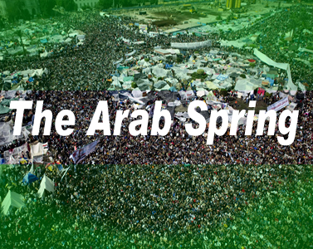
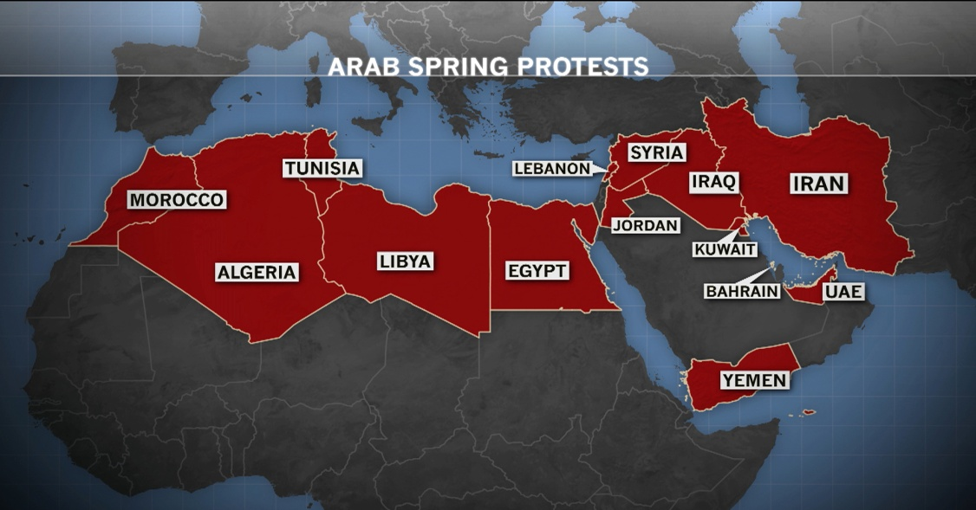
The 2011 Arab Spring uprising was a supernatural event across the Middle East , 3 leaders gone. To have power over 3 nations means you are a from a superpower. 3 horns/kings uprooted of the 10 horned beast during the Obama administration were the leaders of Libya, Egypt and Tunisia, through social media platforms, forced protests and military. Tunisia leader dictator for 24 years Zen Al Abidine Ben Ali was ousted he fled after protests erupted over corruption. He was replaced by Moncef Marzouki in the 2012 elections. The Muslim brotherhood has been at work since 2011 in Tunisia trying to take over through its elections.

Slide 82
Egypt lost Hosni Mubarak Egypt's leader for 30 yrs he was forced to step down by Obama. Muslim brotherhood Muhammad Morsi then became president who immediately went out crucifying Christians he lasted one year. He was arrested by the Egyptian armed forces and later executed. Libya Obama ordered Muammar Kaddafi‘s ships and forces to be attacked. This was due to supposed protests by Libyans. Kaddafi was wanting a new gold currency for Libya and other Middle Eastern nations. This would have affected the US economy Kaddafi was in power for 34 yrs. After his death Libya fell into chaos with 300 thousand Muslim terrorists taking over. The main government funded Islamic terrorist organisation in Libya now is the Muslim Brotherhood holding it at ransom. Kaddafi was killed murdered, Hillary laughed and said we got him (video).

Slide 83
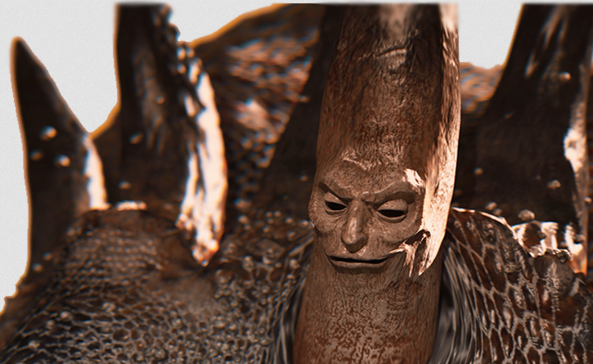

Slide 84
Dan 7:20 and the ten horns that were on its head, and the other horn which came up, before which three fell, namely, that horn which had eyes and a mouth which spoke pompous words (Rev 13:6), whose appearance was greater than his fellows. Dan 7:21 "I was watching; and the same horn was making war against the saints, and prevailing against them. (“War against saints” scriptures Rev 12:13-19, Rev 6:9-11, Rev 13:7-10, Rev 14:12-13, Rev 17:5-6,12-14, Rev 7:13-17, Dan 11:31-36, Dan 12:7-13 and Dan 7:8-27).

Slide 85
Dan 8:9 And out of one of them came a little horn which grew exceedingly great toward the south, toward the east, and toward the Glorious Land. Dan 8:10 And it grew up to the host of heaven; and it cast down some of the host and some of the stars to the ground, and trampled them. Dan 8:11 He even exalted himself as high as the Prince of the host; and by him the daily sacrifices were taken away, and the place of His sanctuary was cast down. Dan 8:12 Because of transgression, an army was given over to the horn to oppose the daily sacrifices; and he cast truth down to the ground. He did all this and prospered.

Slide 86
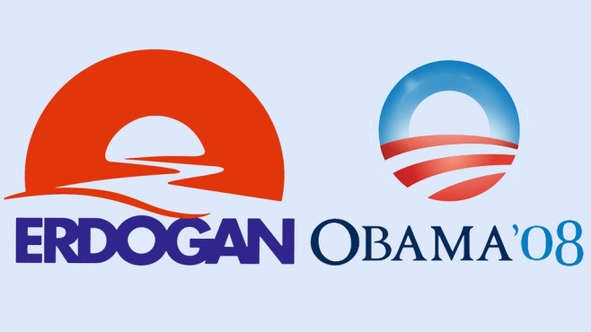
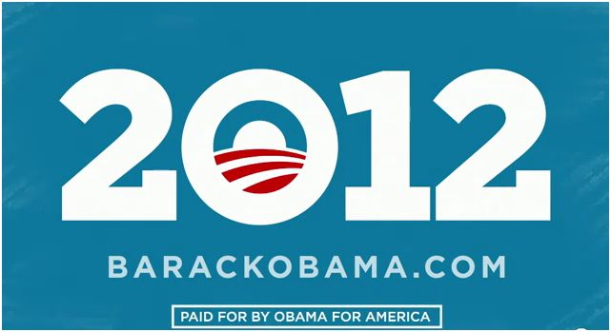
Erdogan’s slogan campaign for 2014 was similar to Obama’s slogan from 2008 and 2012 the sun from the east rising over the west. Erdogan officials have stated that the image represents the light at the end of the tunnel and the birth of a “New Turkey.” The Obama logo was created to represent a rising sun and the start of a new day under Obama. http://brennerbrief.com/the-logo-of-turkeys-future-president-is-both-familiar-and-sinister/

Slide 87
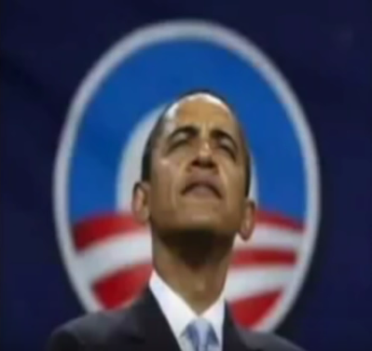

Slide 88
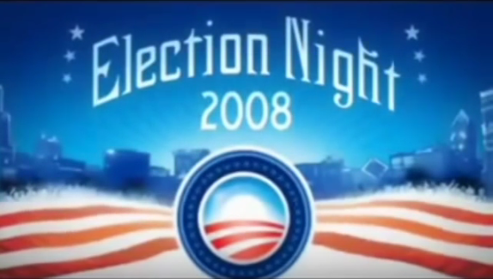

Slide 90
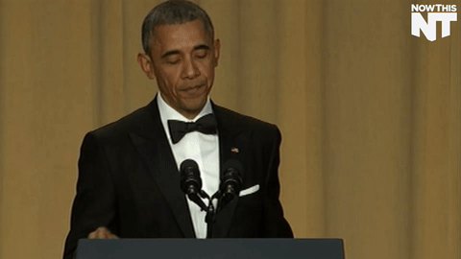

Slide 91
Since Obama came onto the world scene in 2009 23 major prophecies around the end times beast through out scripture have been fulfilled so far.

Slide 92
Odds of Prophecy around Christ being fulfilled As an example prophecy around the coming of Christ and the details of his coming were recorded in Micah 5:2 “Jesus would be born in Bethlehem” written 700 B.C. Or Isaiah 7:14 “Jesus would be born of a virgin” again 700 years before he was born. Or the prophecy made in 1012 B.C. that specified the Messiah's hands and feet would eventually be pierced, this is a clear reference to death by crucifixion. His hands and feet will be pierced (Ps 22:16; cf. Zech12:19 ; Gal 3:13) all this was 800 years before the Romans ever even instituted crucifixion as a form of capital punishment. There was an estimated 300 prophecies recorded from Christ’s birth to His death hundreds of years before He appeared on the world scene, all were fulfilled. The odds of any one man in all of history, fulfilling even eight of 60 major prophecies is incredibly huge, such as what has been fulfilled by Christ. The probability that Jesus of Nazareth could have fulfilled even eight such prophecies would be only 1 in 10¹⁷ Power, that's 1 in 100, 000, 000, 000, 000, 000 according to the mathematical experts. https://christiananswers.net/q-aiia/jesus-odds.html

Slide 93
Odds of prophecy around the end time Beast being fulfilled There are detailed prophecies about the last day “Beast antichrist” in the Book of Daniel, Ezekiel, Mathew and Revelations with over 20 major events and certain characteristics to be fulfilled by the “Beast” antichrist person. There are several prominent characteristics of the antichrist almost universally agreed upon by Bible Scholars that are found in scriptural passages. Any one man fulfilling prophecy written 3000 plus years ago are huge, “Barack Hussein Obama” has fulfilled many of these “Antichrist Beast” prophesies found in the Bible from 2009 onwards. Others who preceded Barrack Obama have had similar claims made about them but none have possessed such striking details of fulfillment. Just to fulfill 3 prophesies such as the “war against the saints” , “3 Horns ripped up” , “body of a Leopard ” , “advances the cause of his God” or “Beast from the the sea” in scripture as Christ did is 1 to the 12 power putting it into the 1 chance in a billionth. Obama has fulfilled 20 plus major traits, characteristics and events of the Beast all simultaneously taking place as seen in the presented research. The probability that Obama could have fulfilled even eight such prophecies would be 1 in 10¹⁷ Power also. That's 1 in 100, 000, 000, 000, 000, 000 the same odds as Christ pointing us to the last day end times.

