Slide 1
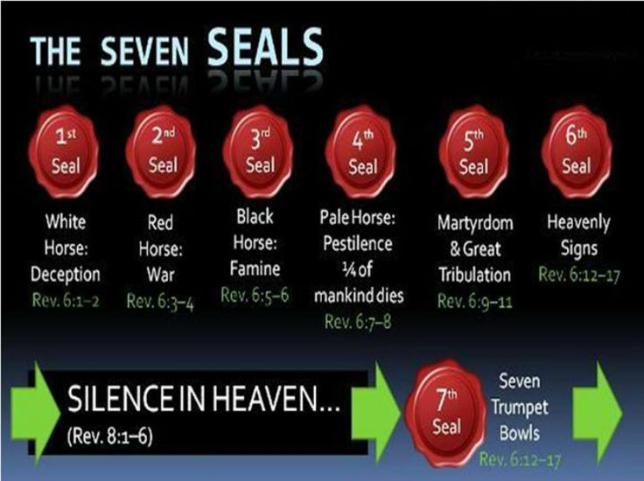

Slide 2
4th seal Pale horse released

Slide 3
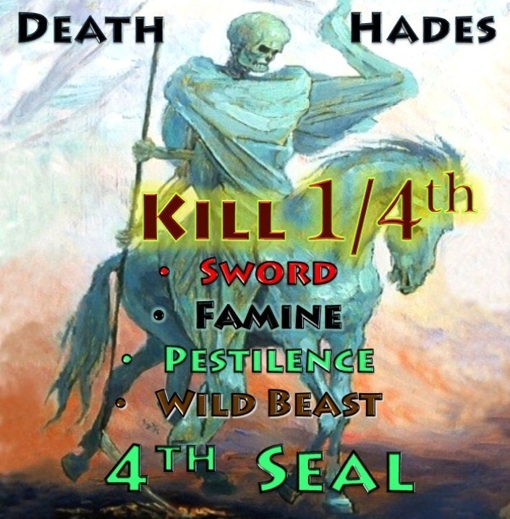

Slide 4
4th seal Pale horse of death followed by hell
Revelation 6:7-8
7And when he had opened the fourth seal, I heard the voice of the fourth beast say, Come and see. 8And I looked, and behold a pale horse: and his name that sat on him was Death, and Hell followed with him. And power was given unto them over the fourth part of the earth, to kill with sword, and with hunger, and with death, and with the beasts of the earth. (NKJV)

Slide 5
Death

Slide 6
Followed by Hell

Slide 7
This fourth seal of death followed by hell is released with the first 3 seals conquerer, peace removed and famine all released at the turn of the 19th century. This fourth seal death and hell is specifically over a quarter part of the earth (Middle East/Europe). It has a sword which is conflict and war it also kills with hunger, famine and starvation bringing death, Killing up to 300 million in the last 100 years. This has happened especially with WW1 and WW2 in Europe and the Middle East along with other conflicts and famine in the region with Africa, Turkey, Russia, Iran , Iraq, Afghanistan, Syria and Israel . The 6 Trumpets that affect the earth are all fulfilled in this region as well, all of the bowls are poured out upon all the Earth affecting many in this region and around the world.

Slide 8
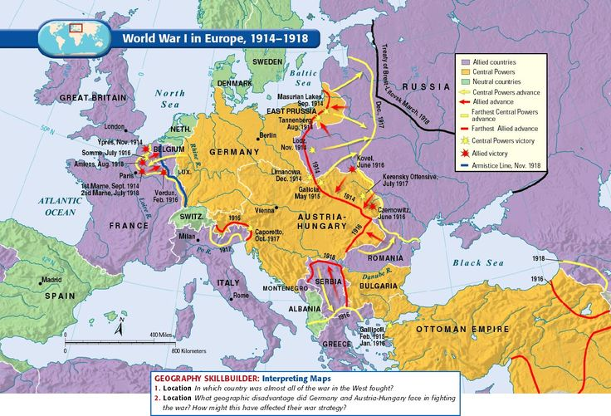
Map of WW1 the 1st Trumpet in Middle East /Europe region 1914-1918 up to 40 million plus Spanish flu of 50 to 120 million killed.

Slide 9
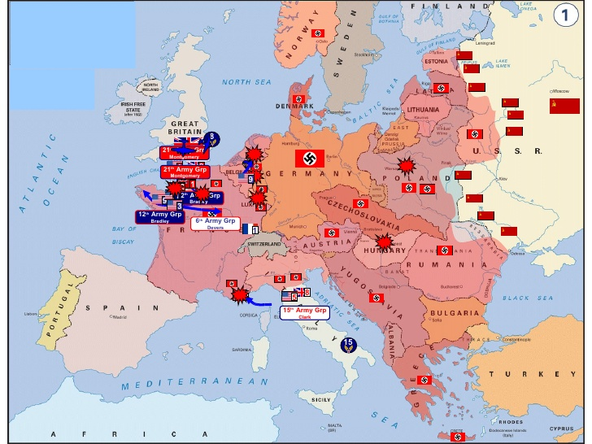
Map of WW2 the 2nd Trumpet in Middle East/Europe region 1939-1945 up to 70 million killed.

Slide 10
The fourth seal kills with the beasts of the Earth this refers to spiritual demonic beasts through man causing destruction, wars and conflicts . In Rev 13:1-18 you find the dragon beast this is the New World Order Holy Roman Empire elites . You have the antichrist beast of the earth and the false prophet beast of the sea which are both Islamic, unclean frog spirits come out of their mouths. In Rev 17:2,7-8 you find the wicked woman Jezebel the queen of Babylon riding the beast the Holy Roman Empire who the kings of the earth committed fornication with and are drunk with the wine of her fornication. In Rev 17:11 you find the 8th Pope king beast who was and is not who goes to perdition/destruction. All these beasts are on the earth now operating , destroying with deception and death. Muslims in the Middle East have a seven headed beast they refer to as Hezbollah, Boko Hiram, Isis, Hamas, Taliban, Al-Qaida and the Muslim Brotherhood. This is what is being used now to bring chaos to kill the saints by the Dragon beast. This is all heading towards the Acts 2:20 , Joel 2:31 “Great day of the Lord “ and His Rev 11:15 7th Trumpet wrath .

Slide 11
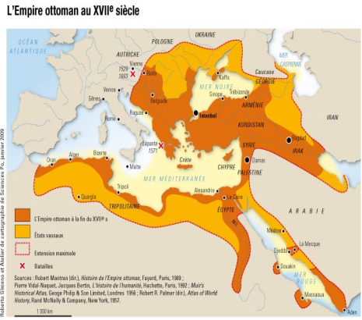
The Middle East Beast

Slide 12
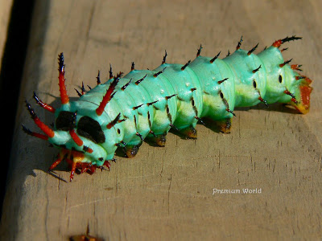
After 9/11 in 2001 A dream came that led to mass destruction. It was of President Bush just before the Iraq war the 5th Trumpet . In the dream I was in a kitchen with George W Bush he had in his hand a jar with a caterpillar in it , he was about to take off the lid to let the caterpillar out ,I said to him: “do you know that if you let that caterpillar out you will cause a release of destruction beyond belief to begin?” this was Jesus in me speaking. This was to do with the Middle east , George Bush just smiled at me and undid the jar lid letting out the caterpillar. The caterpillar is symbolic of destruction and death like the locust that eats and destroys everything. Since 9/11 that’s what we have seen in the Middle East region. Damascus is one of the oldest continually inhabited cities in the world of 120 square miles. Scripture says Damascus the capital of Syria will cease from being a city to be a ruinous heap this is now happening in our modern day; Isaiah 17:1, Iran is currently operating from this region. (Video)

Slide 13
Modern day Damascus

Slide 14
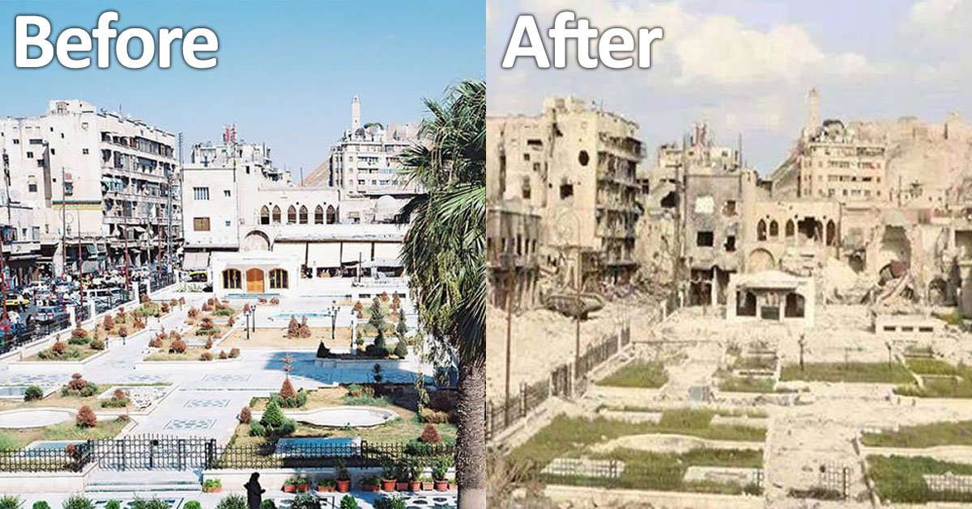

Slide 15
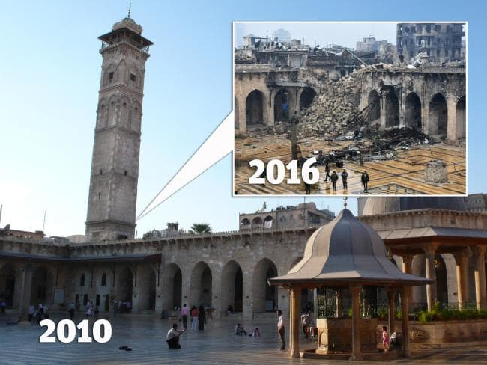
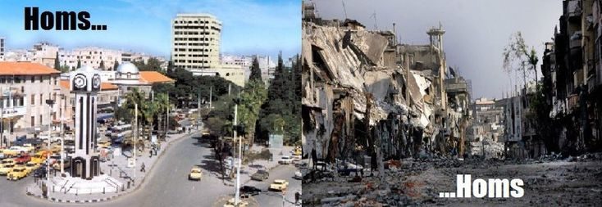

Slide 16
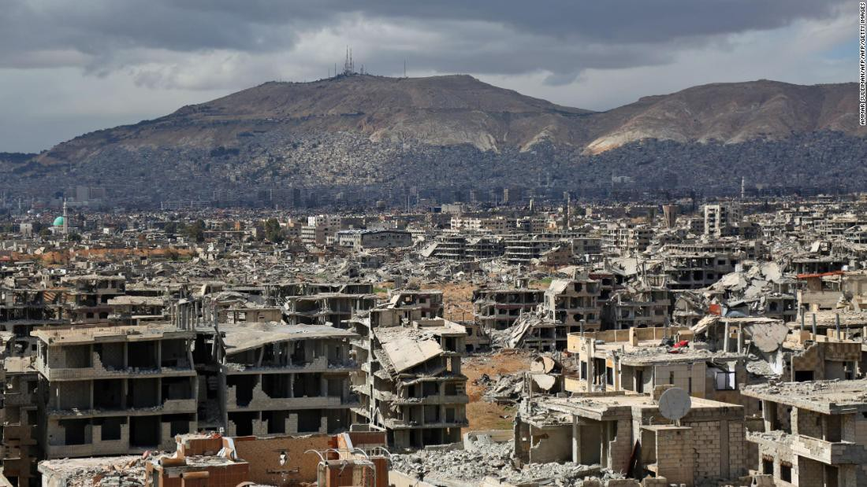

Slide 17
This Horse of death and hell is flexing its muscles once again walking upon the Earth destroying many in its pathway marching through the 4th, 5th and now the 6th Trumpet. On the 4.3.2015, A dream came during the 6th Trumpet, of a massive skeleton spirit of death (Death and Hell “The Destroyer”) it was 4 or 5 hundred feet high arising up out of the depths of hell onto the Earth out of a mountain, at first it was shackled and said “You can’t hold me down” then it stood up across the land (Earth) breaking the shackles and began to walk causing the earth to shake at each step it took. Every where it stepped destruction and death followed (Middle East). It had been shackled after WW1 and WW2 for a season the next major war is WW3 “Armageddon” Rev 16:16.

Slide 18
This fourth seal “Pale” horse in Greek is the word Kloros. This word is found 4 times in the New Testament. Three times it is translated as “green” and once as “pale”. You find it in Mark 6:39 (green grass), Rev 8:7 (green grass), Rev 9:4 (green thing) and Rev 6:7-8 (Pale Horse). Thayer’s Greek-English Lexicon (dictionary of Greek, Hebrew, Syriac or Arabic) redefines the word kloros as 1. green; 2. yellowish, PALE. (page 669, Thayer’s 19 printing, Zondervan, 1978). Liddell and Scott’s Greek Lexicon tells us (page 1995) the Greek word kloros means: 1. greenish yellow, pale green; 2. Generally PALE. So this Horse can also be called green and pale green. This is one of the main colours of Sunni and Shiite Muslims associated with paradise. The current Middle East region was created out of Ottoman territory after WW1 done by 1927, it ‘s in a fourth part a 1/4 of the earth in its geographical position part of the cotenant of Asia . This is exactly the region the 4th seal has power over a 1/4 of the earth. The Middle East is West Asia it extends into Egypt it has a population of 411 million. In 2019 it consisted of 17 countries that are all Islamic with the exception of Israel. All of Asia spans 17,139,445 square miles it is 29.1 percent of Earth’s total land mass population is 2.5 billion, a 3rd of Earths entire population. All of the nations named in Daniel, Ezekiel and Revelations are Middle Eastern.

Slide 19
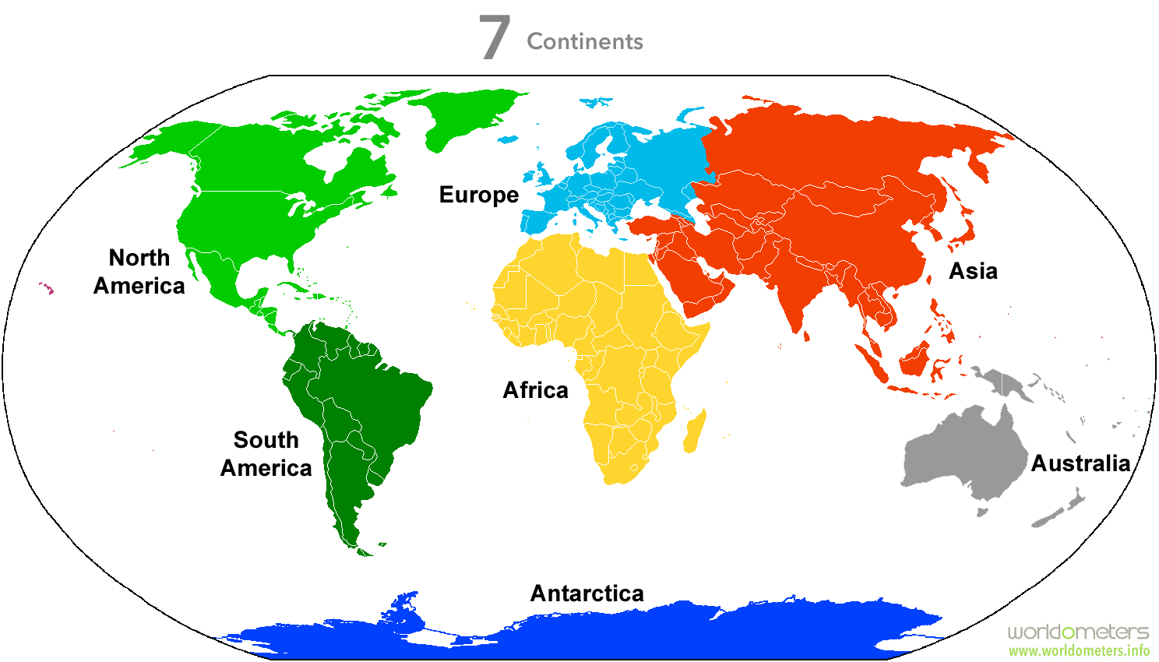
Continent of Asia

Slide 20
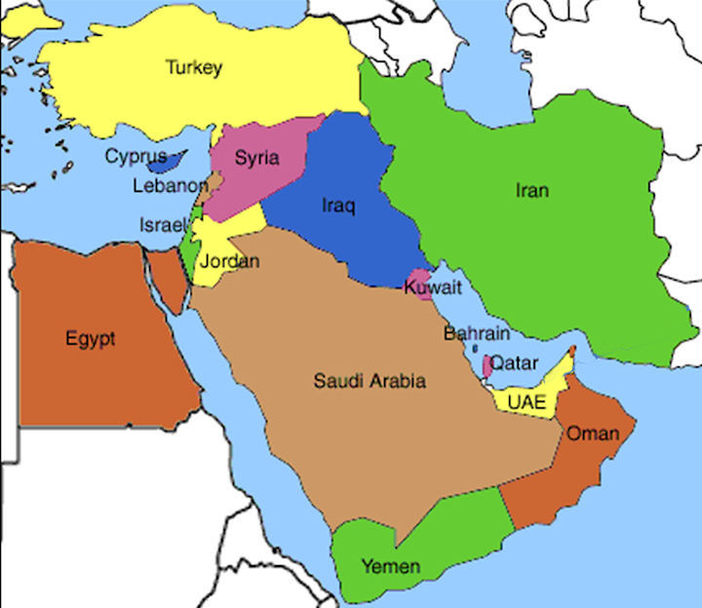
Middle East nations

Slide 23
