Slide 1
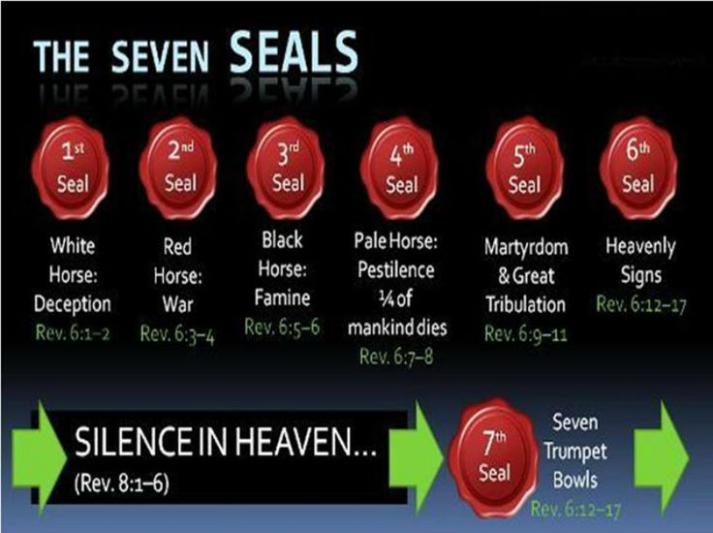

Slide 2
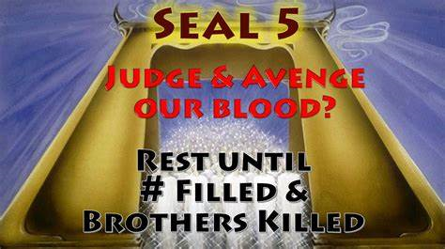

Slide 3
The 5th Seal “Cry of the Martyrs”
Rev 6: 9-11:
When He opened the fifth seal, I saw under the altar the souls of those who had been slain for the word of God and for the testimony which they held. ¹⁰ And they cried with a loud voice, saying, "How long, O Lord, holy and true, until You judge and avenge our blood on those who dwell on the earth?" ¹¹ Then a white robe was given to each of them; and it was said to them that they should rest a little while longer, until both the number of their fellow servants and their brethren, who would be killed as they were, was completed. (NKJV)

Slide 4
HOW THE APOSTLES DIED. 1. Matthew. Suffered martyrdom in Ethiopia, Killed by a sword wound. 2. Mark. Died in Alexandria, Egypt , after being dragged by Horses through the streets until he was dead. 3. Luke. Was hanged in Greece as a result of his tremendous Preaching to the lost. 4. John. Faced martyrdom when he was boiled in huge Basin of boiling oil In Rome. However, he was miraculously delivered From death. John was then sentenced to the mines on the prison Island of Patmos. He wrote his prophetic Book of Revelation on Patmos . The apostle John was later freed and returned to serve As Bishop of Edessa in modern Turkey . He died as an old man, the only apostle to die peacefully. 5. Peter. He was crucified upside down on an x shaped cross. According to church tradition it was because he told his tormentors that he felt unworthy to die In the same way that Jesus Christ had died.

Slide 5
6. James. The leader of the church in Jerusalem , was thrown a hundred feet down from the southeast pinnacle of the Temple when he refused to deny his faith in Christ. When they discovered that he survived the fall, his enemies beat James to death with a fuller's club. This was the same pinnacle where Satan had taken Jesus during the Temptation. 7. James the Son of Zebedee was a strong leader of the church, James was beheaded at Jerusalem. The Roman officer who guarded James watched amazed as James defended his faith at his trial. Later, the officer Walked beside James to the place of execution. Overcome by conviction, he declared his new faith to the judge and Knelt beside James to accept beheading as a Christian. 8. Bartholomew. Also known as Nathaniel. He Was a missionary to Asia. He witnessed for our Lord in present day Turkey. Bartholomew was martyred for his preaching in Armenia where he was flayed to death by a whip.

Slide 6
9. Andrew. He Was crucified on an x-shaped cross in Patras, Greece. After being whipped severely by seven soldiers they tied his body to the cross with cords to prolong his agonyHe continued to preach to his tormentors For two days until he expired. 10. Thomas. He Was stabbed with a spear in India during one of his missionary trips to establish the church in the Subcontinent. 11. Jude. He Was killed with arrows when he refused to deny his faith in Christ. 12. Matthias. The apostle chosen to replace the traitor Judas Iscariot. He was stoned and then beheaded. 13. Paul. He Was tortured and then beheaded by the evil Emperor Nero at Rome in A.D. 67. Paul endured a lengthy imprisonment, which allowed him to write his many epistles to the churches he had formed throughout the Roman Empire. These lettersform a large portion of the New Testament.

Slide 7
The earliest Old Testament martyr was Able killed by Cain 6000 years ago as found in Genesis 4:8 whose blood cried out to God for justice. Down through the generations only God knows those that were His killed for His sake. The cry of untold millions of martyrs is heard beneath Gods throne. Killings of spirit filled Christians began from the first Martyr born again believer Steven in 34 A.D , 2000 years ago. This was ordered by the Pharisees turning on their own brethren of the tribes of Israel who had become Christ followers loosing Saul upon them. The Romans later began killing Christians in great measure from 64 A.D with Emperor Nero falsely declaring Christians as the ones who burnt half of Rome down at the time (video).

Slide 8
Nero used Christians as human candles soaked in wax he lit on fire to brighten the night in his gardens. Christians were torn apart by dogs and thrown to lions they were crucified and impaled on spikes thousands lost their lives. All of the Apostles except John who wrote the book of revelations were eventually martyred they tried boiling John in oil but God protected him (video of man burned in Iraq). The Roman persecution came to an end 249 years later in 313 A.D with the “Treaty of Milan” legalising Christianity in Rome under “Constantine the great”, Constantinople would then become the Byzantine Christian Empire.

Slide 9
Persecution was set to start up again under the Roman Catholic Pope Vigilis who had been handed new papal powers in 538 A.D he began with inquisitions against Christians that refused to yield to the papacy. For the next thousand years persecution under the Holy Roman Empire was severe. A new wave of killing then increased in the 1500’s against the Protestants of Martin Luther’s reformation. Persecution from the Papacy in total went for a 1260 year period. This is believed to be the Rev 12:6,13-17; 1260 days seen as years historically until 1798 A.D, when Napoleons general arrested the last Holy Roman Emperor causing the inquisitions and killings to cease. Since the time of Christ 2000 years ago hundreds of millions of Christians have been martyred . Rome killed tens of thousands the Vatican martyred 50-70 million actual Protestants over 1260 years with estimates of up to 150 million people all together from other ethnic groups . Islam has killed millions with estimates of 669 million people targeting untold numbers of Christians and Jews over 1400 years along with other ethnics, since mid 610 A.D onwards .

Slide 10
In generations past and now modern times in this last century Christians are known to be the most persecuted people group around the world. In one research book called “The New Persecuted” by Author “I Nuovi Perseguitat” published in Rome in 2002, historic research found that 70 million Christians have been killed up until 2002 since Steven’s death (Acts 7:54-59) Steven was the first Martyr killed in 34 A.D. He determines that 24.5 million Christians were martyred over 2000 years from Steven’s death in 34 AD. (other authors estimate it at 50 million plus: see chapter 19B “The martyrs of the Vatican”). Then 45.5 million Christians martyred in the last 100 years, that’s 65% of all Christian murders throughout history taking place in the 19th century alone revealing an expediential increase in Christian martyrs. The 19th century 5 seals, 6 Trumpets and 6 bowls loosed.

Slide 11
Currently in over 60 nations there are up to 215 million Christians facing persecution around the world and it’s on the increase. Christians are the biggest group of people persecuted on the Earth and have been for generations. Nearly all of this persecution in our modern times is done by Muslims in Islamic nations in the Middle East, Africa, China, India and Asia with the exception of the North Koreans 60 year persecutions all on the increase now. 100 years ago Christians made up 20% of the Middle East populations today it is just 4% a genocide has been taking place in the region over 100 years ethnic religious cleansing. Why martyrs ? why has God allowed so many to be killed over the generations ? and now in out generations since the turn of the 19th century ? That’s a good question why is their cry heard beneath Gods throne ? Another good question I have shed tears over asking God why so many ? Then I heard a testimony that happened recently in Pakistan and I understood why.

Slide 12
2017 Testimony (Video) This testimony came recently on a U Tube video in Oct 2017 it was posted March 31st 2017. A woman was sharing how she had been with a group praying for Shiite Muslims to receive dreams from God for salvation. She then one day met another woman who she mentioned what they had been praying for. This woman then turned around and shared a true testimony that had happened recently in a Muslim dominated region. God asked a Pastor to move to a certain village in this Muslim nation to start up a church in the midst of the Muslims so he moved there in obedience. One night he had a knock on the door he opened the door and three Muslim men with balaclavas on grabbed him they shot him killing him. A little while later God spoke to another Pastor, God told him to go to this same village so he went he moved into the same flat/house to start a church. A short time later he too received a knock on the door he opened the door and three Muslim men with balaclavas on grabbed him and put a hood over his head and threw him into the back of a car. They then drove for awhile to a location and took him into a building then removed the hood over his head. He stood there in front of 900 Muslim men that man who removed the mask then said I killed the last pasta in that house.

Slide 13
This second Pasta then thought I am getting a public execution in front of all these men. The man speaking to him who had murdered the last Pasta then said the night we killed that Pasta all of us here in this room had the same dream we dreamt that the blood of that man was on our hands. God said He was going to send another man along to help us cleanse that blood from our hands and you are him. That night 900 Muslim leaders and men gave their hearts to Jesus and their families followed suit. See link: https://www.youtube.com/watch?v=I-AKaDHRUJM&feature=youtu.be

Slide 14
Dream March 2003. March 3rd 2003: A dream came prior to the Iraq invasion by the USA. A gold box was seen at the feet of God for “priority prayer” for the world and nations including Muslim nations. God prompted me to ask Him for souls I said “Lord I don’t know how many to ask for can You tell me the number ? ”. He then said “ask Me for 3 billion souls” (Rev 14:14-16 harvest to come). In this box were the treasures of God gems stones silver and gold representing people and nations. I was then awoken at 3.33 am and prayed for half an hour in His presence for mercy and grace upon the nations and the coming war and shaking of the world (6th trumpet war). That bloodshed and loss of life would be kept to a minimum. To see Babylon fall spiritually and to see Muslim strongholds crumble to allow salvation to flow for this harvest that Gods will is done for His Kingdom to come. (On March 3rd 2003 Muslims from around the world held massive prayer meetings to Allah at the time of this dream Muslims were not a worldwide terror problem as they are by 2017) (2 million Christians have been lost in the Middle East Iraq /Syria conflict with the Islamic Isis and Hezbollah “warring against the saints” from mid 2013 onwards).

Slide 15
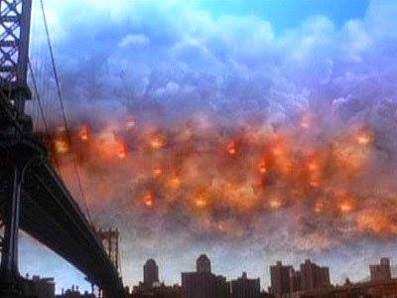
Vision 2011 : In 2011 a vision came at a prayer group meeting. In this vision Gods Glory fire was seen rolling across the Middle East (Arabs and Islam) with two white horse hooves in the front of the fire it was Jesus on His horse. What was seen was millions of Muslims on their mats worshipping Allah then they saw this Glory fire coming and their eyes were opened (like seeing a ghost) to the truth as this fire rolled over them they bowed down to it giving their lives to Christ. The odd person remained standing amongst them refusing to bow only to be burnt to a crisp by this fire. God then said “do not be concerned about Islam Ishmael will come back into the family in these days “, this lined up with the 2003 dream.

Slide 16
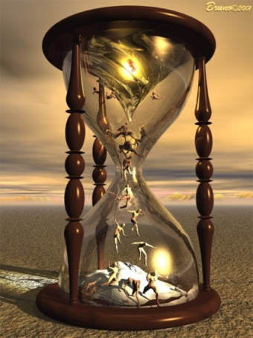
Vision 28.5.2015: From “My dreams of Book of Revelation” Saints (God)
Islam (Satan)

Slide 17
The Lord in a vision brought judgment against Islam. (August 16th 2014 dream of Isis defeat , then Trump becomes President Jan 2017 “Daniel 7:22” at the end of 42 months “warring against the saints”. Things turn heavily against Isis through Trump as a Christian President). Riders were seen on white horses of fire riding across the Earth burning everything in their path with “Holy Fire” (Joel 2 army). The enemy had to flee and run from this onslaught of grace mercy and love as millions came running to God and salvation (Rev 14:14-16 worldwide harvests coming). A great victory the blood of the saints had cried out to God and he answered , God was satisfied with the cry. There was a very clear vision of an egg timer hour glass with sand in it . At first on the top of the timer was written "Islam" (warring against the saints) and its sand (time) had nearly run out.

Slide 19
The Lord turned over the hour glass this time it had "Saints" written on the top of the timer (Daniel 7:22, 25-27, Dan 8:9-14) full of sand. God is about to give judgment and favor to the saints (to posses the kingdom on Earth) against what the enemy has being doing “warring against the saints” to them. The Lord said He was going to destroy Isis from Iraq to push them right out (This happened by November 2017 under Trump). Daniel 7:21: 22: “ "I kept looking, and that horn (Antichrist) was waging war with the saints and overpowering them until the Ancient of Days came and judgment was passed in favor of the saints of the Highest One, and the time arrived when the saints took possession of the kingdom. (November 8 ^{th} 2016 Trump wins presidential race against great odds Dan 7:22, he is a Christian surrounded by evangelicals , Jenetzin Franklin, Paula White ,David Jeremiah the antichrist kingdom got toppled in the USA it’s now ttme for Rev 14:14-16 harvest) (Video on next slide)

