Slide 2
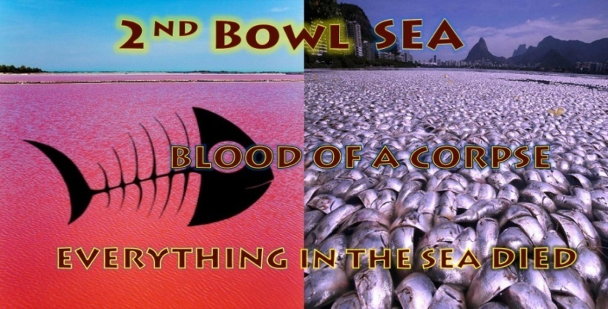

Slide 3
Bowl 2 “Rev 16:3”
Revelations 16:3
And the second angel poured out his vial upon the sea; and it became as the blood of a dead man: and every living soul died in the sea. (NKJV)
(Video)

Slide 4
Bowl 2 has been poured out in the Earth Fukushima 3 reactors blew up due to an earthquake and Tsunami, radiation waste began being poured into the Pacific Ocean a third of the world’s oceans. The Fukushima disaster happened at 2.46 pm on March 11, 2011 (2 years after “The Beast” Obama of Rev 13:10 appears on the world scene) . There were nuclear meltdowns and explosions at three of Fukushima Daiichi’s six reactors. 80 thousand people were evacuated never to return with a 24 km exclusion zone of radiation hot spots.,
Radiation has been pouring into the Pacific Ocean, at an estimated 300 tons per day. Prior to this accident scientist’s estimated dead sea life on the Pacific Ocean floor known as “sea snot” was at 1% annually. Since Fukushima the figure of dead animal sea snot has jumped to 98% the Pacific Ocean is slowly being radiated its dying from invisible radiation death . Like the blood of a dead man with no life left in it an invisible death. Japan estimates it will take 40 -100 years to clean up the Fukushima plant.
The flow of 300 tones of radiated water into the pacific cannot be stopped , it will continue indefinitely due to super heated temperatures caused from the reactor core melt downs. This will contaminate all life in the oceans. Tepco the Fukushima plant owners are partners with General Electric one of the largest companies in the world , owned bu the elite bankers as is most media stopping the information on this disaster getting out to the public . They can trace the radiation source by its fingerprint in this case Fukushima carries Cesium-137 and Strontium-90 contamination as has been found in fish species in American and Canadian waters. Information is being held back from the general public on Fukushima.

Slide 5
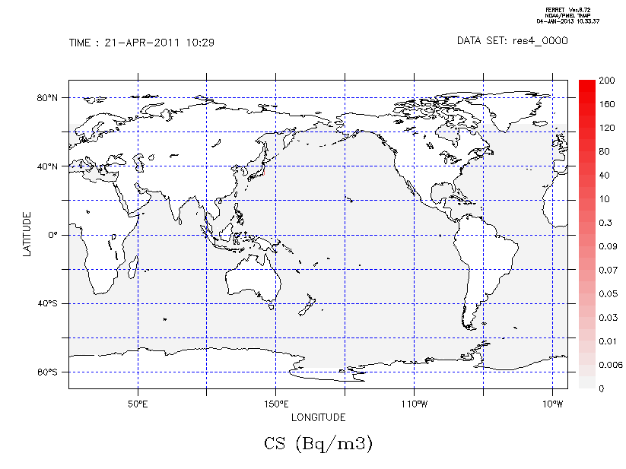
Fukushima Radiation 2011 - 2041

Slide 6
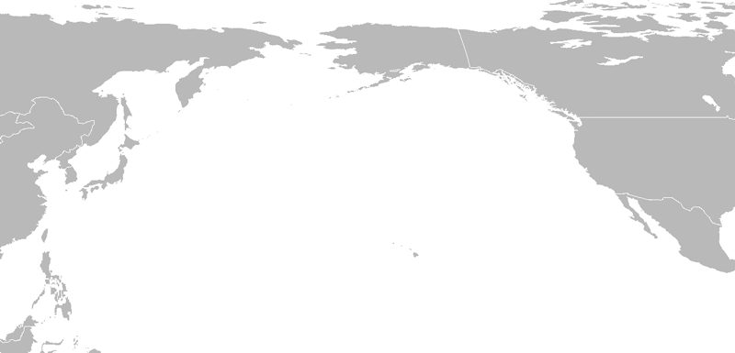

Slide 7
In April 2013 President Obama (The Rev 13 Beast) approved the increased acceptance of radiation in US food its food imports to 2000 milligrams. Then in 2015 he increased radiation levels in water for consumption from the current level to an increased level allowing long term public exposure to radiation as high as 2,000 milligrams as well. This would in effect, increase a longstanding 1 in 10,000 person cancer rate to a rate of 1 in 23 persons exposed over a 30-year period. No compelling justification is offered for increasing the cancer deaths of Americans innocently exposed to radiation. The EU and Canada have also approved radiation level increases for their populations . Imports from Japan have been rejected by China that have radiation levels that are unacceptable yet the USA and other nations have allowed higher radiation levels in food imports from Japan a TPPA partner. Thyroid cancer is a typical radiation cancer in humans. Thyroid cancer rates before Fukushima in Japan were 1 in 1 million as having it. In a report that came out by 2018 they had tested 44 thousand children in Japan , 14 thousand out of 44 thousand now have Thyroid cancer that’s 1 out of 3 children tested.

Slide 8
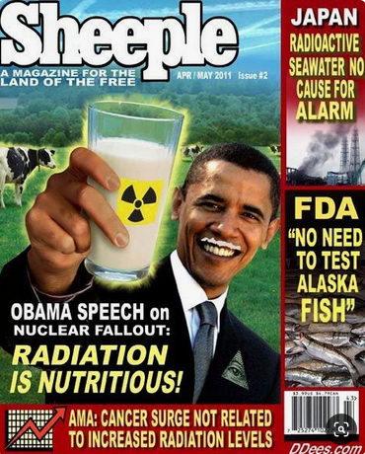

Slide 9
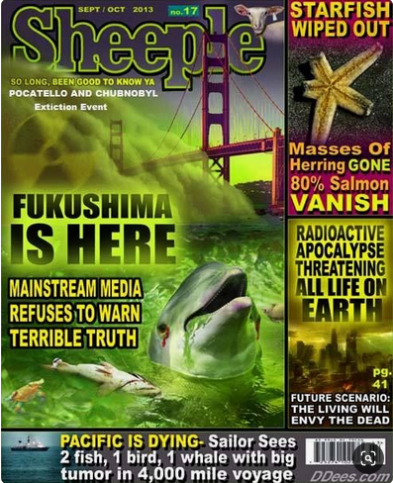

Slide 10
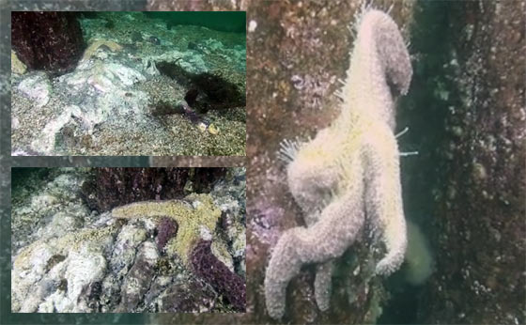
By 2013 thousands of starfish start dying in mass piling up on the sea floor along USA shorelines no one knows why fingers are being pointed at Fukushima. The following pictures are all from reports in regards to the Pacific ocean and Fukushima radiation affecting the sea life.

Slide 11
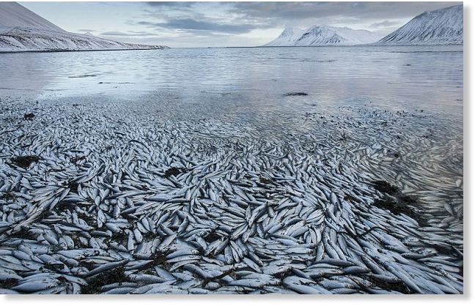
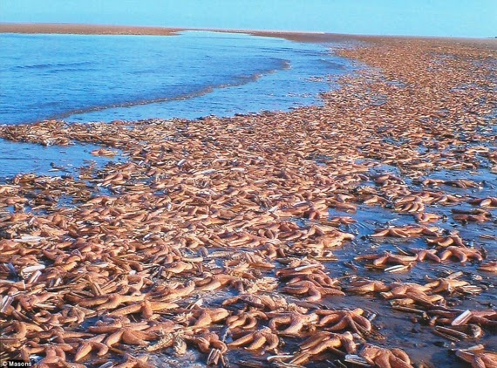
2014 mass die offs of US west coast sea life begin to be reported such as fish and starfish yet it is swept aside. As unimportant.

Slide 12
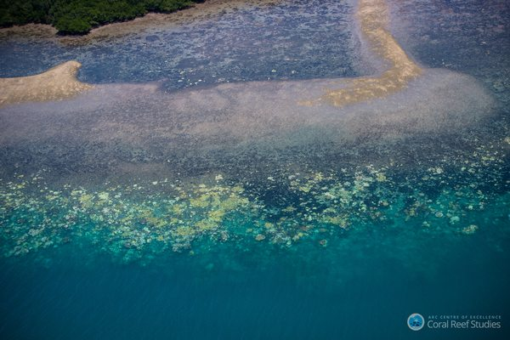
In 2014 Worldwide scientists reported mass animal die offs instead of 50 or so die offs reported a year it is now 50 mass die offs a month with fish , species of birds, crabs, seals, cuttlefish, whales, dolphins, turtles, starfish and most sea life in large numbers being found dead. In Australia in 2016 reports came in of barrier mass die offs, it hasn’t been proven yet exactly what is killing off the Great Barrier reefs (50% gone/dead) at an accelerated rate, 1800 miles worth a natural wonder of the world is now dying they say it could be completely be gone over the next few years. Up to 520 reefs have been affected turning white bleached as they die. Barrier reef coral fish have been found with similar radiation cancers found in fish along the US coast the same cancers as what humans get from radiation poisoning.

Slide 13
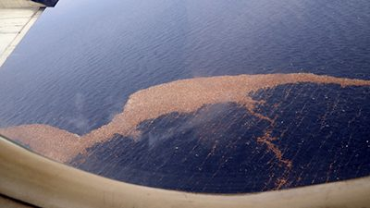
In 2016 Radioactive Debris from Fukushima approaching North America’s western coast was detected.

Slide 14
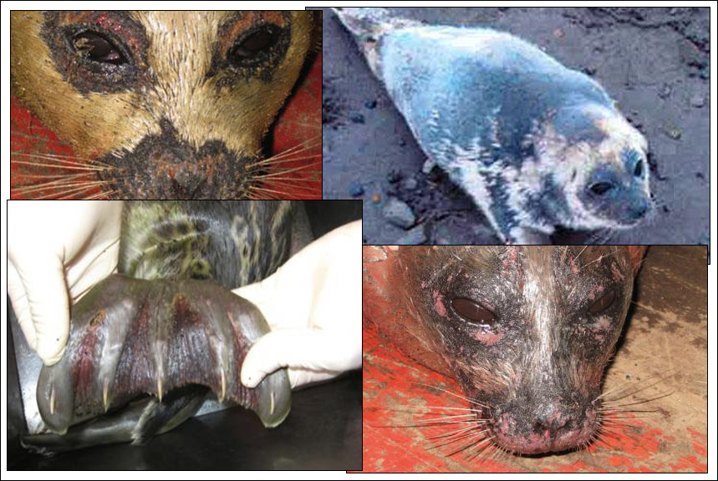
In Alaska it is reported that a large number of polar bears, seals and walruses have experienced hair loss and sores along with mass bird die offs. Fish all over the Pacific are being found with cancerous sores and tumors in their flesh.

Slide 15
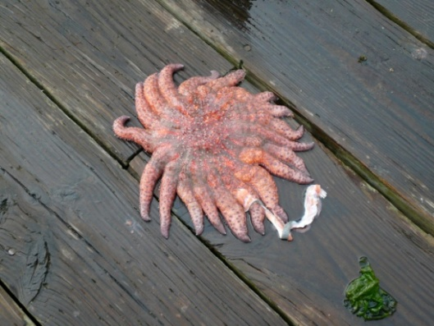
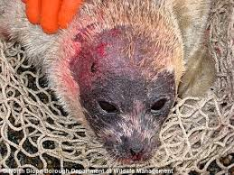
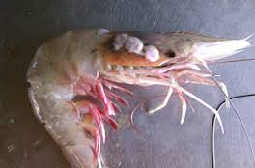
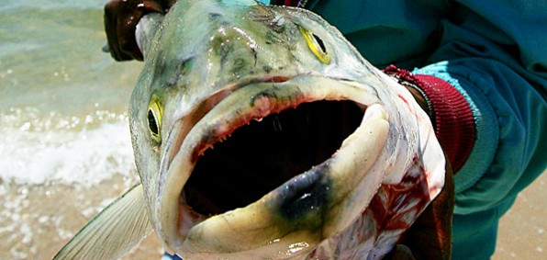
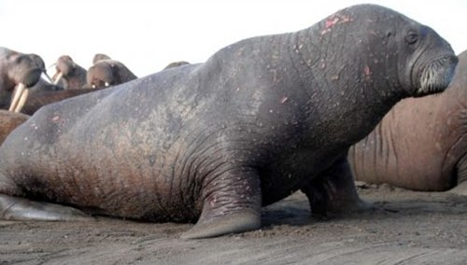
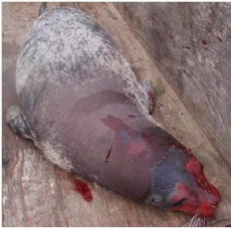

Slide 16
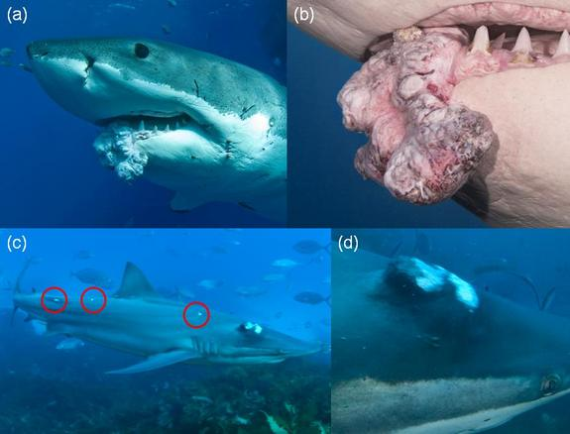

Slide 17
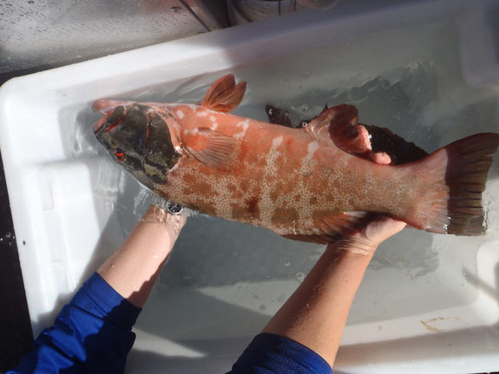
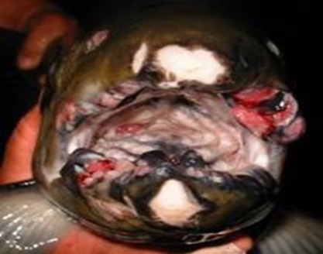
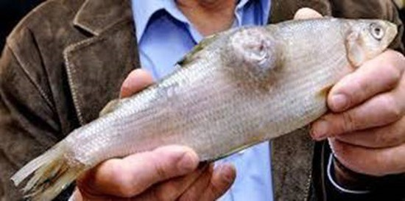
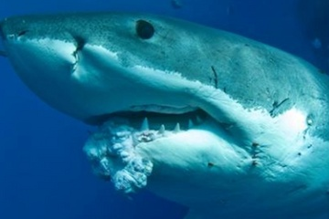

Slide 18
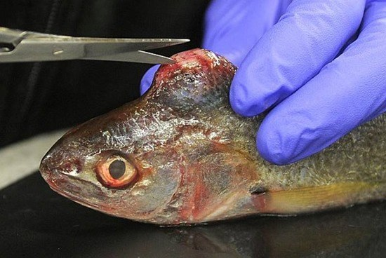
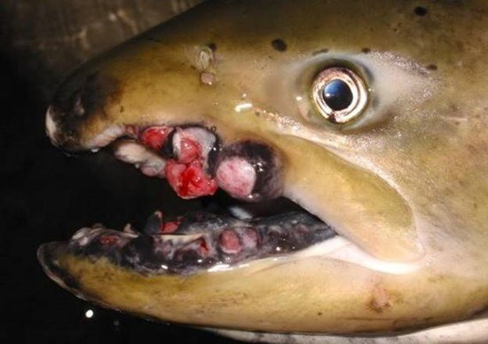
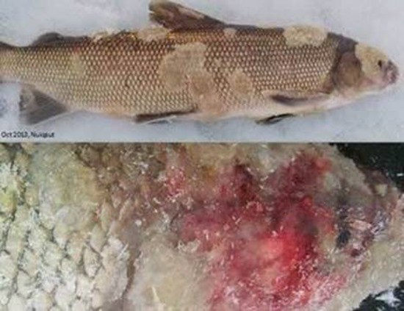
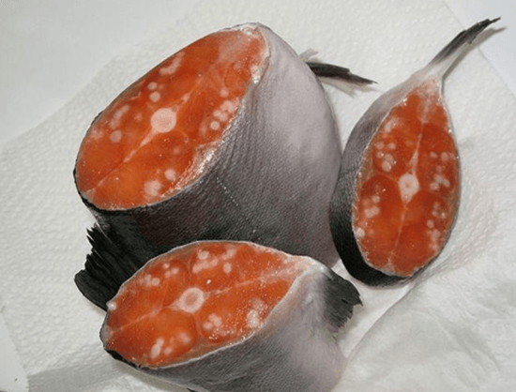

Slide 19
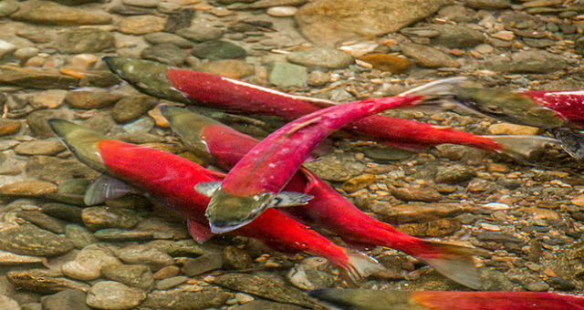
In 2016 the first pictures of Radioactive salmon discovered in British Columbia, Canada have emerged. The first pictures of Radioactive salmon discovered in British Columbia, Canada have emerged. A group of research scientists from the University of Victoria made the discovery recently not long after it had also emerged that Fukushima had contaminated over a third of the world's oceans. Seaborne Cesium 123, which is said to be the indicator of nuclear contamination from Fukushima has been detected on the West coast of the US.

Slide 20
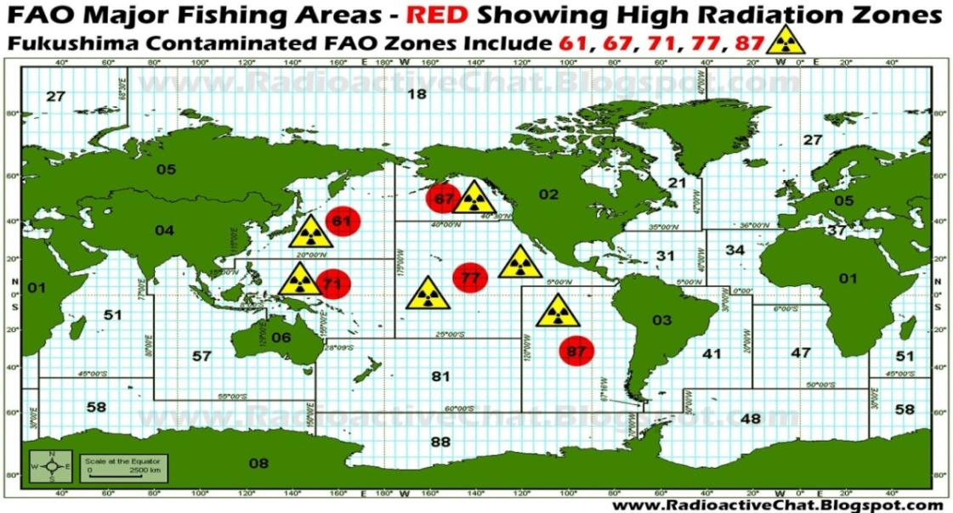
Radiation from Fukushima has been found in Tuna and Kelp and other sea life along the west coast off the US coast, Alaska and Canada, it is also detectable at very strong levels all around Japan and up to 400miles (800kms) miles out into the Pacific from Japan. The Fukushima nuclear contamination into the earths ocean is said to be 100 times worse in comparison to the Chernobyl nuclear disaster in Ukraine in 1987. The Pacific Ocean north and south is one of five world oceans it is the largest and covers the largest geographical area on earth at 35% coverage that’s one third of the worlds ocean coverage this is the 2nd bowl worldwide event of revelations 16:3.

Slide 21
It is predicted that over the next few years mass die offs will continue to occur in the Pacific Ocean affecting the food chain worldwide. It has been reported that whales have been seen in the pacific with massive tumors along with seals with cancerous soars and skin lesions on their bodies. Mass die offs of sea life are occurring around the Pacific Rim baffling scientists of the cause since the Fukushima disaster in 2011. All Tuna tested off the west coast of the USA and other sea life such as the Californian kelp beds have been tested and found positive with High readings of the Fukushima radiation signature. Radiation levels in 2019 have been the highest recorded yet at the Fukushima plant. Radiation from each nuclear blast or accident can be identified through its own signature. There have been many US nuclear tests performed in the Pacific Ocean region releasing radiation over the years. Along with all this going on massive floating islands of rubbish with piles of plastics and contaminates in the oceans have been recorded that go for miles in length. There is also the ongoing problem of radioactive dumps contaminants being released as well as chemical weapons, and millions of tones of munitions dumped into the oceans all around the world from both WW1 and WW2, now leaking into the oceans. The oceans are dying killed off by mans greed, wars and now with nuclear technology.

Slide 22
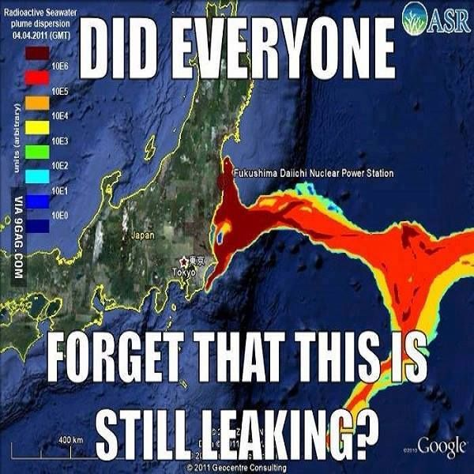
Media blackout of Fukushima

Slide 23
