Slide 1
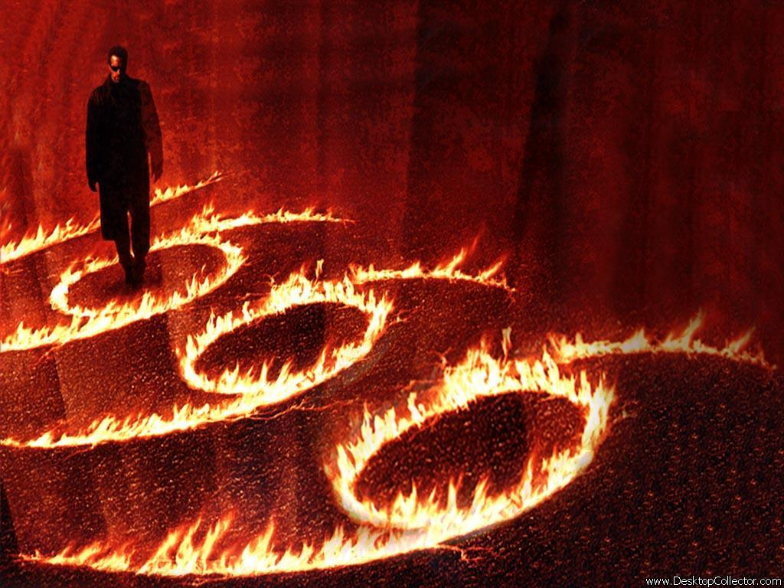
Mark of the beast

Slide 2
Rev 13:11-18 “The Second Beast” Then I saw another beast coming up out of the earth, and he had two horns like a lamb and spoke like a dragon. And he exercises all the authority of the first beast in his presence, and causes the earth and those who dwell in it to worship the first beast, whose deadly wound was healed. He performs great signs, so that he even makes fire come down from heaven on the earth in the sight of men. And he deceives those who dwell on the earth by those signs which he was granted to do in the sight of the beast, telling those who dwell on the earth to make an image to the beast who was wounded by the sword and lived.

Slide 3
He was granted power to give breath to the image of the beast, that the image of the beast should both speak and cause as many as would not worship the image of the beast to be killed. He causes all, both small and great, rich and poor, free and slave, to receive a mark on their right hand or on their foreheads, and that no one may buy or sell except one who has the mark or the name of the beast, or the number of his name. Here is wisdom. Let him who has understanding calculate the number of the beast, for it is the number of a man: His number is 666.

Slide 4
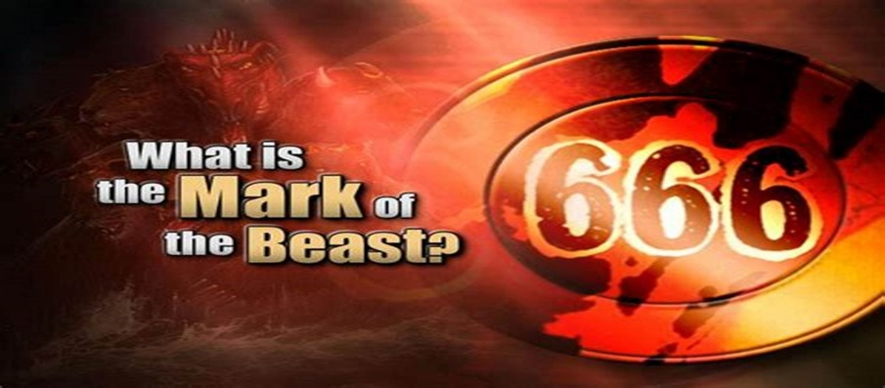

Slide 5
The Meaning of Numbers: The Number 6 In the Bible, the number 6 symbolizes man and human weakness, the evils of Satan and the manifestation of sin. Man was created on the sixth day. Men are appointed 6 days to labour. A Hebrew slave was to serve six years and be released in the 7th year. Six years were appointed for the land to be sown and harvested. The bringing together of three 6's is the number and mark of the beast of Revelation. As such, it represents the system of governance that mankind can produce without God. Man's system on earth is made up of three parts (economic, religious and governmental) all of which are influenced and led by Satan. The 666 represents the rebellion of man against God. https://www.biblestudy.org/bibleref/meaning-of-numbers-in-bible/6.html

Slide 6
The Meaning of Numbers: The Number 7 Used 735 times (54 times in the book of revelation alone), the number 7 is the foundation of God's word. Seven is the number of completeness and perfection (both physical and spiritual). It derives much of its meaning from being tied directly to God's creation of all things. The word 'created' is used 7 times describing God's creative work (Genesis 1:1, 21, 27 three times; 2:3; 2:4). There are 7 days in a week and God’s Sabbath is on the 7th day. The Bible, as a whole, was originally divided into 7 major divisions. They are 1) the Law; 2) the Prophets; 3) the Writings, or Psalms; 4) the Gospels and Acts; 5) the General Epistles; 6) the Epistles of Paul; and 7) the book of Revelation. The total number of originally inspired books was forty-nine, or 7 x 7, demonstrating the absolute perfection of the Word of God. https://www.biblestudy.org/bibleref/meaning-of-numbers-in-bible/7.html

Slide 7
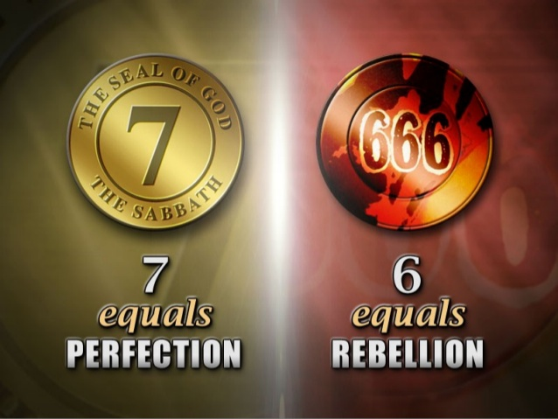

Slide 8
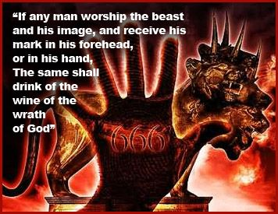

Slide 9
The Mark of the beast is firstly worldwide all who are unsaved are under the dragon beast spirit and authority they are against Christ “antichrist” marked until saved. We are all born into the beast and its mark spiritually, this has been so since Adam and Eve fell in the garden of Eden. Rev 13:8 All who dwell on the earth will worship him (the Rev 13 beast is not 6000 years old but Satan is), whose names have not been written in the Book of Life of the Lamb slain from the foundation of the world. Why is the mark on the forehead or right arm/hand ? The head speaks of authority rulership and spiritual dominion Col 2:10, 1 Pet 2:13-17, Rom 13:1-2. The Lord makes His children the head not the tail; Duet 28:13. God gave Adam dominion over all the Earth Gen 1:26. The right hand and arm speak of the authority and strength of God “His strong hand”; Is 62:8, Ps 20:6, Rom 8:34, Math 28:18. The right hand speaks of mans works as well his sin . Math 8:20: Jesus said "Foxes have holes and birds of the air have nests, but the Son of Man has nowhere to lay His head." His head speaks of His authority . He had no where to lay His head His authority until He died on the cross and was resurrected then He loosed the Holy Spirit into those being saved, marking them with Himself His name and authority as the head of the church.

Slide 10
Rev 22:4 They shall see His face, and His name shall be on their foreheads. Rev 14:1 Then I looked, and behold, a Lamb standing on Mount Zion, and with Him one hundred and forty-four thousand, having His Father's name written on their foreheads. At the cross Jesus defeated sin and Satan. Jesus crushed the serpents head Gen 3:15, Satan lost the stolen spiritual authority he had taken from Adam and Eve. Jesus was victorious forever He has called us into that victory to overcome Satan to be victorious 1 Jn 2:14, 1 Jn 4:4, we now have authority in Christ. Satan had no power no authority in himself to curse the Earth he was a created spirit created by God who is spirit . God gave Adam dominion over the Earth through a created fleshy body filled with a Spirit. Satan had to go through Adam and Eve (Gen 3:14-19) he entered them he stole the authority God gave them in Eden (Gen 2). Satan the dragon beast needed a fleshy body to have dominion in the Earth “Adams”.

Slide 11
The beast nature started with iniquity of heart and pride leading to the rebellion of Lucifer in heaven Is 14:12-20. (Video) A mark because of sin first came upon man after the fall in Eden. You had Cain who’s countenance had fallen because of anger he killed Abel he became cursed. Cain then went out from the presence of the Lord and caused God to set a mark on him Gen 4:6-15. The beast in the religion of the false prophet has a number of his name a mark and a name . The false prophet causes people to receive it, that’s 3 ways it appears in the natural realm . Rev 13:17 And that no one may buy or sell except one who has the mark or the name of the beast, or the number of his name. When salvation in Christ comes to a person the head or authority of the beast is then cut off. Hab 3:13 You went forth for the salvation of Your people, For salvation with Your Anointed (Christ). You struck the head from the house of the wicked, By laying bare from foundation to neck.

Slide 12
When saved from the beasts mark , you move from one spiritual authority to the next , from Satan to Christ , a new creation in Christ. 2Co 5:17 Therefore, if anyone is in Christ, he is a new creation; old things have passed away; behold, all things have become new. The Lord in these end times will come with fire and destroy the wicked who keep the beasts mark, who refuse salvation at His return. Isa 30:27 -28 Behold, the name of the LORD comes from afar, Burning with His anger, And His burden is heavy; His lips are full of indignation, And His tongue like a devouring fire. His breath is like an overflowing stream, Which reaches up to the neck, To sift the nations with the sieve of futility. Psa 145:20 The LORD preserves all who love Him, But all the wicked He will destroy. 2Pe 3:7 But the heavens and the earth which are now preserved by the same word, are reserved for fire until the day of judgment and perdition of ungodly men.

Slide 13
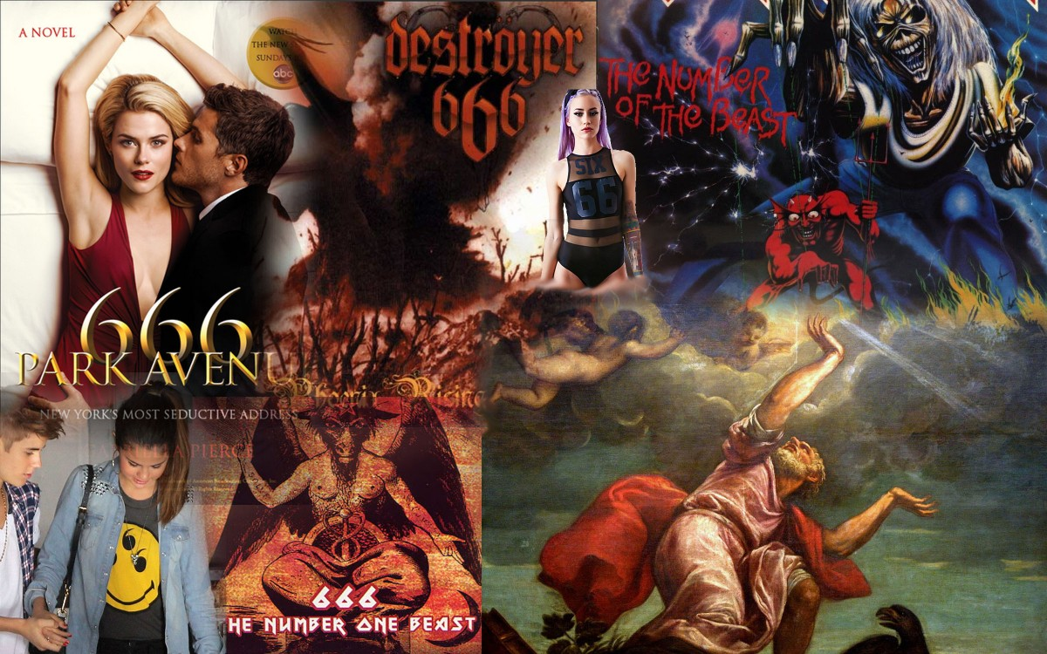
The Beast’s mark is worldwide in place of or against Christ it’s the mark of sin.

Slide 14
THE FALSE PROPHETS MARK OF END TIMES The False prophet is Erdagon of Turkey he rules the country of the Old Ottoman Empire (WW1, 1st Trumpet) Erdagon is Sunni Muslim Brotherhood. Erdagon directly rules over 85 million in Turkey and has great influence over 1.7 billion Muslims in the Middle East and around the world. Erdagon is returning Turkey to Sharia law where you can’t buy or sell unless you are Muslim. He unveiled the statue Image in June 2017 outside his Ottoman styled $600 million dollar palace a statue of the Ottoman Beast the wounded head found in Rev 13, the beast with 7 heads. He called his followers to give allegiance to the Statue and himself declaring he will be -head and kill his enemies to shouts of praise. He then oversaw and built Turkeys biggest Mosque the Camlica seating 64’000 opening it in 2019. The Camlica Mosque sits right next to his palace and statue image giving it a voice , with the Muslim call to Allah 5x per day over loud speakers being heard for miles.

Slide 15
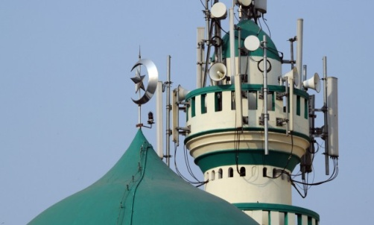
The voice of the image

Slide 16
In the portion of scripture Rev 13:11-18, the mark the number and name of the beast the False prophet causes the people to take is Islamic, as Erdagon is a Muslim under the Islamic religion and so is the antichrist. This is a natural out workings of what's operating in the Spirit realms . Eph 6:12 For we do not wrestle against flesh and blood, but against principalities, against powers, against the rulers of the darkness of this age, against spiritual hosts of wickedness in the heavenly places. This beast spirit is generational and worldwide it is in place of or against Christ in all false religions and beliefs. If you are not saved you have the mark of the beast. Yet in end times prophecy there is a specific outworking of this mark of the beast that’s physically seen. We have begun to see this recently through the Beasts seat of power at the United Nations made up of one third Islamic nations, the world is now bowing to Islam. The new 2019 “UN Global migration pact” will see the spread of Islam in great measure, 167 nations signed it.

Slide 17
More mosques are now being built around the world than churches. Churches are being converted into mosques. Islam is the largest religion in the world, it is a militant religion of war that has raged, been angry with Jihad many times (Cain). Islam in 1500 years has killed more than 669 million people this is not a religion of peace as they try to tell you. It is Islamic militant terrorists that the Rev 13 first beast used to “War against the saints” for 42 months destroying 2.2. million from Iraq and Syria in the lands of Abraham. The false prophet causes the earth and those who dwell in it to worship the beast Islam. Erdagon head of the OIC along with many Muslim nations are pressuring the UN to accelerate its efforts to combat anti Muslim trends to declare Islamphobia a form of racism. For nations to take institutional measures on media platforms creating anti “Islamphobia “ laws. They think this will be the right thing to do, this will become the mark of the beast law that will come to be enforced by governments, submission to the wounded head of the beast and its image. This has been accelerated from the Muslim shooting in NZ from March of 2019 (Video). (Video)

Slide 18
This all shows us what this end times mark under the false prophet (Muslim) actually is its “Islam” its “Sharia law” being set up in cities all around the world. Islam is the blasphemous name on the Rev 13 beasts (Muslim) 7 heads (G7, UNIDIR) with 10 horns (Club of Rome, NAFTA, UN) and the ten crowns (Obama a Muslim and TPPA). Islam is the religion of the Rev 13 first beast that blasphemes God. The saints of God are warred against beheaded by Islam the only religion on earth that beheads people for their false God. The mark of the wounded head of the beast the false prophet causes people to bow to take in the natural is “Islamic”.

Slide 19
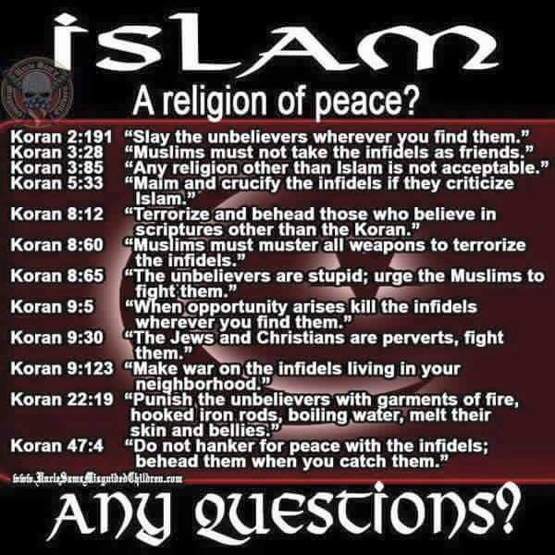

Slide 20
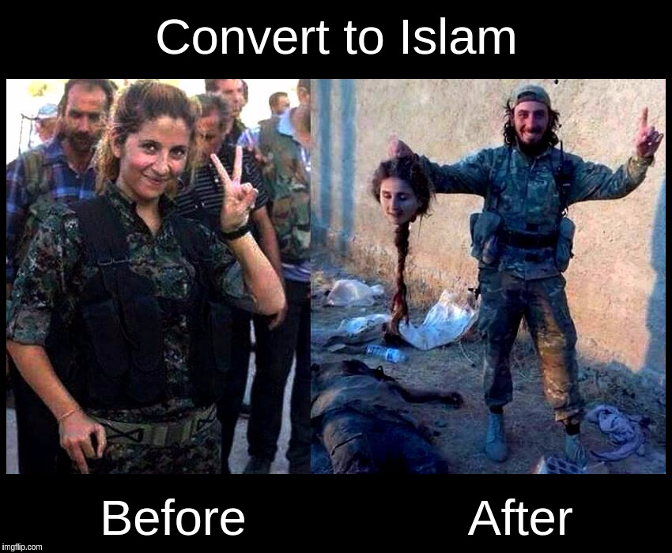

Slide 22
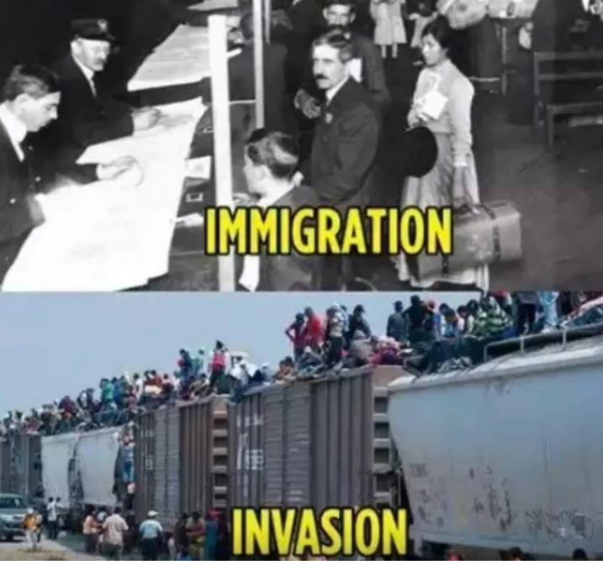
UN Global immigration invasion of nations by Islam

Slide 23
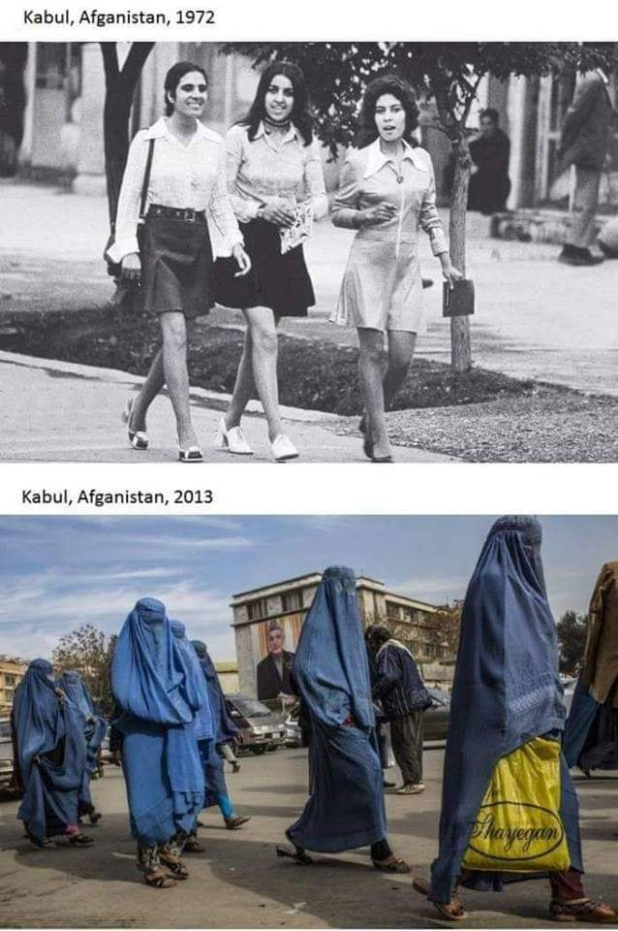
An example of the mark of the beast in Islam

Slide 24
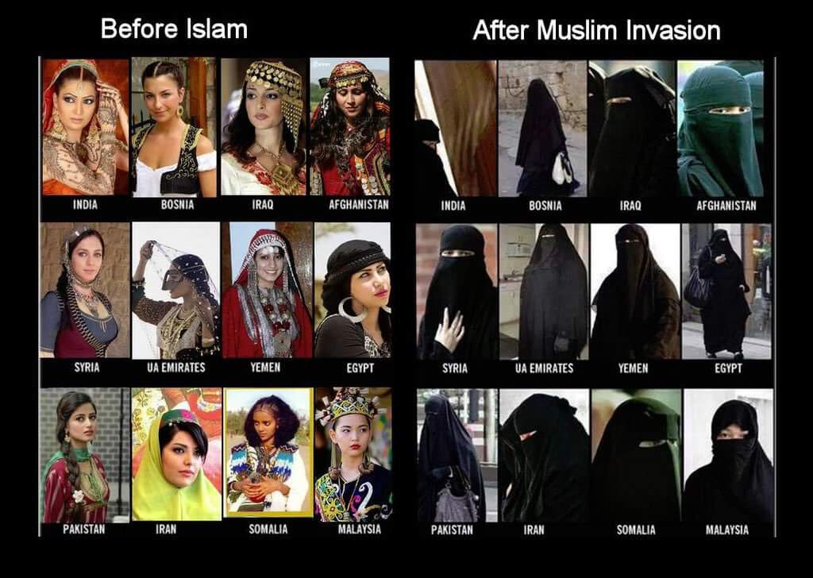

Slide 25
Rev 20:4 And I saw thrones, and they sat on them, and judgment was committed to them. Then I saw the souls of those who had been beheaded for their witness to Jesus and for the word of God, who had not worshiped the beast or his image, and had not received his mark on their foreheads or on their hands. And they lived and reigned with Christ for a thousand years. Beheading is only done by the beasts religion of Islam in the end times.

Slide 26
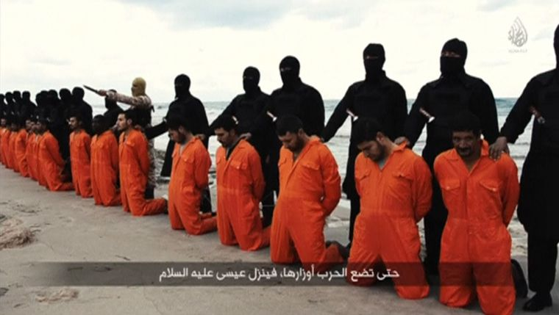
Christians being beheaded by (Isis) the beasts army in end the times “war against the saints”.

Slide 27
A Great Multitude from Every Nation Rev 7:9-17 After these things I looked, and behold, a great multitude which no one could number, of all nations, tribes, peoples, and tongues, standing before the throne and before the Lamb, clothed with white robes, with palm branches in their hands, and crying out with a loud voice, saying, "Salvation belongs to our God who sits on the throne, and to the Lamb!" All the angels stood around the throne and the elders and the four living creatures, and fell on their faces before the throne and worshiped God, saying: "Amen! Blessing and glory and wisdom, Thanksgiving and honor and power and might, Be to our God forever and ever. Amen."

Slide 28
Then one of the elders answered, saying to me, "Who are these arrayed in white robes, and where did they come from?" And I said to him, "Sir, you know." So he said to me, "These are the ones who come out of the great tribulation, and washed their robes and made them white in the blood of the Lamb. Therefore they are before the throne of God, and serve Him day and night in His temple. And He who sits on the throne will dwell among them. They shall neither hunger anymore nor thirst anymore; the sun shall not strike them, nor any heat; for the Lamb who is in the midst of the throne will shepherd them and lead them to living fountains of waters. And God will wipe away every tear from their eyes."

Slide 29
End times martyrs killed in the countries of the world persecuting the saints by mainly Muslims. 200 million Christians under direct persecution in 160 nations.

Slide 30
What the mark of the beast is not in this passage of scripture under the false prophet.

Slide 32
This is not the mark of the beast under the false prophet as taught by futurists.

Slide 33
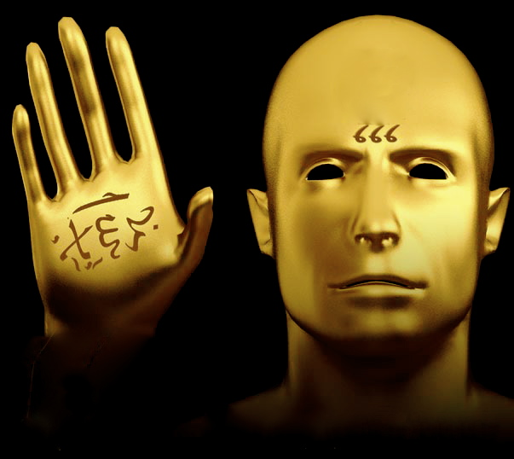
This is what the mark of the beast is, manifested in the natural from the spiritual in end times. The false prophet a Muslim, causes people to worship the image of the beast who was wounded by the sword (War) to receive its mark to bow down to this image and its authority/power/religion.

Slide 34
Since the Christchurch shooting in a mosque killing 55 Muslims in New Zealand in March of 2019. The OIC “Organization of Islamic Cooperation and Unity” of 57 state Islamic nations with 1.8 billion people has pushed an agenda at the United nations. This agenda is to do with what is referred to as “Islamphobia” anti Muslim hate speech. They want controls and management put in place on social media platforms all over the world taking away free speech. They want to use the UN the power seat of the beast to restrict and control nations, by Islam bringing in new international laws on calls of racism against Islam. This is so no one can speak against Islam worldwide the nations are to bow to Islam. This is interesting because Islam is not a race it’s a religion. Islam makes up one third of the UN pressure is now being put upon the UN to do something. The New Zealand prime minister is also pushing this agenda along with Pakistan. The one heading up the OIC on this is Erdagon of Turkey the false prophet that causes people under his direct control (85 million in Turkey alone) to receive the mark and worship the beast of “Islam” to bow down to it. We are seeing a law of the mark of the beast 666 being pushed at the UN over 200 nations in 2019. The OIC is also part of the UN under “UNIDIR ” a UN anti hate speech and gun disarmament organisation.

Slide 35
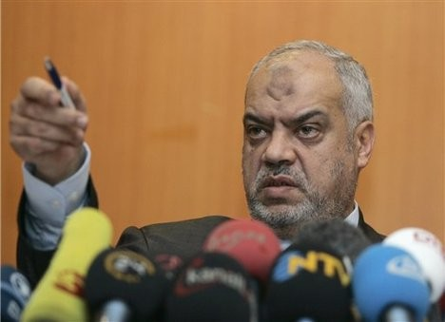
Now lets go through the Islamic mark of the beast under the false prophet. Mark of beast on hand of forehead This specific mark is under the false prophet and his religion. Strangely many devout Muslims that bow five times a day to Allah in prayer actually end up with permanent marks on their foreheads.

Slide 36
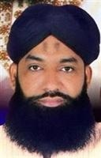
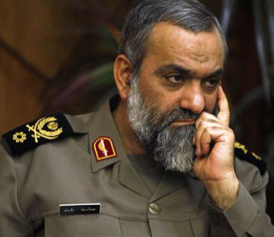
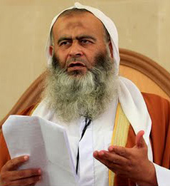
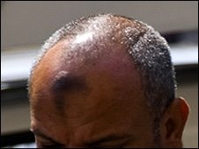
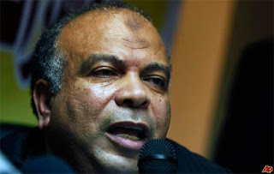

Slide 37
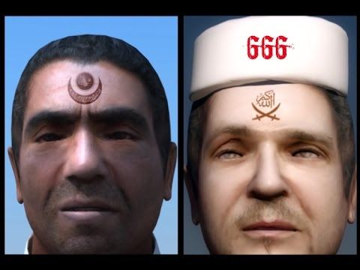
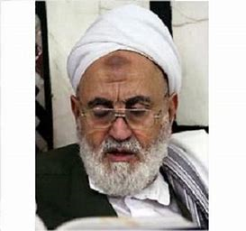
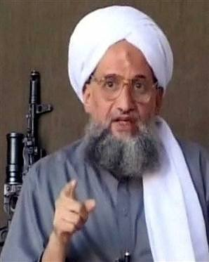
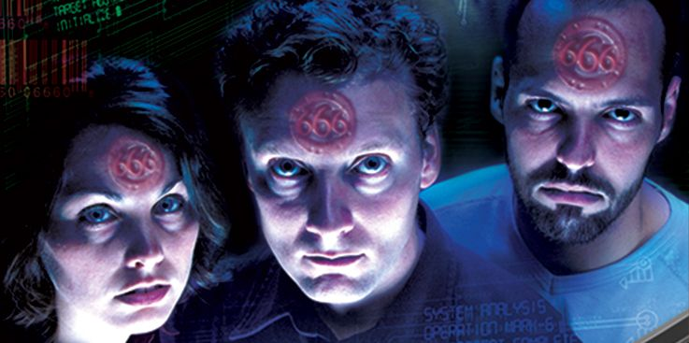

Slide 38
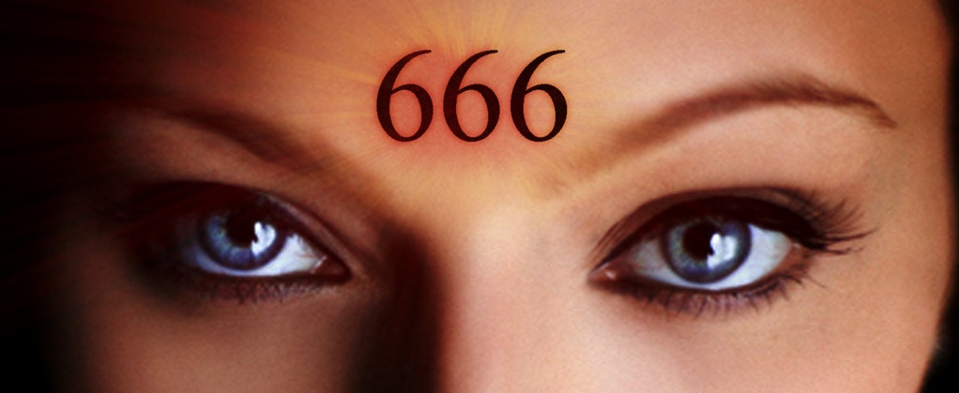

Slide 40
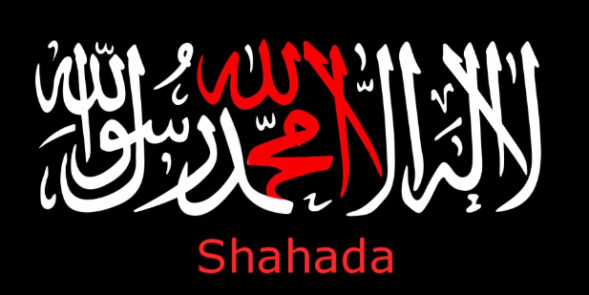
The false prophet causes the beasts mark on their right hand or forehead. In the Islamic religion the “Shahada” is a declaration of allegiance to Allah and Muhammad an Islamic creed to the oneness of God. This Islamic symbol writing is found on flags, Mosques, head and arm bands worn by Islamic militants this badge can be seen openly with Isis, Hamas and other Islamic militants, this writing in Arabic has 666 in it.

Slide 42
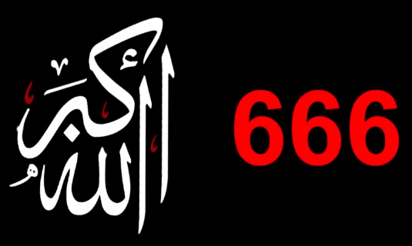
From the Shahada a declaration is found the “Bismillah” this is a “badge of servitude” to Allah (beast). This Islamic symbol writing is also found on flags, Mosques, head and arm bands worn by Islamic militants, this writing in Arabic has 666 in it saying “Allahu Akbar” meaning “Allah is Great”.

Slide 44
In Greek the three similar letters are “XES” turned sideways they are almost identical to the “Bismillah” Arabic Islamic symbol. The Greek word charagma used for mark means an imprinted stamp. In John the revelator’s time this word charagma was used to brand a person as a slave. With Islam this is a physical manifestation of a printed mark on head bands and arm bands.

Slide 45
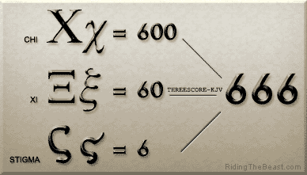

Slide 48
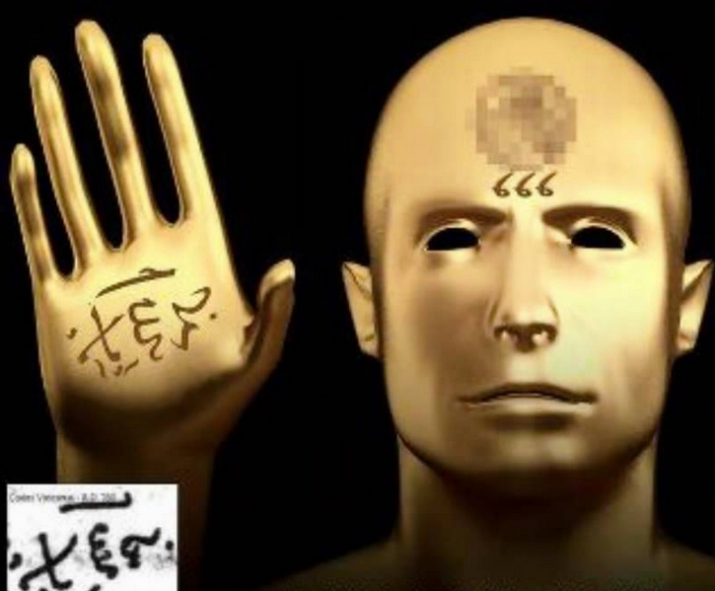

Slide 49
The letters in the Greek word XES turned sideways on its back is the same mark and symbol of Islam in Arabic identical in form and symbol. The first letter in the Greek XES number of the Beast is the “X” character turned sideways it becomes the crossed swords in Islam. For the last 1500 years the “Bismillah” similar to the Greek “XES” has been the symbol of Islamic Jihad used by Muslims on flags and military symbols killing an estimated 669 million people since Islam’s inception. The second letter “E” is in the Islamic “Bismillah” the name for “Allah” or in the name of “Allah” turned on its side and placed in a mirror it forms the same Greek middle character as written by John. The third character of the XES is the “S” in Arabic this is a stigma or badge of servitude . These three letters in Greek translate to the 666 that John sore over 2000 years ago. John wrote his Revelations prophecies 610 years before Islam was formed in 610 AD.

Slide 50
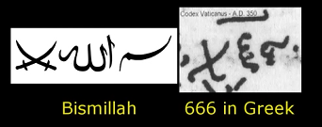

Slide 53
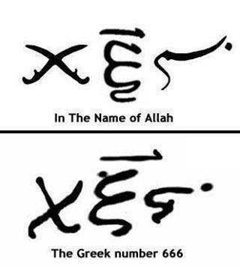

Slide 55
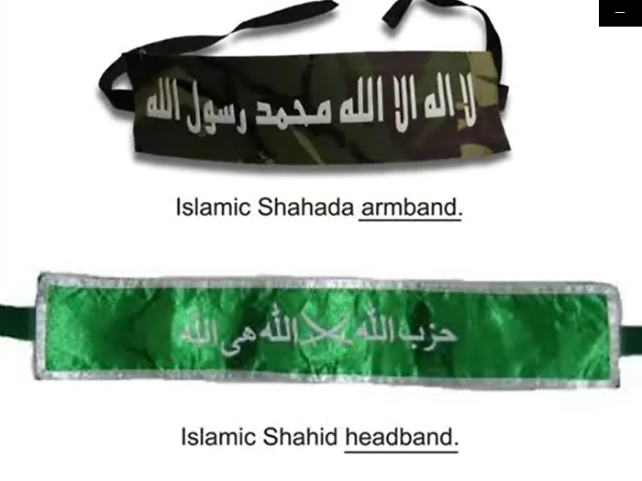

Slide 57
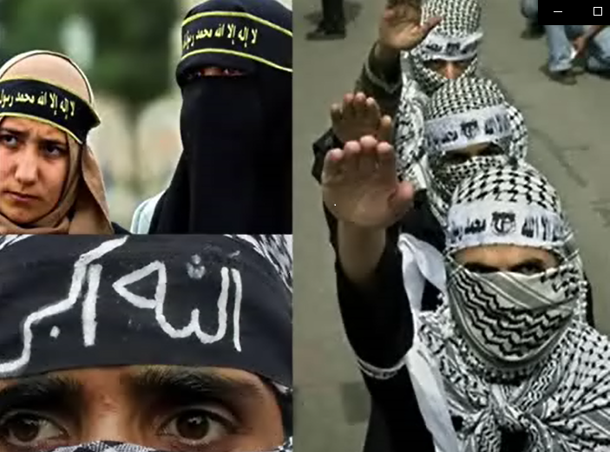

Slide 59
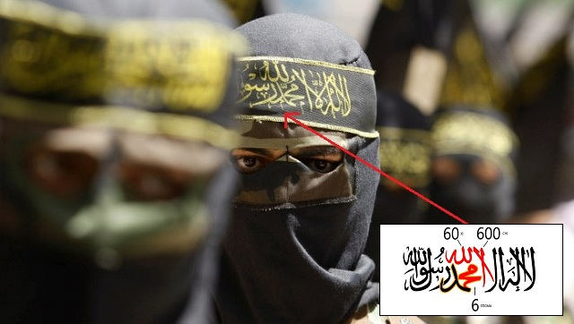

Slide 60
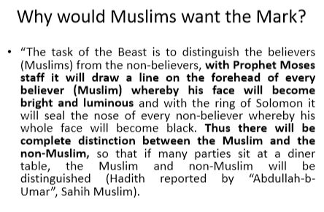
The Hadith is a collection of traditions containing sayings of the prophet Muhammad which, with accounts of his daily practice (the Sunna), constitute the major source of guidance for Muslims apart from the Koran. Any of the sayings from the Hadith. Oxford dictionary “Bing search engine”

Slide 63
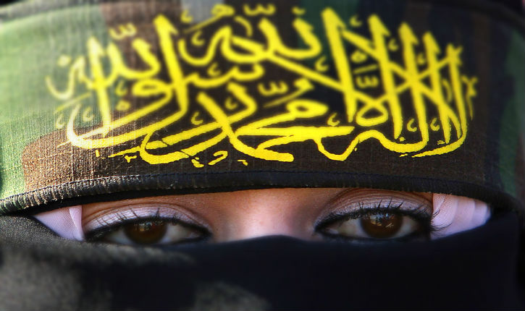

Slide 64
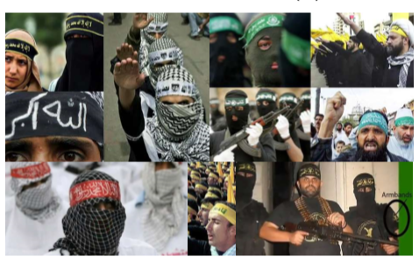

Slide 65
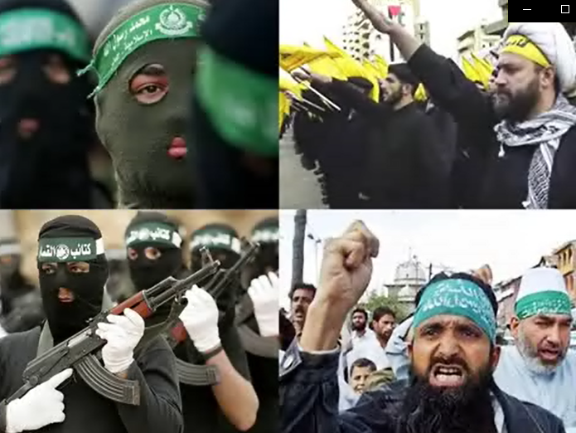

Slide 66
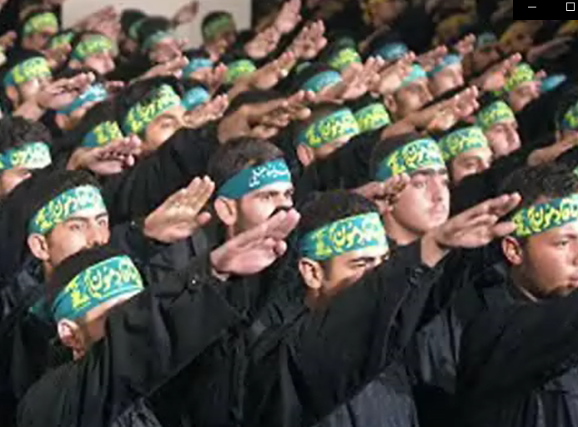

Slide 67
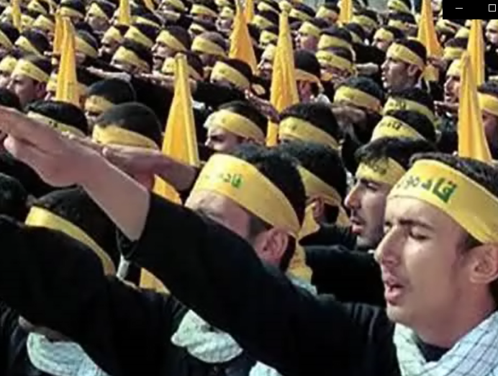

Slide 69
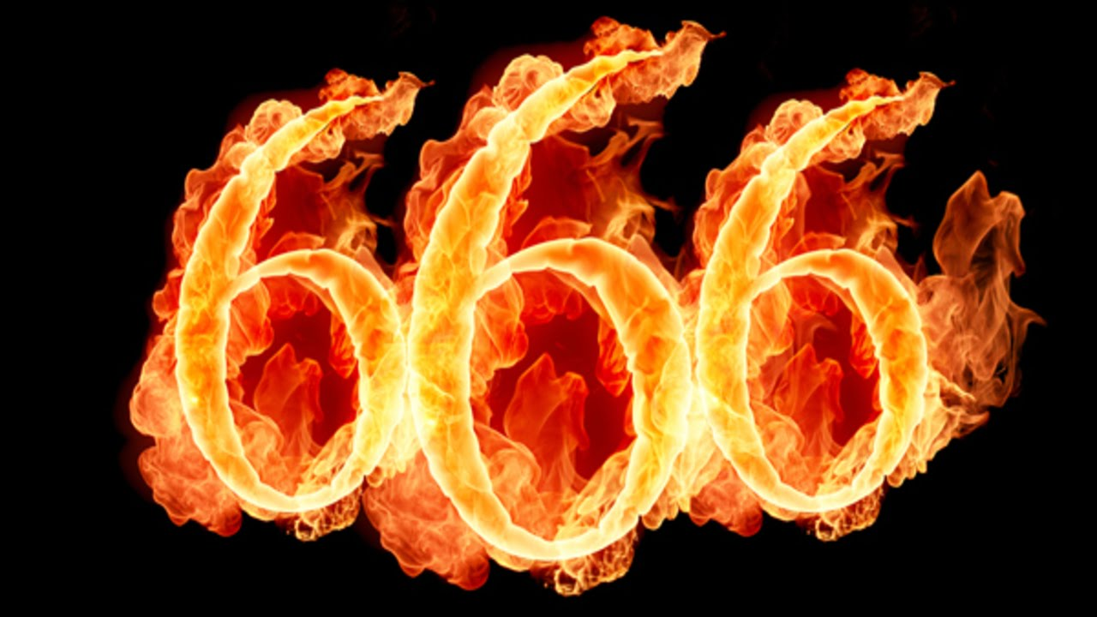
18 Here is wisdom. Let him who has understanding calculate the number of the beast, for it is the number of a man: His number is 666. The number of the beast (the spiritual mark of the end times false prophet) 666 is the number of a man (the demonic comes through man Eph 6:12). Islam was started by Muhammad in 610 A.D the name of the man is “Muhammad” worshipping “Allah” disguised as Satan the beast., who comes to steal destroy and kill (Jn 10:10). This is what John the revelator could have seen Greek turned sideways in Arabic for “Allah” Satan the beast.

Slide 70
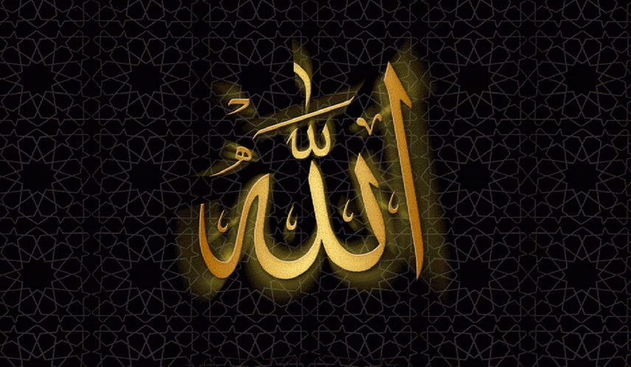
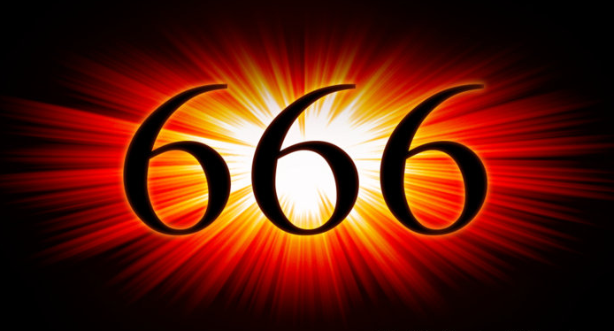

Slide 71
