Slide 3
The 2nd Trumpet Rev 8:8-9
Then the second angel sounded: And something like a great mountain burning with fire was thrown into the sea, and a third of the sea became blood. And a third of the living creatures in the sea died, and a third of the ships were destroyed. (NKJV)
WW2 started just 21 years after WW1 in September 1939 ending in September 1945 a six year war killing between 50 and 70 million people. At the finish of WW1 in 1918 the international settlements of WW1 had not been very wise or fair on the German people. This built much resentment and hatred into the German population towards the controlling European nations who confiscated German territory forcing Germany and its people to pay reparations. This was during hard times in Germany’s own economic situations that were out of control by the 1920’s.
The reparations forced upon Germany were to help rebuild France and repay the WW1 allied war debt to the USA. The German people never believed they had been defeated in WW1 but rather betrayed on the western front by their incompetent leaders and their own weak politicians at home. This caused Europe to become a time bomb ready to explode again due to the unresolved resentments left from WW1. This prepared the platform for the raising up of Hitler of Austrian decent to bring fresh hope to Germany.
(Video)

Slide 4
And something like a great mountain burning with fire was thrown into the sea, and a third of the sea became blood. And a third of the living creatures in the sea died
The Manhattan Project was first brought together in 1942 a secret organization to develop Nuclear bombs in the USA. It was in 1942 that the atom was first split in controlled environments. Then by 1945 the first ever Atomic bomb was created through the “Manhattan project” with the help of Albert Einstein in a race against the Germans to create the first nuclear weapon.
Germany surrendered on May 8, 1945, two months before the successful Trinity test. At 5:30 a.m. on July 16, 1945, scientists, army personnel, and technicians donned special goggles to watch the beginning of the Atomic Age. The bomb was dropped.
See: https://www.thoughtco.com/history-of-the-atomic-the-manhattan-project-1991237
On July 26th 1945 the Allies called for the surrender of Japan Two nuclear bombs were used on Japan the alternative was destruction Japan ignored the warning. Then nuclear bombs were dropped at the Japanese cities of “Hiroshima” at 8.15 a.m. on August 8th 1945 killing 66’000 instantly and then “Nagasaki” on August 9th 1945 over 39’000 people were killed instantly. These bombs were like burning mountains like falling stars they fell upon Japan an island of the sea. The bombs killed up to 226 thousand people also from radiation poisoning. The bombs effected the local wild life also killing animals and poisoning the ocean and surrounding areas with radiation, spilling blood on the ground in mass. On August 15th just six days after the bombing Japan surrendered to save its Emperor and the imperialist system.
(Video)

Slide 5
WW2 and the Vatican
There was also the Vatican agenda of political and religious involvements alliances and interests that helped contribute to the WW2 conflict (Part of Dragon Elite ‘s of Rev 13 along with UN, EU and world banks) .
What people don’t understand about WW2 is the Vatican (Rev 17) with its religious influence played a vital role politically in Germany the Vatican had its own agenda in the establishing and rising up of Adolf Hitler as leader and Fuehrer of Germany. This was even though the Vatican City pursued a policy of neutrality during WW2, its behind the scenes influence was another story all together. Both sides of the coin were played by the Vatican. Truly as Rev 17 states about the “Whore of Babylon” she has fornicated with the nations and has become drunk with the blood of the martyrs WW2. From WW1 the League of Nations was formed as a result of the Paris Peace Conference that ended the war but it failed to stop WW2. The United Nations then replaced the League of Nations after WW2.
Article:
The German Catholics were hostile to Nazism, but were informed that the Pope himself was ‘favorably disposed towards Hitler.’ Consequently the Catholic Zentrum, axis of all parliamentary majorities, voted full rights to Hitler on January 30, 1933. This operation was promptly followed, as in Italy, by the concluding of a Concordat which was most advantageous to the Roman church. The German Episcopate swore allegiance to the Fuhrer and Catholic Youth organizations combined with those of the Nazis. — Edmond Paris, The Vatican against Europe, The Wickliffe Press, page 15.

Slide 6
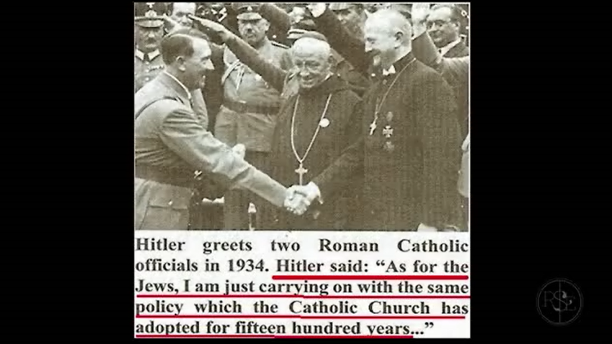
The Vatican helped Hitler to gain power and then helped him consolidate his grip on Germany. This was done in party by ‘advising’ the Catholic Party of Germany to vote for Nazi candidates. The Catholic vote gave Hitler the majority he needed to legally form a government in 1933. Further to this, the Vatican ordered Catholic members of the Reichstag Parliament to support legislation giving Hitler the power to rule by decree. This measure gave Hitler the dictatorial power he needed to destroy the German Communists.
The whole Vatican-Hitler bargain had been conducted in secret before Hitler became Chancellor of Germany in January 1933. In June of the same year, Hitler and the Vatican signed a Concordat, under terms of which the church swore allegiance to the Nazi regime....
Soon afterward, Catholic Franz von Papen, the second in command to Hitler, put the essence of the Hitler-Vatican alliance very succinctly in these words: “The Third Reich,” he said, “is the first power which not only recognizes, but puts into practice, the high principles of the Papacy.” — Avro Manhattan, The Vatican Moscow Washington Alliance, Ozark Books, (quoted in Sydney Hunter, Is Alberto for Real, Chick Publications, pp. 42, 43)
See: http://www.pacinst.com/terrorists/chapter7/ww2.html
(Picture)

Slide 7
Along with Vatican ethics Hitler adopted the Muslim Jihad genocidal tactics against his enemies using Islamic ideals with some Islamic SS officers to run the Nazi concentration death camps such as Auschwitz the largest camp (161 SS officers). The Vatican Jesuits and the Muslims had a lot in common and were intermingled. Germany was well known to be a friend to its Islamic allies with Hitler loving the Islamic way. Many of these SS officers served in the Waffen SS combat divisions. Two of these divisions were Muslim Waffen-SS Handschar divisions.
Six million Jews and countless Christians were murdered in concentration camps by the German Nazi’s. It was also the Italian Prime minister Mussolini from 1922- 1943 and Pope Pius Xll who signed the “Lateran Treaty” in 1929 making the Vatican its own nation state, Mussolini became allied to Hitler in WW2. Pope Pius Xll became Hitler's Pope and the first Pope King of Rev 17:10-11 you only become a King when you have you own nation.
(Video’s)

Slide 8
Article: Hitler believed that Islam was a religion for real men that lacked the flabbiness of Christianity and the filthiness of Judaism. The article also says that even though Muslim people fought on both sides of WW2, the Islamists fought mainly on the side of the Nazis. The Nazis even allowed Muslim people to enroll to the SS, and the Grand Mufti of Jerusalem, a famous Nazi collaborator, was recruiting Muslims for the SS. The Grand Mufti of Jerusalem was the man who convinced Hitler to exterminate the Jews of Europe, because the Jews who were leaving Europe were ending up in Jerusalem, where the Arabs and the Jews were fighting for Palestine. The Grand Mufti of Jerusalem was one of the closest associates of Hassan al-Banna, the man who founded the Muslim Brotherhood in Egypt in 1928, and who was another famous Nazi collaborator. See: https://iakal.wordpress.com/2016/08/18/the-alliance-between-hitler-and-the-muslim-brotherhood/

Slide 9
And a third of the ships were destroyed.
Out of the 105,127 merchant and navy ships involved in WW2 exactly one 3rd was destroyed 36,387 ships both naval and merchant, fulfilled historically word for word. The 36,387 ships that sunk had oil and chemicals spills released this was a huge impact on the sea and environment killing untold amounts of sea life and animal life. This caused a third as scripture says of sea life to die a massive impact on the environment.
After the war millions of tones of military equipment, ammunitions and Chemical weapons were dumped at sea furthering the environmental disaster felt in out modern times.
See: http://www.answers.com/Q/How_many_ships_participated_in_World_War_2_and_how_many_were_sunk
(Video’s)

