Slide 1
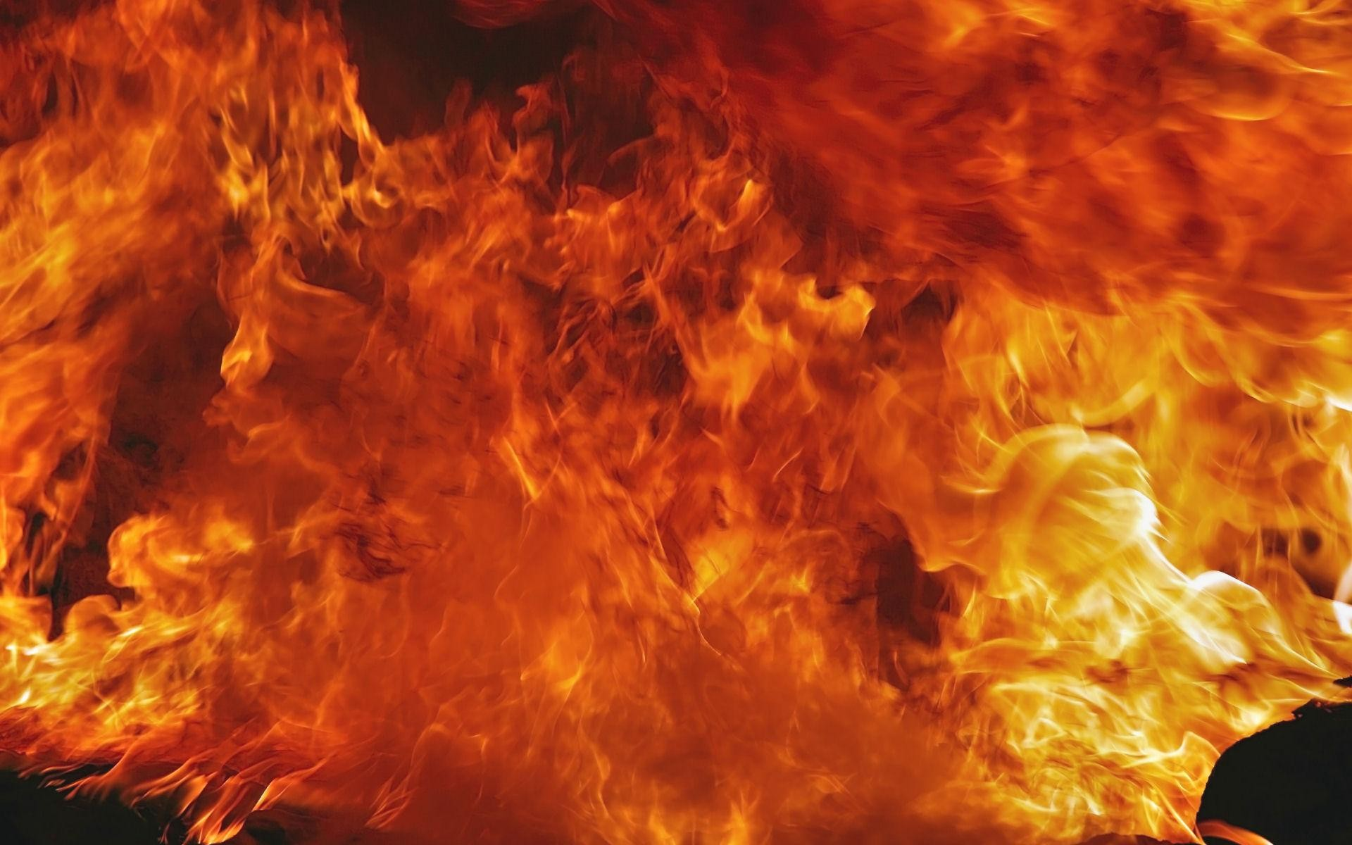
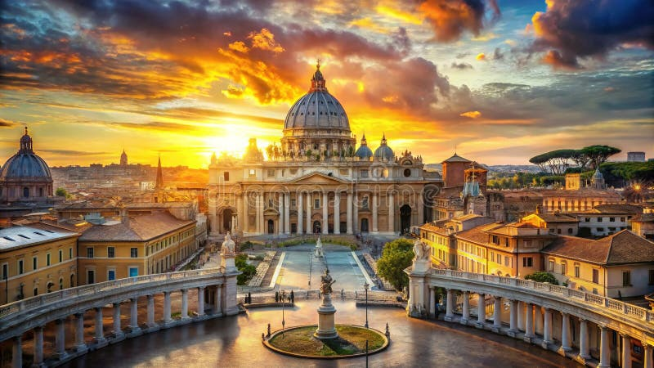
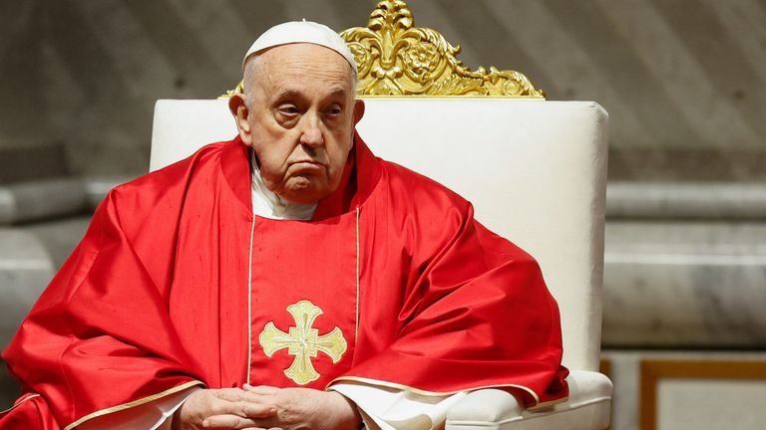
What is Vatican City ? who is the harlot that rides the beast ? Who is the 8th King of Rev 17 ? what are the 7 heads, 10 horns and 10 Kings with 10 crowns ?

Slide 2

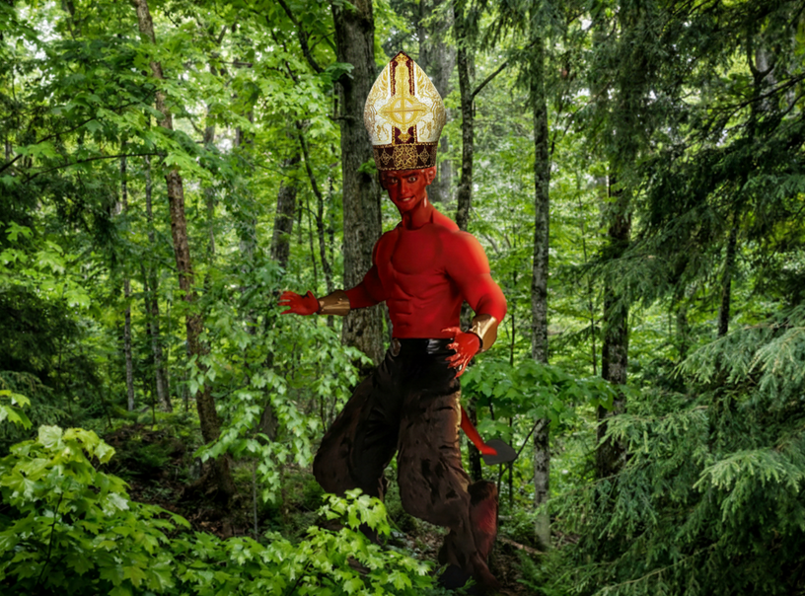

14th October 2014 a dream came after watching a Roman Catholic service on satellite TV:
In the dream I saw Satan as a red skinned Devil with a pontiffs hat on to cover his horns to give himself a human look, this demonic creature had goat’s feet (Baphomet) he was walking through the bush like a wild man. He then spotted a beautiful woman standing on the sand of the beach in an early history type wedding dress with high heels on (Harlot Church).

Slide 3
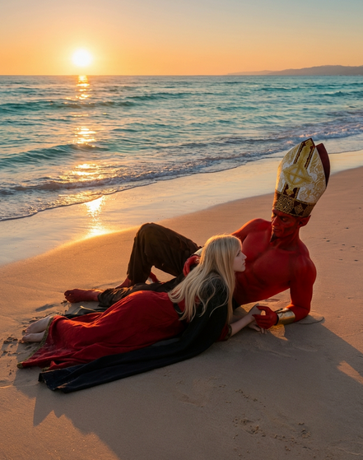
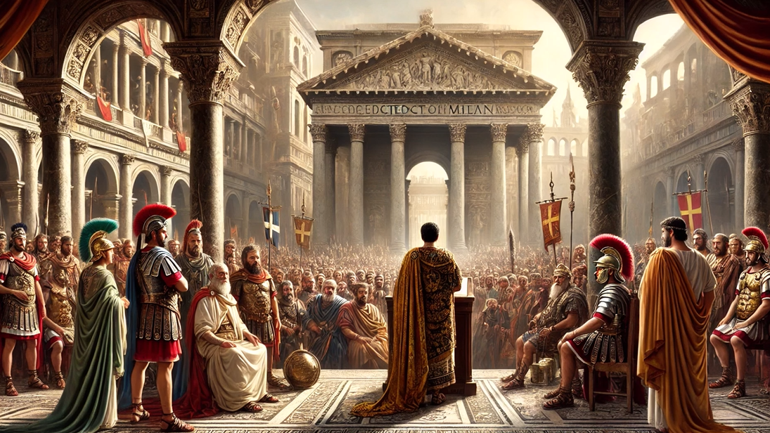
This red skinned devil then came over to the woman it deceived her and seduced her (Constantine in 313 A.D. brought forth the “Edict of Milan” ending Christian persecution in Rome to then corrupt the church with wealth and paganism. The Council of Nicaea then became the first ecumenical council of the Christian church in 325 A.D.) the red skinned beast lay with her on the beach it consummated with this beautiful woman it joined itself to her impregnating her.

Slide 4
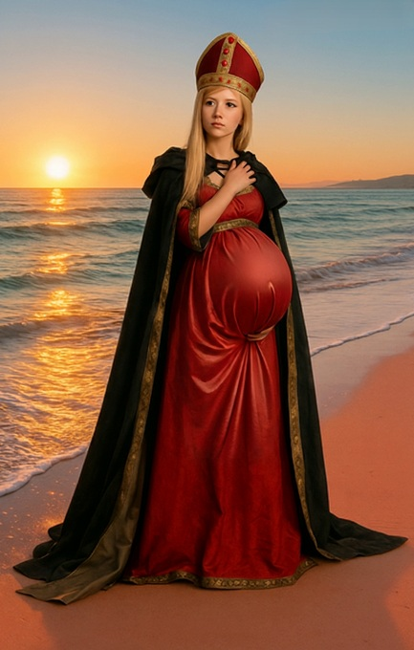
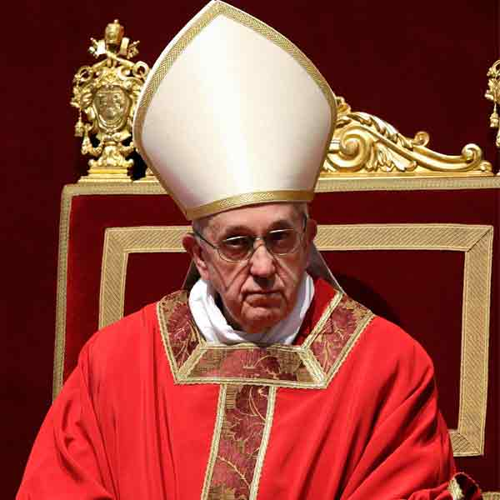
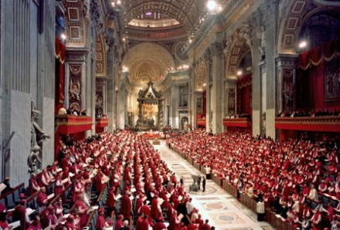
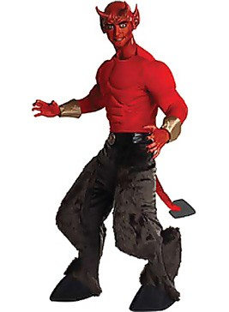
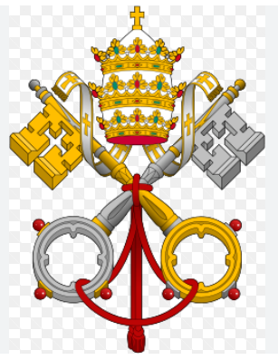

This satanic pregnancy of Rome and the Christians in Rome birthed the “Roman Catholic Church”. Rome’s pagan beliefs and rituals merged into one with the Roman Christians forming new doctrines traditions and beliefs. Pleasing to all at the time in Rome this corrupted and compromised the true word of God this religion is now 1800 years old. This is the whore of Babylon the wicked woman (wicked church) riding the scarlet beast Satan in Rev 17. It became a city that sits on 7 hills in Italy the harlot church prostituted herself with Rome.

Slide 5
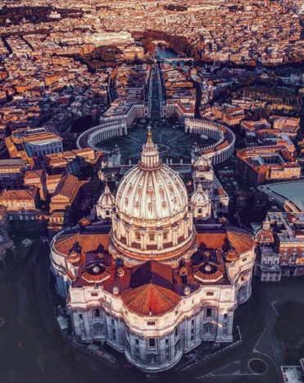
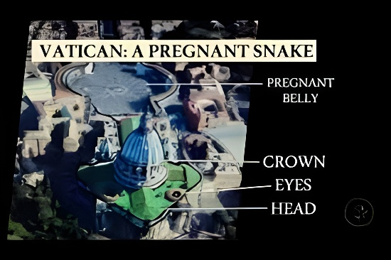
The Vatican is shaped like a snake a beast with a pregnant belly.

Slide 6
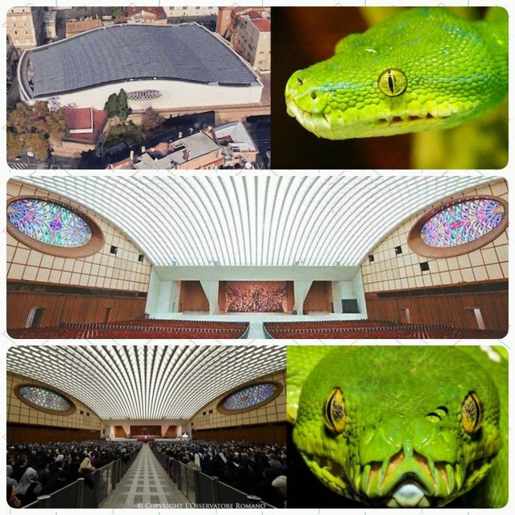
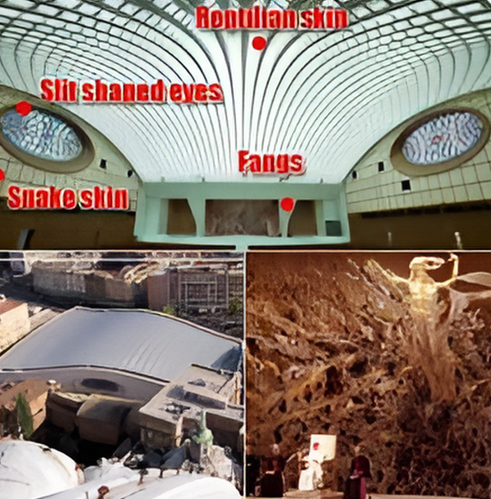
Popes “Paul Vl Audience Hall” on Vatican grounds is a snake's head.

Slide 7
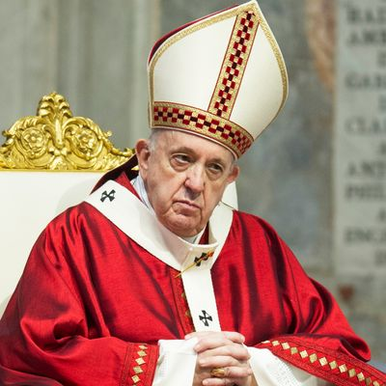
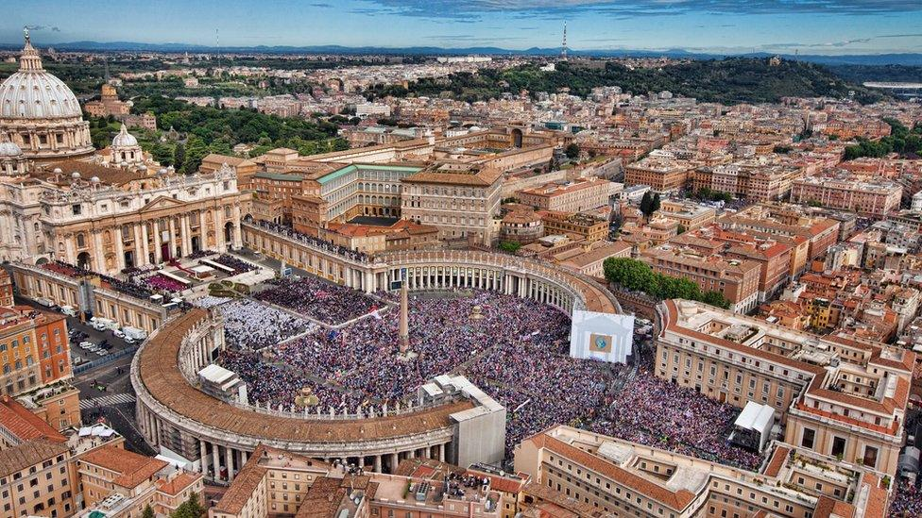

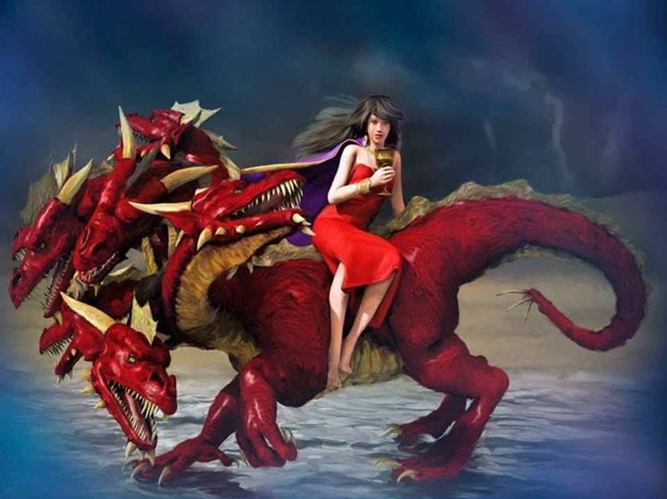
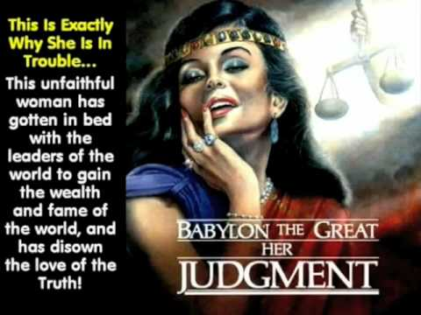
This woman is an unfaithful Harlot church

Slide 8
Rev 17:3 So he carried me away in the Spirit into the wilderness. And I saw a woman sitting on a scarlet beast which was full of names of blasphemy, having seven heads and ten horns. (connected to Rev 13:1-18)
Fast forward to the end of the age to Rev 13:1-18, the G7 (Group 7) consists of seven of the wealthiest nations on Earth. The G7 represent the “7 heads” of the end time beast that formed in 1975 the 7 heads in prophecy are found in Rev 13:1. The G7 precursor was originally called “Group 6” founded in 1975 this group then expanded into G7+1 (G8) with the inclusion of Russia in 1997-1998 then Russia was expelled in 1999. The G7 then expanded itself into another international group called the G20 in 1999 to promote discussion between major industrial and emerging market countries through the World Trade Organization.
The G7 is still the primary group it holds its name and power politically as the 7 richest nations on earth the G8 and G20 are off shoot organizational groups over seen by the G7 group. All of the G7 nations have large populations of Muslims in their borders they are all part of the United Nations whom the Vatican over sees.

Slide 9
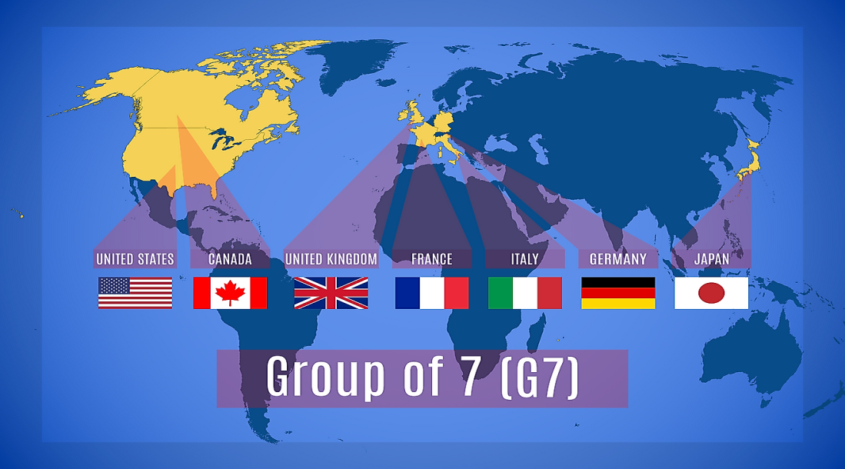
The 7 Heads of Rev 17 and Rev 13 are the G7 (Group 7) all part of the UN one head was wounded Rev 17. The UN is made up of one third Muslim state nations.

Slide 10
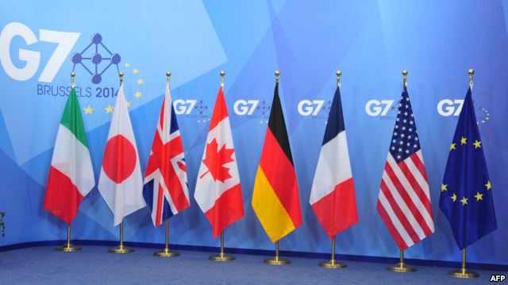
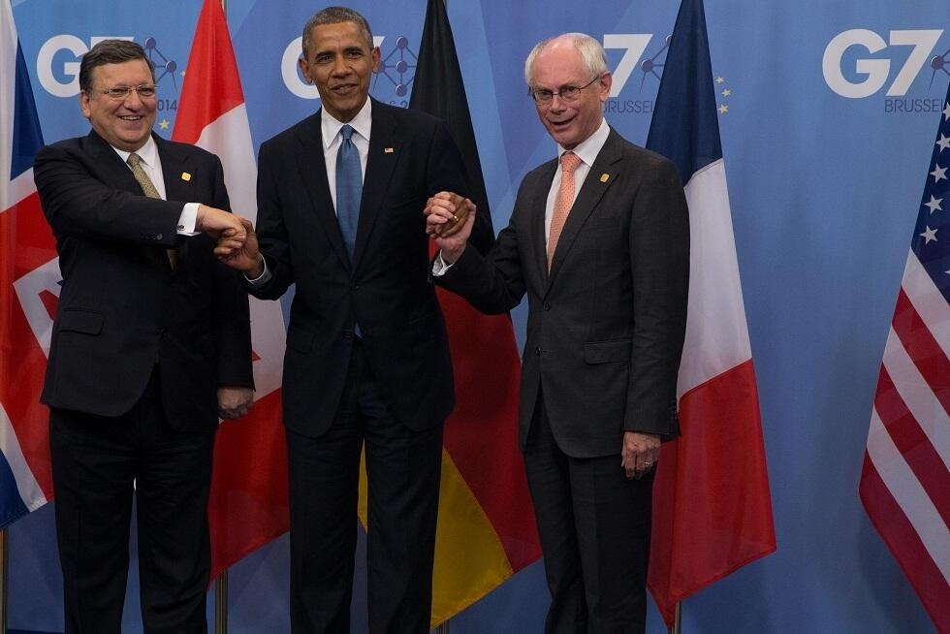
The 7 Heads of Rev 17 and Rev 13 are the G7 (Group 7) all part of the UN and EU, one head was wounded Rev 17. The UN is made up of one third Muslim state nations. The EU declared in 2009 this is the first year of Global Governance (NWO) the same year Obama became president.

Slide 11
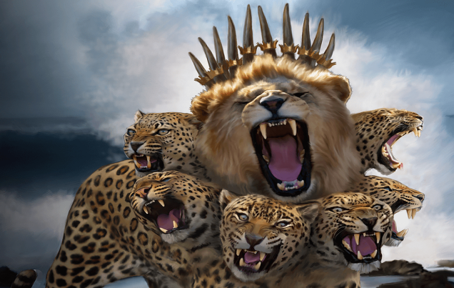

Rev 17 :12-14 "The ten horns which you saw are ten kings who have received no kingdom as yet, but they receive authority for one hour as kings with the beast. These are of one mind, and they will give their power and authority to the beast. These will make war with the Lamb, and the Lamb will overcome them, for He is Lord of lords and King of kings"
2015 Obama was given “Fast Track Authority” from US Congress solely to negotiate the “TPPA” deal with 10 nations handing over 43% of the worlds GDP trade to corporation control signed Jan 6th 2016 in Auckland New Zealand. This striped those nations of their sovereign authority. The ten crowns went onto the Rev 13:1-10 beast given over by ten king leaders of Rev 17.

Slide 12
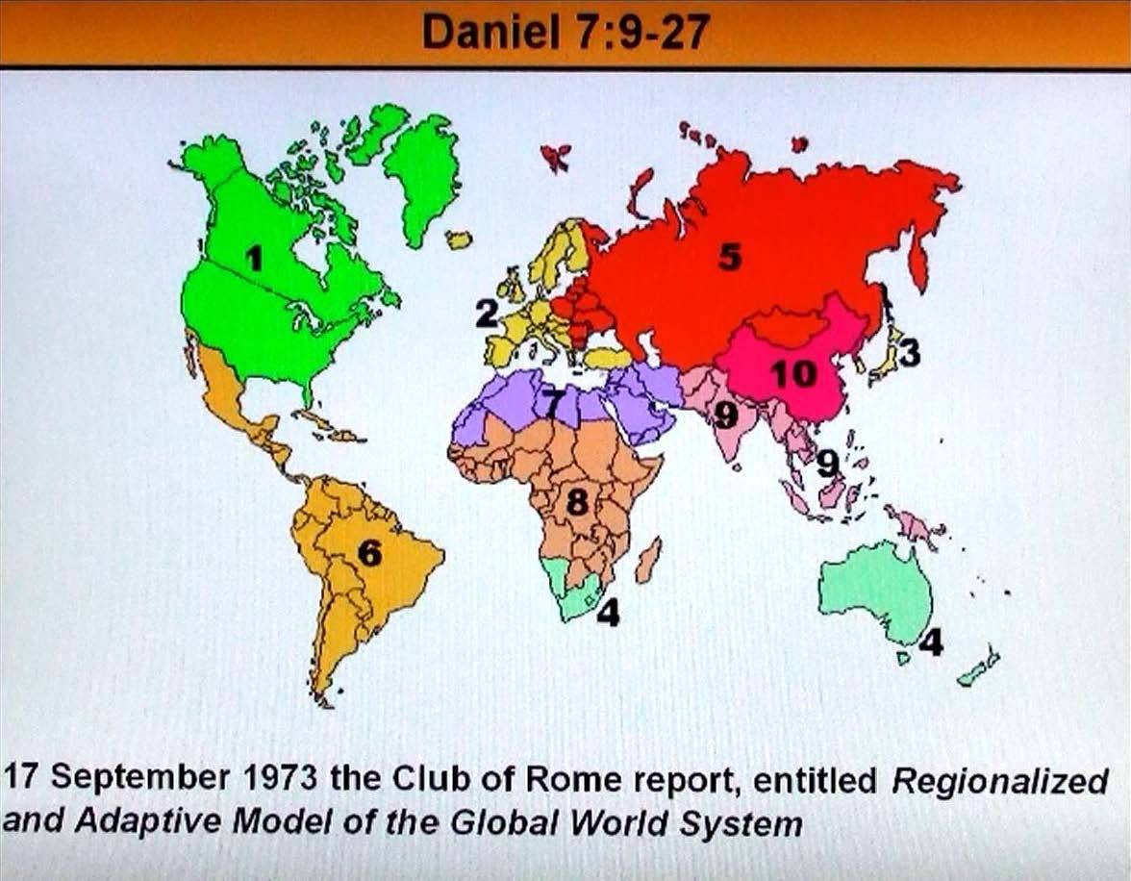

The 10 Horns of the “Club of Rome” shares its concerns with the Vatican the “Holy Roman Empire” they regionalised the worlds nations into ten Trade Unions in 1968 then the UN followed in 1996 then NAFTA in 2009. This was all prepared under the “Holy Roman Empire system” prior to the beast of Rev 13:1-10 arriving on the world scene in 2009.

Slide 13
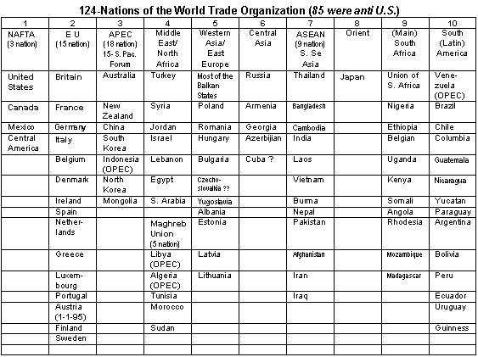
The 10 Horns of the Club of Rome under the UN / WEF/ WTO

Slide 14
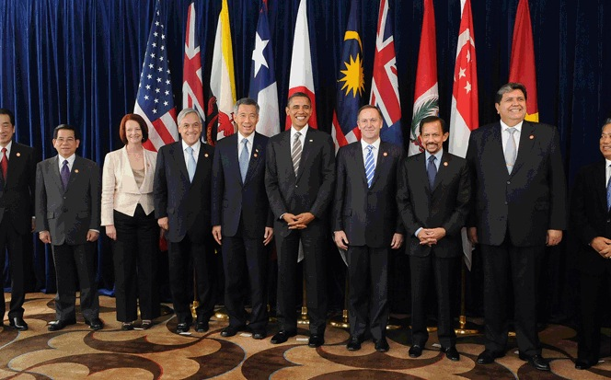

Ez 28:16 "By the abundance of your trading You became filled with violence within, And you sinned; Therefore, I cast you as a profane thing Out of the mountain of God; And I destroyed you, O covering cherub, From the midst of the fiery stones.
(3 years later Covid 19 was released upon the nations and big Pharma enforced experimental vaccinations upon the world Rev 18:23).

Slide 15

Rev 18:15, 17 The merchants of these things, who became rich by her, will stand at a distance for fear of her torment, weeping and wailing… For in one hour such great riches came to nothing.' Every shipmaster, all who travel by ship, sailors, and as many as trade on the sea, stood at a distance.
Rev 18:23 The light of a lamp shall not shine in you anymore, and the voice of bridegroom and bride shall not be heard in you anymore. For your merchants were the great men of the earth, for by your sorcery all the nations were deceived.

Slide 16

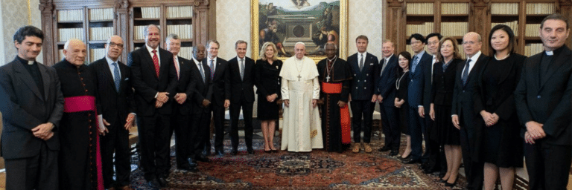


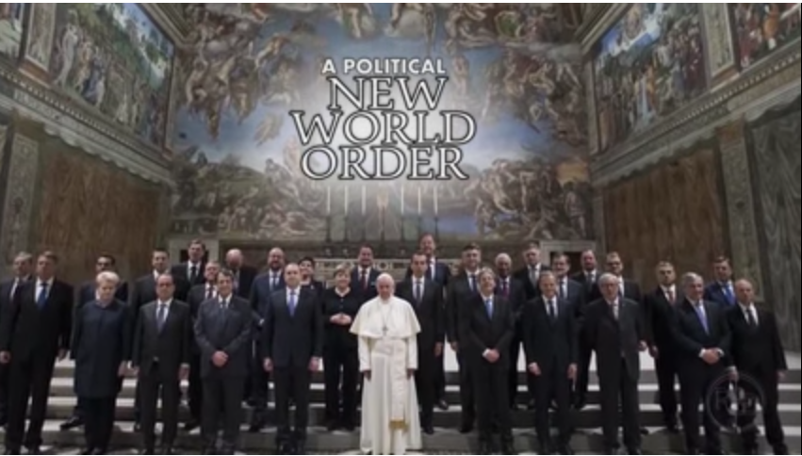


Slide 17


Slide 18
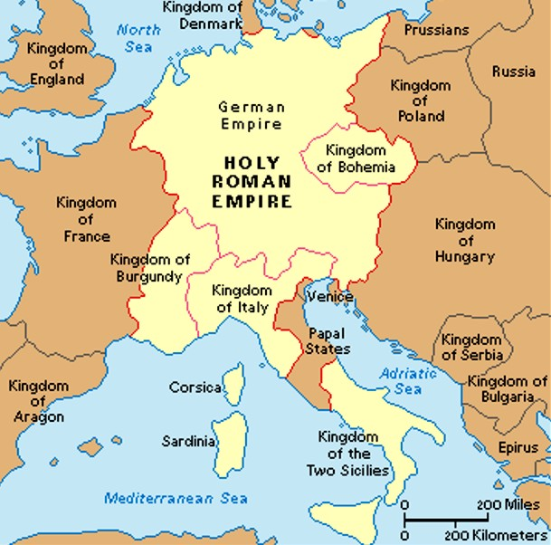
Rev 17 :1-18 is a prophecy of the Vatican, the city of Rome the papacy “A city built on seven hills” . The beast the harlot woman rides is the “Holy Roman Empire” the feet and toes of Dan 2:40- 44 the Jews and Romans did not cleave to each other. This is the last world Empire that the Rev 13:1-18 antichrist beast and false prophet emerge from. The modern-day European Union is the same nations of the old Holy Roman Empire.

Slide 19
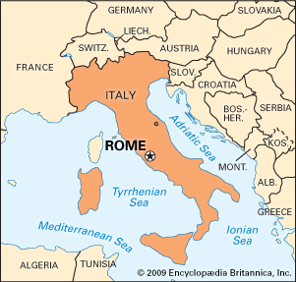
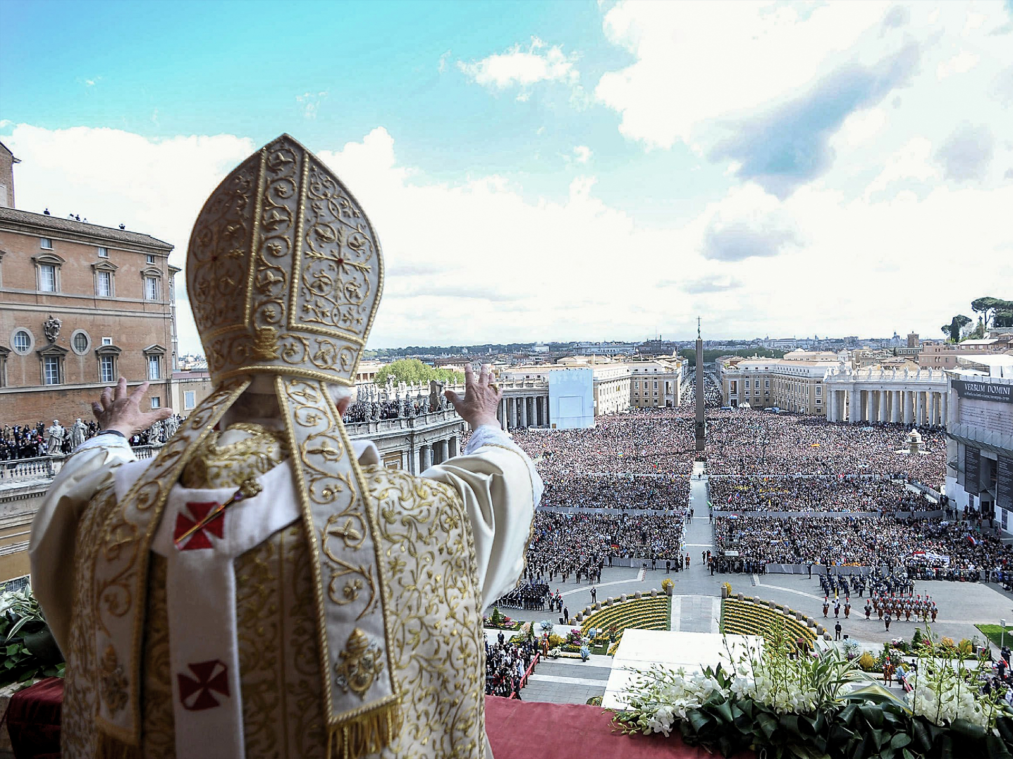

Slide 20
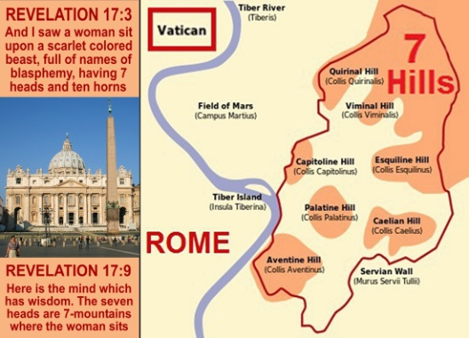

Slide 21
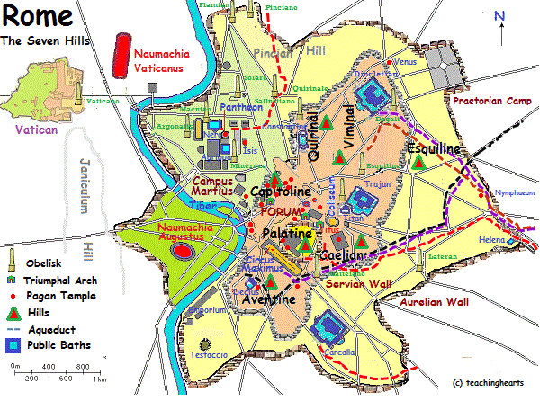

Slide 22
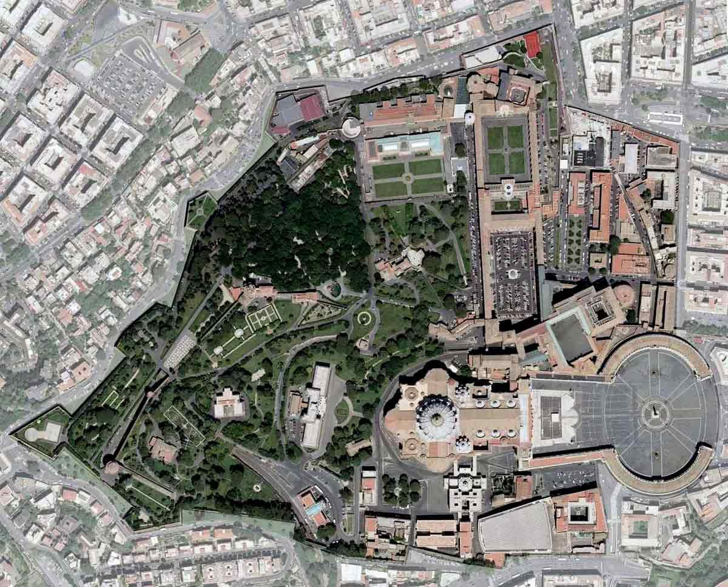

Slide 23
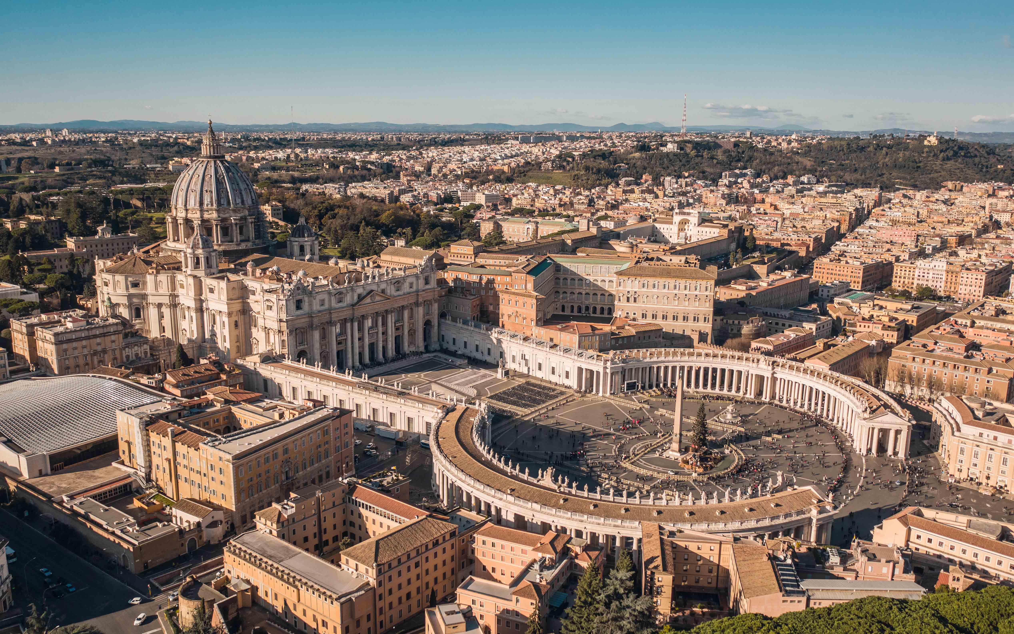

Slide 24
The Holy Roman Empire began in 313 A.D with Constantine the Great signing the “Treaty of Milan” stopping the Roman persecution of Christians. Then for a 1260-year period Rev 12 from 538 A.D starting with the Pope Vigilius decree to punish heretics, the papacy persecuted the saints up until 1796 A.D. With inquisitions that lasted 1260 years the Vatican killed over 150 million heretics and protestants. Napoleon’s general arrested the last Holy Roman Emperor stopping all inquisitions in 1798, he then resigned on August 6th 1806. Then for 123 years the papacy continued without a Holy Roman Emperor over them. The following Popes after 1806 then considered themselves to be prisoners in the Vatican refusing to leave as a sign of protest.

Slide 25
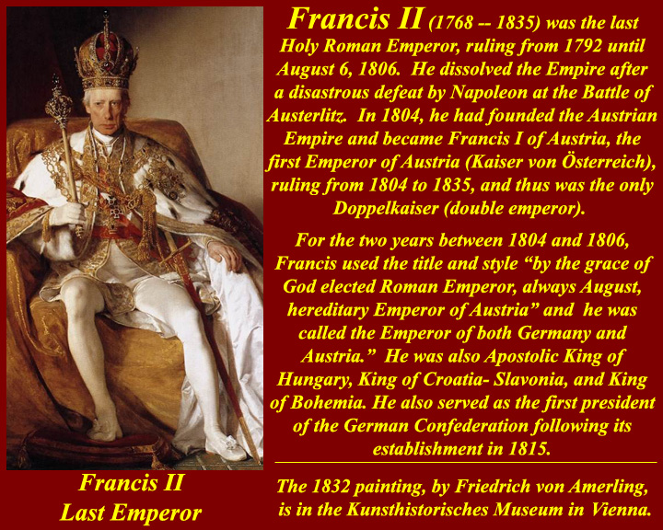

Slide 26
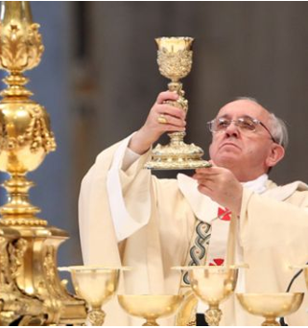
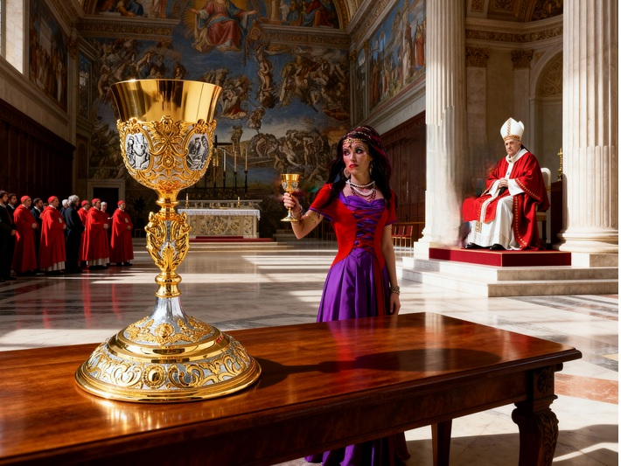
Rev 17:4-5 The woman was arrayed in purple and scarlet, and adorned with gold and precious stones and pearls, having in her hand a golden cup full of abominations and the filthiness of her fornication. And on her forehead a name was written: MYSTERY, BABYLON THE GREAT, THE MOTHER OFHARLOTS AND OF THE ABOMINATIONS OF THE EARTH.

Slide 27
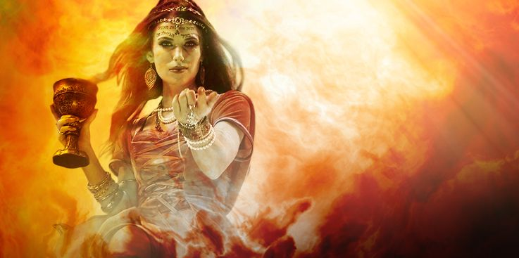
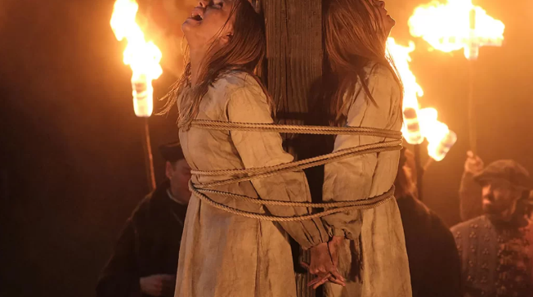
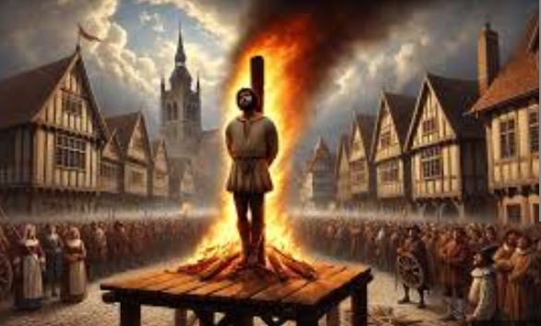
A golden cup filled with the blood of the martyrs.

Slide 28
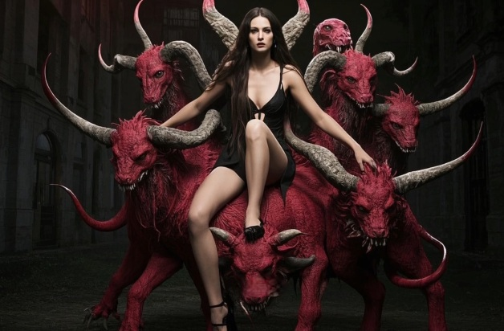
The Harlot Church rides the scarlet beast

Slide 29
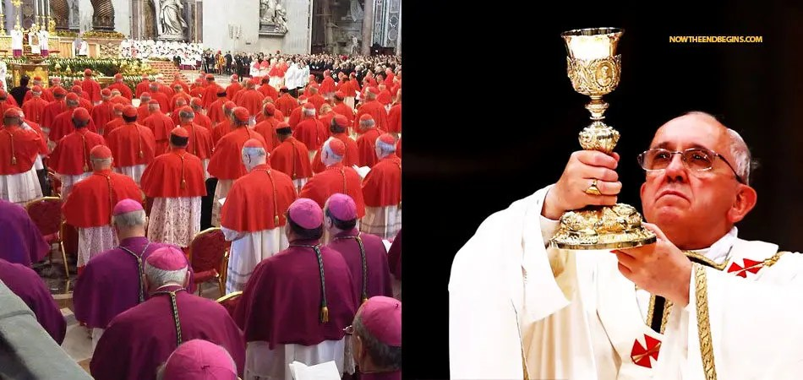
She is drunk on the blood of the martyrs.

Slide 30
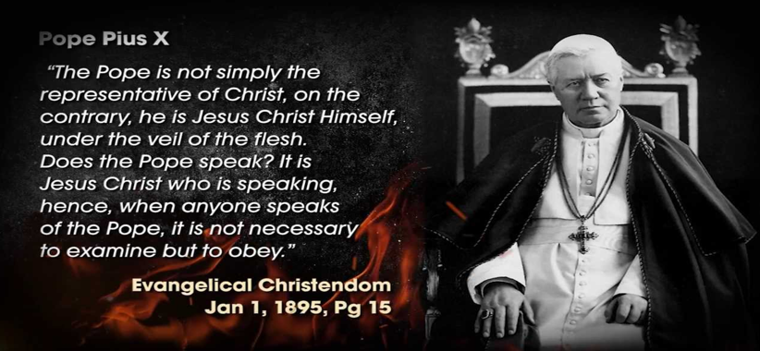

Slide 31
Popes have made outrageous false claims for generations, against the Biblical cannon (Authoritative rule and practice or faith) of truth believed by millions.
# Man evolved he was not created by God the Big Bang Theory.
# The Vatican (Catholic Christians) and Islam worship the same God (worship of Satan/Baal).
# Mother Mary is placed in higher prominence and worship than Jesus.
# They offered salvation to space aliens and blessed LGBT relationships.
# They worship and venerate the dead a form of necromancy, statues and religious relics.
# At death you remain in Purgatory as a way of purification of the soul to enter heaven. Indulgences were offered to minimize the punishment for sins.
# The Pope is seen as Christ on earth his voice is infallible, he is worshiped.
# Confession is where one confesses their sins to a priest for forgiveness not God.

Slide 32
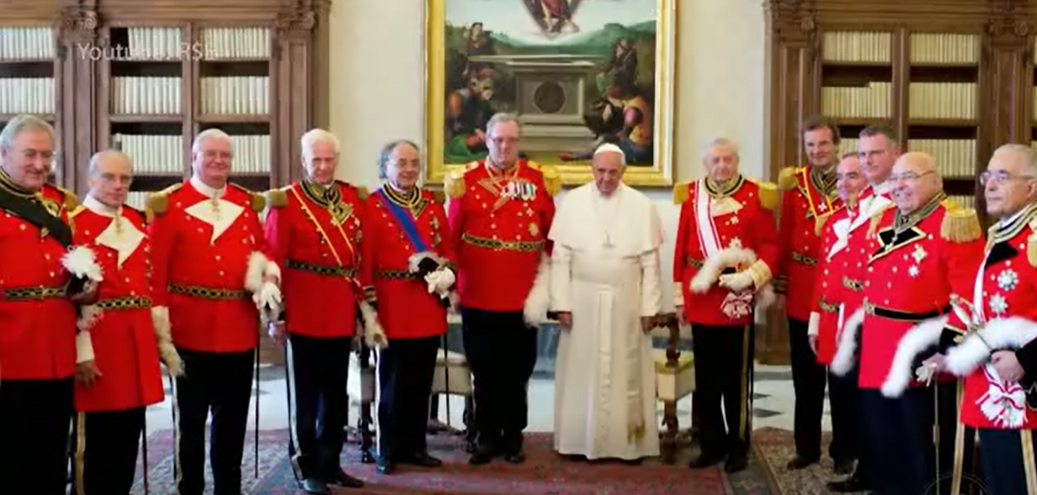
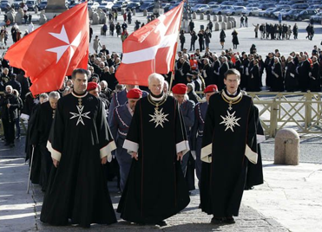
The Vatican Popes are all of the order of the knights of Malta/Templar. The knights of Malta/Templar are Jesuits that formed in 1540 they were then empowered through the Council of Trent from 1545 to 1563 to counter the Martin Luther reformation they are Freemasons. Pope Francis is of German descent he was the first public ally known Jesuit Pope a “Son of perdition”.

Slide 33
The Jesuits are sworn enemies of the protestant church sworn to destroy it by any means possible even from within through false doctrines and interventions. Pope Francis is from Argentina heavily tied into the Jesuit Order. The Jesuits have the same vicious intent as Muslims to kill Christians. Historically the Knights Templer became the Knights of Malta who became Jesuits they formed the Freemasons worldwide along with the secret order of the Illuminati all connected to the “Holy Roman Empire”.

Slide 34
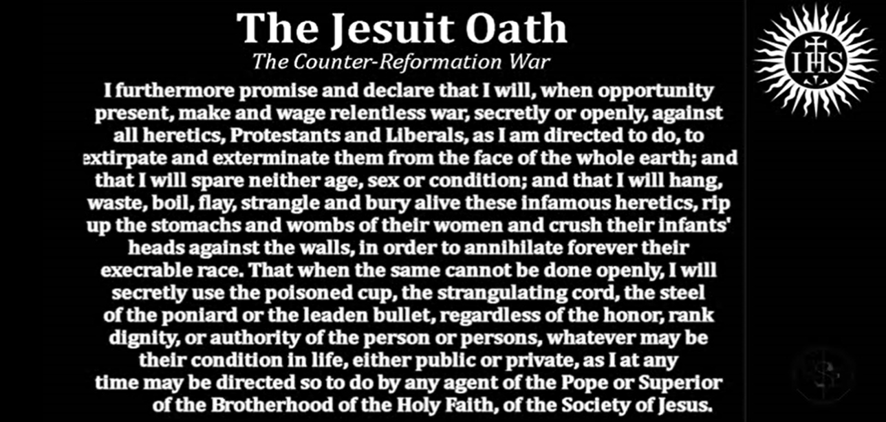
The Jesuits are the military religious order of the Vatican. See part of the Jesuit oath below:

Slide 35
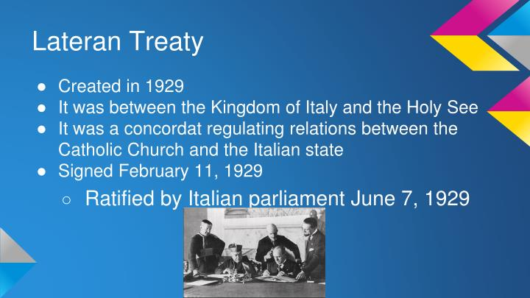
In 1929 the “Lateran Treaty” was signed with Prime minister Mussolini of Rome giving official land and nationhood to the Vatican making the Vatican its own nation state. For the first time in its history the Vatican was now its own nation its own kingdom having the first ever Pope King on the Vatican throne. The pope at that time was Pope Pius 11th the first Pope King of Rev 17:11, just before WW2.

Slide 36
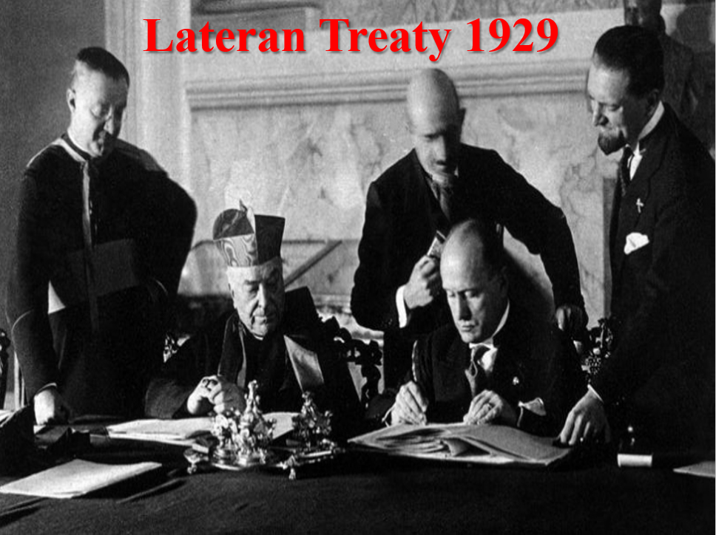

Slide 37
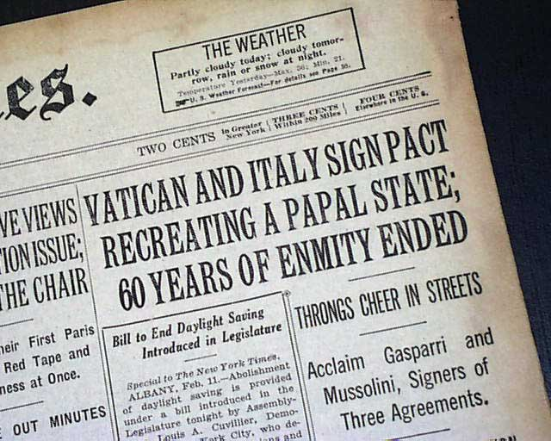

Slide 38
The Pope is a false prophet over a false religious system of 1.2 billion people. There has been 266 false prophet popes up to Pope Francis 1st from 2013 (1700 years since treaty of Milan 313 A.D). From the 1929 Lateran treaty Pope Francis became the 8th Pope King in 2013 he reigned for 11 years.
The papacy started out Christian then became false because of riches, corruption, altered doctrines and religious practices. 88 popes came from Rome; 196 popes came from Italy 1 from Germany and 1 from France.
Nearly all end times teachers say the Pope is the false prophet of Rev 13:11-18 yet prophecy being fulfilled in our current times tells us something else. Since the “Lateran Treaty” in 1929 up until 2013 we have had exactly 8 popes on the Vatican throne 8 Pope Kings. In 2024 a new Pope took the reigns of the Vatican after the 8th King Pope Francis. The New Pope the 267th Pope is unimportant to Revelations prophecy.

Slide 39

Rev 17 The 8th Pope King on His throne Pope Francis from 2013.
At the conclusion of his novitiate in the Society of Jesus, Pope Francis was born as Jorge Mario Bergoglio (Pope Francis) he officially became a Jesuit on 12 March 1960, when he made the religious profession of the initial, perpetual vows of poverty, chastity and obedience as a member of the order.
See: https://www.thefamouspeople.com/profiles/pope-francis-4362.php

Slide 40


Slide 41

Pope Francis is not the false prophet of Rev 13:11-18, he is the 8th king of Rev 17: 11 from the 1929 “Lateran Treaty”.

Slide 42
# Pope Francis a Jesuit insinuated the ten commandments are no longer relevant to follow stating those that do are dangerous.
# Pope Francis officially blessed LGBT partnerships, homosexual priests he bestowed honors upon advocates of abortion, same sex marriage, couples living together before marriage, trans couples.
# Pope Francis opened the flood gates to increased worldwide deception and perversion in the Catholic Church.
# Pope Francis said: “Every religion is a way to arrive at God” that “God wills other religions” he blessed idols of foreign Gods and kissed the Islamic Quran.
# Pope Francis also said: “Mary is the road we must travel to reach Jesus”.
# Pope Francis said: “Islam and the Catholics worship the same God”.
# Pope Francis joined the Vatican to “Council for Exclusive Capitalism” run by the rich corporate elites the Rothchild’s.

Slide 43


Pope Francis died on 21st April 2025 as the last Pope the 112th Pope of the Malachai prophecies .
The Prophecy of the Popes (Latin: Prophetia Sancti Malachiae Archiepiscopi, de Summis Pontificibus, "Prophecy of Saint-Archbishop Malachy, concerning the Supreme Pontiffs") is a series of 112 short, cryptic phrases in Latin which purport to predict popes (along with a few antipopes) of the Catholic Church, beginning with Celestine II. It was first published in 1595 by Benedictine monk Arnold Wion, who attributed the prophecy to Saint Malachy, a 12th-century Archbishop of Armagh.
See: https://en.wikipedia.org/wiki/Prophecy_of_the_Popes

Slide 44

The 8th pope King was the 266th Pope (266 false prophets) from papal beginnings in 313 A.D Rome. Pope Francis 1 is the 112th pope from the Siant Malachai’s prophecies vision list, that began in 1143 A.D that’s over 880 years ago. (Pope Celestine 2nd from 1143 A.D-1144 A.D). This is according to the controversial “Saint Malachai Prophecies” received in 1139-40 A.D. The 1st pope on the vision list Celestine began in 1143 A.D. the 112th Pope Francis 1 began in 2013 A.D. Francis 1 became the Rev 17 8th Pope King since 1929. In Malachai terms he is “Peter the Roman” who would see the beginnings of “tribulations against the saints” (Catholic Church) Rev 13:5-7 of the end of the age (end of the world) in the final persecution of the Catholic saints. The Malacai prophecies never said he was the “Last Pope” but he would be the pope to “sit through the final persecution of the Holy Roman Church” Rev 13:5-7.

Slide 45
The 8th Pope King it says in St. Malachy’s Prophecy of Pope Francis 1st (266th Pope from Vatican papacy of the 1st century) the end of the age 112th Pope: “In persecutione extrema S.R.E. sedebit Petrus Romanus, qui pascet oves in multis tribulationibus: quibus transactis civitas septicollis diruetur, & Judex tremêdus judicabit populum suum. Finis”.
“In extreme persecution (final persecution 42-month war against the saints Rev 13:5-7) the seat of the Holy Roman Church will be occupied by Peter the Roman (Petrus Romanus), who will feed the sheep through many tribulations, at the term (end of the world) of which the city of seven hills (Vatican) will be destroyed, and the formidable Judge (Christ) will judge his people. The End.“
Saint Francis of Assisi, Italian San Francesco d’Assisi, baptized Giovanni, renamed Francesco, original name Francesco di Pietro (Peter) di Bernardone. Francis was the son of Pietro (Peter) di Bernardone, a cloth merchant, and the lady Pica, who may have come from France.
See: http://www.britannica.com/EBchecked/topic/216793/Saint-Francis-of-Assisi

Slide 46
It’s interesting that Pope Francis 1 took the name Francis as his official name from St. Francis of Assisi whose middle name was Peter, and whose fathers name was Peter also. This 112th Pope prophecy has been accurately fulfilled with “Peter the Roman” Pope Francis 1 a “Jesuit” of perdition was inaugurated March 2013 as the 8th Pope King since 1929 an accurate time line. Jesuits are directly connected to Rome (Council of Trent) they formed in Paris France in 1534 A.D, they are connected to the Knights of Malta the papal guard. The 42-month tribulation “war against the Saints” of the 6th Trumpet began 3 months After Pope Francis was inaugurated in March 2019. The Saints war began June 2013 in the Middle East. This was along the Euphrates River region just as prophesied 2000 years ago Rev 13:5-7.
This persecution came against Orthodox Christians in the Middle East whom were originally Catholics from the “Great Scism” of 1054 A.D. It seems the end of the world of the 112th Pope from 1139 A.D. in the Malachai prophecies is accurate it was a time line that lines up with the 8 Pope Kings of Rev 17 and the “war against the saints” Rev 13:5-7.
The Malachai prophecy 112th Pope was an end of the age time line testifying to the coming 42-month war against the saints by the beast of Rev 13:5-7, this is now actual history. We are now in the close of the age, worldwide harvest is next Rev 14:14-16. Then Jesus second coming return takes place where he destroys Babylon and the wicked of this world, just as the 112th prophecy states and scripture.

Slide 47




The 112th Malachai Prophecy Pope since 1143 A.D, the Rev 17 8th Pope King since 1929, the 266th Pope from the Holy Roman Empires beginnings in 313 A.D of Dan 2 appeared March 2013 just 3 months before the Rev 13:5-7 42-month tribulation “war against the saints” that began June 2013 killing Orthodox Christians (Catholics), then he died in 2025. Pope Francis a known Jesuit was the “Pope King / Peter the Roman” in both the Bible and Malachai’s prophecy he did see the “End of the age 42-month war against the saints” a time line where history has proven prophecy.

