Slide 1
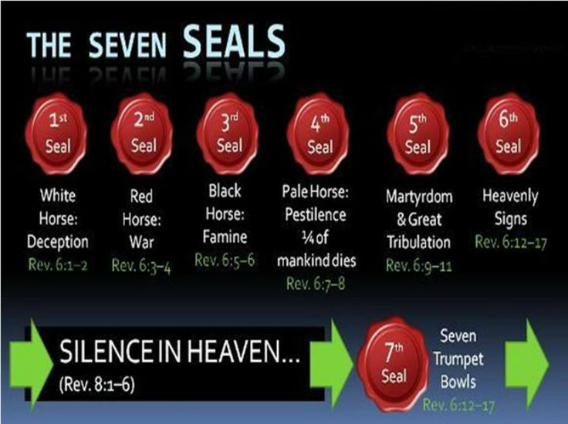

Slide 2
Seal 3 the black horse released

Slide 3
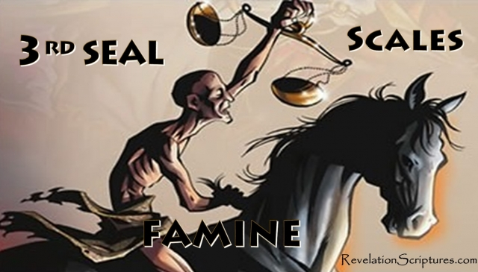

Slide 4
Rev 6:5-6 The Third Seal: Famine
5And when he had opened the third seal, I heard the third beast say, Come and see. And I beheld, and lo a black horse; and he that sat on him had a pair of balances in his hand. 6And I heard a voice in the midst of the four beasts say, A measure of wheat for a penny, and three measures of barley for a penny; and see thou hurt not the oil and the wine. (NKJV)

Slide 5
In reality Famines have been around for a long time. Some of the first ever famines in history recorded go as far back as 2200 B.C. In the Bible you had Moses in 1480 B.C with Egypt's plagues then the Elisha famine with the 3 lepers around 850 B.C then Joseph in Egypt around 345 B.C. Up unto the 19th century in over 2000 years there has been an estimated 200 million or so famine related deaths. In the 19th century alone by 2017 there has been up to 150 million famine related deaths in 100 years . That’s a massive increase in famine related deaths.
Most past famines are from drought a lack of water current 19th century famines are drought related and man made through wars. Currently from 2017 – 2019 in five nations Ethiopia, Kenya, Somalia, South Sudan and Yemen there are up to 80 million people facing crisis level food shortages, there is an estimated 20-30 million people at high risk of major famine right now. As of 2019 famine has already started in Yemen and South Sudan in all of these nations people are starving. There has been an acceleration and an increase in famine related deaths in the 19th century due to larger populations. (Video)

Slide 6
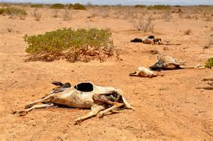

Slide 7
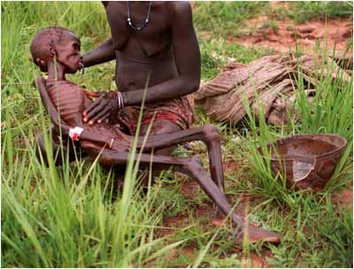

Slide 8
The financial crisis of 2008 rivaled that of the 1929 great depression each economic crash lost an estimated 70 trillion dollars both in 1929 and 2008 causing worldwide issues with economic melt downs, mass job losses, famines, increased food prices and cash strapped economies. There have been many deaths, wars, riots and upheavals since the 2008 stock market crash. This has affected every economy in the world a true worldwide economic disaster with increasing food prices, global industrial slow down and increased inflation this is happening everywhere. There is the looming worldwide fresh water shortage at present 1 in 9 people on earth (780 million) have no access to water or clean water with 3.5 million dying each year, this will increase food shortage due to less water for food production along with increased population numbers.

Slide 9
More than half of humanity will be living with water shortages, depleted fisheries and polluted coastlines within 50 years because of a worldwide water crisis, warns the United Nations. Severe water shortages affecting at least 780 million people today will affect 4 billion people by 2050. A growing global food shortage has caused prices to double in recent years, scientists blame climate change as a factor in an equation that includes increased population and scarce water supplies. Currently around 820 million people suffer from hunger worldwide. That’s almost 12 percent of the world’s population of 7.5 billion people . Recently since 2019 -2020 more people around the planet are potentially at risk of hunger as a result of droughts, locusts, Covid 19, pestilence economic collapse and conflicts. There is a worldwide food shortage in many countries at present. There is radiation poisoning (Fukushima one third of world’s oceans poisoned since 2011) along with mass rubbish pollution in the Pacific Ocean . The world’s oceans are having increased mass die offs of sea life. In the last 6 years the world population has been consuming more food than what’s been available or grown worldwide food stocks are very low. You have the evil agenda of Marxist socialism destroying nations promoted through the liberal left at the UN and in western nations to bring about economic chaos and collapse.

Slide 10
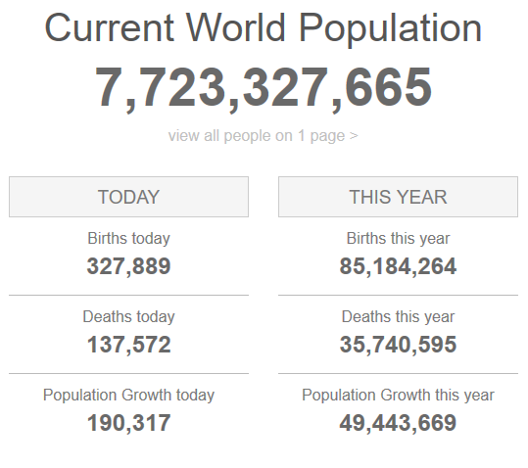
Live world population clock picture taken 8.30pm - 9/8/2019
https://www.worldometers.info/world-population/?fbclid=IwAR2COk-RA--nkbM2qUVMBWE-scWjcBo8H2LRzyYrdgpxYQPr-IXiu2viMUM

Slide 11
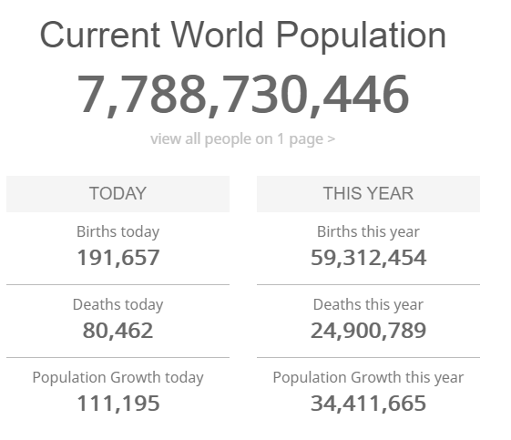
Live world population clock picture taken at 12:01pm -3.6.2020 increase of 65 million in 10 months.

Slide 12
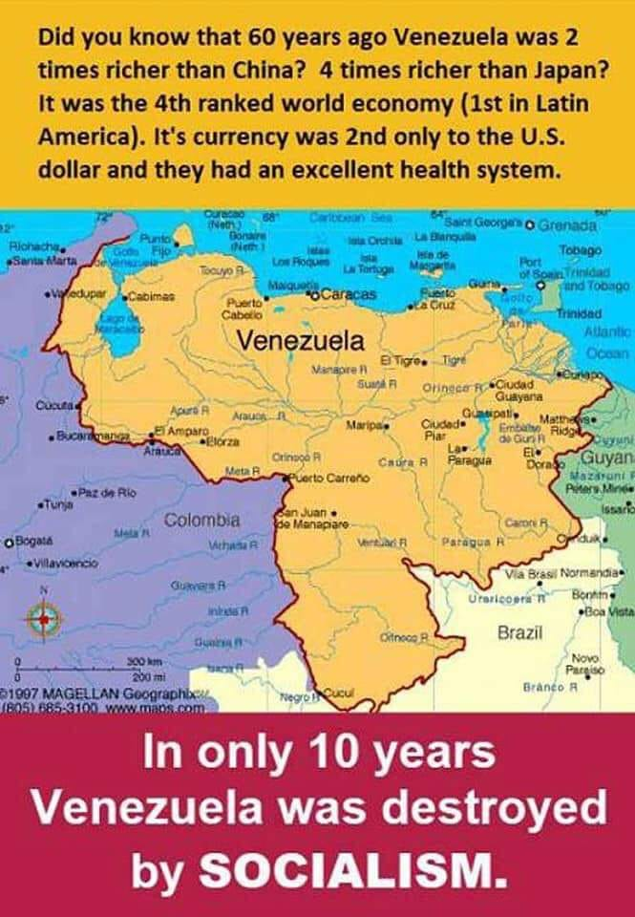

Slide 13
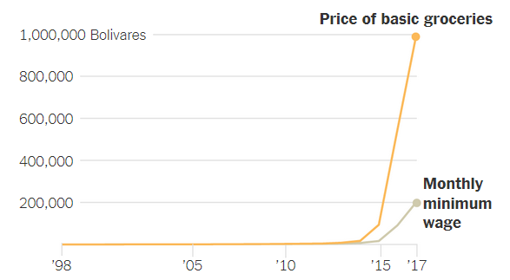
In recent times you have seen Venezuela socialism now turned into a dictatorship once one of the richest countries in South America, food prices have skyrocketed through inflation, forcing many to scavenge for things to eat. The cost of basic groceries is now about five times the minimum wage. It has a population of 28.5 million now starving in chaos.

Slide 14
Some 19th century famines SOMALIA: In 2011, Somalia suffered a famine that killed 260,000 people in south and central regions. NORTH KOREA: From 1995-1999 between 2.8 million and 3.5 million people died because of a combination of flooding and government policy . ETHIOPIA: The Marxist policies of Mengistu a country ravaged by economic decline, famine and regional conflicts, in the famine, up to one million Ethiopians starved to death. CAMBODIA: Up to 2 million died of famine following a decade of conflict during the 1970-1975 civil war. CHINA: Between 10 and 30 million people died as a result of Mao Zedong’s Great Leap Forward in the late 1950s. China’s leaders ignored the severity of the famine as from 1958 until 1961. SOVIET UNION: Up to 8 million people died as a result of Josef Stalin’s forced famine program in the Soviet Union in the early 1930s.

Slide 15
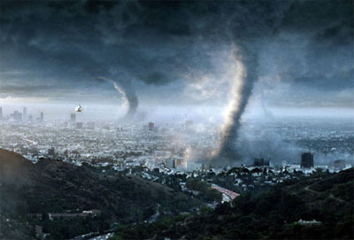
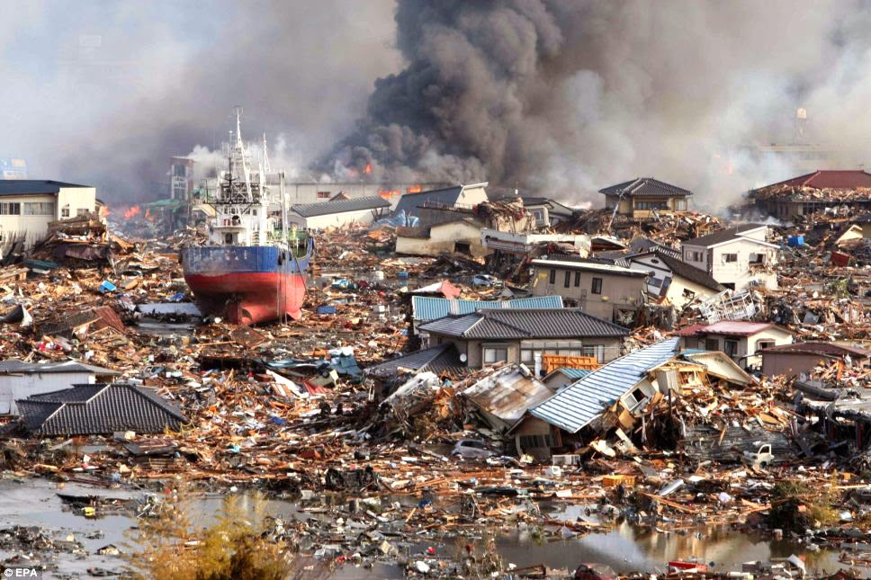
In our modern 20th century with major weather disasters increasing, increases in sin, pollution, diseases, wars, disasters, Tsunamis, earthquakes, super storms, Tornados, fires, floods , greed and civil unrest in nations we are heading for a worldwide major economic meltdown. We have food shortage, water shortage, chaos and over population. This causes mass animal and human deaths , we are in the last days before Christ’s return the 3rd seal is loosed..

Slide 16
