Slide 2
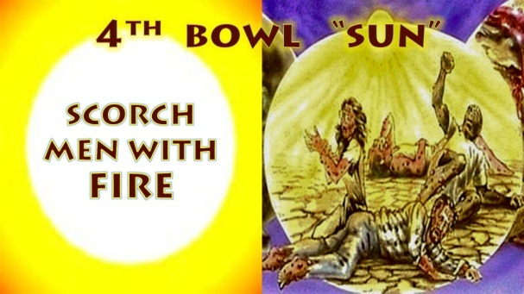

Slide 3
4th Bowl “Men are scorched with fire and heat”
Revelation 16:8-9
8And the fourth angel poured out his vial upon the sun; and power was given unto him to scorch men with fire. 9And men were scorched with great heat, and blasphemed the name of God, which hath power over these plagues: and they repented not to give him glory. (NKJV)

Slide 4
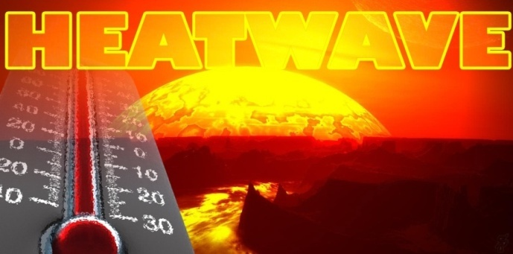

Slide 5
The climate dice are now loaded," NASA's James Hansen said in August 2012. These heat waves used to be exceedingly rare. From 1951 to 1980, extremely hot temperatures affected only one-tenth of one percent of the globe, in the climate records. But in the last three decades, extreme heat events have become more widespread and now affect about 10 percent of the globe. In another decade, the number could rise to about 17 percent. http://news.nationalgeographic.com/news/2012/08/120803-global-warming-hansen-nasa-heat-waves-science/ Over 31 000 scientists say Catastrophic Man Made Global Warming is a complete hoax and science lie. There are the more than 31,000 American scientists (to date) who have signed a petition challenging the climate change narrative , 9,029 hold PhDs in their respective fields. https://www.naturalnews.com/055151_global_warming_science_hoax_climate_skepticism.html?fbclid=IwAR0qZ7TT8iBlGQUQg2ninVatmsGOtddqKXc50OHTrNw83cATVBEVewSZNoE (Video’s Heat wave and Ozone)

Slide 6
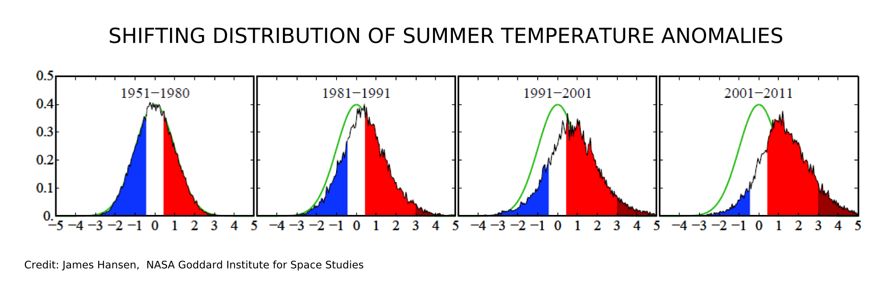
Al Gore the US vice President from 1991-2003 pushed the false Global warming agenda worldwide. He went from 2 million in 1991 to 100 million in 2016 in wealth due to his agenda. The global warming theory has been squashed by scientists as a hoax even though the UN and Paris Accord push it to gain billions in revenue. An increase in temperature spikes causing flare ups in various regions has happened throughout periods in history. It was in 1991 worldwide heat waves were on the increase the same time the 4th Trumpet was released with Kuwait. There is a Ozone layer over the Earth that fluctuates causing atmospheric changes in radiation and light levels getting through to the Earth (Isaiah 30:26).

Slide 7
Ozone hole depletion has only been recorded since 1987 prior to this no one knows. In the upper atmosphere, ozone has a helpful effect by absorbing harmful ultraviolet rays of sunlight. At the surface of the earth, it is harmful to forests, crops, human and animal health, as well as building materials.The Ozone Hole depletion over the Antarctic allows greater radiation directly into the Earth’s atmosphere, causing atmospheric issues and an increase in skin related cancers. The Ozone Hole depletion in the Antarctic is near New Zealand and Australia who both have the highest skin cancer per head of population in the world. Before 1900 going back to 1757 only 3 major heat waves were recorded in 143 years. There have been 23 heat waves in 84 years in the world from 1901 to 2000. There have been 56 major heat waves from 2001 to 2019 killing millions in 14 years an increase of 90% as well as increased water shortage. A heat waves occur when a high air pressure system happens in the atmosphere, warm air is forced down it becomes trapped without cooling causing dry heat. Heat waves are becoming hotter, lasting longer and occurring more often with an estimated 11.5 million deaths this century from drought and heat waves.

Slide 8
There are huge numbers of people perishing worldwide through freak heat waves the forth bowl manifesting on the earth poured out in the 21st century. The year 2014 was the hottest worldwide ever recorded with some of the hottest recorded temperatures known since worldwide temperature record keeping began in 1880 and is expected to rise with more heat waves to come effecting millions killing many. At least 4,500 Australians have died from heat waves since the year 1900. In the European heat wave of 2003, some 70,000 people died. The Russian heat wave of 2010 killed around 55,000 people. In Paris alone in 2003, some 15,000 died in the heat wave. Back in 1961, heat waves with temperatures above the average covered about 1% of our planet's land area. By 2010, this had risen to about 5%. , then to an estimated 10% by 2015 by 2020, it's expected to rise to 10% and by 2040 it is estimated at up to 20%.

Slide 9
In other words, before the middle of this century, when heat waves hit, they will cover about one fifth of all the land area on Earth. In early 2015 in southern India 2600 people died in a heat wave near Hyderabad also killing more than 17 million chickens, as reported on world news channels. Another 1200 people died in a heat wave in Pakistan by June 2015. By mid 2015 heat waves had also hit Alaska, north Canada, central Europe, USA, UK, North Africa, Spain, Portugal, France and Russia. The 2018 Japan heat wave saw 22 thousand hospitalized with 80 deaths. Even though deaths have lessened in the last few years through better treatments the heat waves continue to hit hard.

