Slide 2
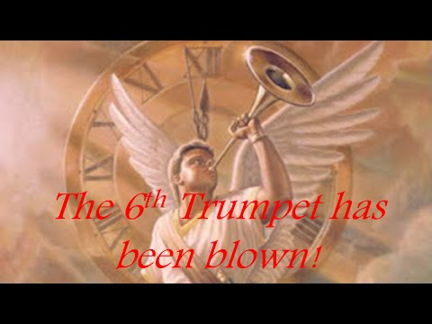

Slide 3
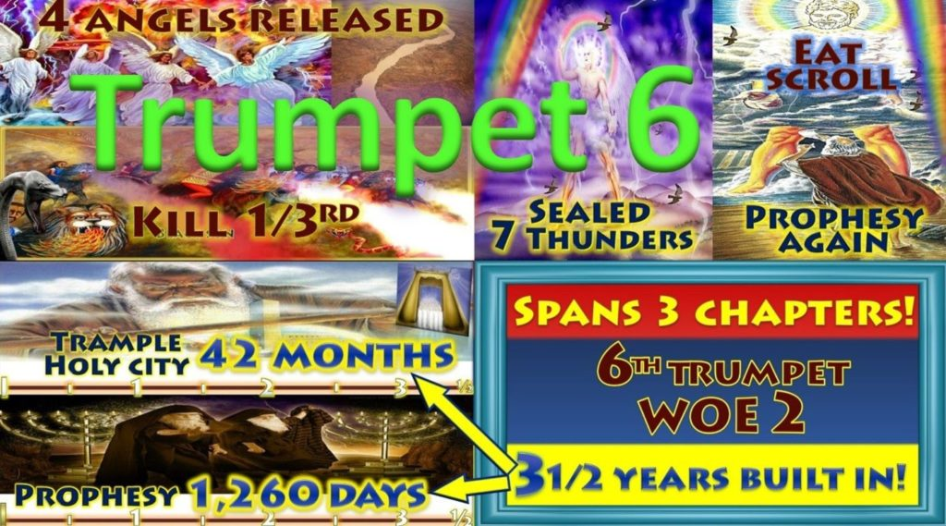

Slide 4
6th Trumpet Rev 9:13-21 “2nd Woe”
The Angels from the Euphrates
¹³ Then the sixth angel sounded: And I heard a voice from the four horns of the golden altar which is before God, ¹⁴ saying to the sixth angel who had the trumpet, “Release the four angels who are bound at the great river Euphrates.” ¹⁵ So the four angels, who had been prepared for the hour and day and month and year, were released to kill a third of mankind. ¹⁶ Now the number of the army of the horsemen was two hundred million; I heard the number of them. ¹⁷ And thus I saw the horses in the vision: those who sat on them had breastplates of fiery red, hyacinth blue, and sulfur yellow; and the heads of the horses were like the heads of lions; and out of their mouths came fire, smoke, and brimstone.
¹⁸ By these three plagues a third of mankind was killed, by the fire and the smoke and the brimstone which came out of their mouths. ¹⁹ For their power is in their mouth and in their tails; for their tails are like serpents, having heads; and with them they do harm. ²⁰ But the rest of mankind, who were not killed by these plagues, did not repent of the works of their hands, that they should not worship demons, and idols of gold, silver, brass, stone, and wood, which can neither see nor hear nor walk. ²¹ And they did not repent of their murders or their sorceries or their sexual immorality or their thefts. (NKJV)

Slide 5
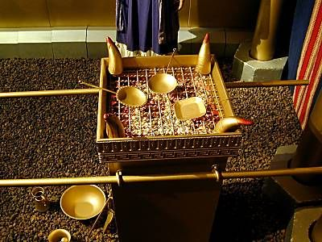
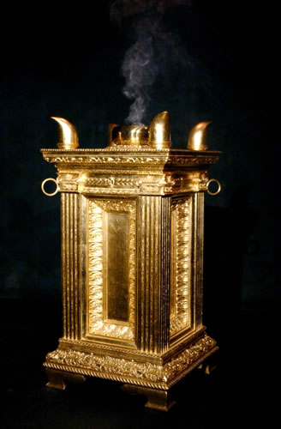
Rev 9:13-21 “Historical Breakdown”
13And the sixth angel sounded, and I heard a voice from the four horns of the golden altar which is before God, The golden alter of incense is a picture of worship and praise before God
14Saying to the sixth angel which had the trumpet, Loose the four angels which are bound in the great river Euphrates In the Bible the only angels that God binds in chains (2 Peter 2:4) are fallen angels, these four angels (In strategic positions) are angels of evil origin. There are four nations that encircle the Euphrates River they are Turkey, Syria, Iran and Iraq. These nations were formed from the 1st Trumpet WW1 defeat of the Ottoman Empire. The four fallen angels are bound in the river that runs through these four nations (positioned there over 2000 years ago) starting in Turkey ending in Iraq.

Slide 6
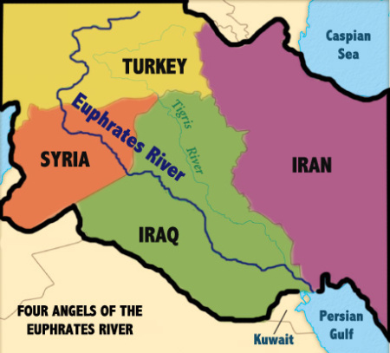

Slide 7
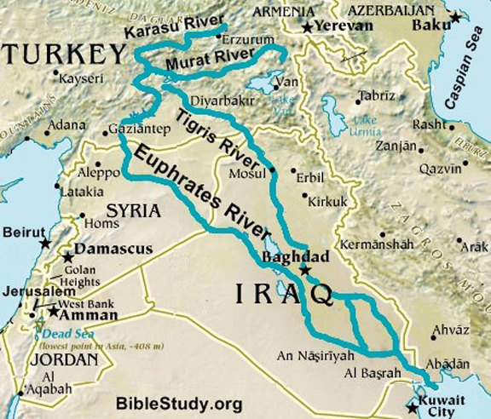

Slide 8
¹⁵ So the four angels, who had been prepared for the hour and day and month and year, This day month and year in the 6th Trumpet prophecy is specific along the Euphrates over four nations . This time line began with the conflict in Syria in 2011, then the “war against the saints “ tribulation Rev 13 :5-7 was loosed a “42 month period” under the Rev 13 beast, in Iraq and Syria Satan used Hezbollah and Isis in the lands of Abraham the birth grounds of the church at the end of 42 months the number of Christians lost from the region now numbers 2.2 million . Both Turkey and Iran have been heavily involved in the Syria and Iraq conflicts all four nations are in conflict in the region. This then leads us into the “42 months” trampling of Jerusalem found in Rev 11:2 at Gods appointed time referred to as the “Great Tribulation” . (Video) were released to kill a third of mankind.

Slide 9
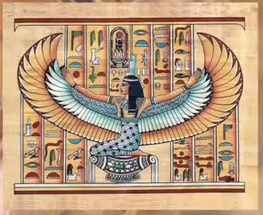
Isis (Islamic State of Iraq and Syria) entered Iraq in 2014 they used the same name as the Egyptian Goddess “ISIS” whom has the physical form of an angel. Its not the flesh we are up against but principalities, powers and rulers of darkness Eph 6:12.

Slide 10
¹⁶ Now the number of the army of the horsemen was two hundred million; I heard the number of them.
Islam in the past was well known for its horse men in war. In these four countries alone Turkey, Syria, Iran and Iraq 97% are Muslim . In 2012 at the beginning of this prophecy the population in each country was Iraq at 32’580’000, Iran 76’420’000, Syria 22’400’000 and Turkey 74’000’000 this equals a total population of 205’400’000 people in these four nations (exact). This fulfills the 200 million people army (Islamic) in the region as mentioned in verse16 of this prophecy. Muslims all believe the same Quran they are militant in their root beliefs. Just as God calls his church an army of saints Islam is an army as well. When we see the term radical Islamists the definition of “radical” simply means returning to the origins the roots. This is a term used by westerners and mainstream media to explain away Islamic Jihad atrocities. There are no radicals or moderate Muslims Islam is Islam they have the call of silent Jihad (when in small numbers) political Jihad (more than a few) or militant Jihad (when many) over nations all are involved in this cause.

Slide 12
Isis entering Iraq early 2014
A dream came in August 2014 of 200 million demonic solders being raised up through Iraq (Muslim population of the four fallen angel nations in 2012) this was tied into Isis. I then saw Isis get defeated pushed out of Iraq (happened by end of 2017 under Trump and Putin a 6th Trumpet fulfillment) .
This has now happened with international coalition forces such as the Kurds, Iraq, USA, Australia, Russia, France, UK, Denmark and Belgium onwards the 6th Trumpet has been blown. By 2015 up to 60 coalition nations were involved in the conflict with Isis.

Slide 13
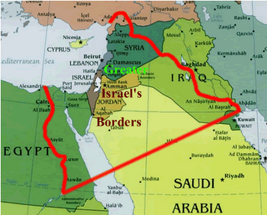
The Euphrates river the four fallen angels are positioned in, runs through four nations . This was also the lands end times prophecy was first released in through prophets like Daniel, Jeremiah, Ezekiel, Malachi, Joel and John the Revelator. It is the lands given to Abraham by God under covenant forever, the land Jesus was born in and where He is returning to when the 7th Trumpet is sounded.

Slide 14
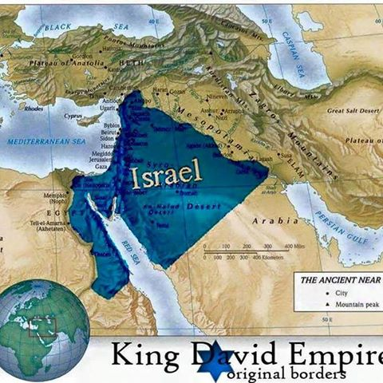

Slide 15
The four angels in the Euphrates are also connected to the drying up of the Euphrates River through their influence over men as found in the 6th Bowl poured out , this includes the beast and false prophet or Rev 13.
Rev 16:12 -13 Then the sixth angel poured out his bowl on the great river Euphrates, and its water was dried up, so that the way of the kings from the east might be prepared. And I saw three unclean spirits like frogs coming out of the mouth of the dragon, out of the mouth of the beast, and out of the mouth of the false prophet.
The four fallen angels are released to kill with a plague of conflict of fire smoke and brimstone in the region through out the 6TH Trumpet fulfillment . Rev 9:15 “four angels were released to kill a third of mankind”. This “third of mankind” crosses over into “Armageddon“ in Rev 16:16 the 6th bowl, when this bowl is fully fulfilled Jesus then returns at the “7th Trumpet 3rd woe “ killing the enemies of Israel Rev 11: 18, Ez 38:21-23, Ez 39:1-7. This also fulfills the two witnesses being raised from the dead Rev 11 and the Ezekiel 38 and 39 war against Israel with Christ's return.
You can’t get to Christs return without going through the 6th Trumpet and the 6th bowl being released they are connected you also must have the Rev 14:14-16 , “2nd angel worldwide harvest of souls” before He returns as the Rev 14:17-19, 3rd angel is part of the wrath of God at the 7th Trumpet blast.

Slide 16
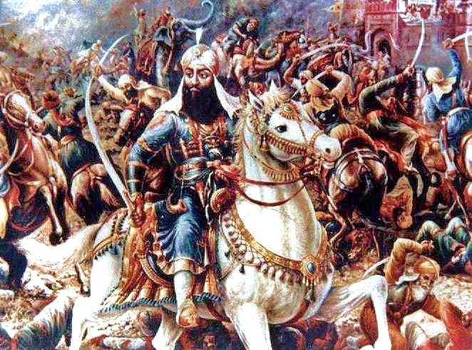
¹⁷ And thus I saw the horses in the vision: those who sat on them had breastplates of fiery red, hyacinth blue, and sulfur yellow; “Red” “Blue” and “Yellow “are defining colors of Muslim nations . The Islamic religion uses these three specific colors on its places of worship “mosques” flags and banners unlike any other religion on Earth. The colors red blue and yellow were also worn by ancient Islamic warriors on their battle clothing and breastplate armor (prophetic symbolism). These three colors are also used by the Ottoman Empire nation in modern Turkish armed forces on uniforms..

Slide 17
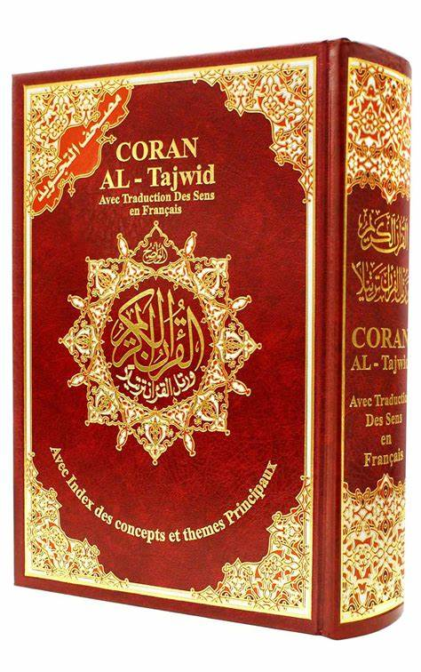
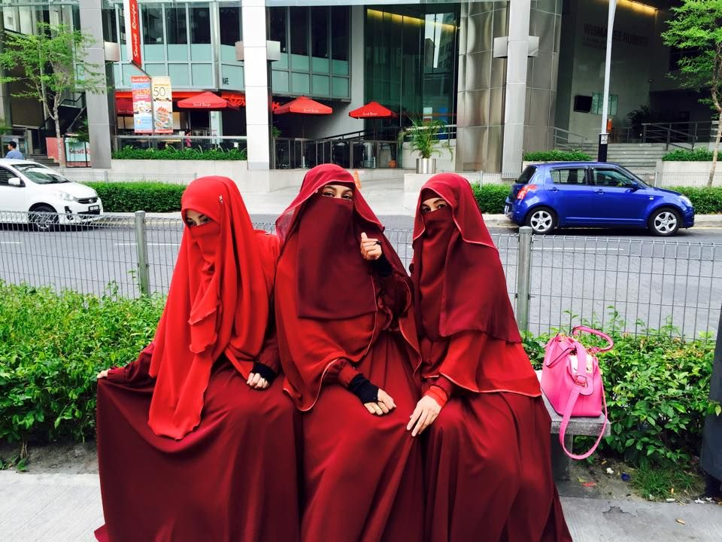
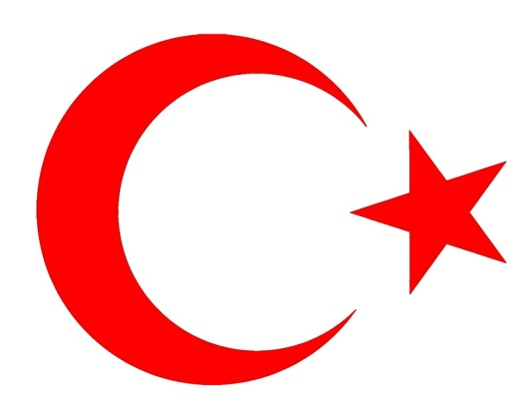
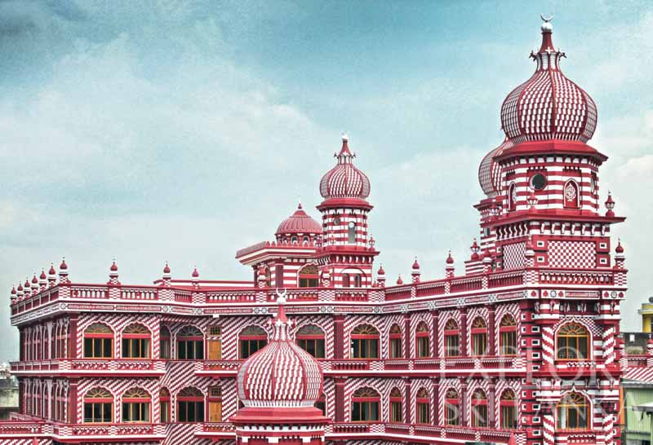
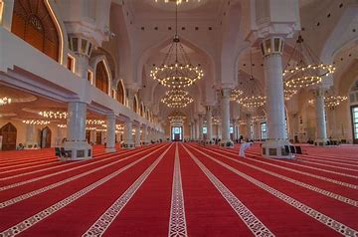
Fiery red in Islam

Slide 18
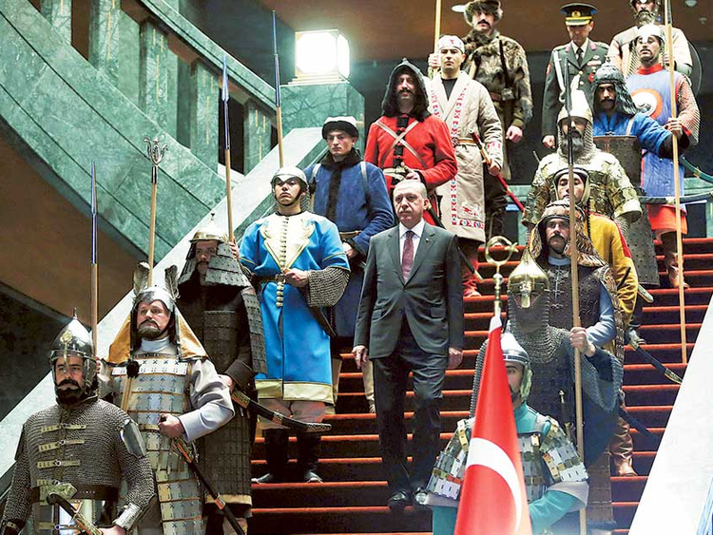
Turkish President Recep Erdogan (false prophet) descends a staircase lined by an honour guard wearing traditional military uniforms from the era of the Ottoman Empire with red blue and yellow.

Slide 19
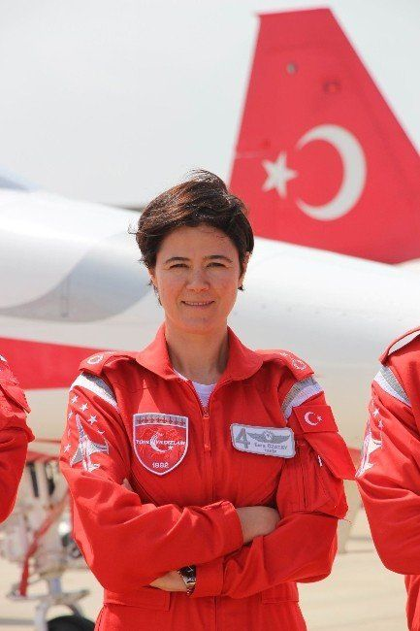
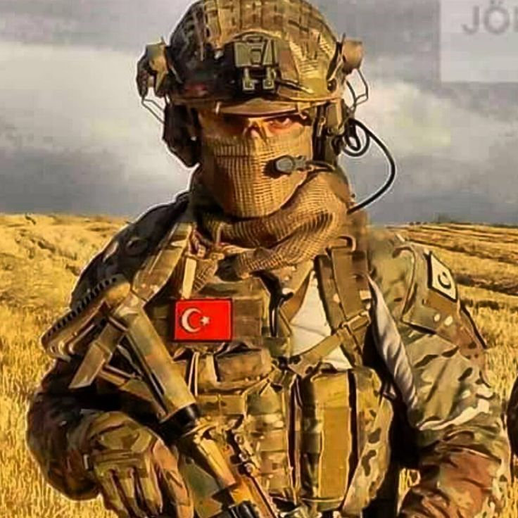
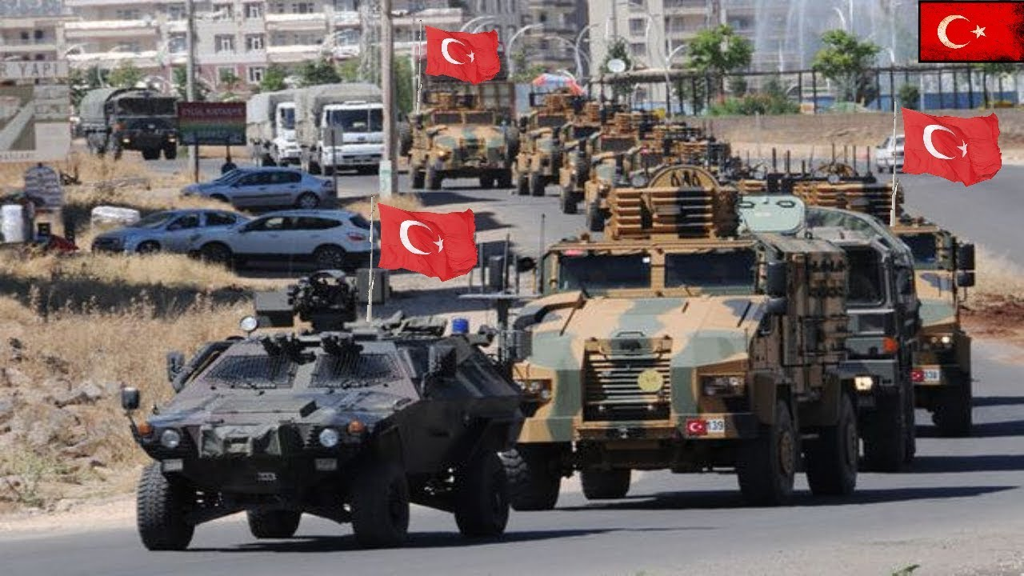
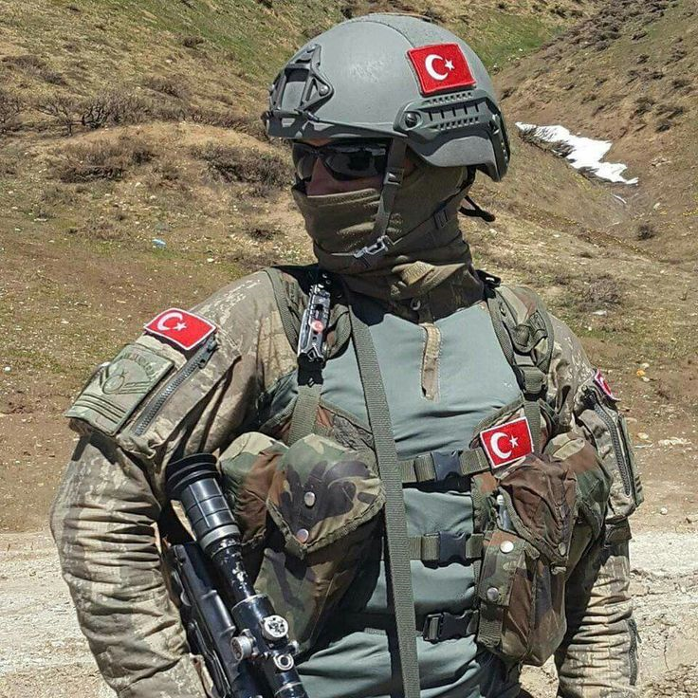
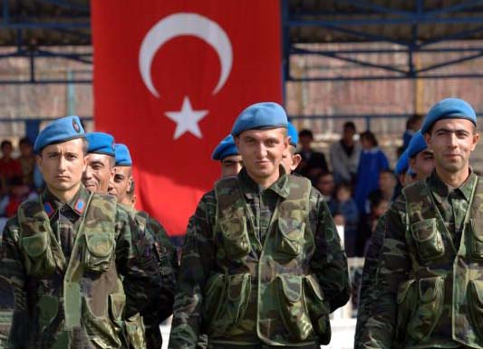

Slide 20
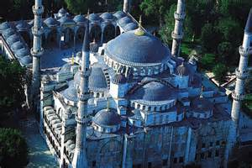
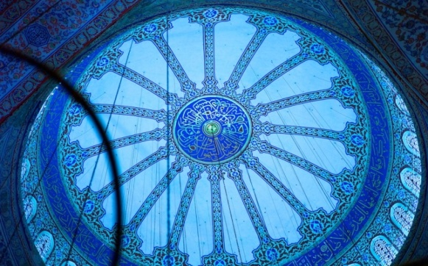
breastplates of fiery red, hyacinth blue, and sulfur yellow Hyacinth blue the color blue was used on Muslim battle dress along with red. Blue is used both on the inside and outside of Islamic mosques this color in Islam is for protection it is considered a secondary color to green as worn by Muhammad. Blue is the color of protection in Islam.

Slide 21
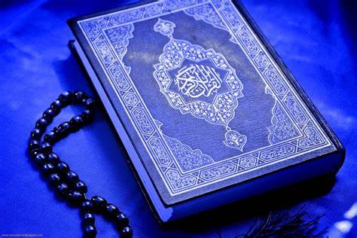
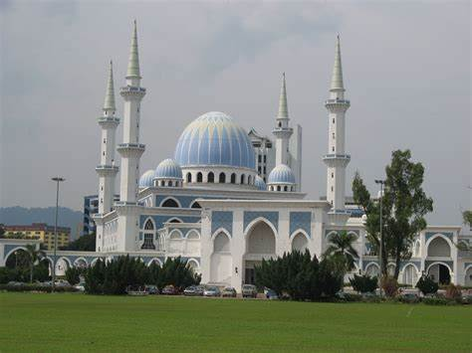
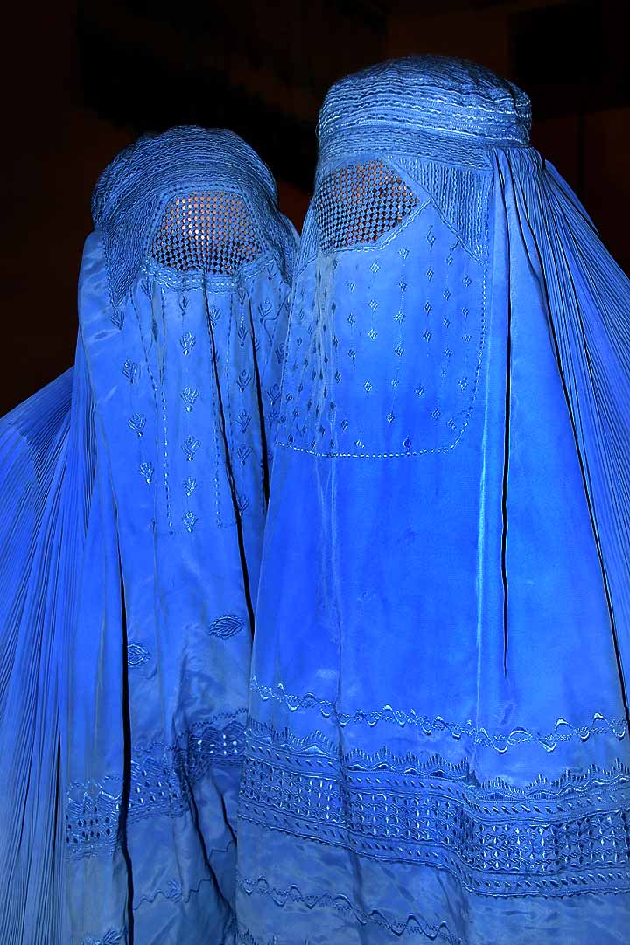
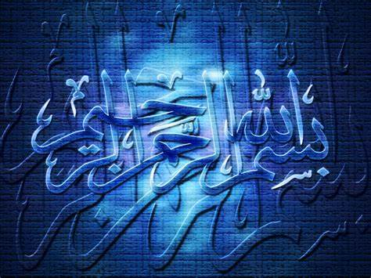
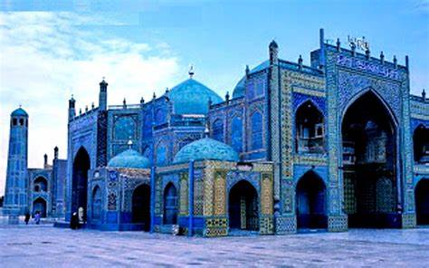
Hyacinth blue in Islam

Slide 22
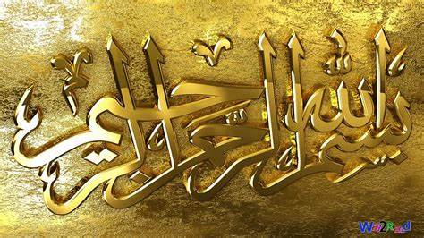
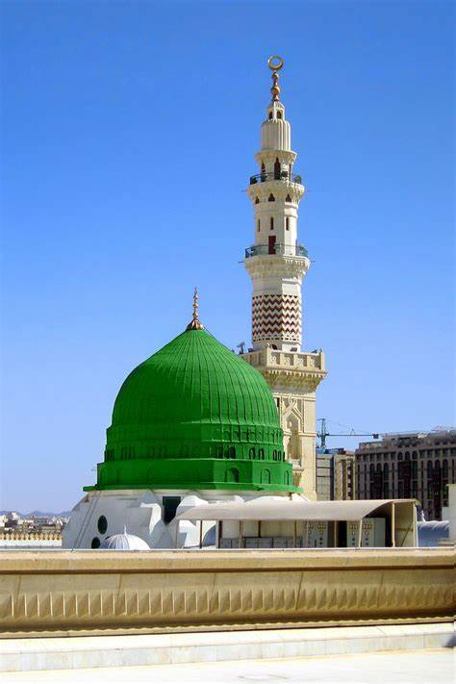
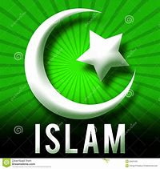
breastplates of fiery red, hyacinth blue, and sulfur yellow
Sulfur Yellow the color yellow or gold is a color of paradise in Islam it also means wisdom it was a color used on the Ottoman empire flag surrounding the moon crest and star of the Ottoman empire for over 700 years . It is also used on other Islamic flags in Arab nations. The color Green in Islam represents paradise, heaven and life. It was worn by Muhammad it is also used on mosques on Islamic head and arm bands:

Slide 23
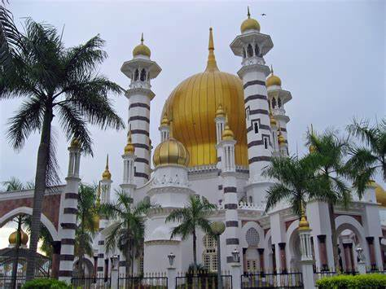
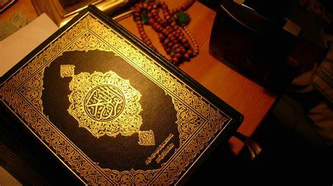
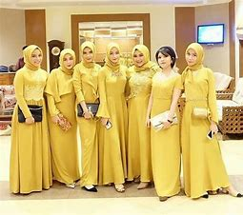
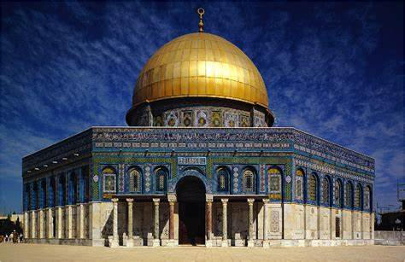
Sulphur Yellow in Islam

Slide 24
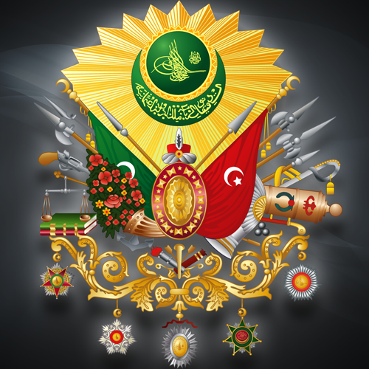
Old Ottoman Empire seal

Slide 25
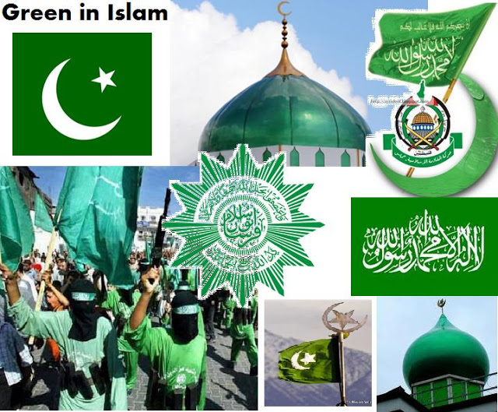

Slide 26
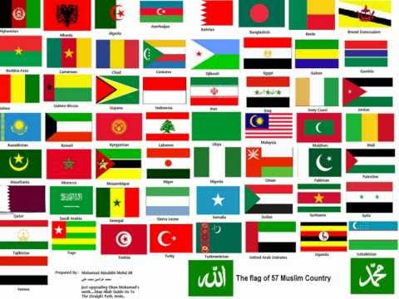
All colours of Islamic flags

Slide 27
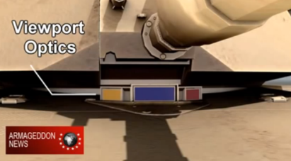
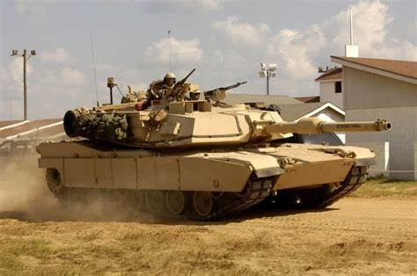
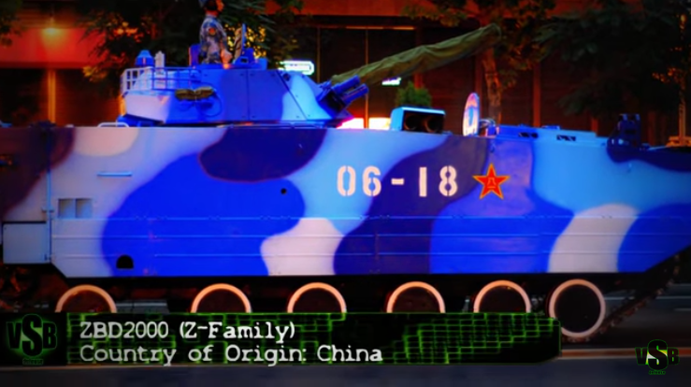
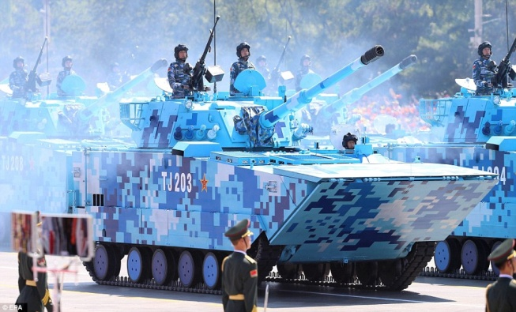
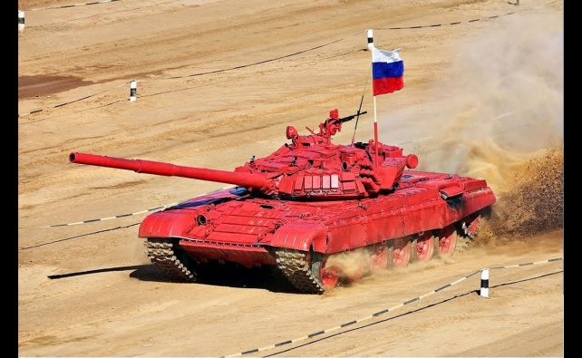
T
and the heads of the horses were like the heads of lions; and out of their mouths came fire, smoke, and brimstone.
The colors John the revelator saw the “breastplates of fiery red, hyacinth blue, and sulfur yellow” are also the exact colors on tank breastplate viewpoint optics for firing turrets. Tanks could have been seen as horses 2000 years ago carrying men. These colors red (Fire), blue (Jacinth) and yellow (Brimstone) are armor colors on tanks in the Middle East . Tanks shoot fire smoke and brimstone like stings as do all missile launchers. (Word Doc)

Slide 28
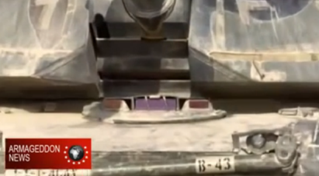

Slide 29
Isis in Yellow T-55 tank

Slide 30
Fire Smoke and Brimstone

Slide 32
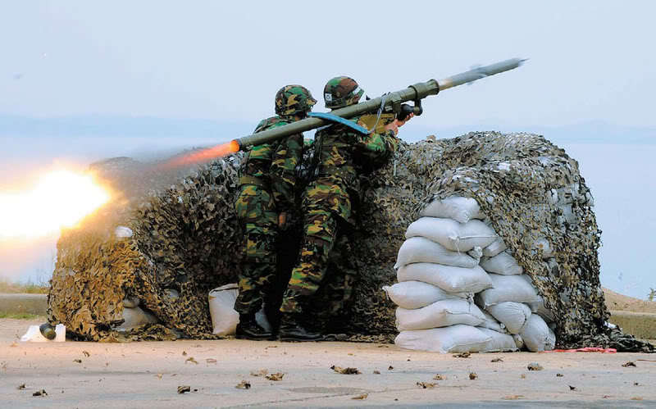
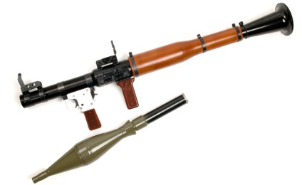
¹⁸ By these three plagues a third of mankind was killed, by the fire and the smoke and the brimstone which came out of their mouths. ¹⁹ For their power is in their mouth and in their tails; for their tails are like serpents, having heads; and with them they do harm. Missile launchers look like fiery tails that sting in behind with smoke and brimstone out the mouth. In Sept 2011 ground to air Grinch SA-24 and SA-7s 20’000 heat seeking shoulder launched missiles went missing in Syria from weapon depots Obama refused to protect, only to turn up in the hands of Muslim extremists such as Isis and Hezbollah. The Apostle John was seeing modern weapons 2000 years ago.

Slide 34
Isis fighter with RPG-29

Slide 35
²⁰ But the rest of mankind, who were not killed by these plagues, did not repent of the works of their hands, that they should not worship demons, and idols of gold, silver, brass, stone, and wood, which can neither see nor hear nor walk. ²¹ And they did not repent of their murders or their sorceries or their sexual immorality or their thefts. (NKJV)

