Slide 1
9/11
World Trade centre

Slide 2
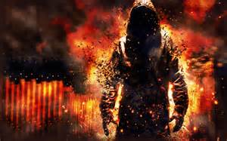
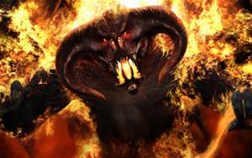
On the 18th June 2000: In a dream a man on fire was coming out of the bush over a hill then a beast on fire twice the man’s size coming in behind him. Both of these creatures were demonic they had come to bring destruction to what was in the dream “Christian city” the bride of Christ. I saw giant demonic strongmen standing over “Christian City” working with these two creatures against the Christians. This is the “Antichrist spirit” coming on the rise in the earth these two beasts worked together (US foreign policy) like vampires grabbing people and sucking the life out of them especially the Christians (The 42 months of warring against the saints ). The Lord then said in the dream “ the next President elected after Clinton is to be a part of the “Book of Revelation” fulfillment (43rd President George W Bush “the man of fire” the 2001, 9/11 towers falling then the 44th President Obama the “Beast of fire” came and the warring against the saints” loosed by mid 2013).

Slide 3
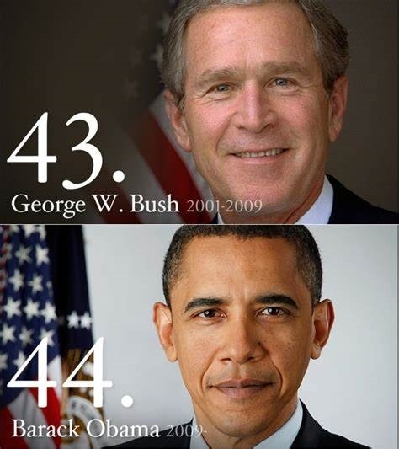
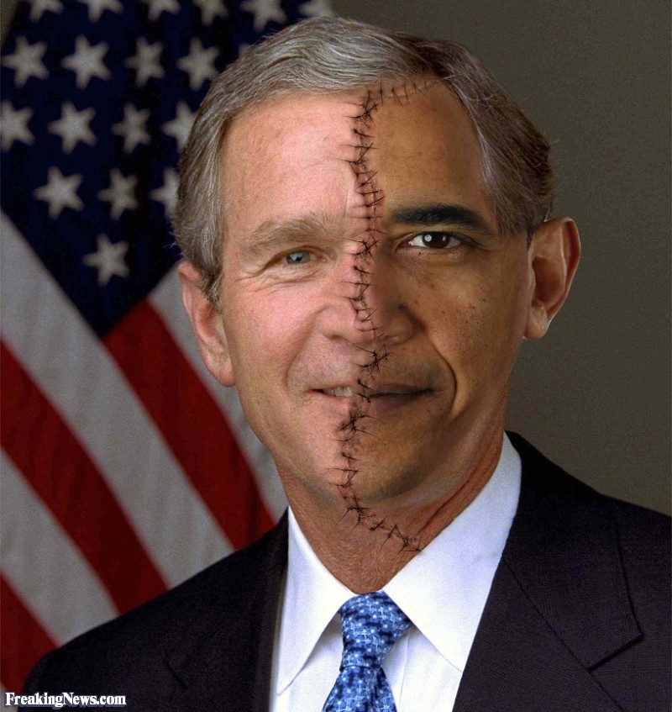
2 demonic men on fire

Slide 4
President George W Bush (2001 – 2009) a liberal democrat he was President at the 9/11 tragedy he blamed Iraq and Osama Bin laden with no evidence at all to support the claims now proven to be fabricated lies. Evidence is now coming forth that this was an inside job by the US government not terrorism but controlled explosives. From this tragedy NATO invoked article 5 allowing its members to respond collectively to self defence starting the Global War on terrorism that still continues. Bush then led the world into a 8 year war in Iraq starting March 19th 2003, killing an estimated 500 thousand to one million people, taking out Saddam Hussein. The 5th Trumpet 1st woe got blown George W Bush was the man of profane fire in the dream. He prepared the way for the Rev 13:1-10 beast to appear. (Video on Bush lies about Iraq)
President Barak Hussein Obama (2009 -2017) a liberal democrat the 2nd beast of fire came to power in 2009 he withdrew all US troops from Iraq creating a terrorist vacuum. The 6th Trumpet was blown under President Obama leading into more conflict in the Middle East. He was heavily involved in the 3 nation Arab spring uprising in 2011. He made nuclear deals with Iran he turned his back on Israel. He spent 10.2 trillion dollars in 8 years he gave billions to Islamic nations. He advanced Islamic ideals in the nations placing many Muslims into US politics he held Islamic prayers in the White House. He became chairman of the UN and negotiated solely the TPPA 40% of the worlds GDP for the corporate rich elite. He loosed the “war against the saints Rev 13:7, 42 month tribulation. He allowed the 2334 resolution through the UN against Israel the first time in 70 years . He refused many Christian refugees into America receiving mainly Muslim. He used predator drones to kill people in the Middle East , he ordered the kills. He said on live TV “I have two words for you Predator Drones, you wont see it coming , you think I’m joking”. he confessed his Islamic faith on live TV .

Slide 5
The Twin Towers World Trade Centre 9/11 is the “Door hinge” to unsealing the Book of Revelations
Sept 11 2001 (Dream Diary)
In a dream last night 5 poison tipped puffa fish (Islamic terrorists planes) were killing animals causing a slow death to these animals (people in nations) by them being filled with maggots (bitterness,, hatred, unforgiveness , corruption). These fish were bouncing up and down hitting animals and people with their sharp spikes. In this dream if a fishes spikes hit you, poison would get in and do something to your heart.
I managed to shoot two fish and killed them on the ground the other two were also shot by another man with me as they bounced into the sky, he blew them to bits with a shot gun. I remember walking along a path with the man with the shot gun. I looked down and saw a duck that was very sick sitting on the ground it was half alive, it had maggots eating its stomach and flesh it was rotting from the inside out (evil and corruption within the US) it had been poisoned. The 5th fish seemed to get away it was smaller than the other 4 that was the end of the dream.
(go to video then maps)

Slide 6
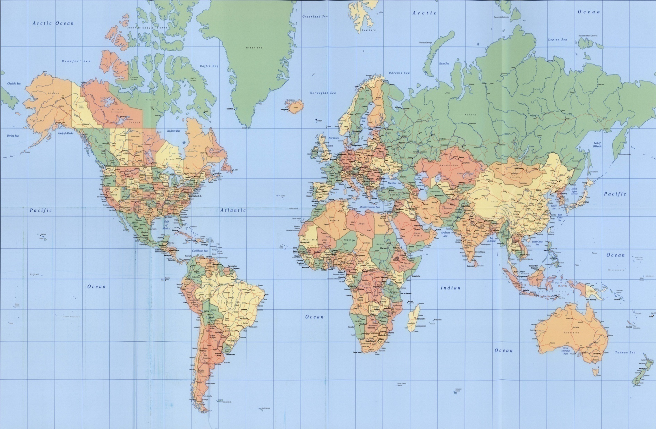

Slide 7
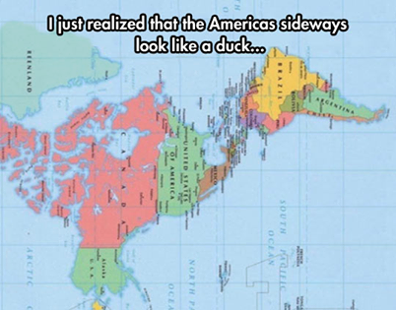

Slide 8
I woke up from the puffer fish dream at 6.30am on the 12.1.2001 to news on TV of terrorist attacks against America. These attacks had just taken place, two planes were reported to have hit the world trade twin towers, one hit the pentagon killing 800 people a forth plane hit the ground killing all on board in Pennsylvania, stopped by heroic passengers. There was no report of a fifth plane over 2740 actually died in the attack. I had seen five puffer fish in the dream. After praying about this dream I had a scripture come to me : John 11::4 “This sickness is not unto death but for the glory of God, that the son of God may be glorified through it” and then Luke 13:1-9 the Galileans and the eighteen who died in a tower that fell on them to for the people to repent. I felt the Lord had said to me through this event He was testing the harvest fields of the nations, to see how ripe it was for harvesting. That repentance was needed in the nations, America had become rotten internally. (16 years on in Jan 2017 Trump gets in Dan 7:22 the favor for the harvest to come in)

Slide 9
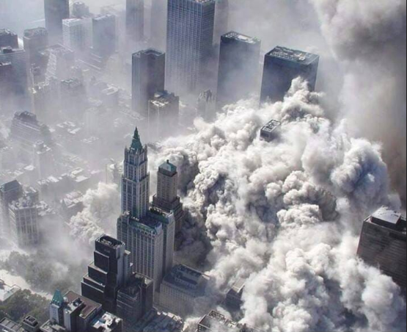
The towers were the one world trade centre, the financial heart of the USA and the world.

Slide 10
I felt strongly men's hearts where being tested in this hour through these times of trouble from 9/11 onwards. That those who took the bait of Satan would become poisoned by the circumstances with bitterness and unforgiveness towards Islamic terrorists (puffer fish spikes) but others would not. This was the beginning of the separation of hearts the chaff from the wheat the goat and the sheep nations was beginning on the Earth , God was going to allow it for harvest. A great famine of His love was now in the nations allowing the mystery of evil to manifest first testing the world. (By 2019 many nations now have Christian leaders) Three years prior to this event in 2001 the Lord had me keep certain articles in my scrap book for a reason I did not know at the time. A week or so after 9/11 news reports were all quoting a false Catholic prophet from the 15th century Nostradamus “fire from the sky prophecy”. God said to me “read the book of Isaiah “. So I did I went through Isaiah looking for a prophecy to do with the twin towers, then I came upon Isaiah 30:25-26 I knew that was it. The three articles I had kept were all in this prophecy.

Slide 11
In this prophecy you find the great slaughter (Live stock in Europe) the sun becoming seven fold (Ozone layer Antarctica) and the towers fall (Twin towers 9/11) exactly as the three articles kept indicated, God was showing me something.
This prophecy by Isaiah was written between 704 BC – 686 BC, 2700 years ago about the towers falling. I then realized this had just begun to be fulfilled in our generation on Sept 11th 2001. This marked the beginning of something from God to unfold in the Earth. A spiritual prophetic seasonal change a in the times and seasons had occurred around the world this was the sound of the 5th Trumpet being blown from heaven. .

Slide 12
Isaiah 30:25-26 : ²⁵ There and on every high hill Rivers will be on every high mountain (Gods mountains Gods river) and streams of waters (outpouring of glory revival waters coming into the earth), In the day of the great slaughter (foot and mouth in UK millions of live stock are slaughtered started Feb 2001 media coverage was worldwide Deut 28:18, 31) When the towers fall. (Sept 11, 9/11-2001 in USA) ²⁶ Moreover the light of the moon will be as the light of the sun (increase in light and radiation Antarctic ozone hole layer depletion a record 10.5 million square miles observed largest ever recorded since 1987 was in Sept 1998 NASA press release) And the light of the sun will be sevenfold (Light radiation increase it’s not the Global warming theory, it’s Ozone hole depletion causing increase in weather anomalies, radiation, heat waves, sun light and cancers in the earth monitored since 1980’s),

Slide 13
As the light of seven days, In the day that the Lord binds up the bruise of His people (This is the worldwide Rev 14:14-16 Harvest Glory outpoured a healing of the saints the bride of Christ from generational antichrist infiltration and persecution culminating with the beasts war at the time and season of the “Fullness of transgression” Dan 8:23 then the 42 months “warring against the saints” takes place as indicated in scripture this happened from mid 2013 to Jan 2017.) And heals the stroke of their wound (supernatural healing from the saints being killed Rev 13:7, the Dan 8:9-14 “2300 days” to the beginnings of the “cleansing of the sanctuary” Joel 2 & Rev 14:14-16”harvest of souls” from 42 months persecution beginnings. See chapter 14A “2300 days” chapter 19 “Twin towers” chapter 35 “warring against the saints”).

Slide 14
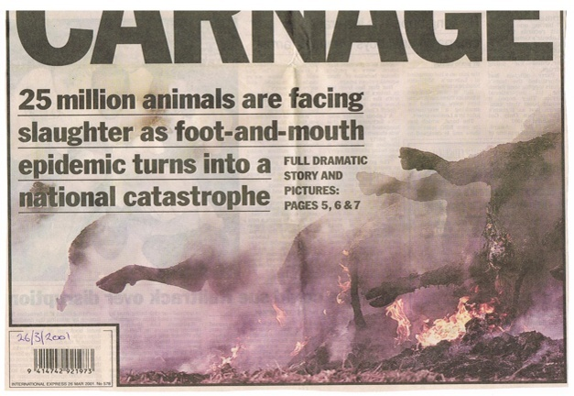
Article: kept in scrap book from 26.3.2001 6 months before 9/11: Deut 28:15 “Disobedience”, 28:18 “Cattle cursed”, 28:21 “plague”, 28:31 “Ox slaughtered”,28:49 “A nation against you from afar a language you will not understand”.

Slide 15
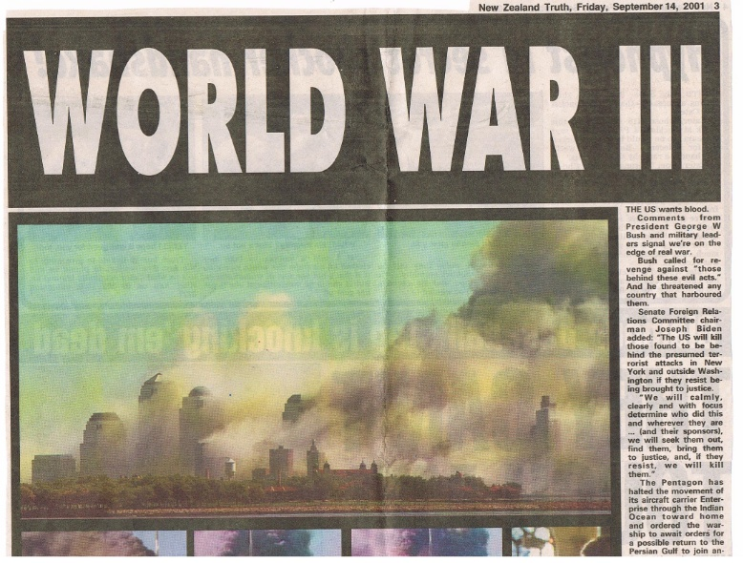
Article : kept in scrap book from 14.9.2001: 9/11 killing 2740 people. End times prophecy of Isaiah 30:25 “In the day of great slaughter when the towers fall” . Isaiah 33:18 “You will meditate on terror, where is the scribe ? Where is he who weighs ? who counts the towers ?”.

Slide 16
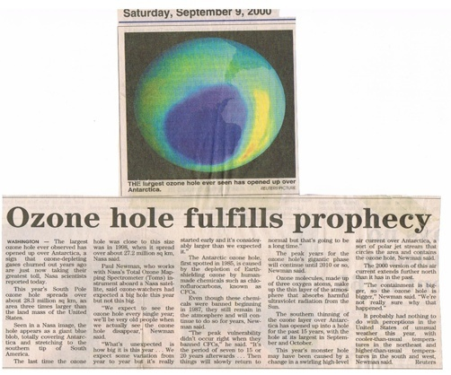
Article: kept in scrap book from 9.9.2000: Ozone hole was first discovered in 1987, 2 years before 9/11. Isaiah 30;26 “light of moon as the sun, light of sun seven fold. In that day the Lord binds the bruise of His people and heals the stroke of their wound”.

Slide 17
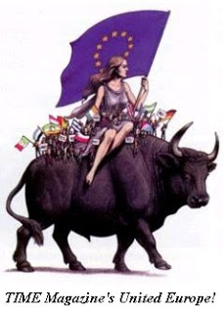
In a second dream the same night I had the 9/11 puffa fish dream there was a person riding a powerful OX at full gallop through all this poo and defecation in the world. This beast is found in Rev 17:3, 7, 8 “The woman of wickedness that rides the Beast”. In Bible symbolegy a woman represents the church “Bride of Christ” and the defiled woman the “Harlot” this particular beast has 7 heads which is the city built on seven 7 hills “the Vatican” influencing nations tied into the EU and UN. This beast with 7 heads and ten horns is generational it transforms itself.

Slide 18
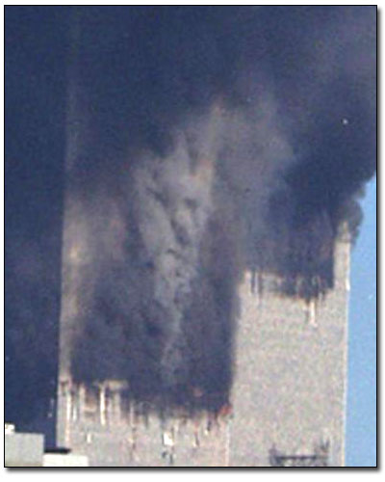
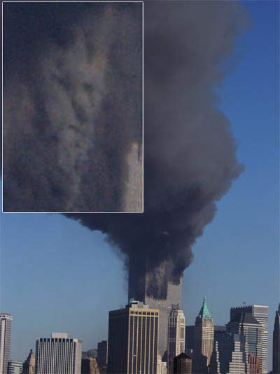

Slide 19
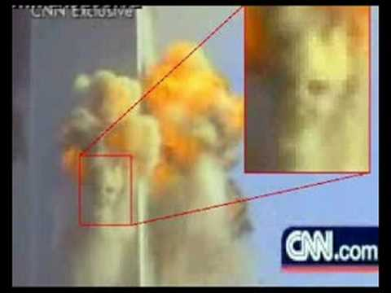
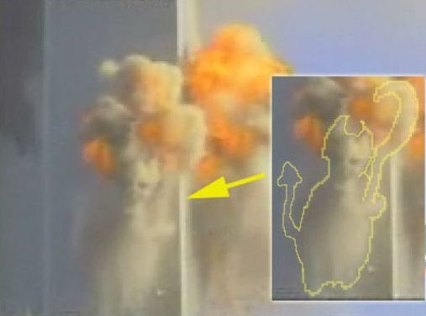

Slide 20
Information came forward 10 days after 9/11 of US intentions in 2001 to go to war against 7 nations starting with Iraq ? (Video) In the year of 2000 there were seven countries without a Rothschild owned or controlled Central Bank: Afghanistan, Iraq, Sudan, Libya, Cuba, North Korea & Iran. In 2001, the United States invaded Afghanistan. In 2003, Da Afghanistan Bank (who picked that name?) was established by presidential decree. In 2003, the United States invaded Iraq. In early 2004, the Central Bank of Iraq was established to manage the Iraqi currency and integrate Iraq into the global financial system. The only countries left by 2003 without a Central Bank owned or controlled by the Rothschild Family were: Sudan, Libya, Cuba, North Korea and Iran. In 2011, the United States bombed the living daylights out of Libya. Before Muammar Gaddafi was even overthrown, the U.S. helped the rebels establish a new central bank of Libya and form a new national oil company. The only countries left by 2011 without a Central Bank owned or controlled by the Rothschild Family are: Cuba, North Korea, and Iran.

Slide 21
Why ? This is the Dragon in Rev 13:4 the beast the woman of wickedness rides in Rev 17:3, Its the feet and toes of the 4th and last empire of Dan 2:40-45 the Holy Roman Empire. Central banking has truly taken over the entire planet. Central banks are specifically designed to trap nations in debt all over the world, people have been told that monetary issues are “too important” to be subject to politics, that the only solution is to have a group of unelected, unaccountable bankers control those things for us. (This is the EU, UN, World Banks rich elite & the Vatican) https://www.zerohedge.com/news/2015-06-10/guess-how-many-nations-world-do-not-have-central-bank

