Slide 2
Rev 16:12-16 the 6th Bowl “Euphrates dries up”
Then the sixth angel poured out his bowl on the great river Euphrates, and its water was dried up, so that the way of the kings from the east might be prepared. And I saw three unclean spirits like frogs coming out of the mouth of the dragon, out of the mouth of the beast, and out of the mouth of the false prophet.
For they are spirits of demons, performing signs, which go out to the kings of the earth and of the whole world, to gather them to the battle of that great day of God Almighty. "Behold, I am coming as a thief. Blessed is he who watches, and keeps his garments, lest he walk naked and they see his shame.“ And they gathered them together to the place called in Hebrew, Armageddon.

Slide 3
Rev 16:12-16 Historic breakdown of events
Then the sixth angel poured out his bowl on the great river Euphrates, and its water was dried up, so that the way of the kings from the east might be prepared.
The Euphrates River began to dry up dramatically for the first time in thousands of years following worldwide reports in 2009. This was the same year Obama “The beast” of Rev 13:1-10 appeared on the scene as US president this was no mere coincidence but a sign of the times.

Slide 4
The Euphrates River is the longest and largest river in southeast Asia at 1740 miles long from its source in eastern Turkey to the Persian Gulf. The river begins at the place where the Karasu and Murat rivers join in north eastern Turkey, it sources its water from melting snow and rainfall from an area of 193’000 square miles of ground. The area around the Euphrates River is known as Mesopotamia. The Euphrates is mentioned first in the Bible in Genesis in Eden along with the Tigris river. 52 species of fish can be found in the Euphrates. The Tigris and Euphrates river at their widest point apart is 250 miles. These rivers are the main source of water for agriculture and humans though out the Middle East many cities line its shores. Only a small part of the river falls within the borders of Kuwait in the Persian Gulf.

Slide 5
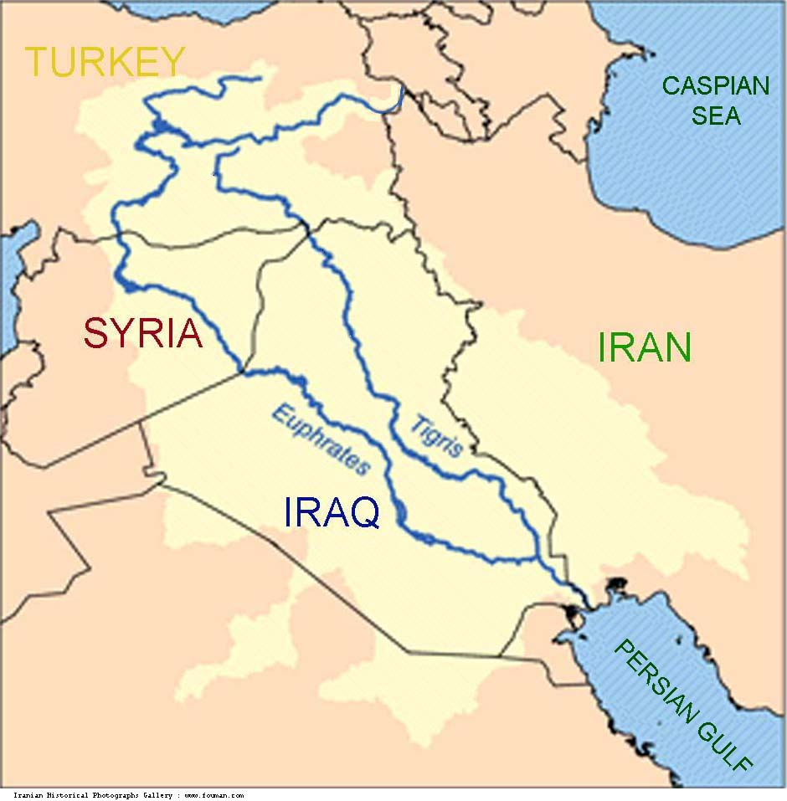

Slide 6
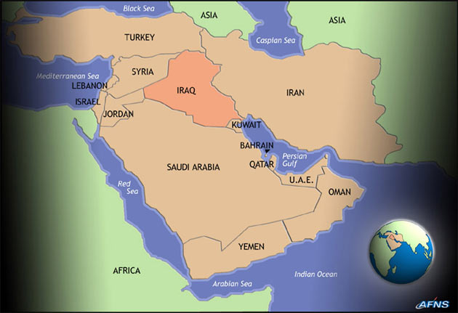

Slide 7
Iraq city before Euphrates dries up

Slide 8
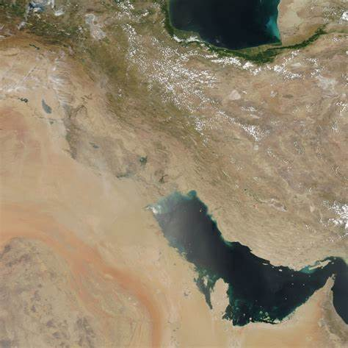

Slide 9
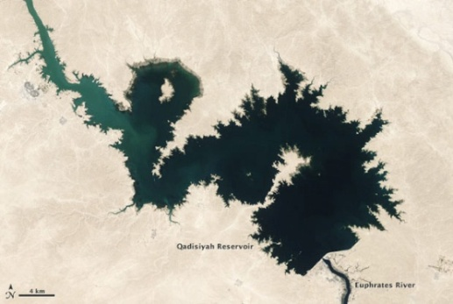
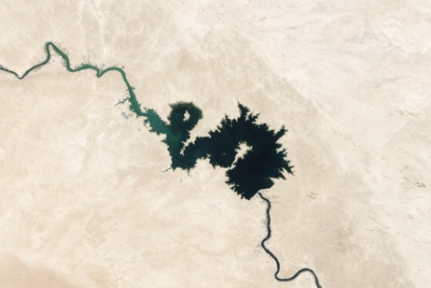
Iraq Euphrates river reservoir 2008 (Tigris Euphrates basin)

Slide 10
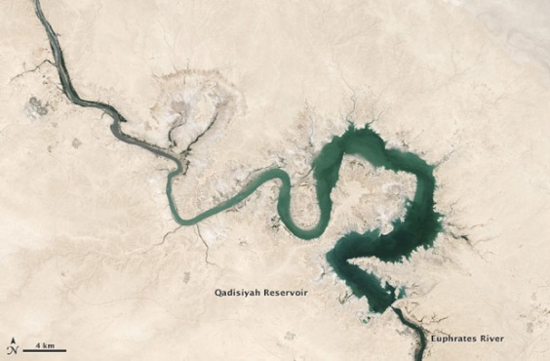
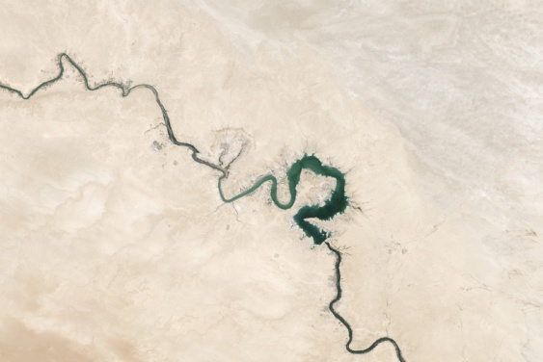
Iraq Euphrates river reservoir 2009 (Tigris Euphrates basin)

Slide 11
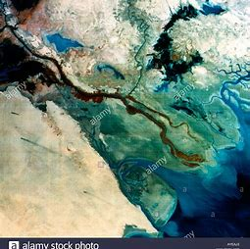
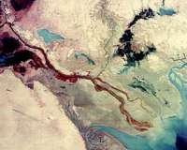
The Iraq gulf basin today Before 2000 2009 onwards

Slide 12
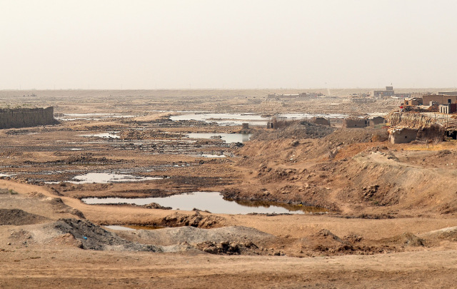

Slide 14
From the 2003-2009 was the 8 year Iraq war with the US, this was the 5th Trumpet through this trumpet we saw major water losses recorded in the region because of damage from war to water infrastructure that has not recovered . In 2009 Turkey dammed the Euphrates River causing greater mass water shortage and Euphrates river shrinkage in Iraq and Syria. Erdagon became president of Turkey in 2016 he built new dams he dammed the river even more by 2017 cutting off further water supply to Syria and Iraq . Turkey has also built dams on the Tigris this could all lead to war over water. Erdagon plans to construct a further 22 dams, with protests from Iran, Syria and Iraq.
Article:
Scientists using the twin gravity-measuring satellites of the Gravity Recovery and Climate Experiment (GRACE) have found that a large portion of the Middle East lost freshwater reserves rapidly during the past decade. The research team observed the Tigris and Euphrates river basins including parts of Turkey Syria, Iraq and Iran they found that 117 million feet (144 cubic kilometers) of fresh water was lost from 2003 to 2009. That amount is roughly equivalent to the volume of the Dead Sea. About 60 percent of the loss was attributed to the pumping of groundwater from underground reservoir. The “GRACE data shows an alarming rate of decrease in total water storage in the Tigris and Euphrates river basins, which currently have the second fastest rate of groundwater storage loss on Earth, after India”.
https://earthobservatory.nasa.gov/IOTD/view.php?id=80613

Slide 15
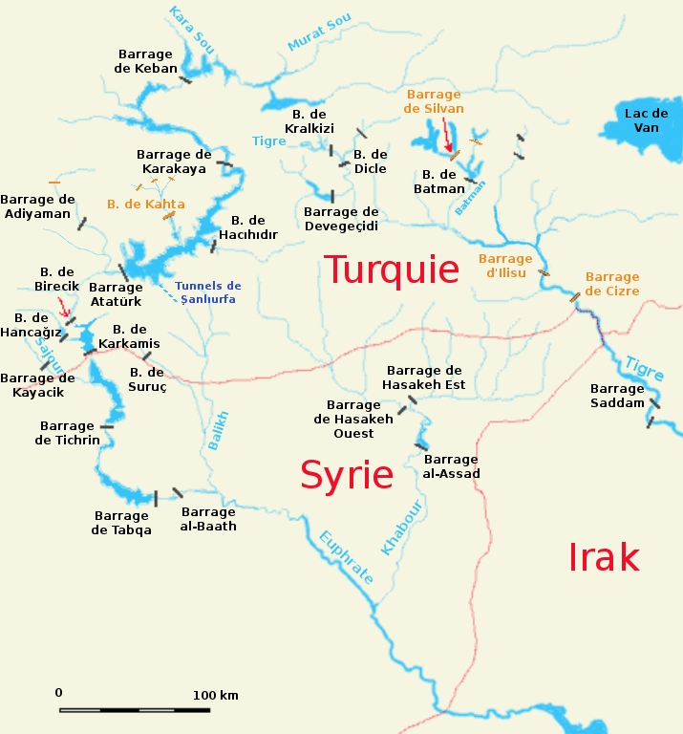

Slide 16
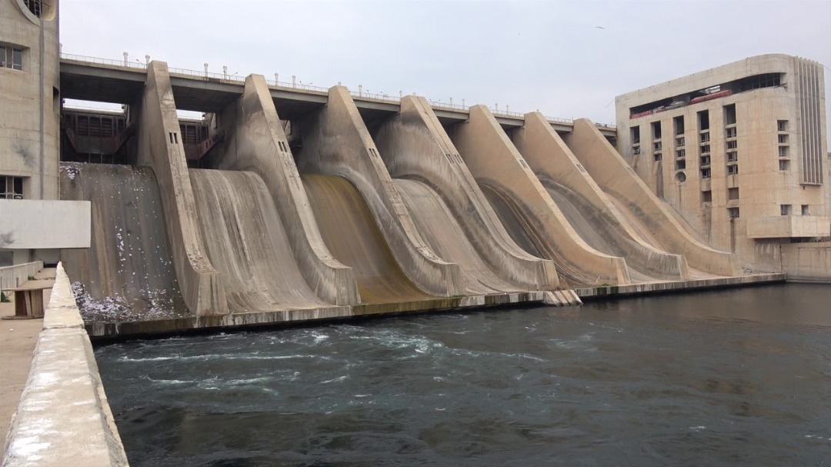

Slide 17
War in Syria then started in 2011 following the Arab Spring uprising, Hezbollah entered fully into the Syrian conflict with 2000 fighters in early June of 2013. Isis came into Iraq from Syria in early 2014 creating destruction and chaos further damaging the Euphrates with the Mosul dam and pouring oil into it. In a few short years of war Syria has killed 5 million people from 2013 - 2018. 1 million Christians have also disappeared from Syria, Iraq has lost 1.2 million Christians from its midst from 2013 - 2017 these Christian losses are not reported about in mainstream media. Christianity in the lands of Abraham in the Middle East along the Euphrates has all but been extinguished.

Slide 19
so that the way of the kings from the east might be prepared.
The 5th bowl and 6th bowl are tied into the 6th Trumpet of Rev 9:13-21 both are fulfilled along the river Euphrates. The 1st woe of the 5th Trumpet of Rev 9:1-12 was completed by 2011 with Saddam Hussein’s reign ending in Iraq then the final withdrawal of US troops from the region under Obama.
This created a vacuum for the 6th Trumpet 2nd woe loosing the four angels bound in the river Euphrates to kill a third of mankind in the region to manifest with Islamic terrorism (Hezbollah, Isis) and conflict that will end at Armageddon the final war against Israel, the 6th Trumpet loosed the “warring against the saints” from mid 2013 to Jan 2017. The Kings of the east being prepared is the Ezekiel 38 and 39 war of Gog of Magog against Israel to come, the Rev 11 trampling of Jerusalem for 42 months by the gentiles non Jews. The prophecy of Zachariah where half of Jerusalem is overrun for a season in the end times. This is during the time of the Rev 11 two witnesses testimony also for 42 months.

Slide 20
13And I saw three unclean spirits like frogs Deceiving demons come out of the mouth of the dragon The World Bank Federal Reserve NWO cartel elite financial masters, and out of the mouth of the beast President Obama of USA a Muslim, and out of the mouth of the false prophet President Erdogan of Turkey a Muslim the modern Islamic Caliph “king if Islam”

Slide 21
14 For they are the spirits of devils, in 2009 unclean lying demonic frog spirits came releasing greater deception, lies and corruption through the US administration with Obama the beast . Because of Bush then Obama’s foreign policies creating conflict in Afghanistan, Syria, Iraq , Libya, Egypt and parts of Africa we saw the destabilization of millions of people . Erdagon was raised up in the Middle East reversing Turkey back to Islamic Sharia with great influence over 57 Islamic nations and the UN. The Dragon elite New World Order agenda using the UN began forced mass immigration of mainly Islamic people into world nations bringing national crisis, economic inflation, increased community violence , rape chaos and disorder. (Video)

Slide 22
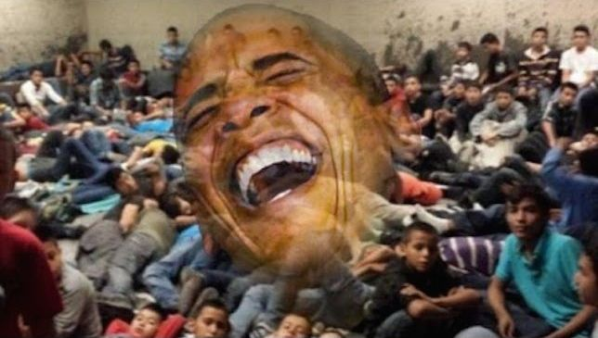

Slide 24
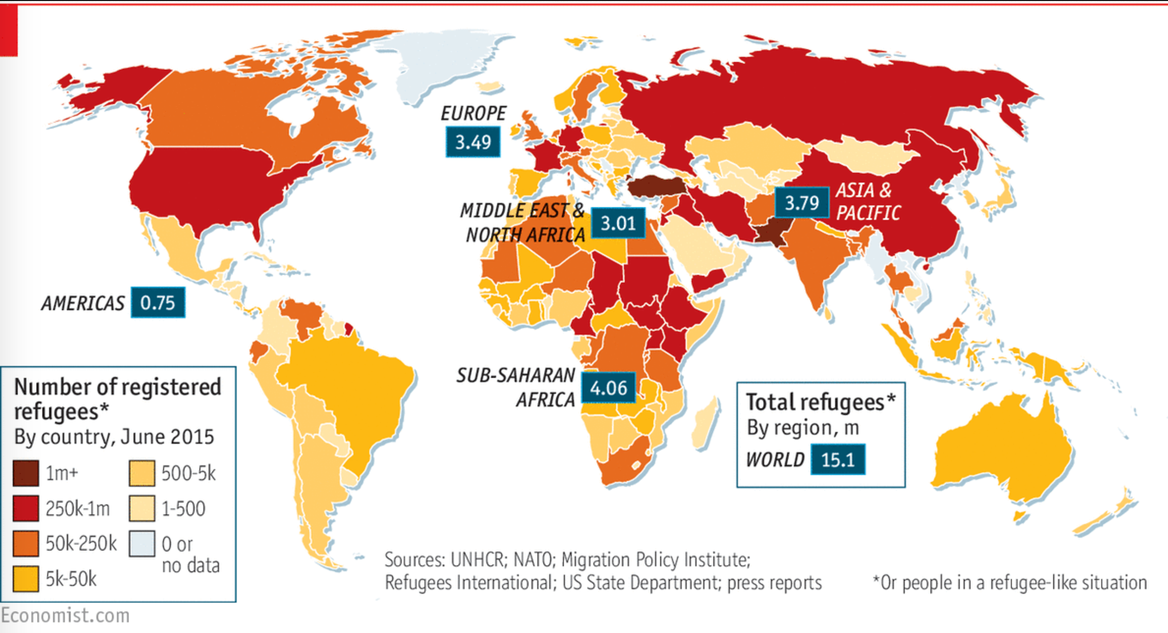

Slide 25
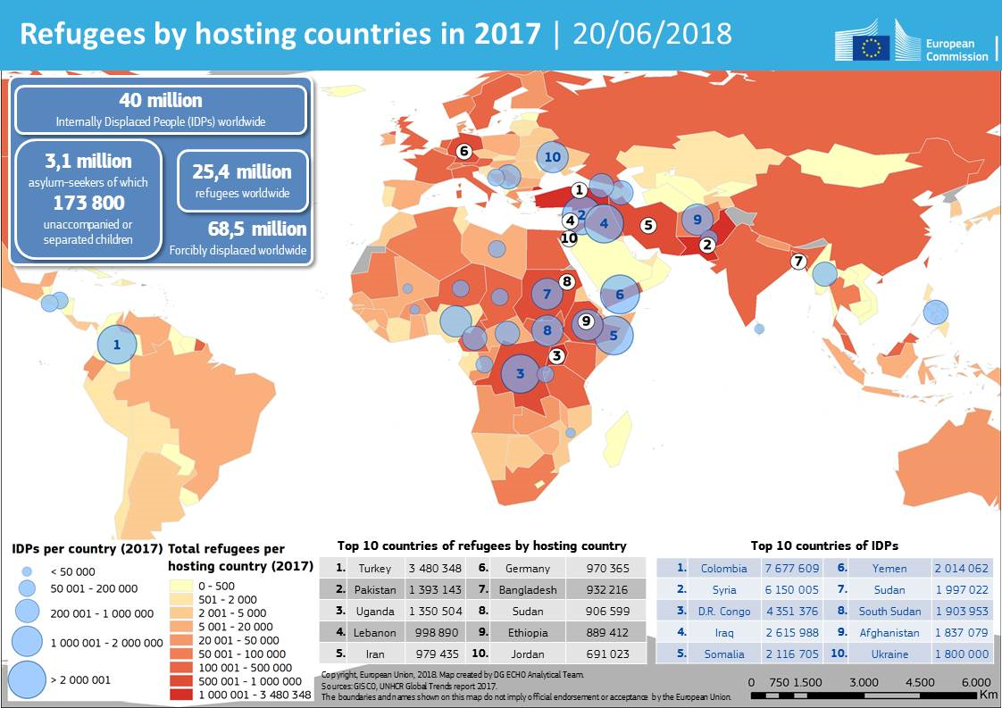

Slide 26
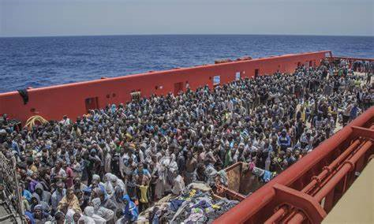

Slide 27
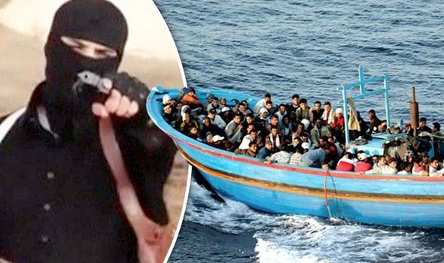

Slide 28
For they are spirits (Unclean frogs) like devils working miracles, which go forth unto the kings deceiving leaders with evil agendas to bring chaos and weaken the nations of the earth and of the whole world, to gather them to the battle to lead nations into conflicts to come against Israel with war. To bring WW 3 in the Middle East region one 3rd of the UN nations are now Muslim, the antichrist spirit manifesting of that great day of God Almighty Ez 38 and 39 war against Israel then at the end of the 42 month trampling of Jerusalem the great tribulation period “Armageddon” 15 Behold, I come as a thief. Blessed is he that watcheth, and keepeth his garments, lest he walk naked, and they see his shame.

