Slide 2
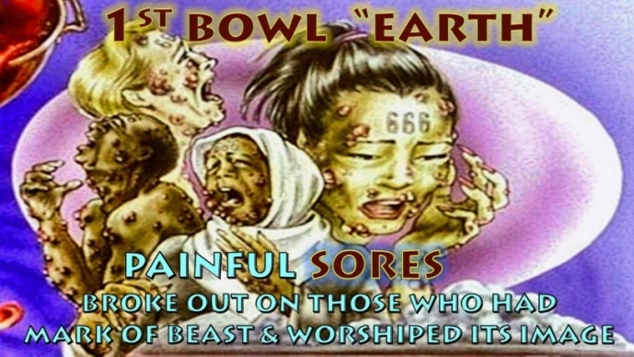

Slide 3
Bowl 1 “Rev 16:1-2”
First Bowl: Loathsome Sores
16 Then I heard a loud voice from the temple saying to the seven angels, "Go and pour out the bowls of the wrath of God on the earth." ² So the first went and poured out his bowl upon the earth, and a foul and loathsome sore came upon the men who had the mark of the beast and those who worshiped his image.

Slide 4
When revelation was asked of the Lord about this Bowl of Judgement, the year “1987” kept coming to mind about this plague poured out upon man. Then the revelation came of what it was, in 1987 the first man in Australia diagnosed with a disease died of HIV/AIDS the same year it was announced on the world stage as a international disease. I actually met this man when I was living in the suburb of Redfern in Sydney Australia just before he died. This was before I became a Christian I was 19 years old at the time. HIV is referred to by some as “The plague of our time”.

Slide 5
A Christian Prophet known around the world Bob Jones (who died in 2014) testified to a visitation he had in 1975 from the Lord. Bob was told during this visitation that Homosexuality was going to come out of the closet out of hiding (LGBT worldwide movement has gained momentum since the mid 90’s). They will demonstrate in your streets and in your government (happened) there will be a homosexual disease (HIV was identified on world scene in 1987). This disease will kill 5 million people a year by the year 2000 (this happened by 2000). That these deaths will increase and increase until that sin is repented of (HIV has killed 35.5 million since 1987 in 2017 39.9 million live with aids in 1997 only 3.4 million globally were diagnosed). (Video) See U Tube video: https://youtu.be/Kq_7-X7ntsw

Slide 6
Known as the HIV/AIDS virus or the human “Acquired Immunodeficiency Virus” infection and “Acquired Immune Deficiency Syndrome” this is the 1st bowl plague poured out since before the 1980’s (Genetically traced back to 1920 around the time of first Trumpet 1914-1918) it was only then recognized on the world scene by 1987. Multiple cases of this unknown disease had been reported as early as 1981 in the USA and around the world. HIV/AIDS is mainly transmitted through unprotected sexual intercourse including anal and oral sex, contaminated blood transfusions, hypodermic needles, from mother to child during pregnancy, delivery, or breastfeeding.
Aids was initially transmitted through blood and sexual contact between homosexuals as it advanced heterosexuals began contracting this disease also from contact with the infected blood cells blood to blood. This virus has killed up to 36 million known cases by 2012 since being diagnosed it has spread worldwide in 199 nations on Earth. HIV/AIDS is a global pandemic as of 2016, approximately 36.7 million people are living with HIV globally, of these approximately 17.2 million are men, 16.8 million are women and 3.4 million are less than 15 years old. (Time line video 55 secs)

Slide 7
A reconstruction of its genetic history shows that the HIV/AIDS pandemic almost certainly originated in Kinshasa, the capital of the Congo, around 1920 (The time of the 1st trumpet of WW 1). HIV/AIDS was first recognized by the United States Centers for Disease Control and Prevention (CDC) in 1981 and meant certain death. Many more victims have died prior to 1981 but impossible to number due to HIV/AIDS being undiagnosed at the time. Aids causes ulcerated sores to appear over one’s body and in the mouth, bringing a slow death it depletes the immune system making one easily open to catching a virus or bacterial infection that could kill the victim. In all the years since this outbreak and identification of HIV/AIDS, there is no known cure only extending ones life span a slowing down of the process, some do live a normal life with drugs. (Video)

Slide 8
and a foul and loathsome sore came upon the men who had the mark of the beast and those who worshiped his image. Truly this has been a curse upon those that worship the image of man who carry the mark of the beast (unsaved) through homosexuality, perversion, promiscuity and sex outside of Gods intended marriage between a man and a woman. In the 21st century this disease is still rampant yet it is no longer covered by mainstream media as it first was. Like most things important the liberal media has swept it under the social media carpet. This is a worldwide disease in nearly every nation and people group truly this scripture Rev 16:1-2 has been fulfilled. As mentioned above those who carry the mark of the beast gives us a huge clue to what the mark of the beast actually is.

Slide 9
HIV/AIDS is the only modern plague impacting millions that causes sores upon the body. No other disease has impacted humanity on such a scale except the black plague 650 years ago from 1346 – 1353 that killed 70 - 200 million people. The Black Bubonic plague caused skin to die to turn black with swollen lymph glands no sores. In modern times the only other sickness to kill 50 to 100 million around the world was the “Spanish Flu” an influenza virus from 1917-1918 it was said to have come from the WW1 Trenches, as found in the first Trumpet. This virus caused suffocation and organ collapse with mass blood loss again no sores on the skin people died very quickly. These days we have inoculations created since WW2 against the influenza virus. There has been outbreaks of the Ebola Virus in Africa but it has been limited, this also does not cause sores upon the body its internal damage.

Slide 11
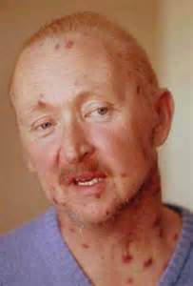
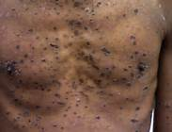
Aids painful sores covering the victim’s body

Slide 12
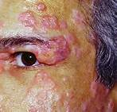
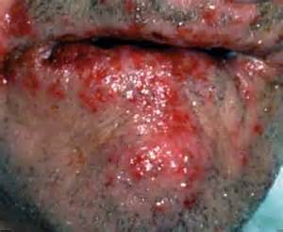
Aids painful sores covering the victim’s body

Slide 14
