Slide 3
The 3rd Bowl of Judgment “Rev 16:4-7”
Rev 16:4 Then the third angel poured out his bowl on the rivers and springs of water, and they became blood. And I heard the angel of the waters saying: "You are righteous, O Lord, The One who is and who was and who is to be, Because You have judged these things.
For they have shed the blood of saints and prophets, And You have given them blood to drink. For it is their just due.“ And I heard another from the altar saying, "Even so, Lord God Almighty, true and righteous are Your judgments."

Slide 4
4And the third angel poured out his vial upon the rivers and fountains of waters; and they became blood. Some of the first blood red waters began to be reported in the media in 2001. There have been waters, rain, oceans and rivers turning blood red all around the world in the last two decades in many nations even in Antarctica. There has been an increase in the blood waters around the world as reported in recent years an acceleration of this sign.

Slide 5
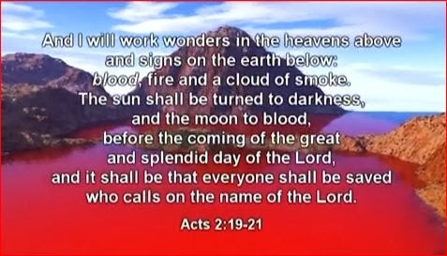

Slide 6
5And I heard the angel of the waters say, Thou art righteous, O Lord, which art, and was, and shalt be, because thou hast judged thus. 6For they have shed the blood of saints and prophets, and thou hast given them blood to drink; for they are worthy. The martyrdom of the saints is directly tied into this sign and wonder according to this prophecy. In Rev 17 the woman of wickedness is drunk on their blood. Christian martyrs doubled in number worldwide from mid 2013 when Hezbollah entered into the Syrian conflict then Isis into Iraq in early 2014. Bringing forth the “Warring against the saints” for 42 months in the Middle east region. There has been 1.2 million Christians destroyed from Iraq and 1 million from Syria no one know fully where they all are they have been either murdered become refugees or slaves to Islam. It wasn’t until President Donald Trump (2017) came to power that the killing of Christians slowed down in the Middle East. In Syria since 2011 the beginning of its war over 5 million people have been killed. Worldwide reports of blood rivers and seas start back in 2001 the year of 9/11 that led us into conflict in the lands of Abraham. From 2008 to 2010, only 5 -8 reports of seas and rivers turning blood red occurred world wide. As an overflow from the 2011 Arab spring greater persecution of the saints began by 2013 onwards, more waters began turning to blood. From mid 2011 -2019 an 8 year period there have been over 45 known reports of major waters turning blood red around the world .

Slide 7
7And I heard another out of the altar say, Even so, Lord God Almighty, true and righteous are thy judgments. In 2013 it was estimated up to 160 thousand Christians were martyred worldwide. Since Christ walked on the earth and died until now it is estimated that 50 million Christians were martyred by the Vatican alone. Recent events are all part of the compliment of martyrs coming to fullness as mentioned in Revelations 6:9-11 the fifth seal opened. There are currently 215 million Christians under persecution worldwide in 64 nations with tens of thousands being killed each year. In North Korea alone it is estimated that 100 thousand Christians are serving as state slaves in jails , they have public executions of Christians. The wide scale persecution of Christians has been impacted since 2009 with President Obama's foreign policy. Obama trained and funded Islamic Jihadists he armed them with weapons giving Jihadists power to persecute and kill on a massive scale. Obama has been key in advancing Islamic causes he arranged the Iran nuclear deal in 2015 . He sent 150 billion dollars in hard US currency to Iran a terrorist supporting nation and allowed the UN 2334 resolution against Israel .

Slide 8
Since 2001 there has been blood red rivers, waterfalls, lakes and oceans in places all over the world. The China river Yangtze turned blood red, Lebanon’s Beirut river, Australian beaches turned blood red. There was been blood red rain for 3 months in India, Pakistan and Shri Lanka in 2012, the sea of Azov turned blood red in Russia, Blood red rivers in Netherlands, beaches in Turkey turn blood red, blood red rain falls in Kannur Kerala. Lakes have turned blood red in France, Antarctic glaciers had blood red rivers and waterfalls, a river turned red in Slovakia USA has had several rivers and lakes turn blood red in places such as Ohio, Texas and Minnesota. There are many more reports of waters turning blood red in color these events are occurring in countries all over the world. reported on the news media and internet. (Video) The following pictures are from articles on blood waters around the world taken from 2008 – 2019.

Slide 9
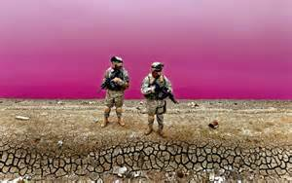
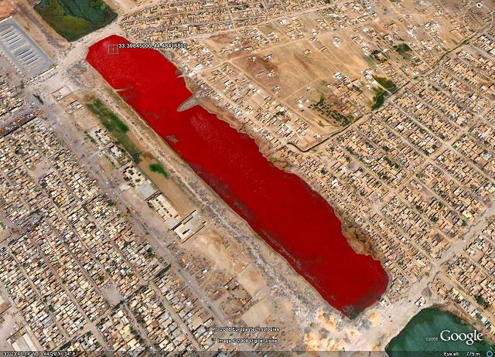
2008 Lake in Iraq

Slide 10
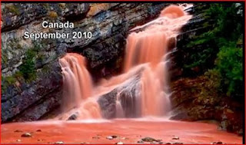

Slide 11
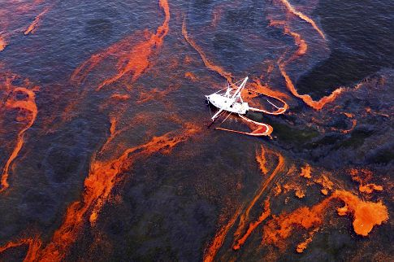
2010 Gulf of Mexico oil spill turns

Slide 12
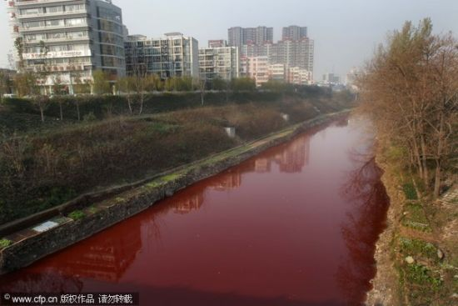
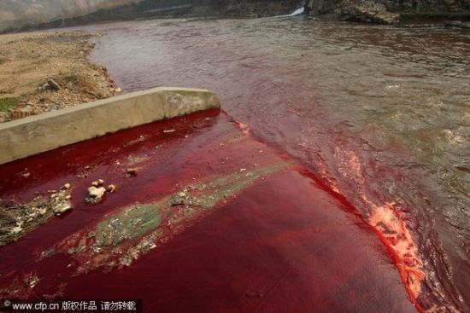
2011 Jianghe River China

Slide 13
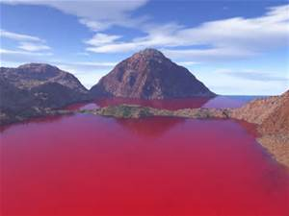
2011 Texas lake USA

Slide 14
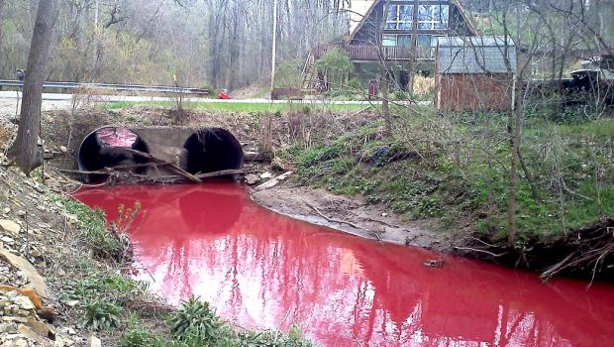
2011 Norwalk Ohio USA

Slide 15
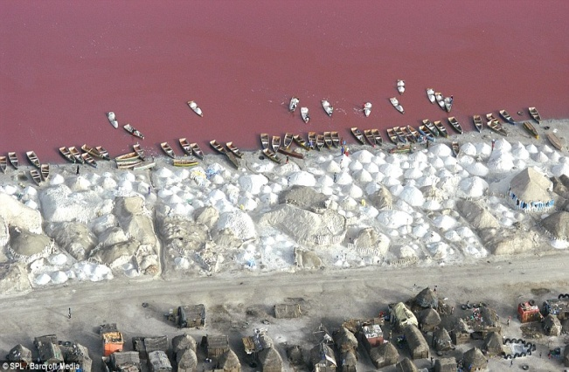
2012 Lake Retba, Senegal, West Africa

Slide 16
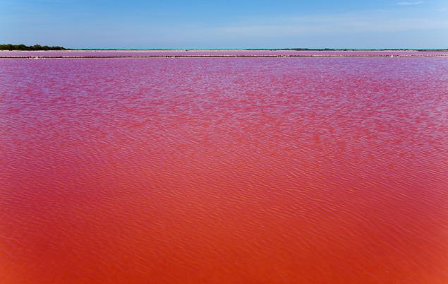
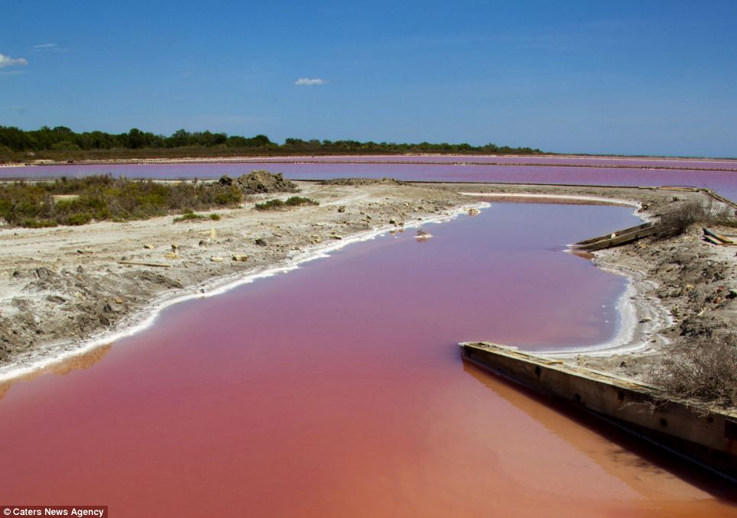
2012 Camargue, southern France

Slide 17
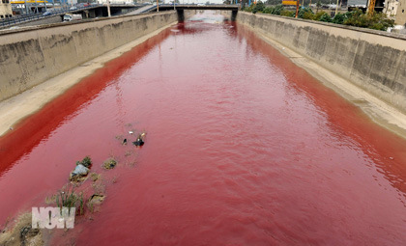
2012 Arkansas USA

Slide 18
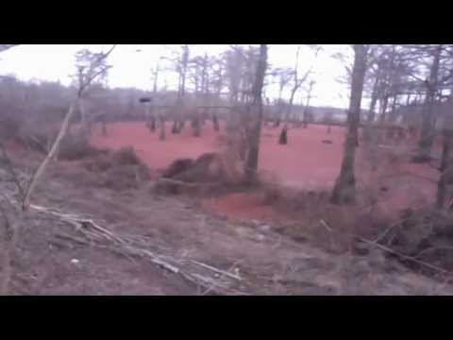
2012 Tennessee USA

Slide 19
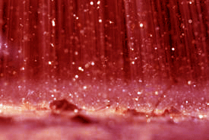
2012 Red rain Kannur, Kerala, India

Slide 20
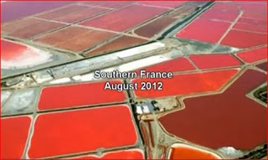

Slide 21
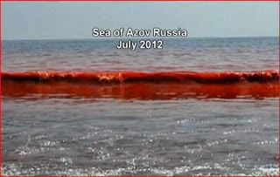

Slide 22
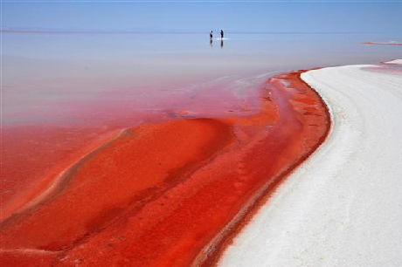
2012 lake in Anatolia ,Turkey

Slide 23
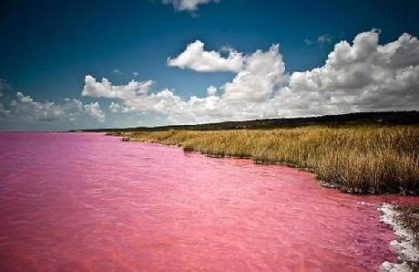
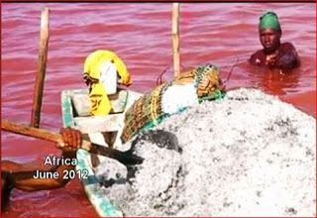
2012 The Retba Lake, Senegal West Africa

Slide 24
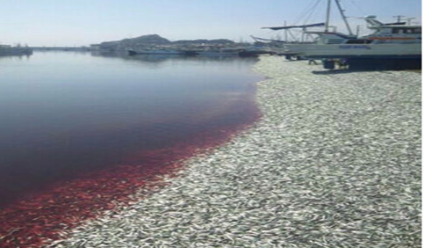
2012 Gizmodo Japan 200 tons of dead sardines

Slide 25
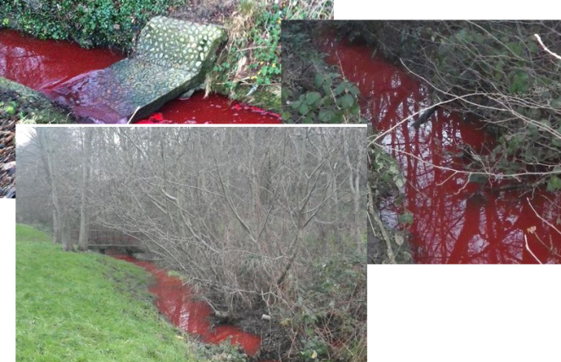
2013 River in Slovakia Switzerland.

Slide 26
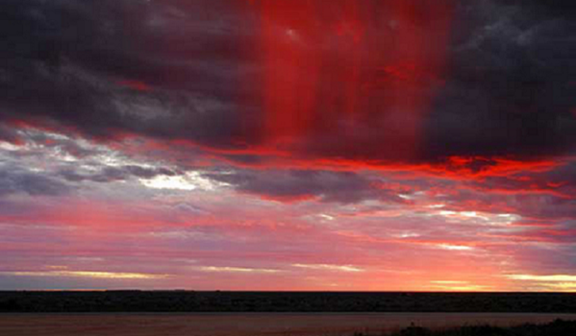
2013 Red rain in Sri Lanka

Slide 27
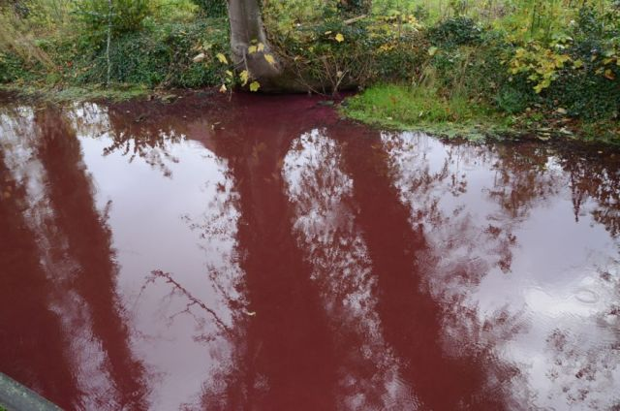
2013 Netherlands

Slide 28
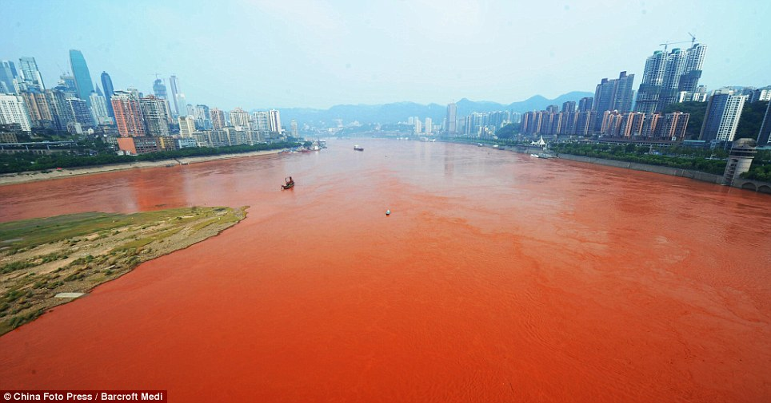
2013 China Yangtze river

Slide 29
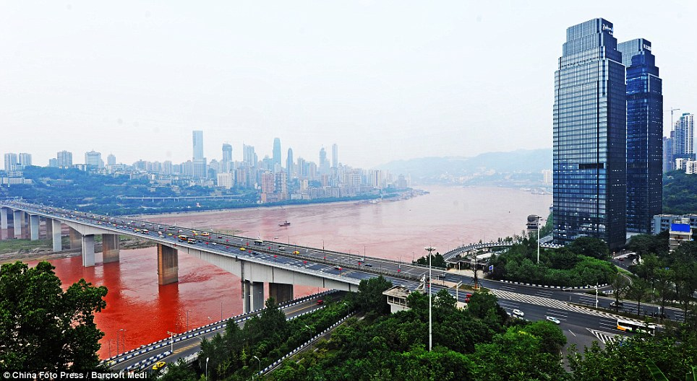

Slide 30
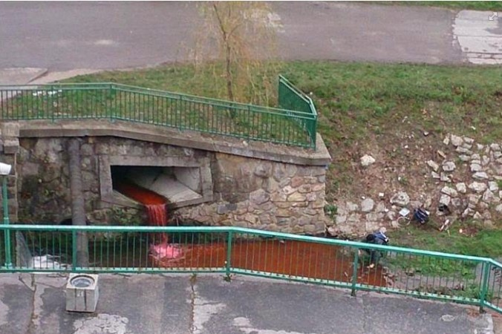
2013 Slovakia Poland

Slide 31
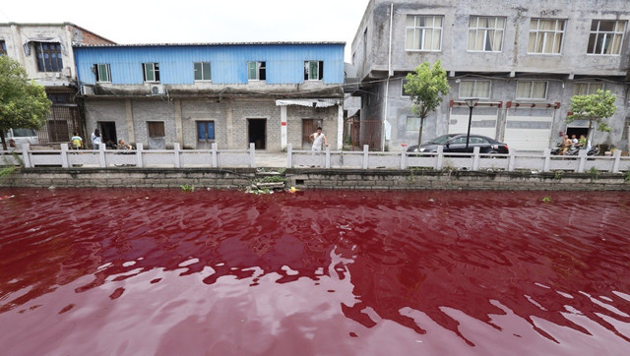
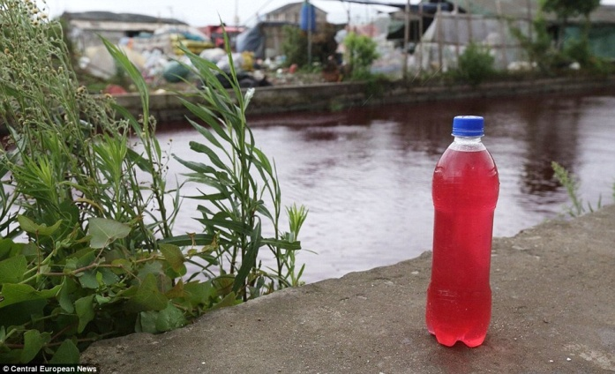
2014 Wenzhou River China

Slide 32
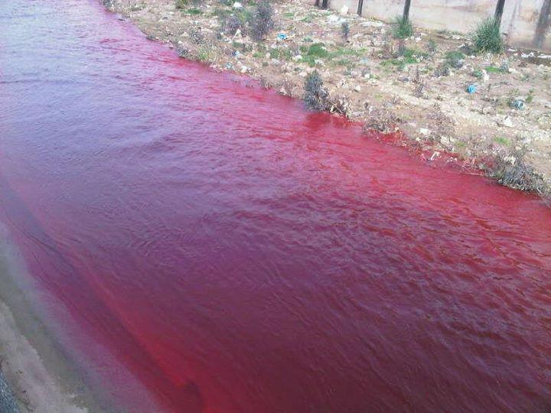
2014 Beirut canals

Slide 33
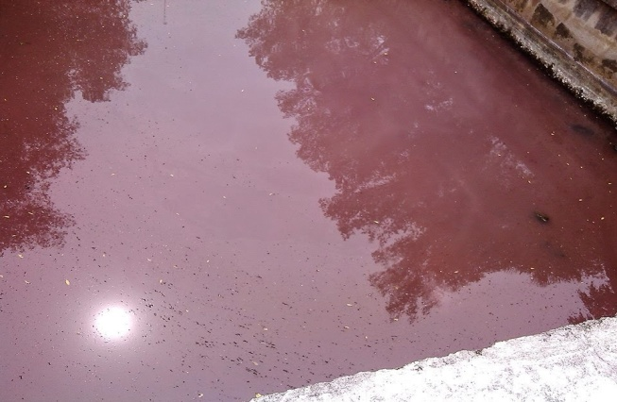
2014 Siquijor, Philippines

Slide 34
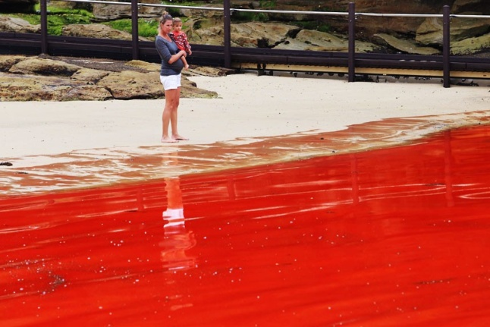
2014 Sydney Australia Clovelly beach

Slide 35
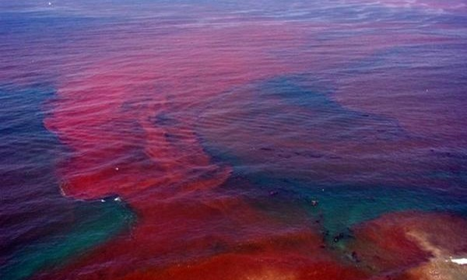
2014 Gulf of Mexico

Slide 36
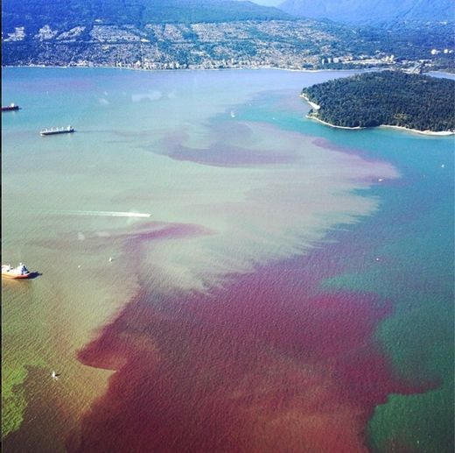
2014 Vancouver Canada

Slide 37
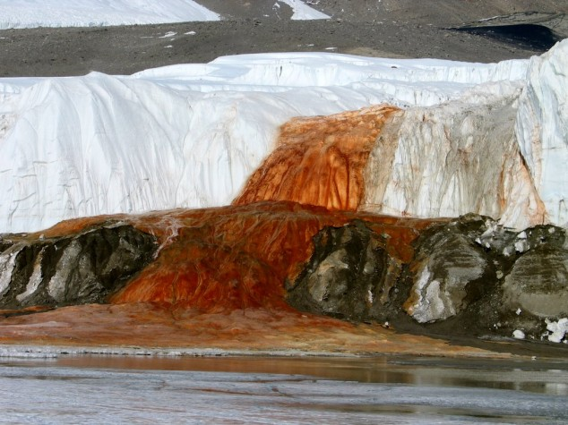
2014 Antarctica

Slide 38
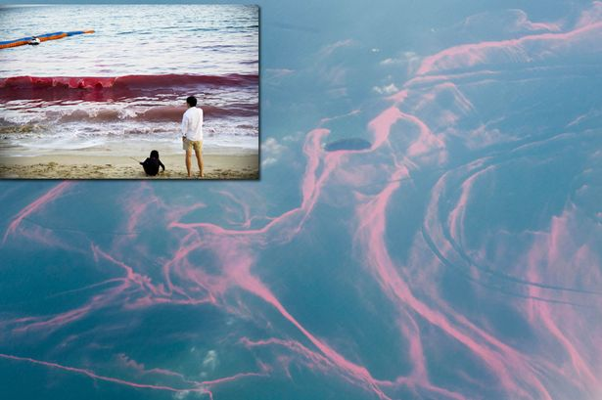
2014 China Shenzhen sea

Slide 39
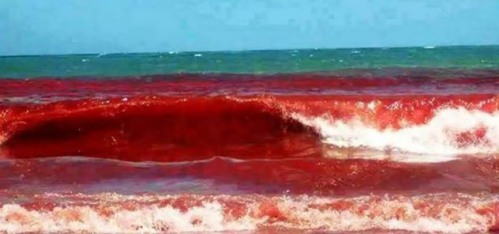
2015 Brazil beach

Slide 40
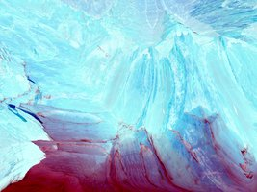
2015 Blood Falls In Antarctica

Slide 41
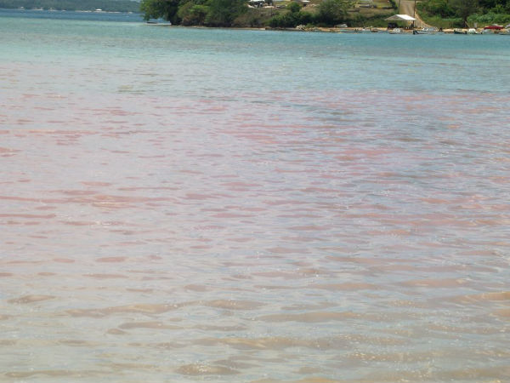
2015 Vava’u beach, Tonga

Slide 42
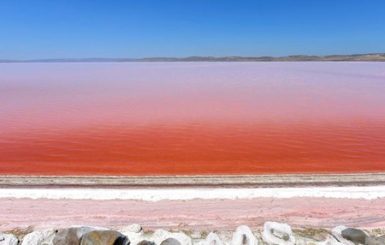
2015 Turkey’s Tuz Golu salt lake

Slide 43
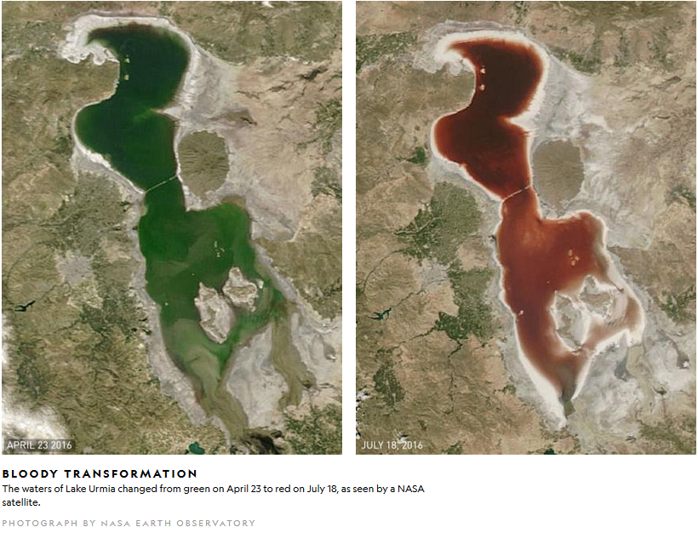
2016 Iran Lake Urmia satalite picture with highway bridge in middle

Slide 44
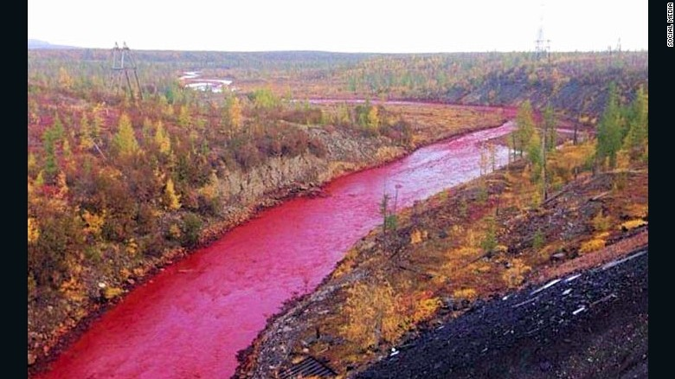
2016 Daldykan River, Siberia, Russia

Slide 45
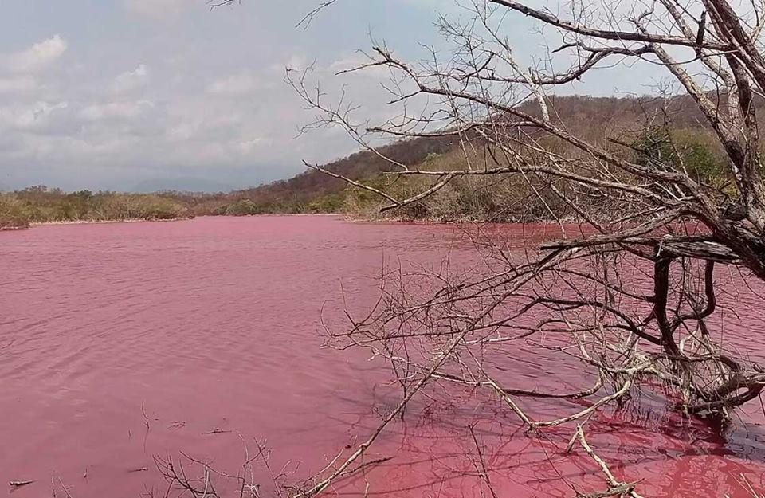
2016 Lagoon Mexico

Slide 46
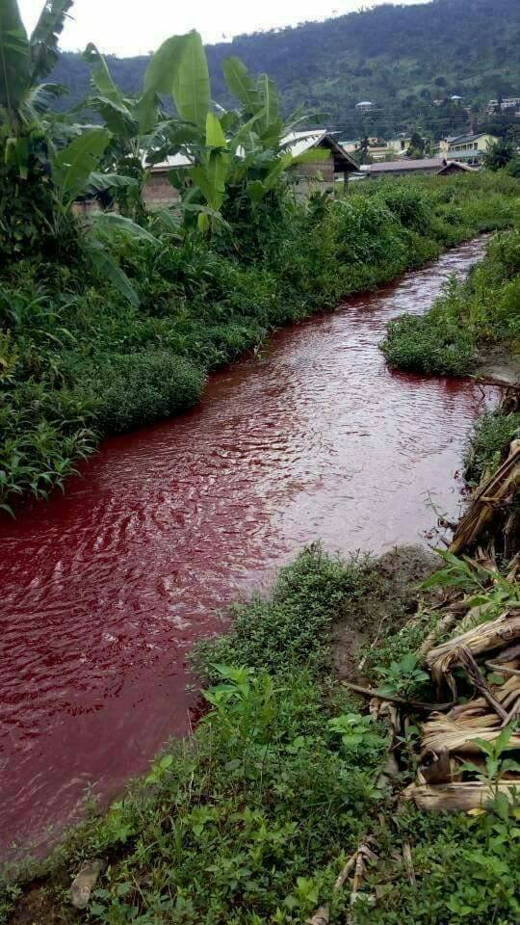
2017 Ghana river Africa

Slide 47
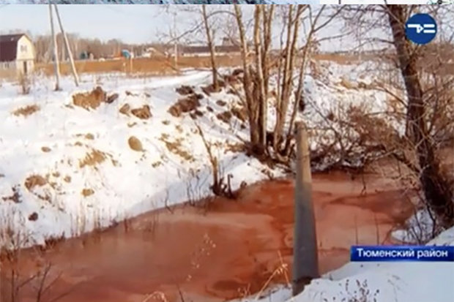
2018 The Molchanka River, Siberia, Russia

Slide 48
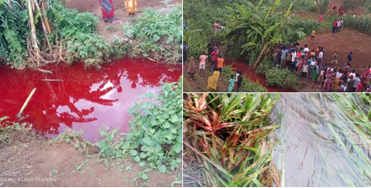
2019 Three rivers in Malawi and Indonesia

Slide 49
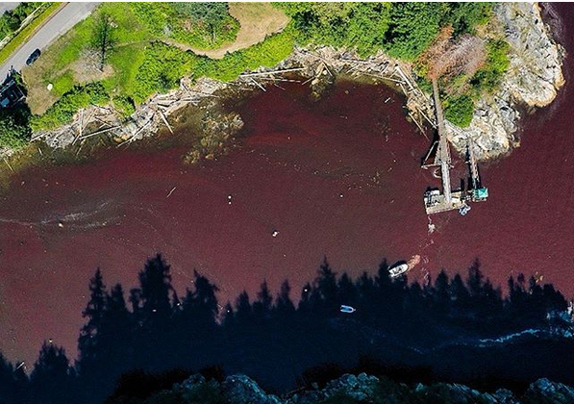
2019 Vancouver lake

