Slide 1
Seal 6 & 7, Bowl 7, Trump 7, “Cosmic Disturbance” Wrath

Slide 2
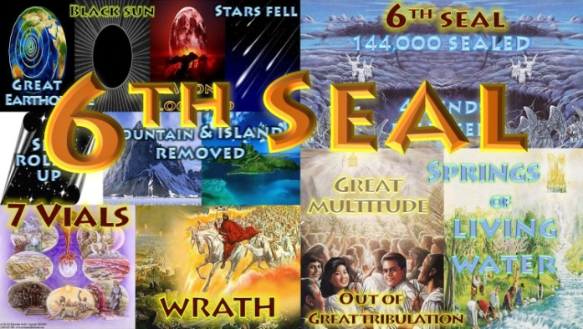

Slide 3
Revelation 6: 12-17 “Third woe” Seal 6
¹² I looked when He opened the sixth seal, and behold, there was a great earthquake; and the sun became black as sackcloth of hair, and the moon became like blood. ¹³ And the stars of heaven fell to the earth, as a fig tree drops its late figs when it is shaken by a mighty wind. ¹⁴ Then the sky receded as a scroll when it is rolled up, and every mountain and island was moved out of its place.
¹⁵ And the kings of the earth, the great men, the rich men, the commanders, the mighty men, every slave and every free man, hid themselves in the caves and in the rocks of the mountains, ¹⁶ and said to the mountains and rocks, "Fall on us and hide us from the face of Him who sits on the throne and from the wrath of the Lamb! ¹⁷ For the great day of His wrath has come, and who is able to stand ? ”able to stand?" (NKJV)

Slide 4
This 3rd woe is Gods wrath in revelations being unfolded at Christ’s return at the end of the Great tribulation period Math 24:21, Mk 13:19-24: Mat 24:21 For then there will be great tribulation, such as has not been since the beginning of the world until this time, no, nor ever shall be. Rev 7:13-14 Then one of the elders answered, saying to me, "Who are these arrayed in white robes, and where did they come from?“ And I said to him, "Sir, you know." So he said to me, "These are the ones who come out of the great tribulation, and washed their robes and made them white in the blood of the Lamb. (2nd 42 months Tribulation) . All of this comes to a finish with the battle of “Armageddon” of the Dragon, beast and false prophet at the “Great day of God” Rev 16:13-16. Rev 16:13-14 And I saw three unclean spirits like frogs coming out of the mouth of the dragon, out of the mouth of the beast, and out of the mouth of the false prophet. For they are spirits of demons, performing signs, which go out to the kings of the earth and of the whole world, to gather them to the battle of that great day of God Almighty. Rev 16:16 And they gathered them together to the place called in Hebrew, Armageddon. (Ez 38 and 39) .

Slide 5
This battle is at the end of the worldwide harvest of souls where God shortens the days least no flesh survives. Rev 14:14-16 And another angel came out of the temple, crying with a loud voice to Him who sat on the cloud, "Thrust in Your sickle and reap, for the time has come for You to reap, for the harvest of the earth is ripe." Joel 3:13-14 Put in the sickle, for the harvest is ripe. Come, go down; For the winepress is full, The vats overflow. For their wickedness is great." Multitudes, multitudes in the valley of decision! For the day of the LORD is near in the valley of decision. God steps in He stops Armageddon supernaturally, cuts the time short . Math 24:21-22 For then there will be great tribulation, such as has not been since the beginning of the world until this time, no, nor ever shall be. And unless those days were shortened, no flesh would be saved; but for the elect's sake those days will be shortened.

Slide 6
The Lord cuts the time short why ? to save the elect of God His saints His Bride : Eph 5:27 That He might present her to Himself a glorious church (Bride), not having spot or wrinkle or any such thing, but that she should be holy and without blemish. He cuts the time short least no flesh survive the crisis of potential nuclear war exchange from both Israel and other nuclear nations these are those surrounding Israel. The Lord destroys the wicked supernaturally in the Armageddon battle. He comes to reward His servants the prophets and the saints. The wicked are destroyed taken away from the Earth cast into the fire Rev 19:20. The righteous are translated caught up in Christ for the millennial reign of 1000 years on Earth.

Slide 7
At His return He destroys the beast his armies the wicked and the false prophet Rev 19:20 (Ez 38 & 39) Rev 19:19 -21 And I saw the beast, the kings of the earth, and their armies, gathered together to make war against Him who sat on the horse and against His army. Then the beast was captured, and with him the false prophet who worked signs in his presence, by which he deceived those who received the mark of the beast and those who worshiped his image. These two were cast alive into the lake of fire burning with brimstone. And the rest were killed with the sword which proceeded from the mouth of Him who sat on the horse. And all the birds were filled with their flesh. This destruction is known as the “Great supper of God” . Rev 19:17-18, (Ez 39:17-22.) Then I saw an angel standing in the sun; and he cried with a loud voice, saying to all the birds that fly in the midst of heaven, "Come and gather together for the supper of the great God, that you may eat the flesh of kings, the flesh of captains, the flesh of mighty men, the flesh of horses and of those who sit on them, and the flesh of all people, free and slave, both small and great."

Slide 8
At the time of this happening the sun becomes black the stars of heaven fall to the Earth the sky recedes back like a scroll Rev 6:14, Heb 1:10-12 , Is 34:4-5 , Is 51:6, Math 24:35 , 2 Pet 3:7, 10,12 , Rev 20:11, Rev 21:1, Heb 1:11-12 (Scroll rolled up), a blood moon appears Jesus returns with great wrath with great hail stones and fire, He shelters His people . Joel 3:14-16 Joe 3:16 The LORD also will roar from Zion, And utter His voice from Jerusalem; The heavens and earth will shake; But the LORD will be a shelter for His people, And the strength of the children of Israel. He covers the saved from His wrath. We are caught up translated to Him and changed in the twinkling of an eye, we get a new body that’s incorruptible , to be with Him to reign with Him forever . 1Co 15:52 -53 In a moment, in the twinkling of an eye, at the last trumpet. For the trumpet will sound, and the dead will be raised incorruptible, and we shall be changed. For this corruptible must put on incorruption, and this mortal must put on immortality. 1 Thes 4:17 Then we who are alive and remain shall be caught up together with them in the clouds to meet the Lord in the air. And thus we shall always be with the Lord.

Slide 9
Jesus return is after one hour of the two witnesses being raised up from the dead in Jerusalem after 3 and one half days. A great earthquake hits and shakes Israel where 7000 die the 2nd woe . Rev 11: 12-14 And they heard a loud voice from heaven saying to them, "Come up here." And they ascended to heaven in a cloud, and their enemies saw them. In the same hour there was a great earthquake, and a tenth of the city fell. In the earthquake seven thousand people were killed, and the rest were afraid and gave glory to the God of heaven. The second woe is past. Behold, the third woe is coming quickly. Israel then recognizes Jesus as messiah from the two witnesses raised to life and say “blessed is he that comes in the name of the Lord” Math 23:37-39, Luke 13:33-35 .(Chicken gathering her chicks). Mat 23:37-39 "O Jerusalem, Jerusalem, the one who kills the prophets and stones those who are sent to her! How often I wanted to gather your children together, as a hen gathers her chicks under her wings, but you were not willing! See ! Your house is left to you desolate; for I say to you, you shall see Me no more till you say, 'BLESSED is HE WHO COMES IN THE NAME OF THE LORD!'

Slide 10
Israel is the last nation of the Rev 14:14-16 harvest to be saved. Math 20:16 (Math 20:1-16 workers wages in the field) So the last will be first, and the first last. For many are called, but few chosen." This is also at the time when the “Fullness of the Gentiles” has come in, where the wickedness on Earth is at its fullness. Rom 11:25-27 For I do not desire, brethren, that you should be ignorant of this mystery, lest you should be wise in your own opinion, that blindness in part has happened to Israel until the fullness of the Gentiles has come in. And so all Israel will be saved, as it is written: "THE DELIVERER WILL COME OUT OF ZION, AND HE WILL TURN AWAY UNGODLINESS FROM JACOB; FOR THIS IS MY COVENANT WITH THEM, WHEN I TAKE AWAY THEIR SINS." (New Covenant Jer 31:31, Ez 26:22-33)

Slide 11
The 3rd woe is the 7th trumpet blast (eternal silence in Heaven for half an hour after the hour of the two witnesses being raised up) then the wrath of God comes with thundering, lightning’s, earthquake , fire , brimstone and great hail against the angry nations. God destroys those that would destroy the Earth Rev 11:18 (Ezekiel 38-39 war against Israel culmination) The nations were angry, and Your wrath has come, And the time of the dead, that they should be judged, And that You should reward Your servants the prophets and the saints, And those who fear Your name, small and great, And should destroy those who destroy the earth." 3rd WOE

Slide 13
The Seventh Trumpet Rev 11:15-19; Then the seventh angel sounded: And there were loud voices in heaven, saying, "The kingdoms of this world have become the kingdoms of our Lord and of His Christ, and He shall reign forever and ever!" 16 And the twenty-four elders who sat before God on their thrones fell on their faces and worshiped God, 17 saying: "We give You thanks, O Lord God Almighty, The One who is and who was and who is to come, Because You have taken Your great power and reigned. 18 The nations were angry, and Your wrath has come, And the time of the dead, that they should be judged, And that You should reward Your servants the prophets and the saints, And those who fear Your name, small and great, And should destroy those who destroy the earth." 19 Then the temple of God was opened in heaven, and the ark of His covenant was seen in His temple. And there were lightning’s, noises, thundering’s, an earthquake, and great hail. (NKJV)

Slide 14
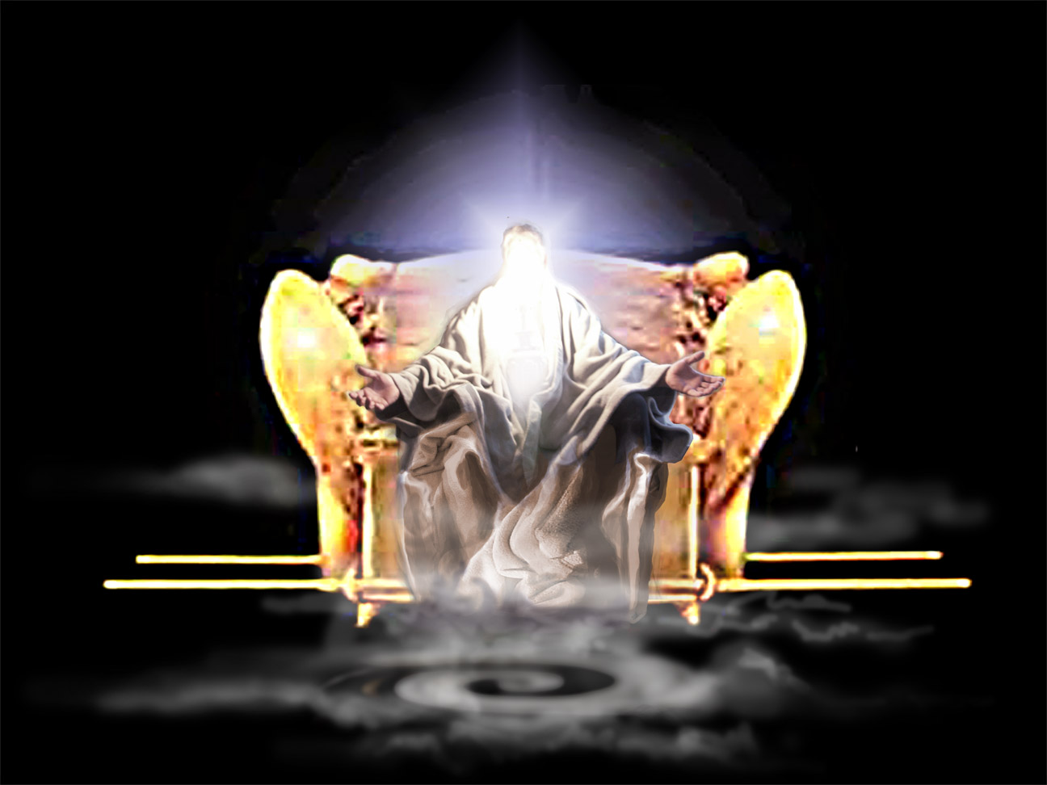
Ark of covenant seen in Heaven

Slide 15
At His return God is hallowed in the sight of Israel and all nations supernaturally. He destroys Gog of Magog (Ez 38 and 39) the Rev 13:1-10 beast from the sea (Obama) and the Rev 13:11-18 false prophet beast from the Earth (Erdagon) with the brightness of His coming 1 Thes 2:8 . He destroys with fire the wicked and those that came against Israel led by Gog (the beast) . He destroys the spiritual city Babylon (worldwide) and the woman of wickedness who rides the beast . Rev 18:1-14 (come out of Babylon my people) Rev 18:16 -18 and saying, 'Alas, alas, that great city that was clothed in fine linen, purple, and scarlet, and adorned with gold and precious stones and pearls! For in one hour such great riches came to nothing.' Every shipmaster, all who travel by ship, sailors, and as many as trade on the sea, stood at a distance and cried out when they saw the smoke of her burning, saying, 'What is like this great city?' The 8th King beast goes into perdition Rev 17, Dan 2::35 (stone ). Rev 17:10 -11 There are also seven kings. Five have fallen, one is, and the other has not yet come. And when he comes, he must continue a short time (8th king Pope Francis 1st ). The beast that was, and is not, is himself also the eighth, and is of the seven, and is going to perdition.

Slide 16
The 7th seal moves through eternity forwards and backwards in time, where it says there is silence in heaven for half an hour when opened. Seal 7 moves into the giving of the 7 Trumpets to seven angels to their blowing at certain times in the fulfillment of the 7 Trumpets (Trump 1 was WW1). God is a God that can go backwards and forwards in prophecy. Rev 1:8 "I am the Alpha and the Omega, the Beginning and the End," says the Lord, "who is and who was and who is to come, the Almighty." Seal six is Gods wrath as is the 7th Bowl and 7th Trumpet at His return, the sixth seal takes us into seal 7 in Revelations 8:1 they coincide and unfold together.

Slide 17
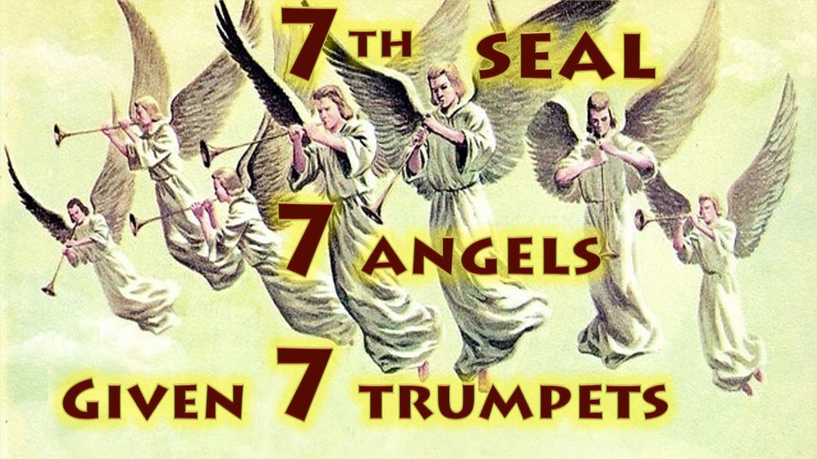

Slide 18
The Seventh Seal (7th Seal bowl, 7th bowl, 7th Trumpet of wrath, third woe) Revelation 8:1-2; When He opened the seventh seal, there was silence in heaven for about half an hour. ² And I saw the seven angels who stand before God, and to them were given seven trumpets. (NKJV)

Slide 19
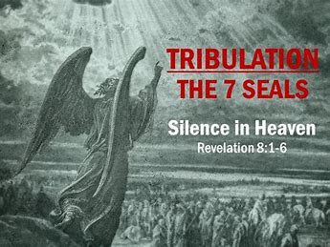

Slide 20
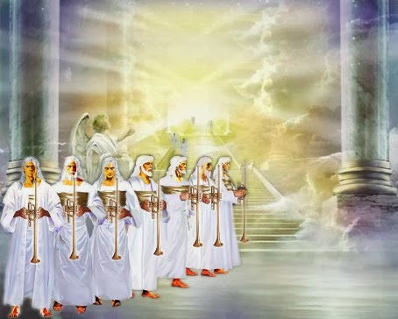
7 Angels given 7 Trumpets (Video)

Slide 21
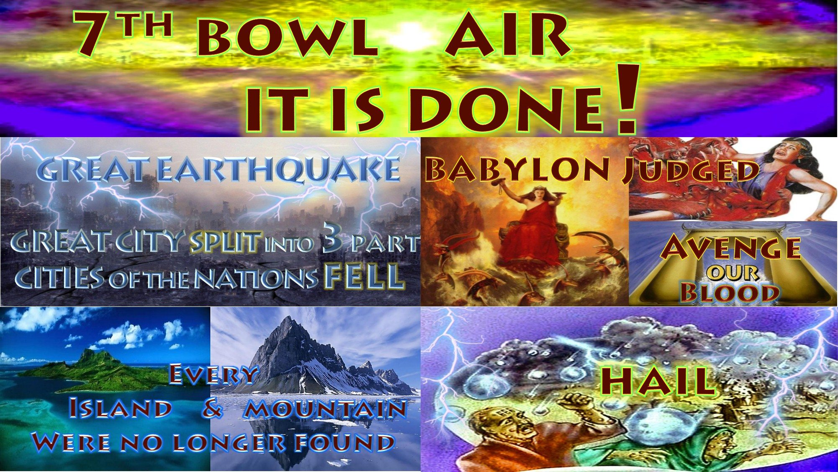

Slide 22
The Seventh Bowl Rev 16:17-21; Then the seventh angel poured out his bowl into the air, and a loud voice came out of the temple of heaven, from the throne, saying, "It is done!" 18 And there were noises and thunderings and lightning's; and there was a great earthquake, such a mighty and great earthquake as had not occurred since men were on the earth. 19 Now the great city was divided into three parts, and the cities of the nations fell. And great Babylon was remembered before God, to give her the cup of the wine of the fierceness of His wrath. 20 Then every island fled away, and the mountains were not found. 21 And great hail from heaven fell upon men, each hailstone about the weight of a talent. Men blasphemed God because of the plague of the hail, since that plague was exceedingly great. (NKJV)

Slide 23
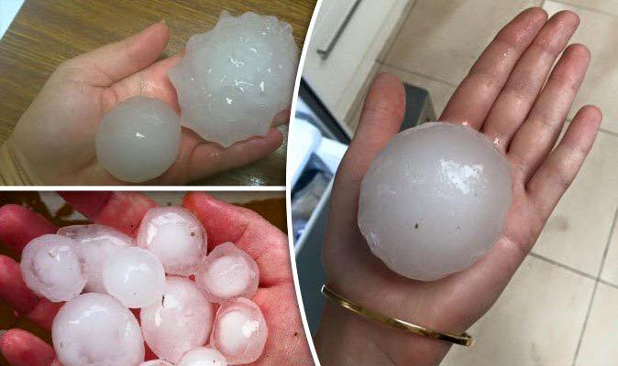
Hailstones that have fallen in recent times a Babylonian talent was about 30kg the Greek/Roman Hebrew talent was 26-35kg this one in the hand is about 1kg. Hail stones the size of a talent fall in wrath.

Slide 24
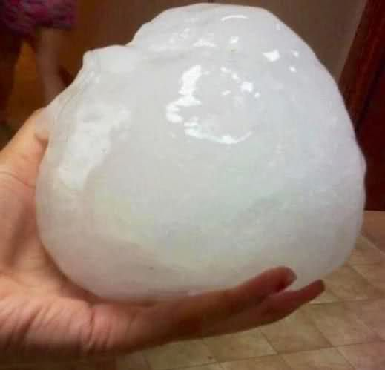
Kansas Hail USA (video)

Slide 25
Movie clip

Slide 27
The wicked and their works are burned up by “FIRE” 2 Pet 3:10

Slide 28
The wicked are destroyed taken away from the earth .This is opposite to what is taught in the mainstream end times futurist theology with the “Rapture” theory. Psa 37:37-38 Mark the blameless man, and observe the upright; For the future of that man is peace. But the transgressors shall be destroyed together; The future of the wicked shall be cut off. Psa 94:23 He has brought on them their own iniquity, And shall cut them off in their own wickedness; The LORD our God shall cut them off. Psa 11:6 Upon the wicked He will rain coals; Fire and brimstone and a burning wind Shall be the portion of their cup. 2Pe 3:7 But the heavens and the earth which are now preserved by the same word, are reserved for fire until the day of judgment and perdition of ungodly men.

Slide 29
Those who remain are the just the wicked are taken away cast into fire 2Pe 3:10 But the “DAY OF THE LORD” will come as a thief in the night, in which the heavens will pass away with a great noise, and the elements will melt with fervent heat; both the earth and the works that are in it will be burned up. Mat 24:38 -41 For as in the days before the flood, they were eating and drinking, marrying and giving in marriage, until the day that Noah entered the ark, and did not know until the flood came and took them all away, so also will the coming of the Son of Man be. Then two men will be in the field: one will be taken and the other left. Two women will be grinding at the mill: one will be taken and the other left. Luk_17:34 I tell you, in that night there will be two men in one bed: the one will be taken (wicked) and the other will be left (saint).

Slide 30
Rev 11:18-19 The nations were angry, and Your wrath has come, And the time of the dead, that they should be judged, And that You should reward Your servants the prophets and the saints, And those who fear Your name, small and great, And should destroy those who destroy the earth." Then the temple of God was opened in heaven, and the ark of His covenant was seen in His temple. And there were lightnings, noises, thunderings, an earthquake, and great hail. 3rd Angel of Wrath : Rev 14:18-20 And another angel came out from the altar, who had power over fire, and he cried with a loud cry to him who had the sharp sickle, saying, "Thrust in your sharp sickle and gather the clusters of the vine of the earth, for her grapes are fully ripe." So the angel thrust his sickle into the earth and gathered the vine of the earth, and threw it into the great winepress of the wrath of God (wicked taken away in wrath). And the winepress was trampled outside the city, (taken away outside of God) and blood came out of the winepress, up to the horses' bridles, for one thousand six hundred furlongs.

Slide 31
Rev 11:13 In the same hour there was a great earthquake, and a tenth of the city fell. In the earthquake seven thousand people were killed, and the rest were afraid and gave glory to the God of heaven. (Jesus gathers His people Math 23:37) Rev 18:17-21 For in one hour such great riches came to nothing.' Every shipmaster, all who travel by ship, sailors, and as many as trade on the sea, stood at a distance and cried out when they saw the smoke of her burning, saying, 'What is like this great city?' "They threw dust on their heads and cried out, weeping and wailing, and saying, 'Alas, alas, that great city, in which all who had ships on the sea became rich by her wealth! For in one hour she is made desolate.' "Rejoice over her, O heaven, and you holy apostles and prophets, for God has avenged you on her!" Then a mighty angel took up a stone like a great millstone and threw it into the sea, saying, "Thus with violence the great city Babylon shall be thrown down, and shall not be found anymore.

Slide 32
Antichrist , false prophet and those who worship the image of the beast are destroyed at “Supper of God” Rev 19:15-21, Ez 39:17-22. Rev 19:15 -21 Now out of His mouth goes a sharp sword, that with it He should strike the nations. And He Himself will rule them with a rod of iron. He Himself treads the winepress of the fierceness and wrath of Almighty God. And He has on His robe and on His thigh a name written: KING OF KINGS AND LORD OF LORDS. Then I saw an angel standing in the sun; and he cried with a loud voice, saying to all the birds that fly in the midst of heaven, "Come and gather together for the “SUPPER OF THE GREAT GOD” (same time as wedding feast Rev 19:9), that you may eat the flesh of kings, the flesh of captains, the flesh of mighty men, the flesh of horses and of those who sit on them, and the flesh of all people, free and slave, both small and great “

Slide 33
And I saw the beast, the kings of the earth, and their armies, gathered together to make war against Him who sat on the horse and against His army. Then the beast was captured, and with him the false prophet who worked signs in his presence, by which he deceived those who received the mark of the beast and those who worshiped his image. These two were cast alive into the lake of fire burning with brimstone. And the rest were killed with the sword which proceeded from the mouth of Him who sat on the horse. And all the birds were filled with their flesh.

Slide 34
Eze 38:21-22 I will call for a sword against Gog throughout all My mountains," says the Lord GOD. "Every man's sword will be against his brother. And I will bring him to judgment with pestilence and bloodshed; I will rain down on him, on his troops, and on the many peoples who are with him, flooding rain, great hailstones, fire, and brimstone. 2Th 2:8 And then the lawless one will be revealed, whom the Lord will consume with the breath of His mouth and destroy with the brightness of His coming. Dan 8:25 "Through his cunning He shall cause deceit to prosper under his rule; And he shall exalt himself in his heart. He shall destroy many in their prosperity. He shall even rise against the Prince of princes; But he shall be broken without human means. Dan 2:44 And in the days of these kings the God of heaven will set up a kingdom which shall never be destroyed; and the kingdom shall not be left to other people; it shall break in pieces and consume all these kingdoms, and it shall stand forever.

Slide 35
2Th 1:5-10 it is a righteous thing with God to repay with tribulation those who trouble you, and to give you who are troubled rest with us when the Lord Jesus is revealed from heaven with His mighty angels, in flaming fire taking vengeance on those who do not know God, and on those who do not obey the gospel of our Lord Jesus Christ. These shall be punished with everlasting destruction from the presence of the Lord and from the glory of His power, when He comes, in that Day, to be glorified in His saints and to be admired among all those who believe, because our testimony among you was believed. Dan 7:22 until the Ancient of Days came, and a judgment was made in favor of the saints of the Most High, and the time came for the saints to possess the kingdom. Dan 7:26-27 'But the court shall be seated, And they shall take away his dominion, (Antichrist Rev 14:14-16 harvest of souls Joel 2 army) To consume and destroy it forever. Then the kingdom and dominion, And the greatness of the kingdoms under the whole heaven, Shall be given to the people, the saints of the Most High. His kingdom is an an everlasting kingdom, And all dominions shall serve and obey him.

Slide 36
God will cover and protect his during this time of Wrath and fire 2Th 3:3 But the Lord is faithful, who will establish you and guard you from the evil one. Psa 121:7 The LORD shall preserve you from all evil; He shall preserve your soul. Joel 3:14-16 Multitudes, multitudes in the valley of decision! For the day of the LORD is near in the valley of decision. The sun and moon will grow dark, And the stars will diminish their brightness. The LORD also will roar from Zion, And utter His voice from Jerusalem; The heavens and earth will shake; But the LORD will be a shelter for His people, And the strength of the children of Israel. 2Th 1:7 -10 and to give you who are troubled rest with us when the Lord Jesus is revealed from heaven with His mighty angels, in flaming fire taking vengeance on those who do not know God, and on those who do not obey the gospel of our Lord Jesus Christ. These shall be punished with everlasting destruction from the presence of the Lord and from the glory of His power, when He comes, in that Day, to be glorified in His saints and to be admired among all those who believe, because our testimony among you was believed.

Slide 37
God comes burns up the wicked and the works of wickedness in all the Earth He shelters those that are His, preserves you from Evil, you join Him in the air during this time for the wedding feast away from the Great supper of God His wrath protected in Him. We posses all the greatness of the kingdoms in one kingdom in Him. He glorifies us and glorifies Himself in us He returns to Israel at the mount of Olives. Satan is bound for 1000 years to deceive nations no more the Earth is purified. Jesus sets up sets up the millennial Kingdom on Earth for the next 1000 years . 1Th 4:16-17 For the Lord Himself will descend from heaven with a shout, with the voice of an archangel, and with the trumpet of God. And the dead in Christ will rise first. Then we who are alive and remain shall be caught up together with them in the clouds to meet the Lord in the air. And thus we shall always be with the Lord.

Slide 38
Rev 20:2 -4 He laid hold of the dragon, that serpent of old, who is the Devil and Satan, and bound him for a thousand years; and he cast him into the bottomless pit, and shut him up, and set a seal on him, so that he should deceive the nations no more till the thousand years were finished. But after these things he must be released for a little while. And I saw thrones, and they sat on them, and judgment was committed to them. Then I saw the souls of those who had been beheaded for their witness to Jesus and for the word of God, who had not worshiped the beast or his image, and had not received his mark on their foreheads or on their hands. And they lived and reigned with Christ for a thousand years. (on Earth Is 2:1-4, Micah 4:1-3, Is 4:2-6, Is 11 & 12, Is 66:17-25, Jer 3:17-18, Rev 20:2-6, Zech 14:16-21, Ez 37:1-28, Zech 9:11-17, Ez 36:24-38) Rev 20:7 -9 Now when the thousand years have expired, Satan will be released from his prison and will go out to deceive the nations which are in the four corners of the earth, Gog and Magog, to gather them together to battle, whose number is as the sand of the sea. They went up on the breadth of the earth and surrounded the camp of the saints and the beloved city. And fire came down from God out of heaven and devoured them. (This is Humans/demons gathered on Earth against the saints on Earth, we need to read our Bibles and stop believing false theories)

